Slide 1
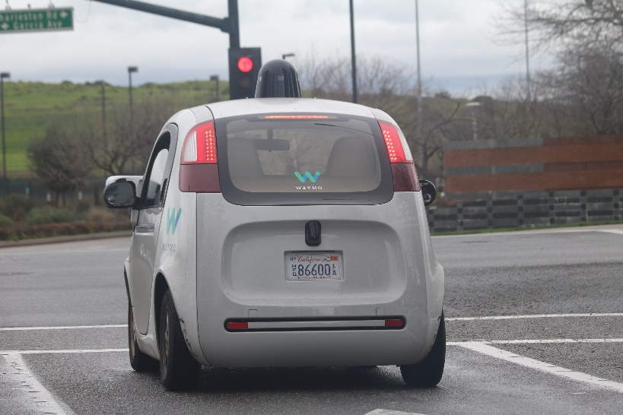
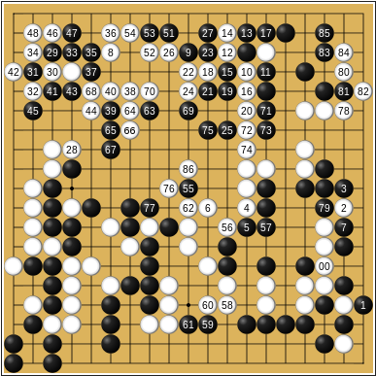

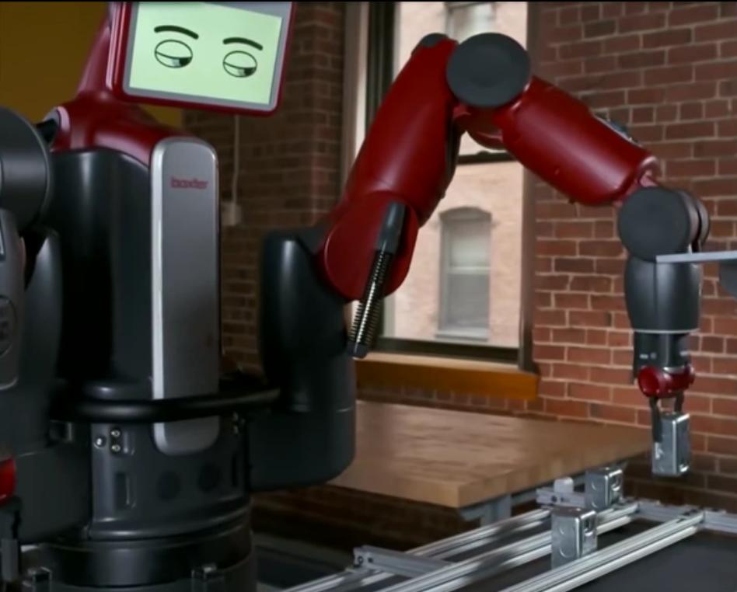

Slide 2








Slide 3
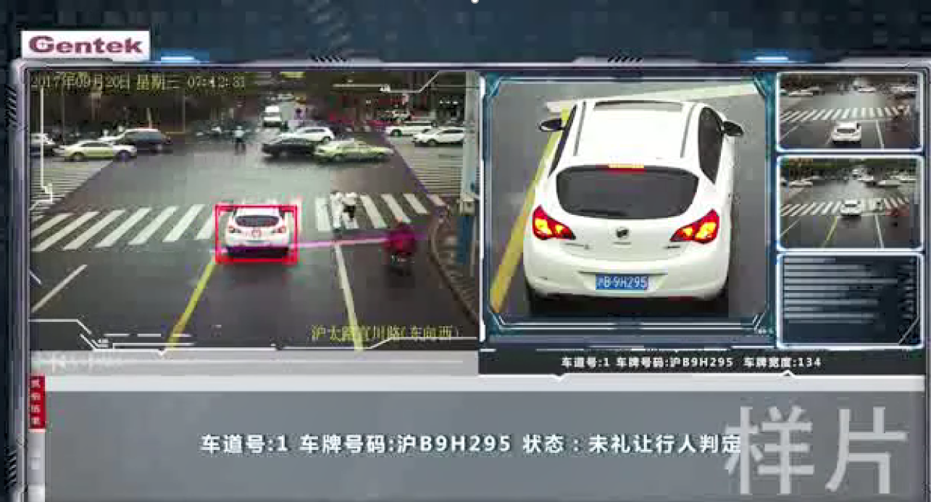

Slide 4

Good AI requires
good answers
good reasons
good choices
Notes:
Disruptive tech: create new levels of value, making old style business obsolete/niche
Napster
Wiki
Google
Youtube
WhatsApp
Uber

Slide 5
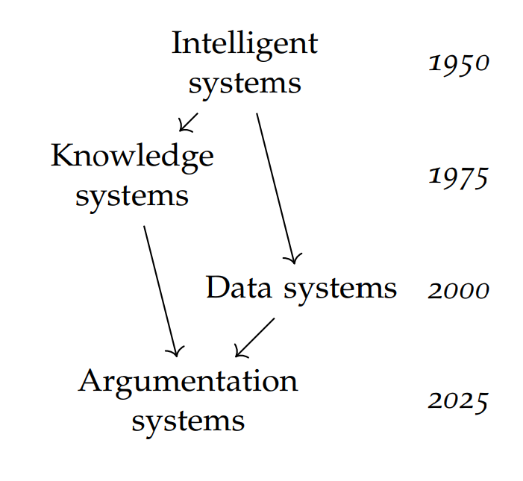

Slide 7
Mary is owner
John is owner
Mary is original owner
John is the buyer
Pros
Cons

Slide 8
Mary is owner
John is owner
Mary is original owner
John is the buyer
John was not bona fide
Pros
Cons
John bought the bike for €20

Slide 9
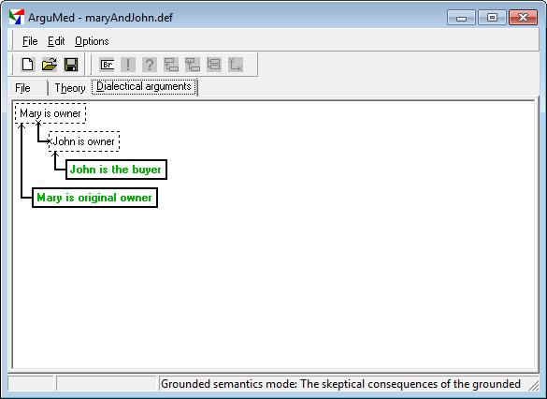
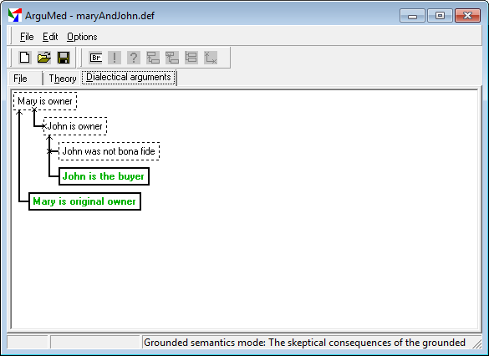
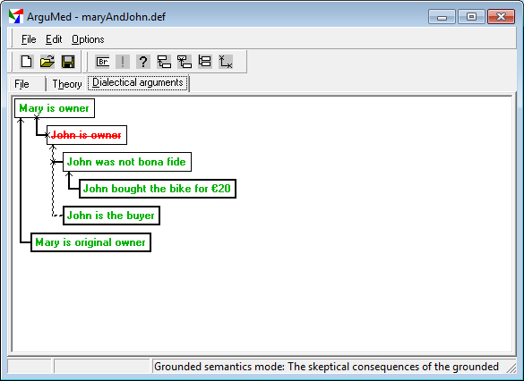

Slide 10
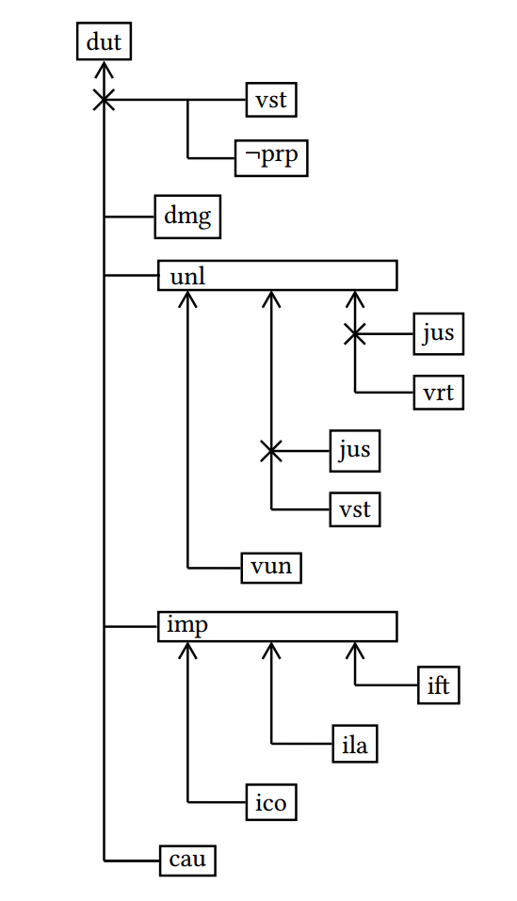
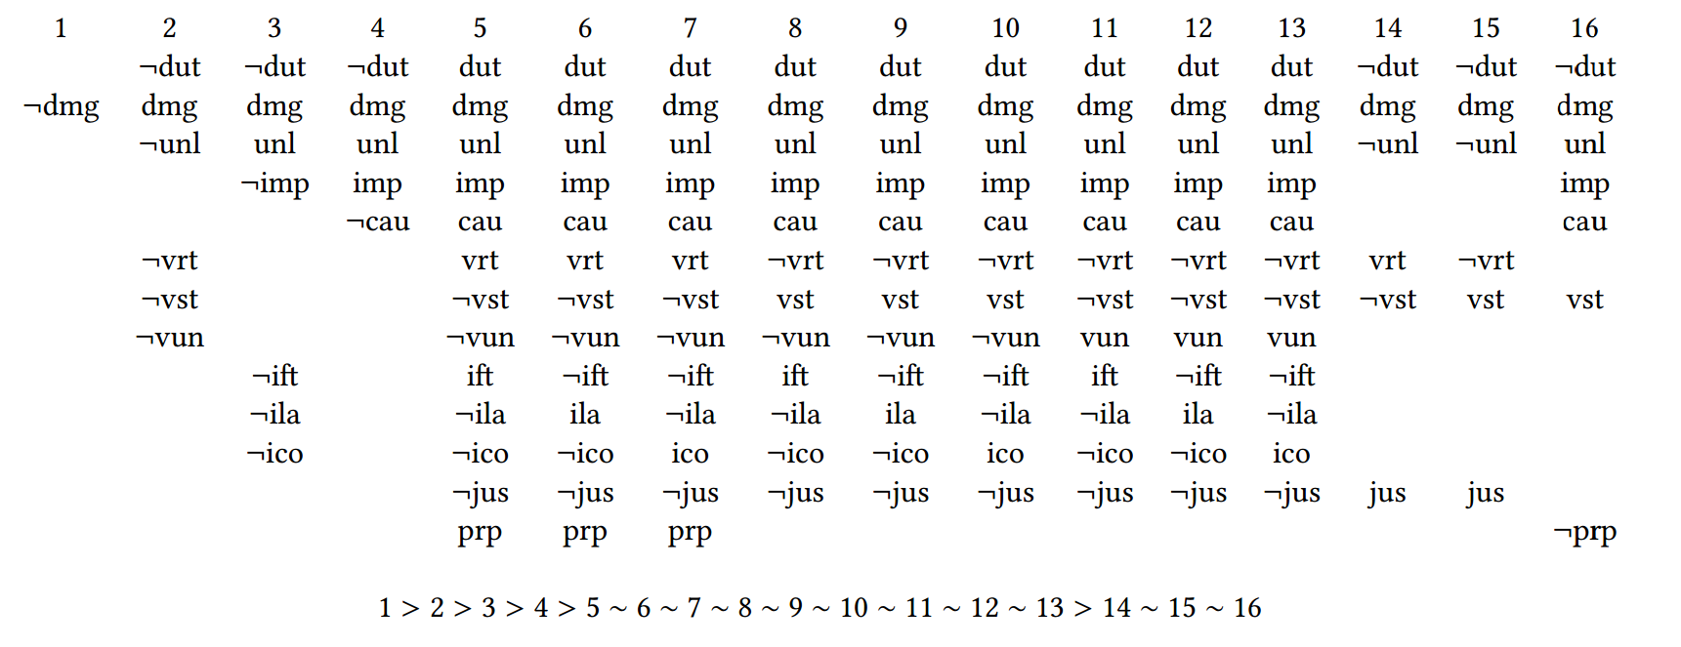
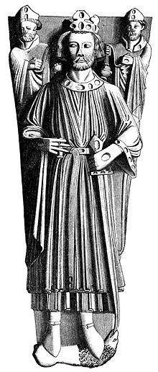
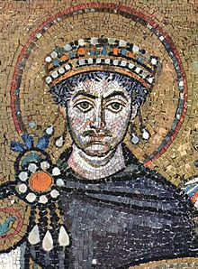
Cases and rules
Data
Knowledge

Slide 11
NWO AI Research Agenda (AIREA-NL)
Building AI components
Responsibility and accountability
Explainability and transparency
Human alignment and social awareness
Generalizability and contextualization
Data and energy efficiency
AI systems and society
Building AI systems
AI systems and humans

Slide 12
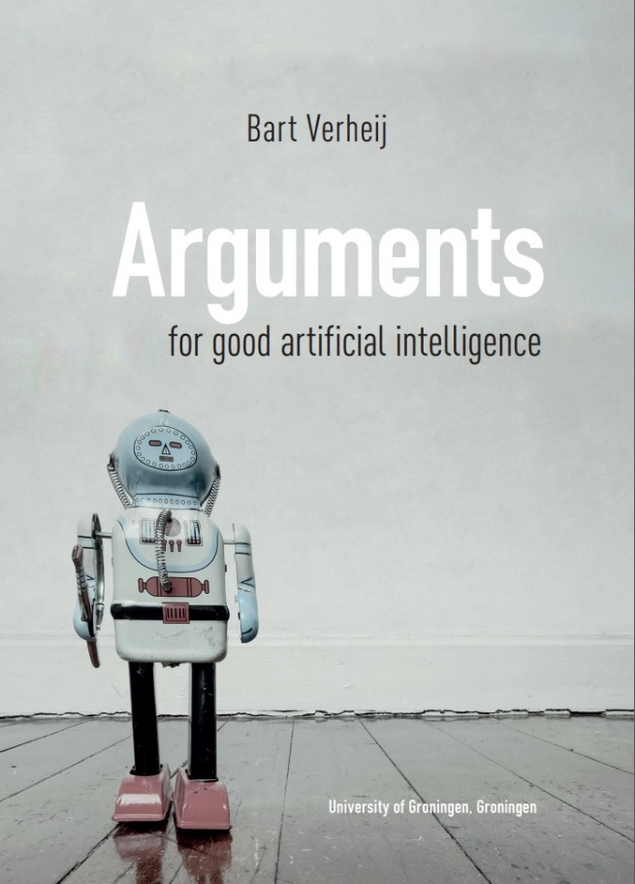
Further reading
B. Verheij. Arguments for Good Artiﬁcial Intelligence. University of Groningen, Groningen, 2018. Inaugural lecture. www.ai.rug.nl/~verheij/oratie
B. Verheij. Artiﬁcial Intelligence as Law. 17th International Conference on Artiﬁcial Intelligence and Law (ICAIL 2019). June 17-21, 2019 (Montreal, Canada), Presidential address, 2019.
www.ai.rug.nl/~verheij/icail2019

