Slide 1
Some common misconceptions about P-values and confidence intervals
Hans Burgerhof
Medical Statistics and Decision Making
UMCG

Slide 2
Help! Statistics! Lunchtime Lectures
What? frequently used statistical methods and questions in a manageable timeframe for all researchers at the UMCG
No knowledge of advanced statistics is required.
When? Lectures take place every 2nd Tuesday of the month, 12.00-13.00 hrs.
Who? Unit for Medical Statistics and Decision Making
When? | Where? | What? | Who?
Feb 14, 2017 | 3212.0217 | Some common misconceptions about p-values and confidence intervals | H. Burgerhof
Mar 14, 2017 | Room 16 | Mediation analysis | S. la Bastide
Apr 11, 2017 | Rode Zaal | Basics of survival analysis | D. Postmus
May 9, 2017 | Rode Zaal | Multiple linear regression; some do’s and don’ts | H. Burgerhof
June 13, 2017 | Room 16 | Multiple testing | C. zu Eulenburg
Slides can be downloaded from http://www.rug.nl/research/epidemiology/download-area

Slide 3
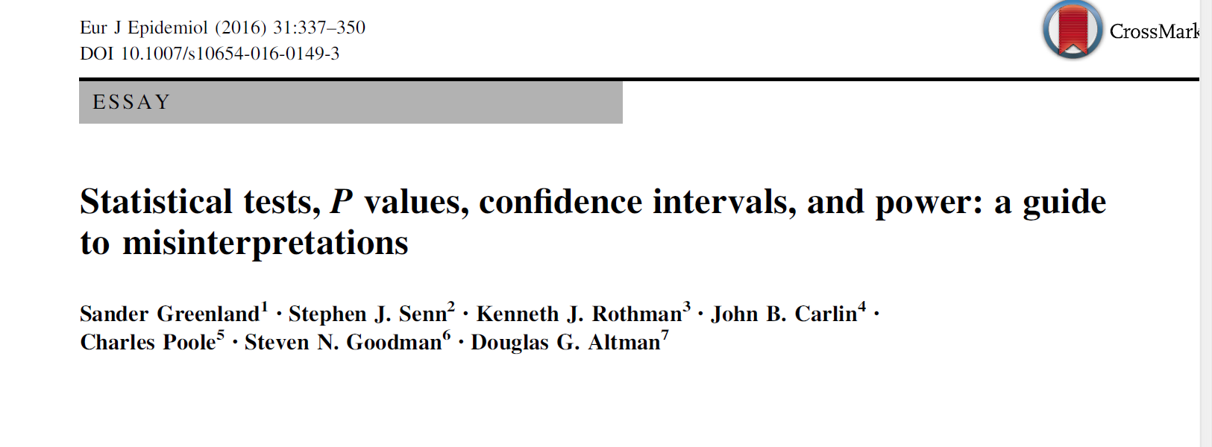
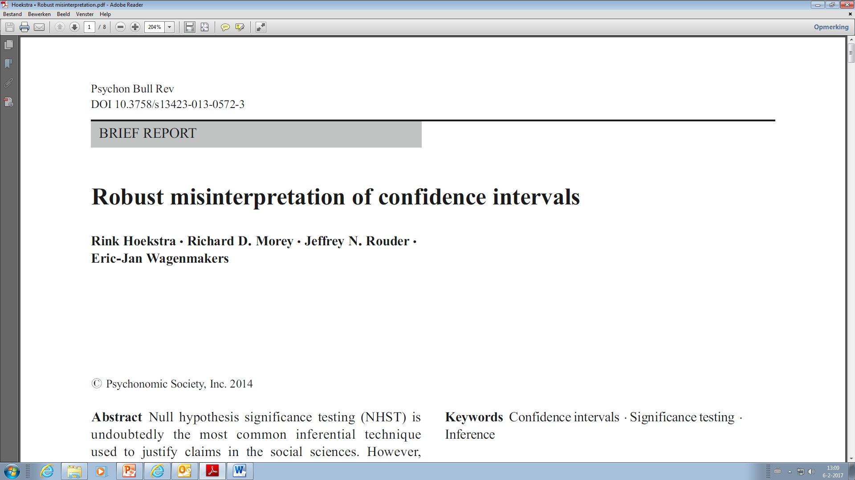

Some publications
Article in NRC (Dutch newspaper) June 18th 2016
“De val van het P-getal” (“The fall of the P-value”)
It is true!

Slide 4

Program
Some statements: true or false?
Theory of Frequentist Statistics
  Confidende Intervals
  P-values
Correct answers to the statements
One of the most prevalent “misconceptions” about Confidence Intervals revisited
A new horizon?

Slide 5
Statements, true or false?
1. The P-value is the probability that the null hypothesis is true
2. A P-value larger than 0.05 proves the null hypothesis to be true
3. A P-value smaller than 0.05 tells us we found a clinically relevant difference
4. A two-sided P-value always equals twice the one-sided P-value
5. Statement 4 is true if the underlying distribution is symmetric

Slide 6
Statements, true or false? (continued)
6. In case of a one sample t-test, the following equivalence relation holds:
  the 95% CI contains the value of the null hypothesis ⇔ the two-sided P-value > 0.05
7. Statement 6 holds for any statistical test
8. If the 95% CI’s concerning two means overlap, the difference between the two means is not significant (using an alpha = 0.05)

Slide 7
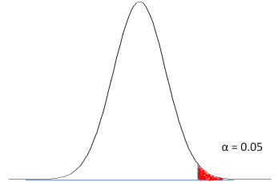
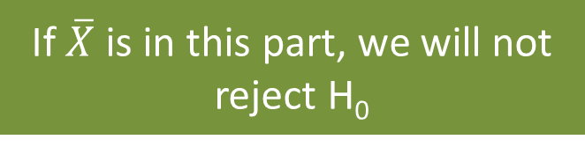
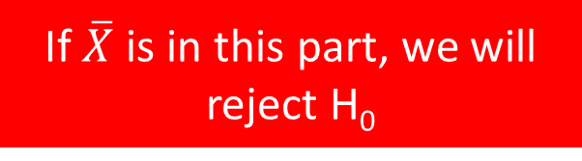
Testing H₀: μ = 96 against H₁: μ > 96
Distribution of the sample mean if H₀ is true
Significance level
H₀ :μ = 96
If $\overline{X}$ is in this part, we will not reject H₀
If $\overline{X}$ is in this part, we will reject H₀

Slide 8
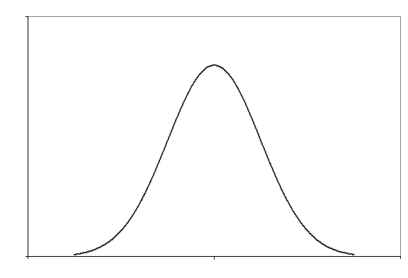
Significance level α
(most common value 0.05)
H₀: μ = 96
H₁: μ > 96
(one-sided alternative)
H₀: μ = 96
H₁: μ ≠ 96
(two-sided alternative)
α = 0.05
0.025
0.025
H₀ :μ = 96
H₀ :μ = 96
α = 0.05
We will reject the null hypothesis if the sample mean is in the rejection area or, equivalently, if P ≤ α. The P-value is a conditional probability.

Slide 9
Statements, true or false?
1. The P-value is the probability that the null hypothesis is true
2. A P-value larger than 0.05 proves the null hypothesis to be true
3. A P-value smaller than 0.05 tells us we found a clinically relevant difference
4. A two-sided P-value always equals twice the one-sided P-value
5. Statement 4 is true if the underlying distribution is symmetric
FALSE
FALSE
FALSE
FALSE
FALSE

Slide 10
Testing H₀:π = 0.3. n = 50, k = 23
23
15
One-sided P-value: P(X ≥ 23) = 0.0123
Two-sided P-value: P(X ≥ 23) + P(X ≤ 7) = 0.0196

Slide 11
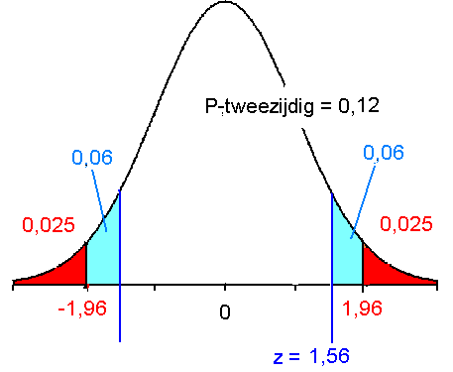
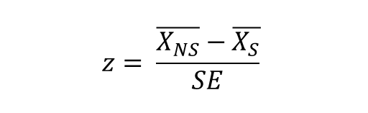
Two sided test, mean SBP smokers = mean SBP non-smokers
H_{0:}
H₁:
reject H₀ if z (or t)
is too small or too high
Say z = 1.56 than the
two sided P = 0.12
Two sided P = 0.12
$$z= \frac{\overline{X_{NS}}−\overline{X_{S}}}{SE}$$

Slide 12
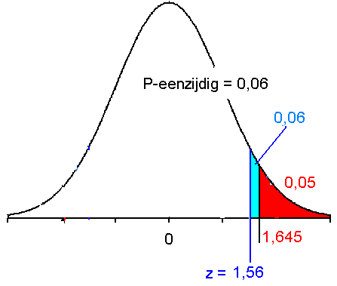
One sided test (1)
reject H₀ if z (or t) is too high
We are only interested in
the probability on the right hand side
H_{0:}
H₁:
The result is in the direction
of H₁
P(one sided) = ½ P(two sided)
One sided P = 0.06
$$z= \frac{\overline{X_{NS}}−\overline{X_{S}}}{SE}$$

Slide 13
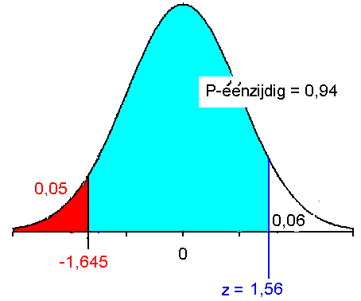
One sided test (2)
H_{0:}
H₁:
reject H₀ if z (or t) is too small
We are interested in the
probability on the left hand side
One sided P = 0.94
The result is not in the direction of H₁
P(one sided) = 1- ½P(two sided)

Slide 14
Confidence Interval (for μ)
X₁ = 99
X₂ = 104
….
X_{n} = 97
μ ?

Slide 15
Interpretation of 95%-CI for µ
Imagine you will take thousands of samples and for each sample you will calculate the 95% CI
95% of these intervals will contain the population mean μ.
μ
Sample number →

Slide 16
Statements, true or false? (continued)
6. In case of a one sample t-test, the following equivalence relation holds:
  the 95% CI contains the value of the null hypothesis ⇔ the two-sided P-value > 0.05
7. Statement 6 holds for any statistical test
8. If the 95% CI’s concerning two means overlap, the difference between the two means is not significant (using an alpha = 0.05)
TRUE
FALSE
FALSE

Slide 17



8. What can happen …
$$\overline{X_{1}}$$
$$\overline{X_{2}}$$
100 ± 2*3 = [ 94 ; 106 ]
112 ± 2*4 = [ 104 ; 120 ]
112 – 100 ± 2*5 = [ 2 ; 22 ]
0
$$\overline{X_{2}}−\overline{X_{1}}$$
$$SE\left(difference\right)=\sqrt{{{{SE}_{1}}^{2}+{SE}_{2}}_{}^{2}}$$

Slide 18
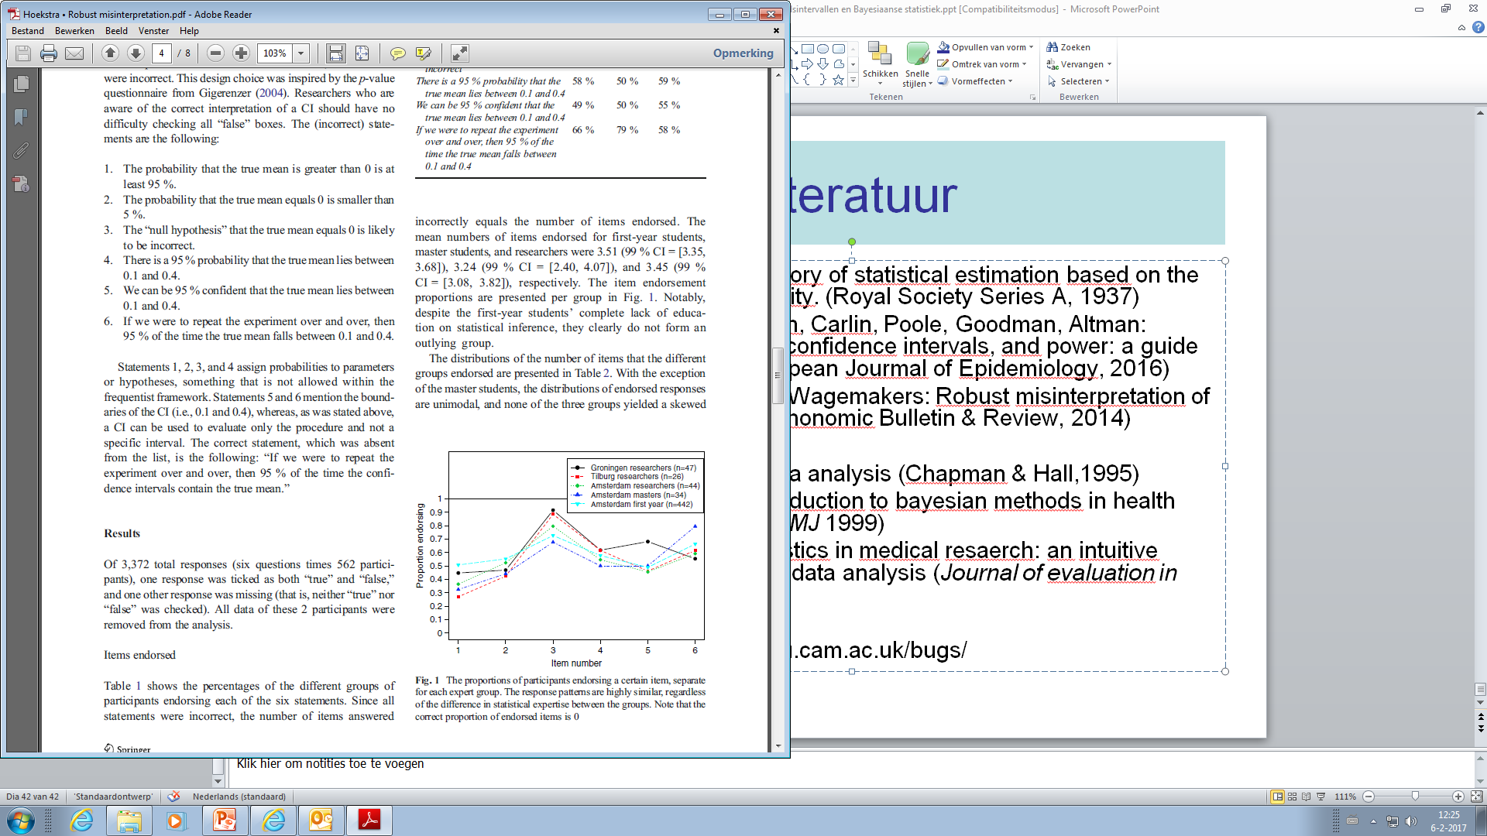
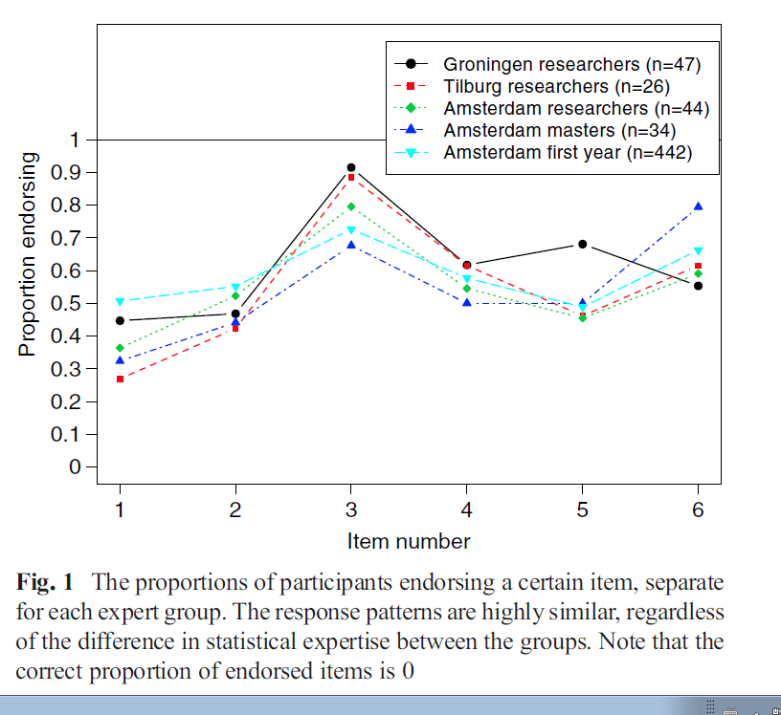
Hoekstra et al: Robust misinterpretation of CI’s
(Psychonomic Bulletin & Review, 2014)
Given: 95% CI = [ 0.1 ; 0.4]

Slide 19
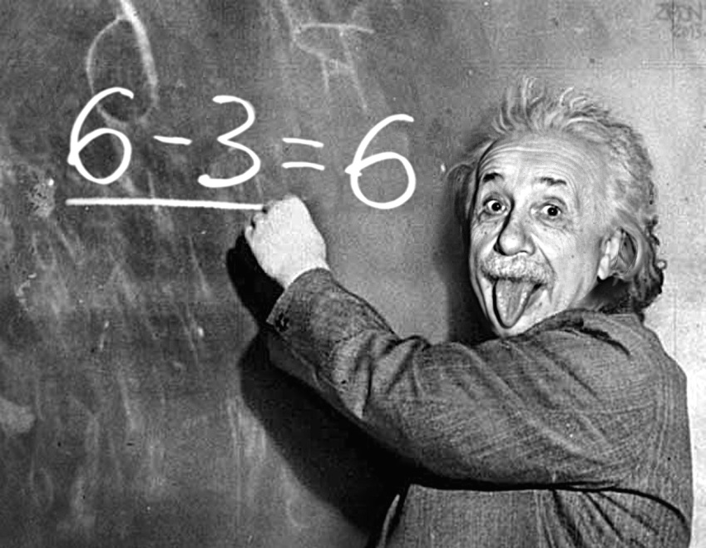
Back to basics
Jerzy Neyman wrote in 1937: Outline of a theory of statistical estimation based on the clasical theory of probability.
As soon as the Confidence Interval has been calculated (e.g. [ 0.1 ; 0.4]), frequentists cannot do any probability statements. The unknown (and fixed) parameter is either in the interval or not.
That holds for any interval !

Slide 20
What to do?
Bayesian statisticians do make probability statements about population parameters (future lunch lecture?)
Option for Liberal Frequentist Statistics?
  P(new colleague has his birth day in April)?
  For me, under certain assumptions (not born in a leap-year, all days same probability), P = 30/365
  For him: P is either 0 or 1.

Slide 21
Living in ignorance …
As long as I do not know my new colleague’s birthday, my probability is still 30/365.
As long as I do not know the real population mean, I am 95% confident that my confidence interval contains μ
“Being confident” is not a mathematically defined concept (yet…)
FALSE ?

Slide 22
Liberal Frequentist definition of “being confident”
I solemnly swear that I do know that, in the context of Frequentist Statistics, the parameters I estimate have fixed values and by no means are random variables. Lower limits and upper limits, calculated according to Jerzy Neyman’s 1937 paper, will give me x% Confidence Intervals, one for each parameter. X% of these intervals will contain the real and unknown values of my parameters. For each of the random intervals there is probability equal to x/100 of containing the real and unknown parameter. As long as I do not know the real value of a specific parameter, I am x% confident that the calculated interval for this parameter contains the real, fixed, value.

Slide 23


By the way, I asked my new colleague
Say Willy, what’s your birth day?
April 27,
why?

Slide 24
Next Lunchtime Lecture of
Help! Statistics!
March 14, 2017
Room 16 UMCG
Sacha la Bastide
Mediation analysis
Any questions?

