Slide 1

Meta-analysis
Michiel de Boer
Dept of Primary and Long-term Care, UMCG
Notes:
Voorstellen en rondje doen. Doel en inhoud: waarom moet je kritisch lezen & hoe kun je kritisch lezen. Slecht nieuws gesprek.

Slide 2

Notes:
Hoe: met achtergrondkennis en gezond verstand= vraag durven stellen

Slide 3
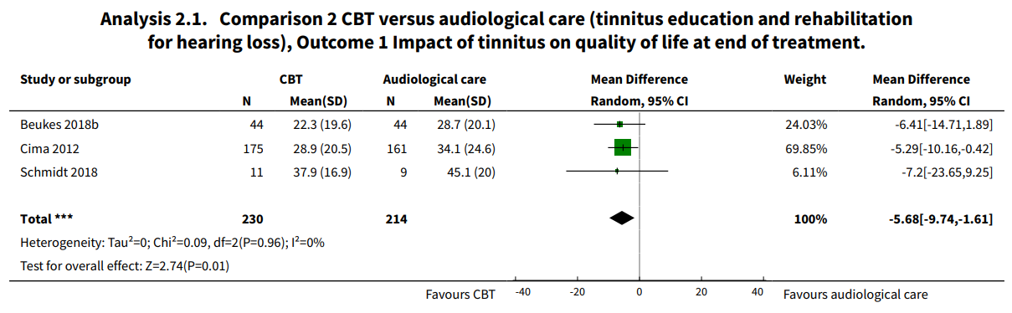
Notes:
Hoe: met achtergrondkennis en gezond verstand= vraag durven stellen

Slide 4
What to pool?
….
….
….
Notes:
Hoe: met achtergrondkennis en gezond verstand= vraag durven stellen

Slide 5
What to pool?
Continuous outcomes:
  Mean differences
  Standardized mean differences
  Regression coefficients
  Correlation coefficients
Notes:
Hoe: met achtergrondkennis en gezond verstand= vraag durven stellen

Slide 6
What to pool?
Binary outcomes
  Risk differences
  Relative risks
  Odds ratios
Other outcomes:
  Sensitivity & specificity (diagnostic accuracy studies)
Notes:
Hoe: met achtergrondkennis en gezond verstand= vraag durven stellen

Slide 7
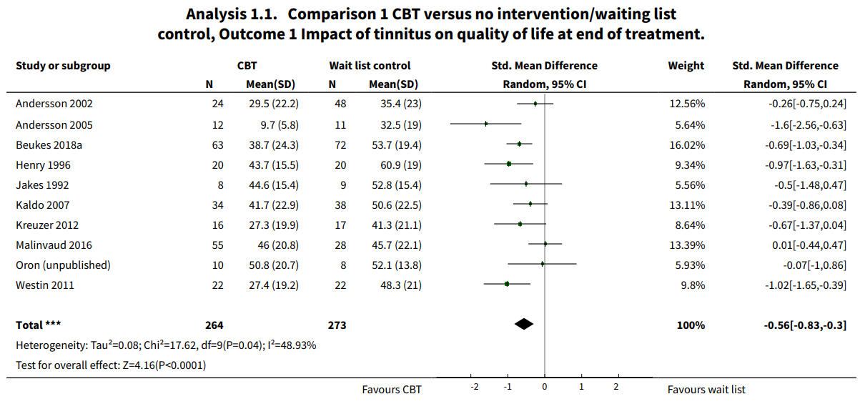

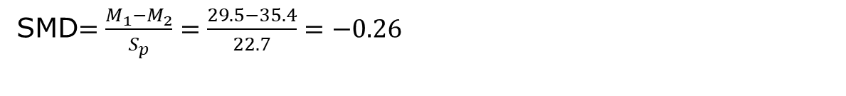
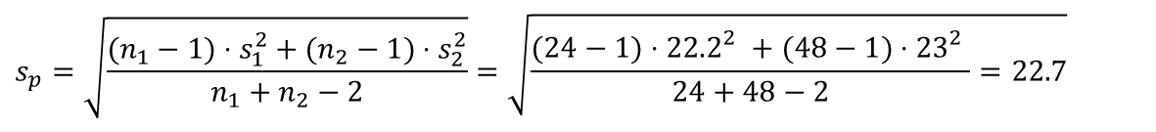
SMD$=\frac{M_{1}−M_{2}}{S_{p}}=\frac{29.5−35.4}{22.7}=−0.26$
$$s_{p}=\sqrt{\frac{(n_{1}−1)⋅s_{1}^{2}+(n_{2}−1)⋅s_{2}^{2}}{n_{1}+n_{2}−2}}=\sqrt{\frac{(24−1)⋅{22.2}_{}^{2}+(48−1)⋅{23}_{}^{2}}{24+48−2}=22.7}$$
Notes:
Hoe: met achtergrondkennis en gezond verstand= vraag durven stellen

Slide 8
Determining weights
How should we weigh the study results?
Notes:
Hoe: met achtergrondkennis en gezond verstand= vraag durven stellen

Slide 9
Determining weights
More precise studies (should) get larger weights
Precision = inverse of variance of estimate
summation
study specific
estimate
Standard error of estimate -> based on SD and N
Pooled estimate
Weight of study
Notes:
Hoe: met achtergrondkennis en gezond verstand= vraag durven stellen

Slide 10
Determining weights: fixed and random effects models
Different assumptions:
Fixed effects: there is one overall true population effect
Random effects: there is a ‘population’ of (similar) true effects that can be averaged
Notes:
Hoe: met achtergrondkennis en gezond verstand= vraag durven stellen

Slide 11
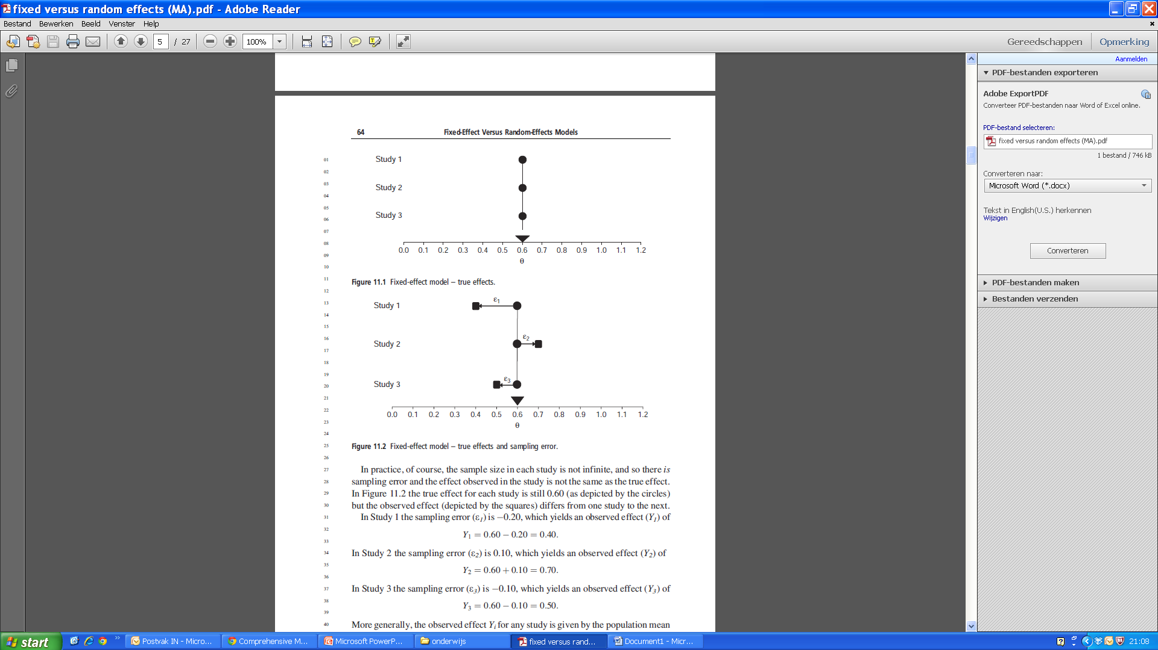
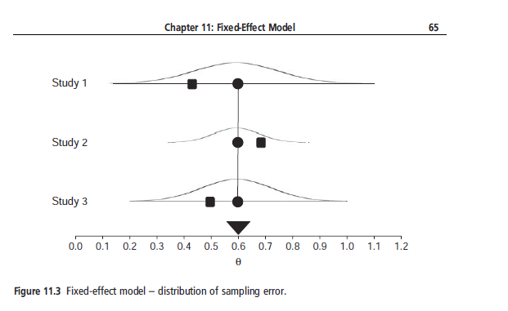
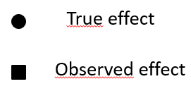
Fixed effects model
Figures from the manual of
Comprehensive Meta Analysis
Notes:
Hoe: met achtergrondkennis en gezond verstand= vraag durven stellen

Slide 12
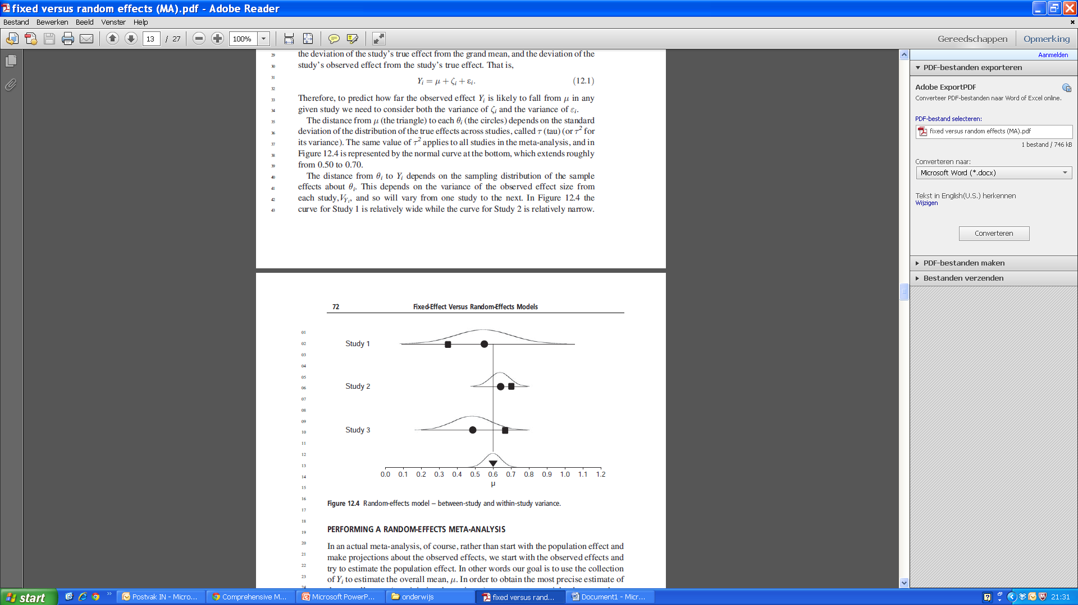
Random effects model
Notes:
Hoe: met achtergrondkennis en gezond verstand= vraag durven stellen

Slide 13
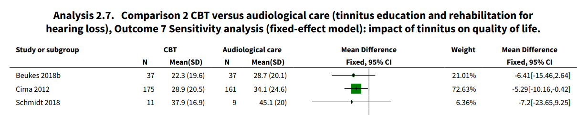
fixed vs random effects models
Notes:
Hoe: met achtergrondkennis en gezond verstand= vraag durven stellen

Slide 14
Why pool?
Notes:
Hoe: met achtergrondkennis en gezond verstand= vraag durven stellen

Slide 15
Why pool?
Increased precision of estimate
Summary of effect: unequivocal answer to research question
  Which research question?
Notes:
Hoe: met achtergrondkennis en gezond verstand= vraag durven stellen

Slide 16
Research questions and PICO
In summary, this review synthesises the latest evidence related to CBT for tinnitus, which will help inform decisions on whether CBT for tinnitus is effective at reducing the impact of tinnitus on quality of life.
P = C =
I = O =
Notes:
Hoe: met achtergrondkennis en gezond verstand= vraag durven stellen

Slide 17
Research questions and PICO
In summary, this review synthesises the latest evidence related to CBT for tinnitus, which will help inform decisions on whether CBT for tinnitus is effective at reducing the impact of tinnitus on quality of life.
P = patients with T? C = ?
I = CBT O = Qol
Notes:
Hoe: met achtergrondkennis en gezond verstand= vraag durven stellen

Slide 18
Patients
Participants were at least 18 years of age with tinnitus as the primary reason for seeking treatment. In the event that studies included an age range of participants below 18 years (e.g. 16 to 21 years), they were included if the mean age was 18 years or above.
Notes:
Hoe: met achtergrondkennis en gezond verstand= vraag durven stellen

Slide 19
Intervention
The primary intervention of interest was CBT. For the purposes of this review we included studies that also described CBT interventions that apparently only used cognitive or behavioural elements. Interventions such as acceptance and commitment therapy (ACT) and mindfulness were also included but simply considered as types of CBT.
Notes:
Hoe: met achtergrondkennis en gezond verstand= vraag durven stellen

Slide 20
Comparisons
We stratified studies into four comparisons:
  CBT versus no intervention/waiting list control;
  CBT versus usual audiological care (tinnitus education and rehabilitation for hearing loss);
  CBT versus TRT (directive counselling and the use of bilateral sound generators as per TRT protocol);
  CBT versus other experimental control (pooled if using the same experimental control).Other experimental controls may include transcranial magnetic stimulation, electrical or electromagnetic stimulation therapy and bio- neuro-feedback.
Notes:
Hoe: met achtergrondkennis en gezond verstand= vraag durven stellen

Slide 21
Outcome(s)
Primary outcomes:
  Impact of tinnitus on quality of life as measured by validated tinnitus-specific multi-item questionnaires identified in a systematic review of outcome instruments used in studies of interventions for tinnitus (Hall 2016).
Secondary outcomes:
  Generalised depression; Generalised anxiety; Health-related quality; Negatively biased interpretations of tinnitus; Other adverse effects: acute emotional discomfort
Notes:
Hoe: met achtergrondkennis en gezond verstand= vraag durven stellen

Slide 22
Dealing with heterogeneity
The primary intervention of interest was CBT. For the purposes of this review we included studies that also described CBT interventions that apparently only used cognitive or behavioural elements. Interventions such as acceptance and commitment therapy (ACT) and mindfulness were also included but simply considered as types of CBT.
Does CTB as defined above, exert one typical effect, or do comprehensice CTB and e.g. ACT have different effects on qol?
Epidemiological concept at stake here = …?
Notes:
Hoe: met achtergrondkennis en gezond verstand= vraag durven stellen

Slide 23
Dealing with heterogeneity
The primary intervention of interest was CBT. For the purposes of this review we included studies that also described CBT interventions that apparently only used cognitive or behavioural elements. Interventions such as acceptance and commitment therapy (ACT) and mindfulness were also included but simply considered as types of CBT.
Does CTB as defined above, exert one typical effect, or do comprehensive CTB and e.g. ACT have different effects on qol?
Epidemiological concept at stake here = …?
Notes:
Hoe: met achtergrondkennis en gezond verstand= vraag durven stellen

Slide 24
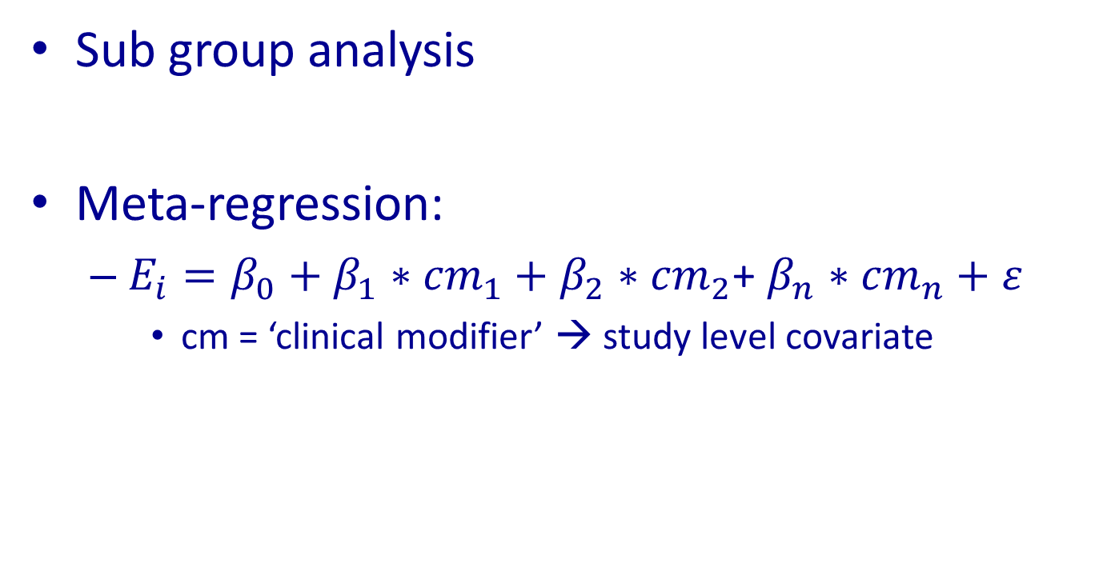
Handling heterogeneity in meta-analysis
Sub group analysis
Meta-regression:
  $E_{i}=β_{0}+β_{1}∗{cm}_{1}+$ $β_{2}∗{cm}_{2}$+ $β_{n}∗{cm}_{n}+ε$
    cm = ‘clinical modifier’ → study level covariate

Slide 25
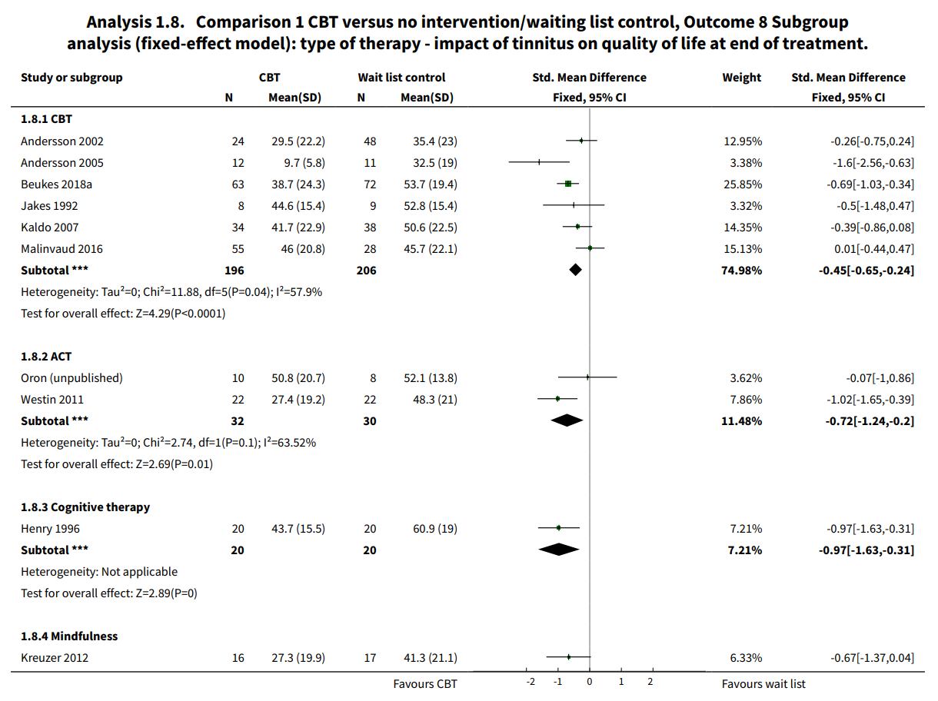
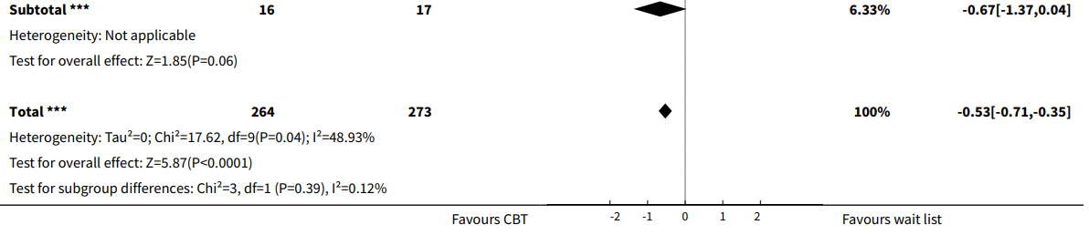
Notes:
Hoe: met achtergrondkennis en gezond verstand= vraag durven stellen

Slide 26
Dealing with heterogeneity
Important to define potential clinical modifiers / sub group analyes a priori
If not → fishing expedition (you’ll bound to catch something!)
Notes:
Hoe: met achtergrondkennis en gezond verstand= vraag durven stellen

Slide 27
Interpreting sub group analyses/meta-regression
Watch out for ecological fallacy!
  Results on study level, cannot automatically be translated to individual patient level
Notes:
Hoe: met achtergrondkennis en gezond verstand= vraag durven stellen

Slide 28
Dealing with heterogeneity
Important to define potential clinical modifiers / sub group analyes a priori
If not → fishing expedition (you’ll bound to catch something!)
Solution: Individual patient data (IPD) meta-analysis
Notes:
Hoe: met achtergrondkennis en gezond verstand= vraag durven stellen

Slide 29
Dealing with analytical choices
Often, it is possible to make different analytical choices in your analyses, based on different assumptions
The influence of such choices on the robustness of the result can be assessed through sensitivity analyses
Notes:
Hoe: met achtergrondkennis en gezond verstand= vraag durven stellen

Slide 30
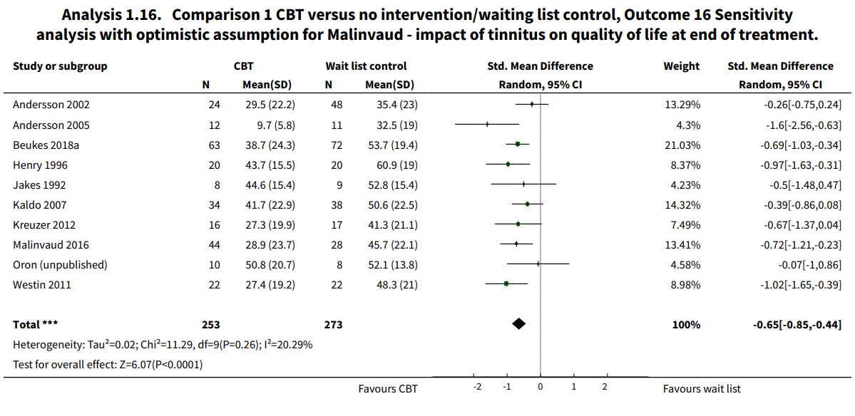
Sensitivity analysis
Notes:
Hoe: met achtergrondkennis en gezond verstand= vraag durven stellen

Slide 31
primary analysis
Notes:
Hoe: met achtergrondkennis en gezond verstand= vraag durven stellen

Slide 32
Answering the research question
What else do we need to know?
Notes:
Hoe: met achtergrondkennis en gezond verstand= vraag durven stellen

Slide 33
Answering the research question
Evidence synthesis, e.g. using GRADE framework
Incorporating other aspects:
Notes:
Hoe: met achtergrondkennis en gezond verstand= vraag durven stellen

Slide 34
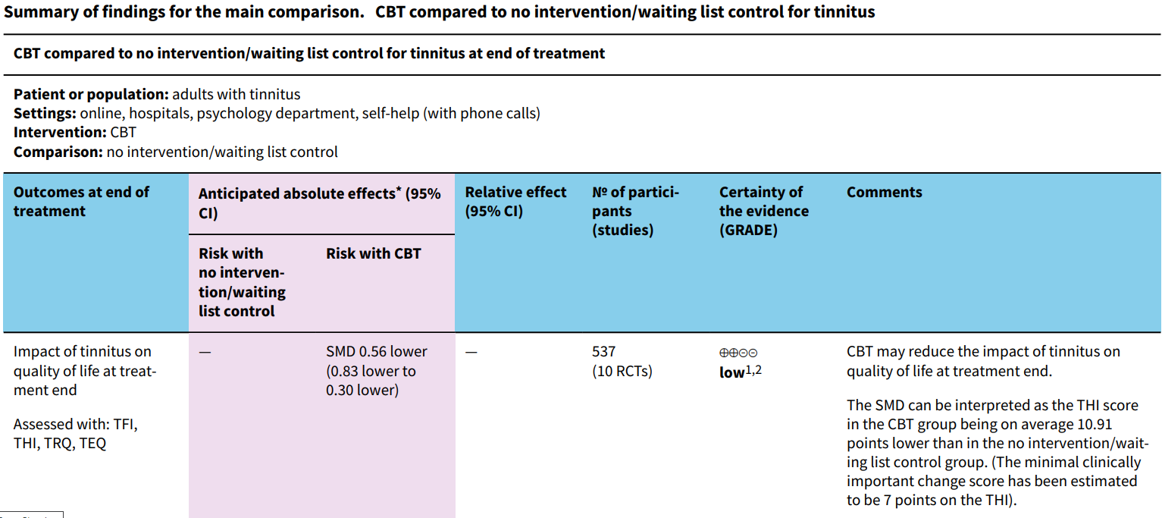
Answering the research question
1. Downgraded one level due to study limitations (risk of bias): all studies included for this outcome were judged to be either unclear or at high risk of performance bias due to an absence of blinding of participants and personnel.
2. Downgraded one level due to inconsistency: significant heterogeneity in the studies
Notes:
Hoe: met achtergrondkennis en gezond verstand= vraag durven stellen

Slide 35
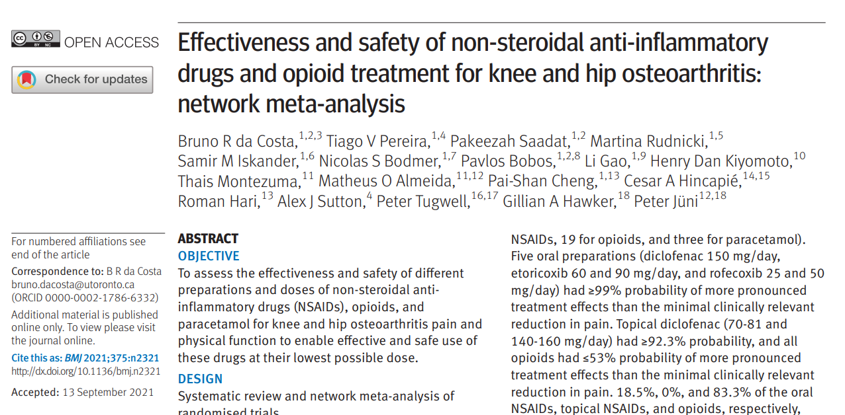
Comparing > 2 treatments
Notes:
Hoe: met achtergrondkennis en gezond verstand= vraag durven stellen

Slide 36
Network meta-analysis
Based on direct and indirect comparisons
Rank ordering effectiveness
Notes:
Hoe: met achtergrondkennis en gezond verstand= vraag durven stellen

Slide 37
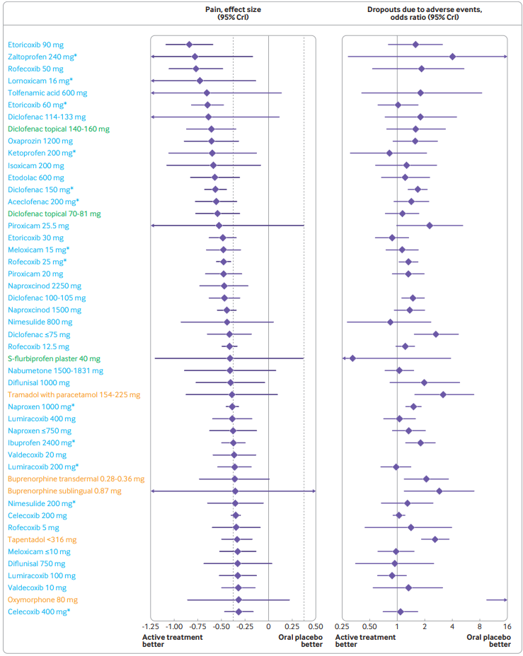
Network meta-analysis
Notes:
Hoe: met achtergrondkennis en gezond verstand= vraag durven stellen

Slide 38
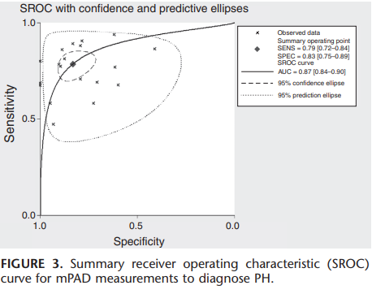
Meta-analysis of diagnostic accuracy studies
Shen Y, Wan C, Tian P, Wu Y, Li X, Yang T, An J, Wang T, Chen L, Wen F. CT-base pulmonary artery measurement in the detection of pulmonary hypertension: a meta-analysis and systematic review. Medicine (Baltimore). 2014 Dec;93(27):e256. doi: 10.1097/MD.0000000000000256.
Notes:
Hoe: met achtergrondkennis en gezond verstand= vraag durven stellen

