Slide 1
Sustainable landscapes
06-12-2019
Anne Marel Hilbers

Slide 2
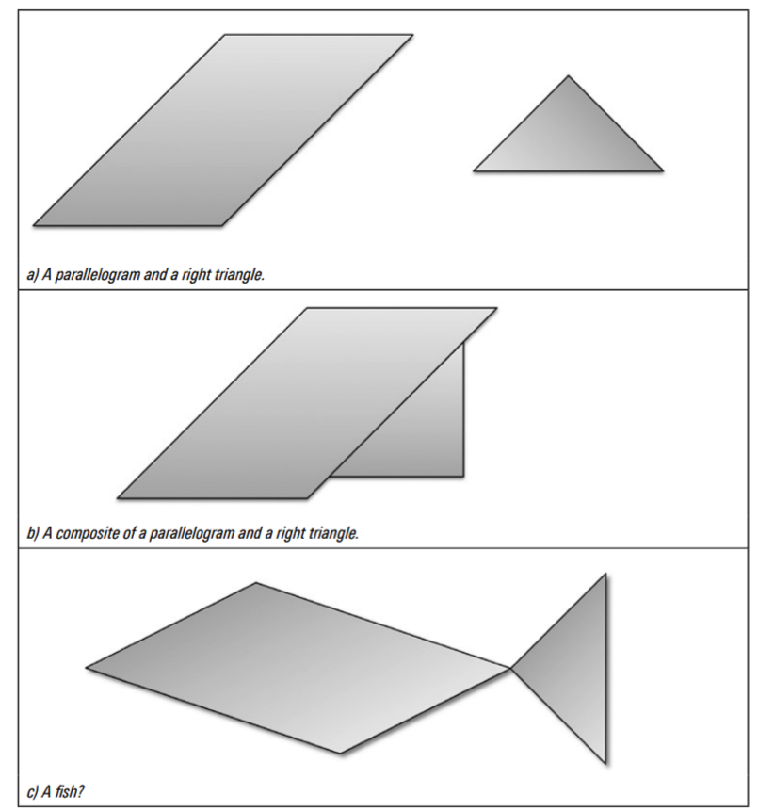
PhD in spatial planning:
“Consensus-based added value assessment of integrated transport infrastructural- and spatial development”

Slide 3
Three dilemma’s:
integrated projects require different evaluation: traditionally evaluation often uses hard data to select an ‘optimal plan alternative’;
in practice, a project often starts with a problem definition, after which a solution needs to be found right away. For example: we are widening a road because there are accessibility issues;
spatial projects often provoke resistance from public local stakeholders. This can translate into a negative value judgment about a project and can make planning of these projects difficult.

Slide 4
Decision-making, then:
not only needs to incorporate specific (soft) place values to facilitate the selection of an acceptable – instead of optimal – plan alternative, but;
also needs to start with a shared understanding of these key place values, and;
needs more insight in data that is generated through, instead of about, citizens and relevant stakeholders in order to reach the selection of an acceptable plan alternative.
So… Take a step back!?

Slide 5
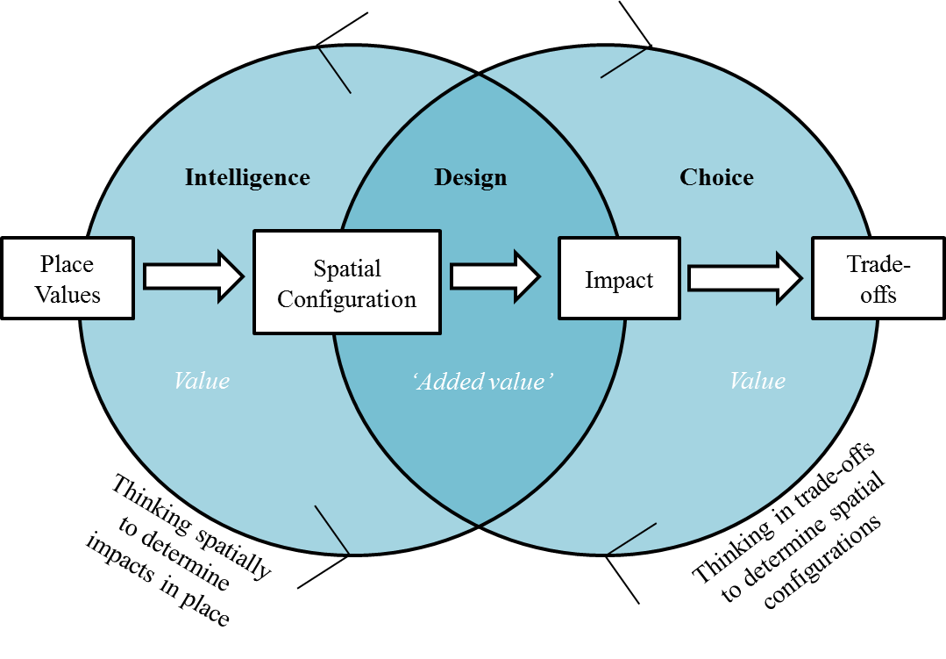
IDC-model (based on Simon, 1960)

Slide 6
What contributes to added value?
Intelligence
Understanding key values of the area and the infrastructure network
Understanding value changes per plan component and alternatives
Understanding trade-offs between values for decision making
Design
Choice

Slide 7
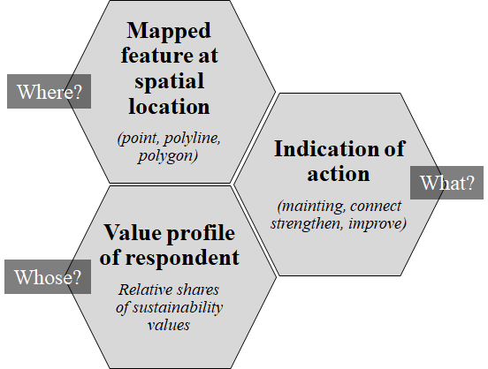
place value, what?!
Not there yet
Improve
Make more accessible
Strengthen
Keep in good condition
Connect
Add something what is not there yet
Already there
Add some of what is already there
Maintain
Protect
Call to action
Composition of place value
Indications of action

Slide 8
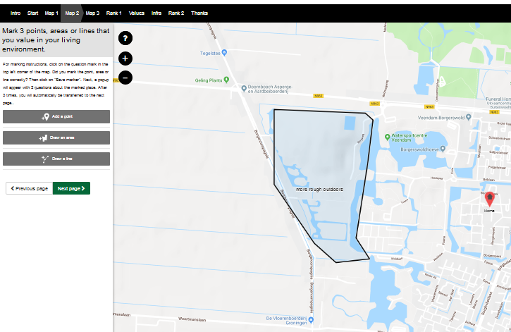
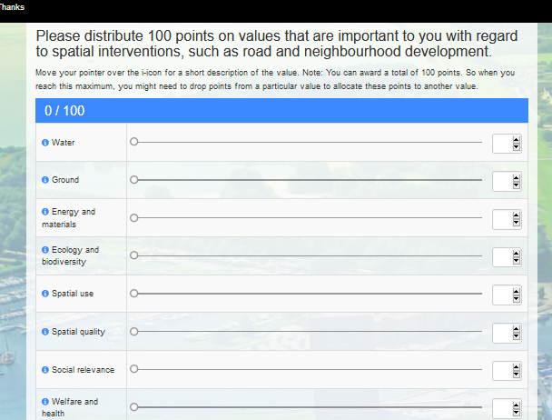
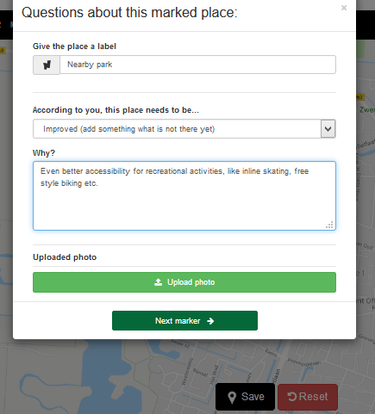
place value identifier

Slide 9
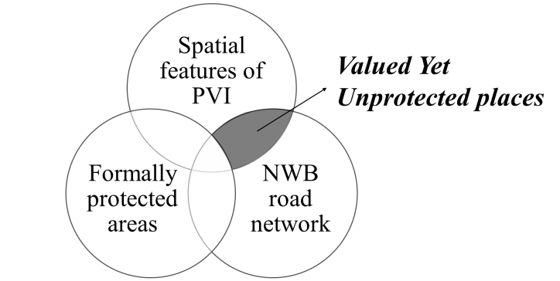
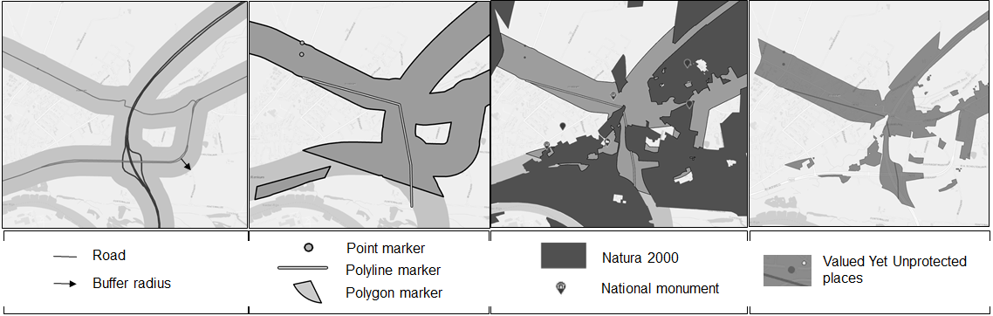
Valued yet unprotected places

Slide 10
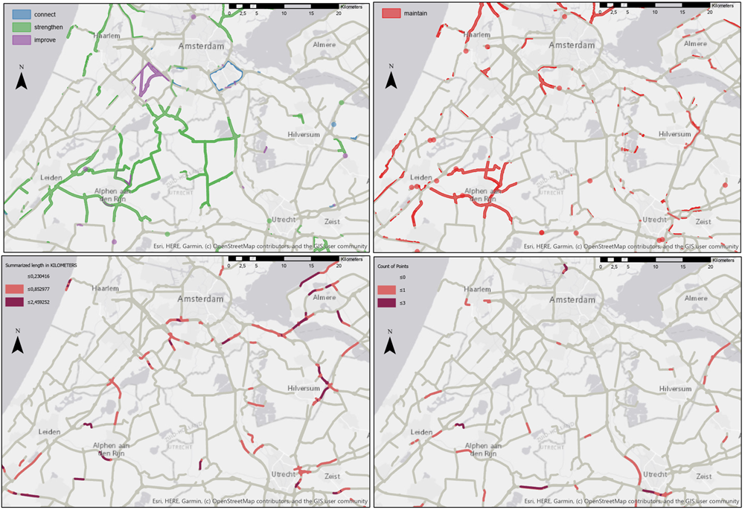

Slide 11
The ‘added value’ of the PVI
Mapping public place values in a spatial planning relevant and rich way
Relating ‘soft’ value mapping to ‘hard’ spatial data layers
Improving the knowledge base for developers of spatial and transport infrastructure projects

Slide 12

Questions?
a.m.hilbers@rug.nl

