Slide 1
Changes in the Carbon Footprint of Chinese Manufacturing Exports:
A Structural Decomposition Analysis
2025 Conference in Carbon neutralization
and energy security issues in the EU and Korea
Xianjia Ye
Faculty of Economics & Business
University of Groningen

Slide 2
What’s special in China?
Possibility of “Carbon Leakage”
From high-income country’s perspective:
  Low-wage with large endowment of well-educated workers,
  Developing country not binding to reduce CO₂ in the Kyoto Protocol,
China’s policy making
  For a long time since open & reform, Chinese government adopted an export-led growth strategy, prioritizing on trade.
  In the past, the evaluation and promotion decision for local government officials were largely based on economic metrics.
Around 1/3 CO2 emission linked to production activities in exports
(see also e.g. Weber et al 2008).

Slide 3
What often seen in the media…

Slide 4
Total CO₂ v.s. GDP and Export (1990=1.0, log scale)
Emission grows but at a much slower speed than real GDP and exports.
More important to quantify what drives the changes in China’s CO₂ in relation with export.

Slide 5
This paper…
Quantifying the intensity of China’s CO2 emission in relation with its manufacturing exports.
Use a structural decomposition analysis (SDA) to break down the changes in CO2 intensity into different sources,
Disentangle various sources in the changes, that can be linked to
private and governmental efforts in decarbonization.

Slide 6
Tracing CO2 in China’s export
Volume of total exports… (not the particular interest here)
Basket of exported products.
How the products are being made
=> Input-output linkages within China, and the emission in different production stages.

Slide 7
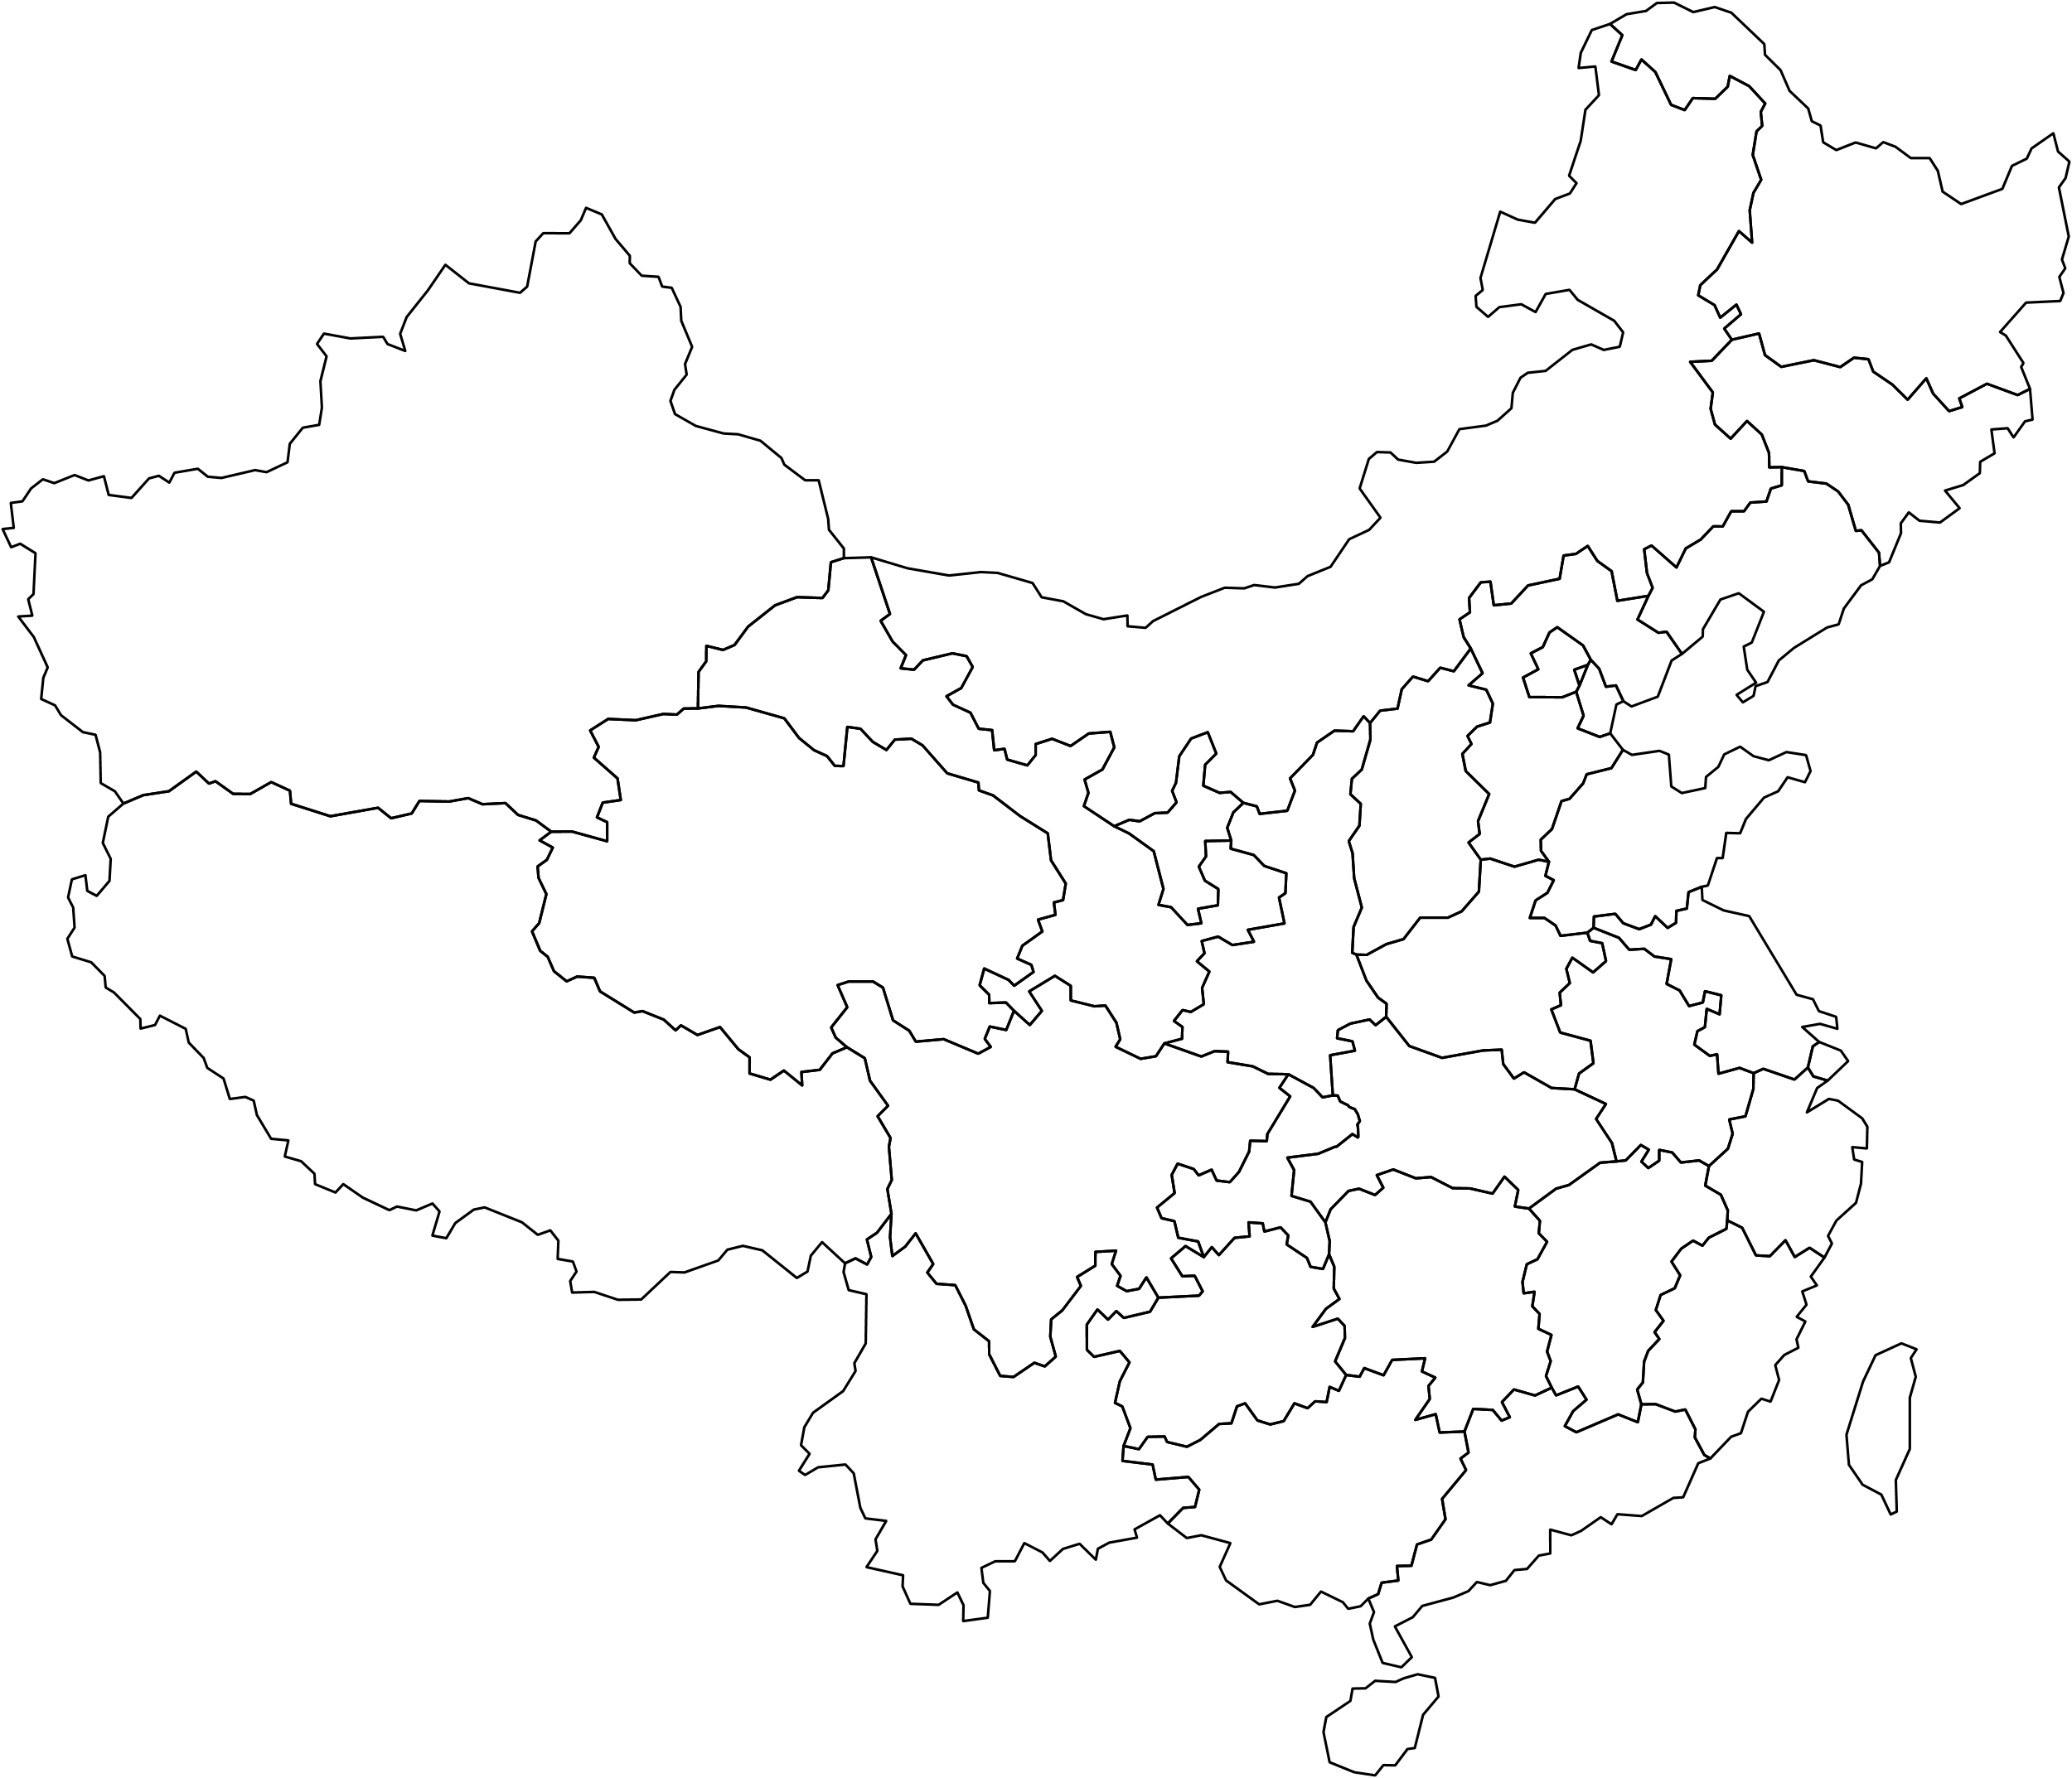














Air conditioners, mostly manufactured and exported from costal provinces
Needs inputs like electrical chips but also metal & plastic at various upstream stage, which might come from somewhere else.
Also needs services inputs like design, ICT & software, and finance, etc.
CO2 footprint should include the emissions by all upstream stages of production in various locations
All stages have also used electricity, of which the CO2 used in electricity generation should be accounted for.

Slide 8
Input-output analysis to trace the carbon footprint embedded in manufacturing exports
Data source:
  Chinese Inter-Provincial Input-Output Tables (“IPIO”, 2023, Scientific Data)
  Emission by sector/province from the CEADs project.
In essence:
  I-O Table gives the structure of intermediate inputs: For a certain sector in a province, what kinds of intermediate inputs it uses in its production process?
  And from which (other) provinces does it source these inputs?

Slide 9
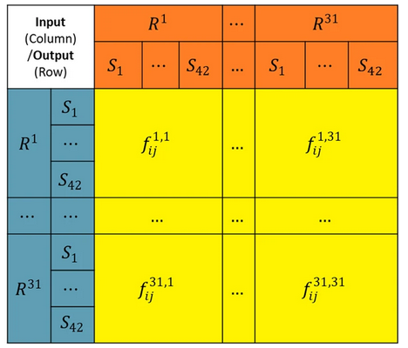
Structure of the IPIO Tables
In order to produce ¥1 gross output in Region 1, Sector 1, how much intermediate inputs from different sectors in different regions are needed?
Data available from 1997 to 2017 for every five years.
Major advantage of the IRIO2023: Their raw data is based on micro-level VAT invoice data, identifying individual selling and purchasing firms. Almost a god’s view on market sectors.
Properly trace the structure of intermediate input usage and sourcing across provinces.
Inputs from Region 31, Sector 1,
used by Region 1, Sector 42.

Slide 10
Input-output analysis to trace the carbon footprint embedded in manufacturing exports
Data source:
  Chinese Inter-Provincial Input-Output Tables (“IPIO”, 2023, Scientific Data)
  Emission by sector/province from the CEADs project.
In essence:
  I-O Table gives the structure of intermediate inputs: For a certain sector in a province, what kinds of intermediate inputs it uses in its production process?
  And from which (other) provinces does it source these inputs?
  “Leontief Inverse”: A mapping from “A product from a place”, to
  “Production activities in different sectors and locations”.
  Link to emission data from CEADs to trace the CO2 footprint.
  Separately account for operational emission, and emission due to electricity.

Slide 11
Structural Decomposition Analysis (SDA)
Change in the basket of manufacturing exports.
Change in Task Bundles
  E.g. Air conditioners now use less metal, but more sensors, chips, and smarter software. Needed production activity across sectors therefore has changed.
Sourcing locations
  Some places may have more efficient suppliers and/or greener electricity.
Operational emission intensity in production.
Electricity intensity in production.
CO₂ Intensity for electricity available in different provinces
  Depending on the way of electricity generation, and cross-province transmission.
  Largely a public choice, shaped by central and local governments.

Slide 12
Outcome
Unit: gram CO₂/¥ (at 2007 price)
 | 1997 | 2002 | 2007 | 2012 | 2017
Export Volume (billion ¥, 2007 price) | 1,033 | 2,680 | 7,138 | 8,627 | 11,434
CO2 Intensity | 296.83 | 170.85 | 179.46 | 145.67 | 113.29
Changes in | 97~02 | 02~07 | 07~12 | 12~17 | Whole Period
Operational CO2 intensity | -37.89 | -1.57 | -13.07 | -10.10 | -62.62
Electricity intensity in production | -1.53 | 14.96 | -0.04 | -18.04 | -4.65
Task Bundle | -30.94 | -0.41 | 8.28 | 1.42 | -21.65
Sourcing Locations | -14.84 | -1.67 | -1.78 | 7.10 | -11.20
CO₂ intensity in avail. electricity | -28.96 | -1.57 | -16.09 | -8.95 | -55.57
Export Basket | -11.83 | -1.12 | -11.10 | -3.80 | -27.85
Total | -125.99 | 8.62 | -33.79 | -32.38 | -183.54
CO2 intensity in manufacturing exports declined by more than 60% in 20 years.
Largest contributions from:
  34% Operational emission.
  30% CO₂ intensity in electricity
And…
  15% Export Basket
  12% Changes in task bundle

Slide 13
Changes in | 97-02 | 02-07 | 07-12 | 12-17 | Whole
Operational CO2 intensity | -37.89 | -1.57 | -13.07 | -10.10 | -62.62
Electricity intensity in production | -1.53 | 14.96 | -0.04 | -18.04 | -4.65
Task Bundle | -30.94 | -0.41 | 8.28 | 1.42 | -21.65
Sourcing Locations | -14.84 | -1.67 | -1.78 | 7.10 | -11.20
CO2 Intensity in Avail. Electricity | -28.96 | -1.57 | -16.09 | -8.95 | -55.57
Export Basket | -11.83 | -1.12 | -11.10 | -3.80 | -27.85
Total | -125.99 | 8.62 | -33.79 | -32.38 | -183.54
60% of reduction in emission achieved in between 97 to 02.
  Possibly due to large scale market reform of SOEs, and the closure of inefficient ones.
Decarbonization stagnated in years immediately after WTO membership.
  Note that this is also the period with most rapid export growth.
  Increase in electricity intensity of production suggests the adoption of newer production technology.

Slide 14
Product level evidences
Textile
Computer & Electronics
 | 1997 | 2002 | 2007 | 2012 | 2017
Export Volume | 1,033 | 2,680 | 7,138 | 8,627 | 11,434
CO2 Intensity | 296.83 | 170.85 | 179.46 | 145.67 | 113.29
Changes in | 97-02 | 02-07 | 07-12 | 12-17 | Whole
Operational CO2 intensity | -20.35 | 3.71 | -9.66 | -13.23 | -39.53
Electricity Intensity in Prod. | 43.15 | 14.24 | 15.41 | -21.53 | 51.28
Task Bundle | 23.06 | -13.02 | 14.57 | 2.02 | 26.62
Sourcing Locations | -15.10 | -6.02 | 2.06 | 2.58 | -16.47
CO2 Intensity in Avail Elec. | -32.63 | 3.48 | -27.31 | -12.25 | -68.70
Export Basket |  | Not | Applic | able
Total | -1.87 | 2.39 | -4.92 | -42.41 | -46.81
1997 | 2002 | 2007 | 2012 | 2017
1,033 | 2,680 | 7,138 | 8,627 | 11,434
296.83 | 170.85 | 179.46 | 145.67 | 113.29
97-02 | 02-07 | 07-12 | 12-17 | Whole
-30.94 | 0.82 | -7.37 | -5.24 | -42.73
-5.13 | 2.16 | -6.25 | -9.92 | -19.13
-74.41 | -16.27 | -3.48 | 2.40 | -91.76
-11.85 | -1.71 | 2.01 | 5.21 | -6.34
-20.60 | -1.86 | -8.60 | -3.80 | -34.87
0.00 | 0.00 | 0.00 | 0.00 | 0.00
-142.93 | -16.87 | -23.69 | -11.35 | -194.83

Slide 15
Changes in | 97-02 | 02-07 | 07-12 | 12-17 | Whole
Operational CO2 intensity | -37.89 | -1.57 | -13.07 | -10.10 | -62.62
Electricity intensity in production | -1.53 | 14.96 | -0.04 | -18.04 | -4.65
Task Bundle | -30.94 | -0.41 | 8.28 | 1.42 | -21.65
Sourcing Locations | -14.84 | -1.67 | -1.78 | 7.10 | -11.20
CO2 Intensity in Avail. Electricity | -28.96 | -1.57 | -16.09 | -8.95 | -55.57
Export Basket | -11.83 | -1.12 | -11.10 | -3.80 | -27.85
Total | -125.99 | 8.62 | -33.79 | -32.38 | -183.54
60% of reduction in emission achieved in between 97 to 02.
  Possibly due to large scale market reform of SOEs, and the closure of inefficient ones.
Decarbonization stagnated in years immediately after WTO membership.
  Note that this is also the period with most rapid export growth.
  Increase in electricity intensity of production suggests the adoption of newer production technology.
Steady progress from 2007 to 2017
There is little dynamics in domestic sourcing from 02~12 (activities were actually increasingly clustered within the coastal exporting provinces),
After 2012, the increase in domestic sourcing slightly increased CO2 emission

Slide 16
Provincial decomposition and link to domestic sourcing
Changes in CO2 Intensity of Manufacturing Exports by Province
(log scale, gram/¥, bubble size = Export volume in 2017)
Most provinces have notable decline in their exports’ Carbon footprint.
The provinces that exports the most were relatively the
“cleanest” to begin with…
Fire powerplants in the coastal provinces are relatively cleaner, and there are also nuclear powerplant, esp. in Guangdong and Zhejiang from already quite early years.

Slide 17
Provincial decomposition and link to domestic sourcing
SDA for Guangdong (largest exporting province)
 | 1997 | 2002 | 2007 | 2012 | 2017
Export Volume | 1,033 | 2,680 | 7,138 | 8,627 | 11,434
CO2 Intensity | 296.83 | 170.85 | 179.46 | 145.67 | 113.29
Changes in | 97-02 | 02-07 | 07-12 | 12-17 | Period
Operational CO2 intensity | -26.71 | -4.29 | -7.46 | -9.95 | -48.41
Electricity Intensity in Prod. | 9.21 | 7.23 | -3.54 | -19.66 | -6.77
Task Bundle | -39.89 | 15.20 | -3.92 | 18.07 | -10.54
Sourcing Locations | -7.75 | 4.75 | -13.40 | 15.59 | -0.80
CO2 Intensity in Avail Elec. | -20.52 | -6.16 | -4.75 | -7.04 | -38.47
Export Basket | 5.51 | -5.54 | -1.99 | -7.10 | -9.12
Total | -80.15 | 11.18 | -35.06 | -10.08 | -114.11
Share of values from other provinces
 | (%)
1997 | 41.0
2002 | 33.3
2007 | 41.2
2012 | 19.9
2017 | 50.7

Slide 18
Further research
Renewable energy (water, solar, and wind) are now increasingly installed in inland provinces, and the government is actively promoting intra-country value chain and spillover from coastal to inlands. Will newer data show a different pattern in the recent years concerning the role of domestic sourcing?
IPIO not very clear in its identification about the exact details in the electricity generation and the transmission through power grid. Possible to combine the current work with dedicated data on electricity, to evaluate the environmental effect of the Chinese power grid infrastructure.

