Slide 1
Empirical Research Projects (for Intl. Business)
Tutorial Week 5
Questions based on: Rhee & Cheng (2002) Foreign Market Uncertainty and Incremental International Expansion: The Moderating Effect of Firm, Industry, and Host Country Factors. MIR: Management International Review. Vol. 42(4), pp. 419-439.

Slide 2



Question 1. Moderator
What is a moderator? What is the moderator in the paper of Rhee and Cheng (2002)?
A moderator is a variable that influences (changes) the relation between two other variables.
When the relation between X and Y is influenced by the characteristics of another variable Z, that Z variable is said to be a moderator.
Example: Rising oil price and how unhappy you are
Moderator: How often do you drive

Slide 3
Question 1. Moderator
What is the moderator in the paper of Rhee and Cheng (2002)?
The authors look at the relationship between foreign market uncertainty and incremental international expansion (hyp. 1)
Three factors are considered as moderators (hyp 2, 3, 4):
Organizational slack.
Resource recoverability.
Locational advantage.

Slide 4
Question 8
The following statement is taken from the paper by Barkema & Drogendijk (2007), Internationalising in small, incremental or larger steps?, Journal of International Business Studies, 38(7): 1132-1148.
p. 1141: ‘if the interaction effect is included, the main effect should be interpreted as a conditional effect rather than as an independent effect on the dependent variable’.
What do the authors mean by that?
Once you have moderator (or interaction) variable in the regression, the marginal effect of y on x is a function of the moderator z.
It is not independently from x itself anymore, but conditional on z

Slide 5
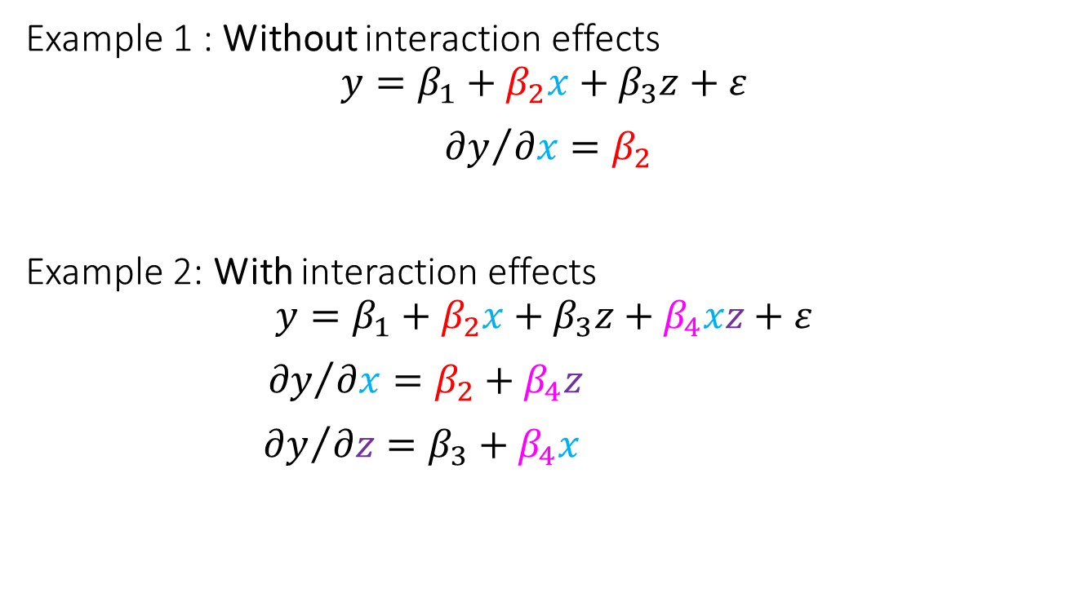
Question 8
To see it more clearly, we consider the following regressions
Example 1 : Without interaction effects
$$y=β_{1}+β_{2}x+β_{3}z+ε$$
${∂y}/{∂x}=β_{2}$
Example 2: With interaction effects
$$y=β_{1}+β_{2}x+β_{3}z+β_{4}xz+ε$$
${ ∂y}/{∂x}=β_{2}+β_{4}z$
${∂y}/{∂z}=β_{3}+β_{4}x$

Slide 6
AP Quiz – 1
Consider dependent variable y represents how (un)healthy a person is, measured by number of days sick in a year.
Drinking is bad for health, and the effect of drinking is worse for:
People higher in age, and
Male.
Questions
Write down one regression equation which is able to test the above suggested two relationships. Use b1, b2, b3, etc to represent the coefficients.
What is the marginal effect of drinking on sickness? Give the equation for the marginal effect based on the regression equation you give in the above question.

Slide 7
2. What is a mediator? Is it the same?
NO. They are not the same.
A mediator: The effect of X on Y is driven (partly) by another variable (W). Mediator explains the process between X and Y.
Recall that moderator shows the existence of a characteristic that influences the relationship.
Moderator Z
X
Y
Mediator W

Slide 8

Example of mediator and moderator
Your ability to cope with stupid persons
Stupid Boss
Unreasonably high workload

Slide 9
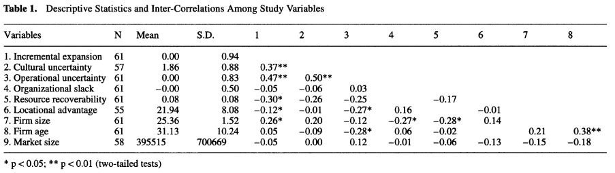
3. Multicollinearity
Table 1 presents correlations among variables.
How should the correlation matrix be examined to detect possible multicollinearity?
Multicolliearity is a problem that can arise if some independent variables inside a same regression are too highly correlated.
liberal approach: exceeds 0.7 or even 0.8 (in absolute value). more conservative: 0.6 or even 0.5. (but always clarify your criteria used!)
NO NEED

Slide 10
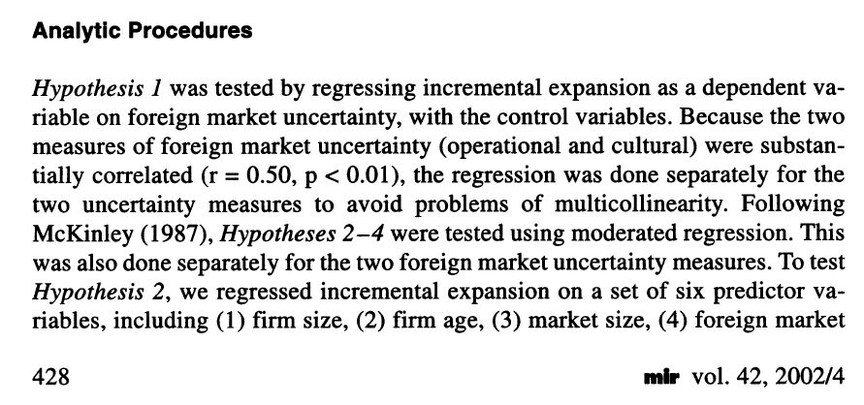
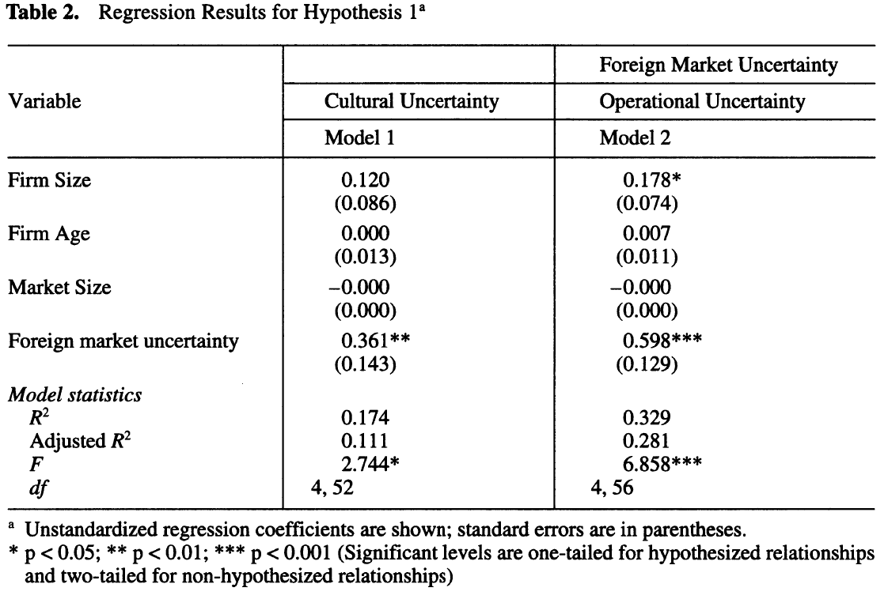
4. Have a look at Table 2.
Why have the authors analyzed two different specifications of the same model?
To avoid multicollinearity problems of including both cultural uncertainty and operational uncertainty variables at the same time.

Slide 11
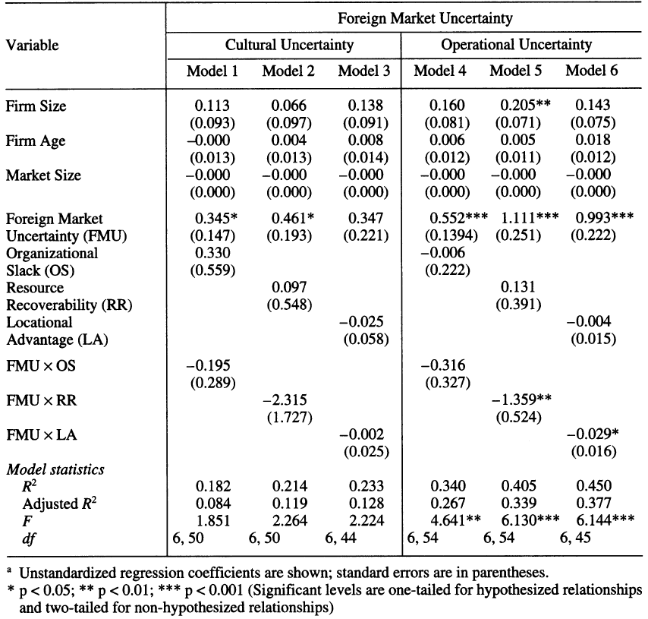
5. Looking at Table 3, …
Which control variables have been used in the model? Do all control variables have a significant effect in the regression model?
Controls
IVs that are Related with hypotheses

Slide 12
Question 6
Hypothesis 1 states: “Foreign market uncertainty will have a positive effect on firms’ involvement in incremental international expansion”. Looking at Table 2, can we conclude that there is enough evidence to support Hypothesis 1?
Locate the main IV(s)
Assess the direction of the relationship
We find coefficient
0.361**, 0.598***
Check significance level and sign
Both positive and significant
Draw conclusion

Slide 13
Question 6
The results show that firms facing greater foreign market uncertainty will be more involved in incremental international expansion, as we can see looking at the significant positive estimated coefficient for foreign market uncertainty in both models.
Hypothesis 1 is supported, because the effect is significant and the coefficients have the hypothesized sign (positive).

Slide 14
7. Explain the set-up of Table 3.
6 models, three using cultural and other three using operational uncertainty. Each includes a different kind of moderator
Controls
IVs Related with hypotheses;
Incl. the moderators and the interactions with FMU
Model characteristics

Slide 15
9. Evaluate if hypotheses 2-4 are confirmed
Look at the interaction terms
Check if they are significant?
Do they have expected sign?
So: First read again what are the hypothesis!

Slide 16
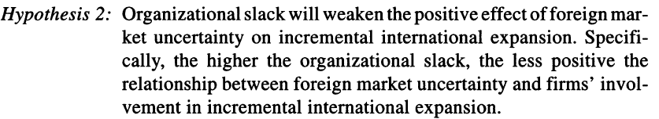
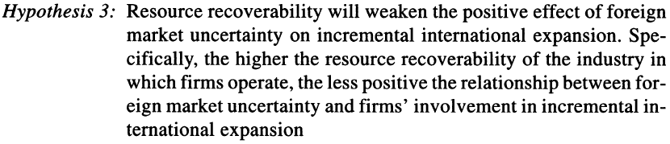
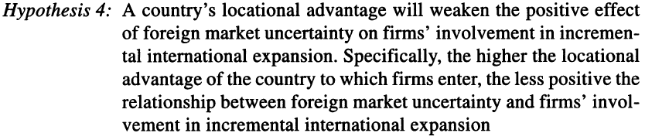

Slide 17
9. Evaluate if hypotheses 2-4 are confirmed
Hyp. 2: Correct sign, not significant.
NOT Supported.
Hyp. 3: Partially supported.
Hyp. 4: Partially supported.

Slide 18
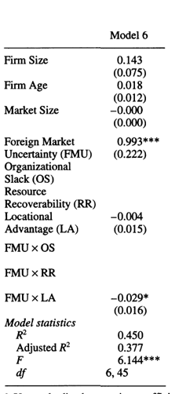
10. Look at table 3, model 6:
Explain the relationship between foreign market uncertainty and incremental expansion.
Mention the sign, size and significance of both the direct and indirect effects.
Explain the relationship not only by the direct effect but also by the indirect effect.
Assumption in interpretation: ceteris paribus, so when all other IVs are held constant (apart from the moderator, since this is a conditional hypothesis that is being tested).

Slide 19
10. Look at table 3, model 6:
Explain the relationship between foreign market uncertainty and incremental expansion.
The direct effect of FMU is positive (sign) with a coef. of 0.993 (size). Highly significant (sig. 0.1% level).
This direct effect is negatively moderated by locational advantage, as the interaction effect FMU*LA presents a negative coef. Of –0.029, it is significant at 5% level.
(verbal) interpretation of the indirect effect: When the relative cost advantage that the firm can obtain by operating in a foreign country is 1 unit higher, the positive effect of market uncertainty on incremental expansion decreases by 0.029 units, ceteris paribus. The effect is significant at 5% level.

Slide 20
AP Quiz – 2
A researcher examines how international experience of top managers affects firms’ export performance. She proposes that managers with greater international experience develop stronger cross-cultural communication capabilities, which help the firm build relationships with foreign partners and achieve higher export performance. She further expects that this indirect effect will be stronger in firms that operate in highly competitive international markets, where such capabilities are especially valuable.
What is the role of cross-cultural communication capability in this relationship?
What is the role of international market competition in this relationship

Slide 21
AP Quiz – 2
CEO’s Leadership affect performance of a firm in a way that it affects the commitment of employees in the firm. Great leadership makes people feel more committed to the vision of the firm, hence improve the performance of the firm.
What’s the role of “employee’s commitment” in this relationship?

Slide 22

AP Quiz – 2
Direct or moderation of mediation effect?
“Working hard makes me happy because I can make a lot of money for more enjoyment!”
“I’m a workaholic so I enjoy working hard!”
“Working had makes me happy, if at the same time I can have good work-life balance!”

