Slide 1

PROF. Ronald Holzhacker, Director

Slide 2
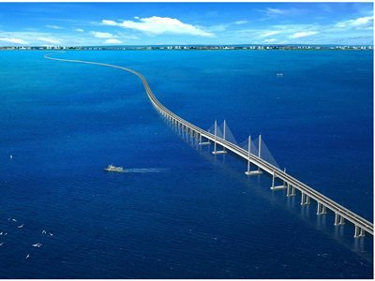

Slide 3
Steps in Searching for European Partner to Supervise Phd
Build on your prior experience: academic studies, employment, life experiences.
Link your ‘research topic’ to a wider disciplinary or trans-disciplinary field and current theoretical debates.
Consider what is ‘new and innovative’ about the proposed research, for science and society.
Contemplate the societal impact of your research.
Investigate which European universities, research centres, and professors are currently researching and publishing in your field.
Identify scholarship and funding opportunities for your research.

Slide 4
Practical Matters
Consider having long versions (fully documented file), short versions (one-page summary), very short versions (paragraph, abstract for emails), and extremely short versions (email subject line), so a supervisor / graduate school officer can derive the relevance of your message from the title in their inbox.
Consider the priorities and goals of the scholarship sponsor, and show yourself to take these seriously by addressing them intelligently in your proposal.

Slide 5
Structure of a Research Proposal
Introduction (2 para., one topical, one theoretical)
Research Question (1 paragraph)
Scientific and Social Significance of the RQ (2 para)
Methodology (1 or 2 para.)
Theoretical Overview and Literature Review (3 pages)
Analysis (4 pages)
Conclusion (1 page)

Slide 6
Considering linking your research to current major scientific, policy or societal agendas.
Some examples, consider:
-one or a group of the Sustainable Development Goals (SDGs).
-regional integration issues (ASEAN)
-climate change, mitigation and adaptation
-sustainable and resilient development
-comparative research, implementation challenges

Slide 7
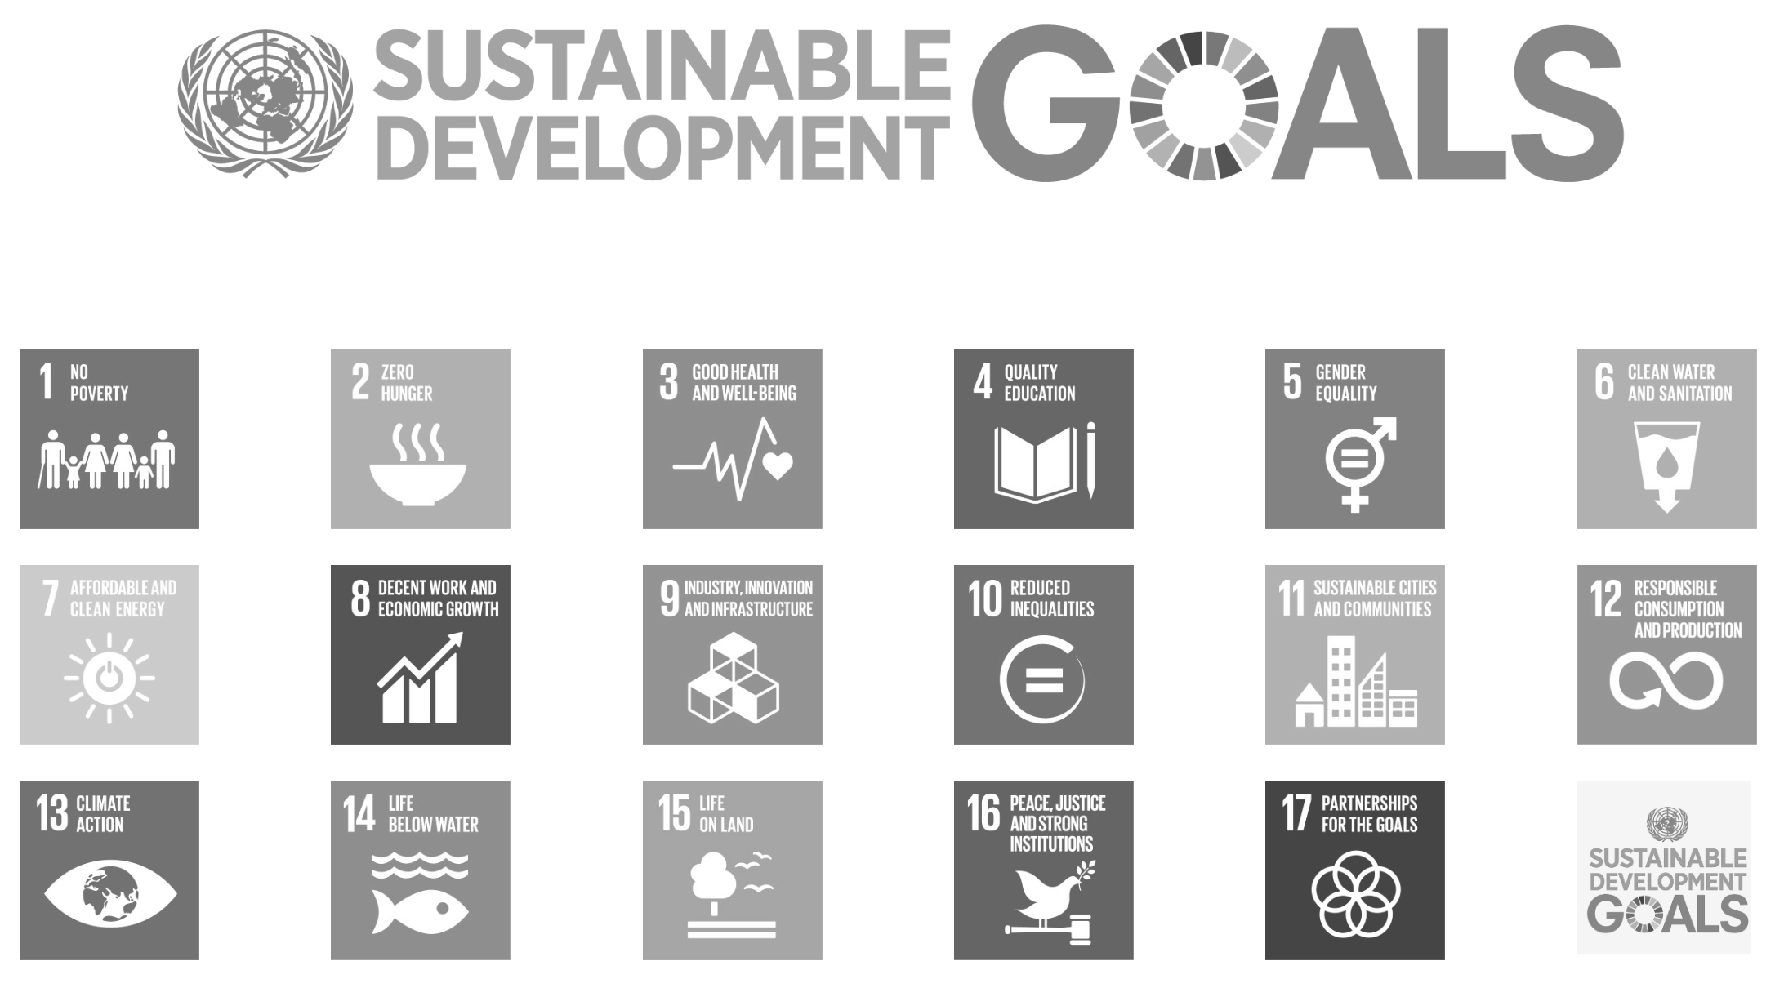












Notes:
Once those key areas are addressed, sustainable mobility is guaranteed, it will also increase accessibility equity. The current system makes the rich richer and the poor poorer (lack of ability to pay for cars or too much time to get to key facilities and locations or even access cultural and social institutions).

Slide 8


Slide 9


Slide 10
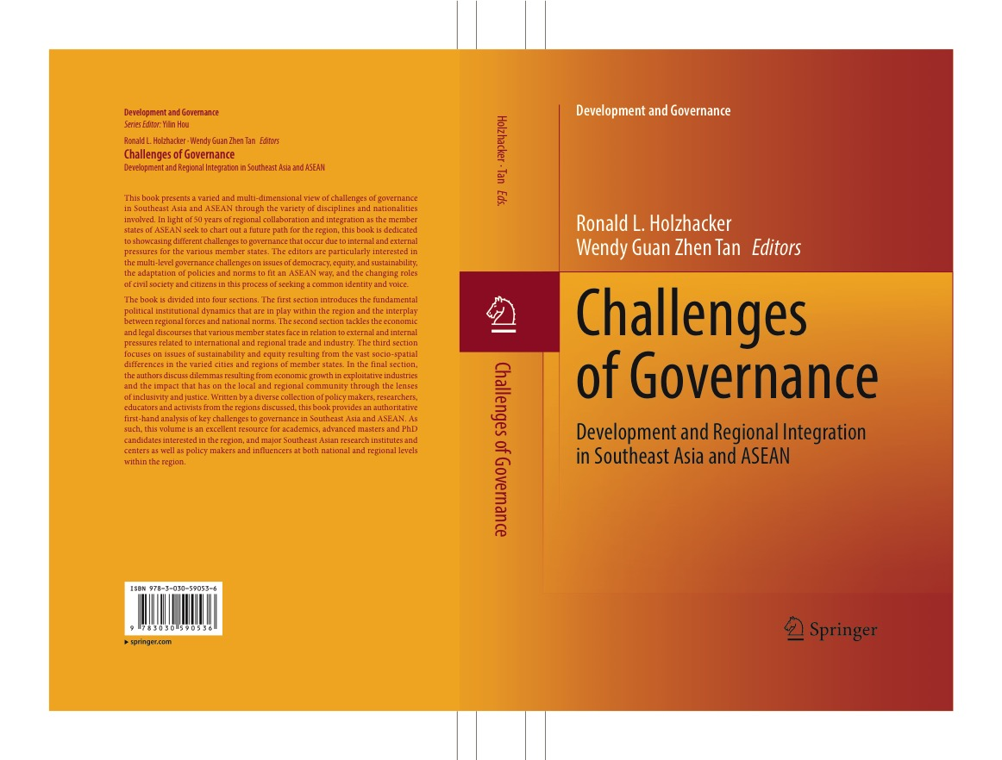

Slide 11
Searching for Synergies in the Sustainable Development Goals and Climate Change Agendas

Slide 12
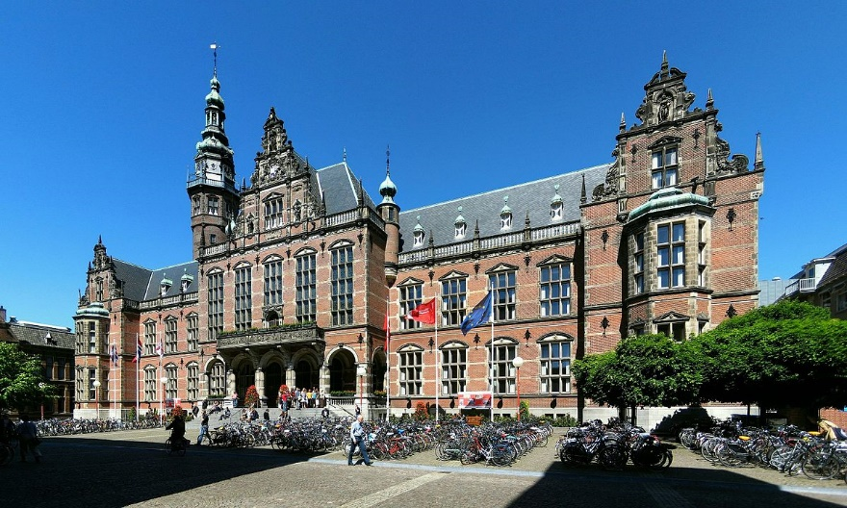

Slide 13
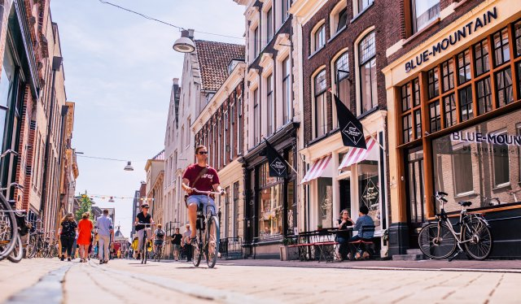

Slide 14
