Slide 1
Moving from academia into sales
Do stuff and get yourself connected
Marnix Wieffer,
Senior marketing manager Drug safety
m.wieffer@elsevier.com
Notes:
-Tell a bit about my work
-About the pros/cons
-About the journey, how I got there?
-> At the end provided sufficient and a bit of advice insight to help you explore post-academic career.

Slide 2


Take home message
Do stuff (away from the bench)…
And get yourself connect
Notes:
Tell a bit about my work
About the pros/cpns
About the journey, how I got there?

Slide 3
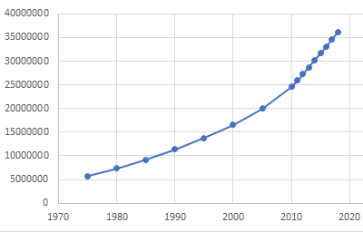


Elsevier life sciences, what do we do?
Number of articles in Embase per year
1,417,665 records in 2018.......
400 m
Scientific data exchange is 400 years old
Most scientific data still published in unstructured format
Data retrieved from www.Embase.com
Notes:
My 4th point :Published lit is increasing every year
Which is great because we have more information to read

Slide 4

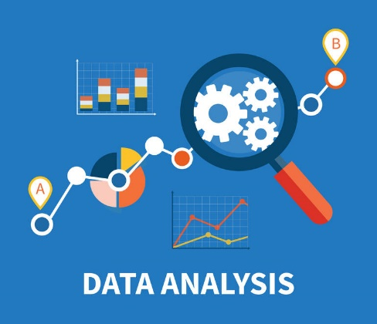




Elsevier life sciences, what do we do?
Documents
Databases
Analytics

Slide 5
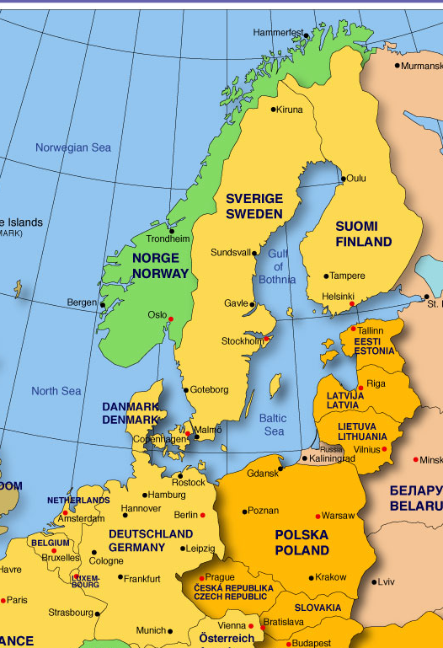
What do I do?
New sales of Elsevier life sciences databases and analytics
Visit chemical and Pharmaceutical companies
Visit government and academic institutes
Interact with PhD level scientists and business
Nordics & Benelux
Sales is the sole entry point for life sciences revenue -> Bring in the revenue
Traveling
Cold calling
Networking
Presentations
Emailing
Meetings

Slide 6

Sales: Is it any good?
Job satisfaction
Rewards (wins/losses)
Independence
Sales targets
Pressure
Travel
Experience/skills
Entry points for further careers

Slide 7




My academic Journey
Study
PhD
Postdoc
Postdoc
Notes:
Best grade ever was at Utrecht university for my management course

Slide 8


Reflect
People
Science
Business
Research
Apply

Slide 9



What happened along the way
Support Elsevier day at TU Dresden
Career day at MPI-CBG
Mendeley advisor
“Why do they never talk about sales on these type op events?”

Slide 10

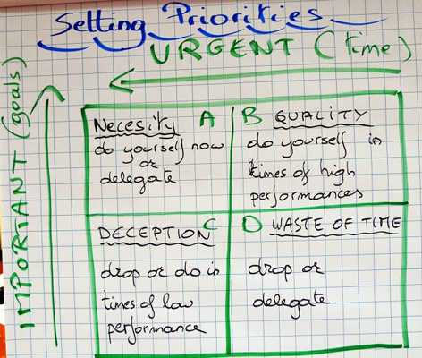
Keep educating yourself

Slide 11
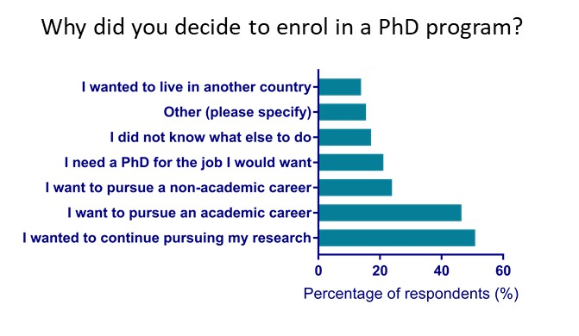
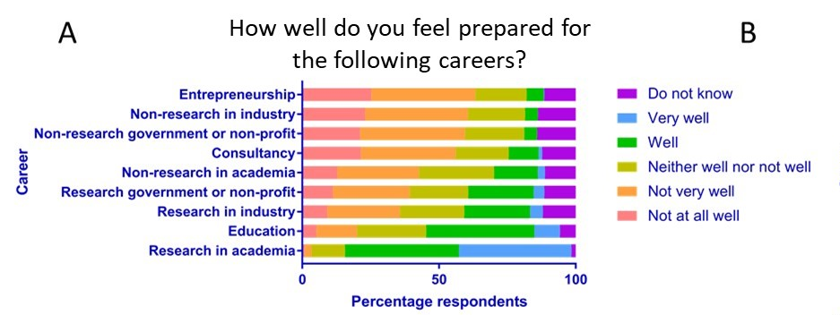
What do you think?
70% of the PhDs in the Netherlands hold a position outside of academia

Slide 12
Non-research in industry: You’ve got it all!
Business
Academic
Sales pitch
Poster presentation
Demonstration
Conference presentation
Business plan
Grant proposal
Advertisement
Research paper
Digital marketing
Citations

Slide 13
Take home message
Do stuff (away from the bench)…
And get yourself connect

Slide 14
Marnix Wieffer,
Senior marketing manager Drug safety
m.wieffer@elsevier.com

