Slide 1
Careers of Postdocs
Liesbeth Volbeda
e.f.volbeda@rug.nl

Slide 2
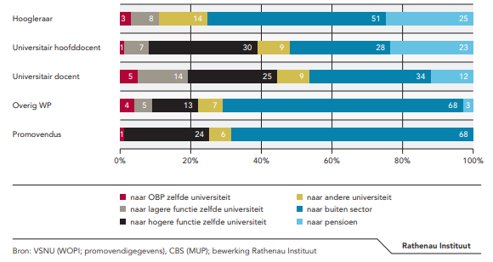
Academic careers

Slide 3


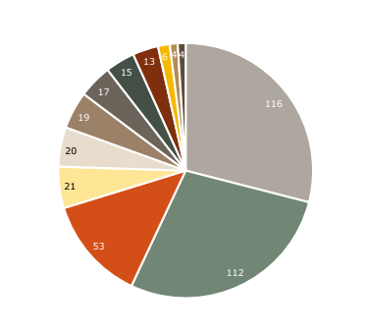


400 CV’s of Postdocs
Industry/ R&D
Universities
Businesses, Banking and Consultancy
Higher Education
Knowledge Institutions
Hospitals
Government
Care

Slide 4
First organization after Postdoc
Industry/ R&D
Universities
Businesses, Banking and Consultancy
Higher Education
Knowledge Institutions
Hospitals
Government
Care Institutions
Education

Slide 5
Roles or jobtitles
Researcher
Assistant and associate professor
Engineer
Manager or project manager
Lecturer or teacher
Data Scientist
Consultant
Entrepreneur
Expert (domain specific)
Policy/ administration

Slide 6


Self awareness
opportunity awareness
You
Labour - market
Decision making
Transitional skills
Notes:
Self awareness: what do you have to offer, what do you want, what is your nice, what is your specialisation
What do they have to offer what do they want, what are new projects?
Decision making plan A, plan B, networking
Transitional skills: networking, applications

Slide 7

Self awareness
Notes:
Self awareness is
How do you come across, how are you perceived, did you find three qualities that you are good at?
Who would like to share this quality!

Slide 8
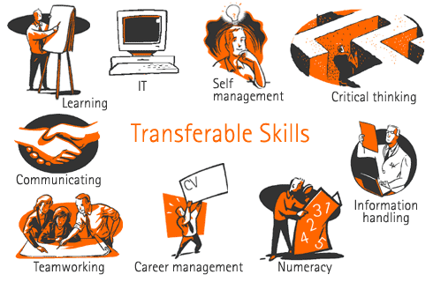
www.professionalresumewriters
Leadership
© TD UoG
Notes:
So what do you learn during your education/ PhD project.

Slide 9

Opportunity awareness

Slide 10
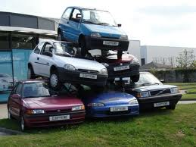
CHOICES
Maximizers
Satisfiers
Within or beyond academia
What fits you best?

Slide 11
Career development
Individual Career counselling.
Career course for Postdocs and Young UG – Sept/Oct
Job application training
Unstuck: the art of productivity
Time management - workshop series
Leadership and Management Skills
Coaching PhD students

Slide 12
Talent Development
Grant writing training courses - Talent Development
From chaos to focus
Rubicon
Veni, Vidi, ERC
Editors at Talent Development
------------------------------
Corporate Academy

Slide 13


