Slide 1
Have Fun
Get Funded!
Drs. Geert-Jan ARENDS
sr consultant EU funding
Strategy Department for Education and Research
University of Groningen (NL)
g.j.arends@rug.nl

Slide 2
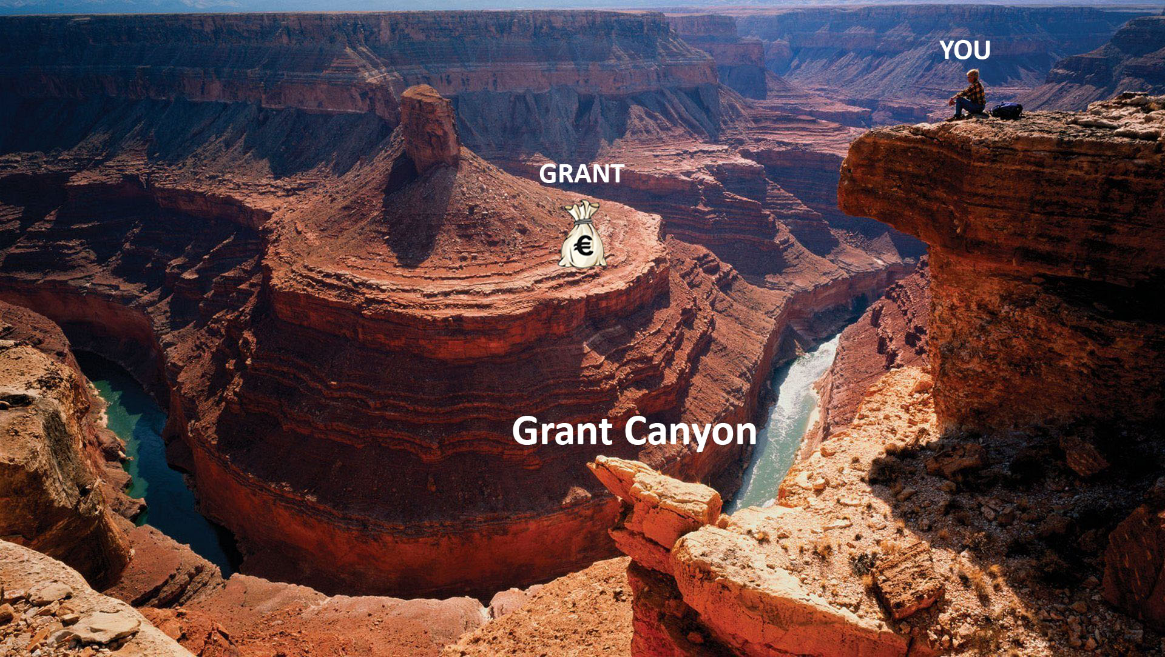
Grant Canyon

Slide 3
Geert-Jan Arends
Solid State Chemistry at University of Groningen (1987)
4 years multinational corporation
4 years regional small company
Joined University of Groningen in 1995
More than 20 years funding experience

Slide 4
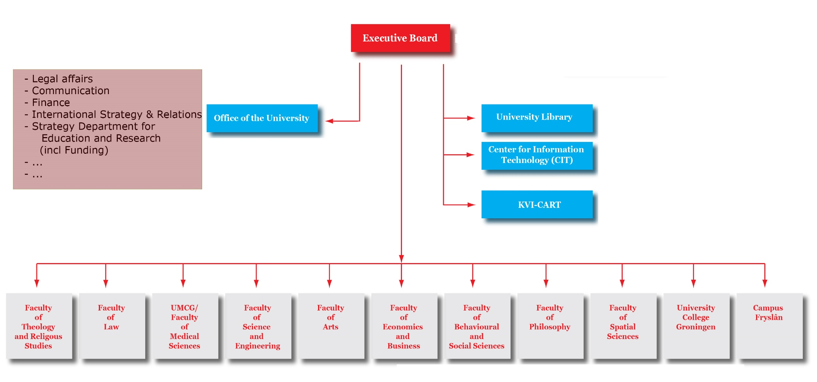

Slide 5
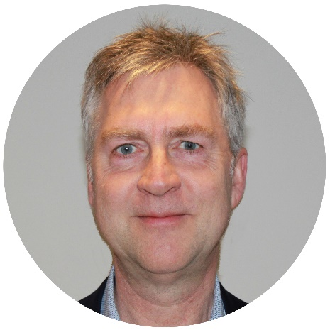
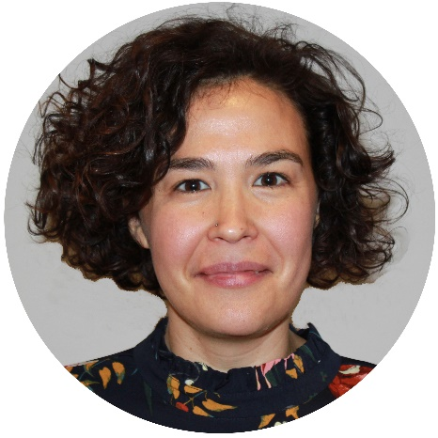
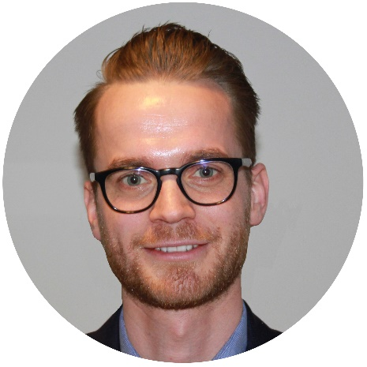
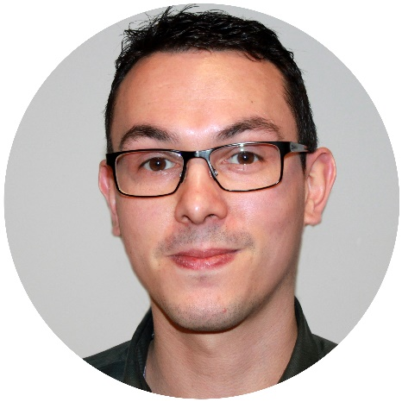
Strategy Department for Education & Research
Education Policy & Student Affairs
Research Policy & Funding
    - Research Policy
- Development Cooperation
- European (and other) Funding
Geert-Jan Arends
Gema Ocana Noriega
Maarten Eisema
Robert Otten

Slide 6
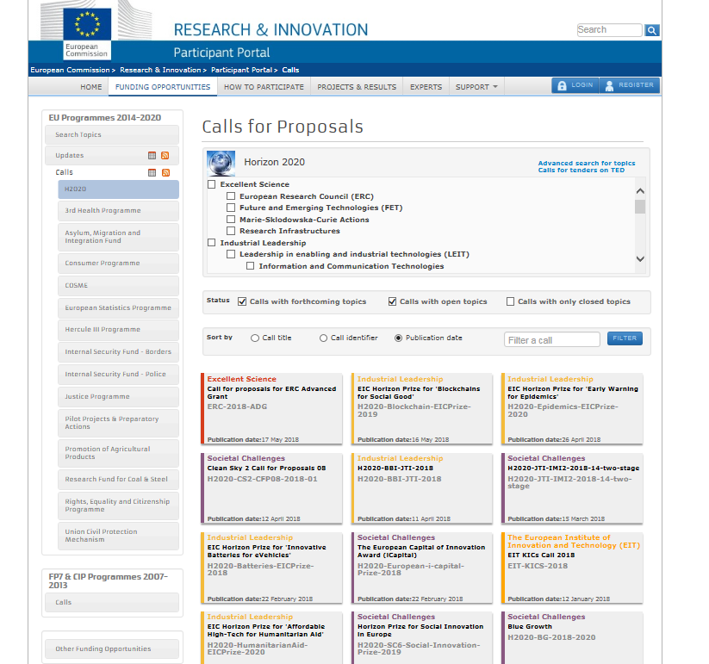
?
?
?
?
?
?
?
?
?
?

Slide 7
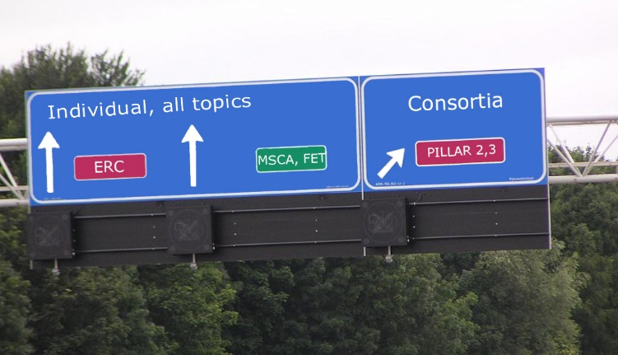
Specific topics!

Slide 8
Specific topics!
EU: ERC
Marie Sklodowska Curie Actions – Individual Fellowships
NL NWO: Rubicon
VENI, VIDI, VICI
EU: Pillar 2, 3
NL: NWA, NWO, Topsectors, …
US: NIH
…

Slide 9


INDIVIDUAL GRANTS
YOU
PROJECT/HOST
Notes:
YOU!

Slide 10
INDIVIDUAL GRANTS
Prepare your CV early (start now!)
Do extra things (prizes, MSCA-IF, conferences, Board memberships, visits, …)
From Proposal Improvement to Talent Development
YOU
Notes:
YOU!

Slide 11
INDIVIDUAL GRANTS
Prepare your project
Think about your project.
Visit Host Institute
Dream your dream. Find the WOW
PROJECT/HOST
Notes:
YOU!

Slide 12
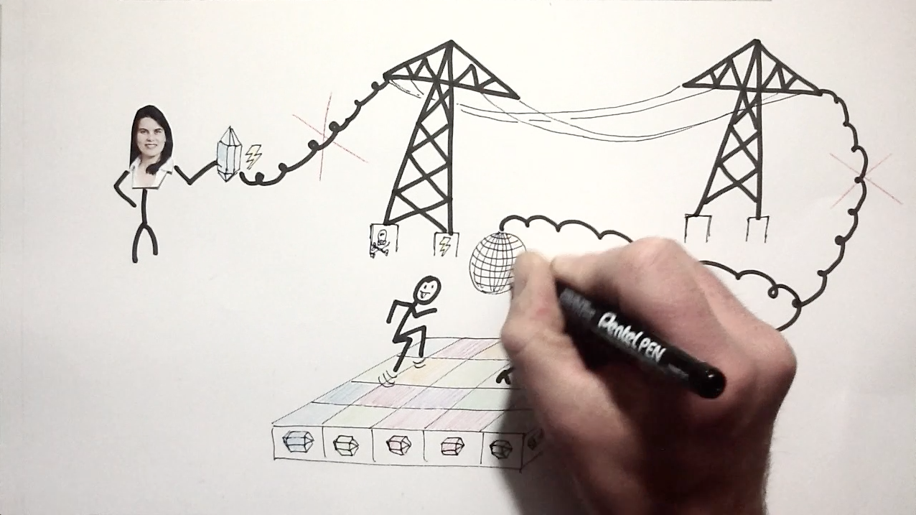
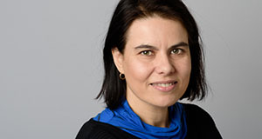
Dream
your
Dream!
Beatriz Noheda

Slide 13

Collaborative grants – Top down, specific topics
2 ways to participate
  Coordinator
  Partner
Make sure that you are found!

Slide 14
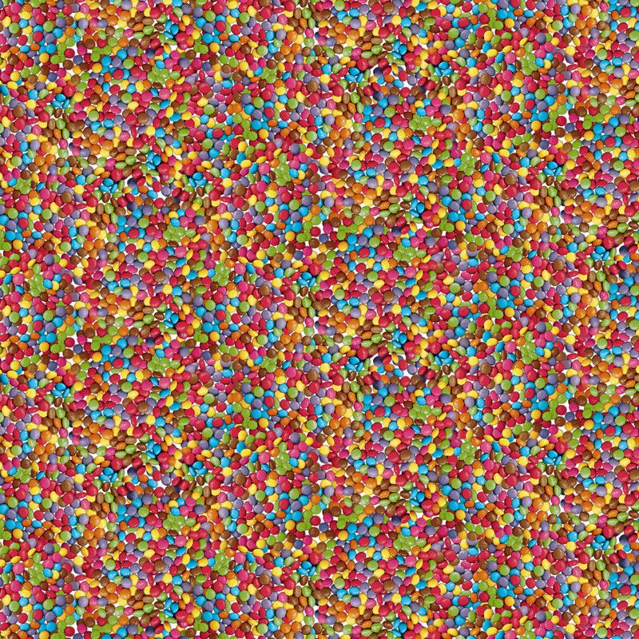

Slide 15
How can you be found? Find the people with the money!
Who took my money*
Use Google to find existing projects on your subject
(e.g. H2020 + keywords)
Look at the consortia
Follow the people and find out where ‘their’ conferences are
Make contact!!!!
* Sean McCarthy, www.hyperion.ie

Slide 16
General tips about proposal writing
Title
Acronym (FCRISPR-GHQ vs ACCOMPLISSH)
From telling to selling

Slide 17
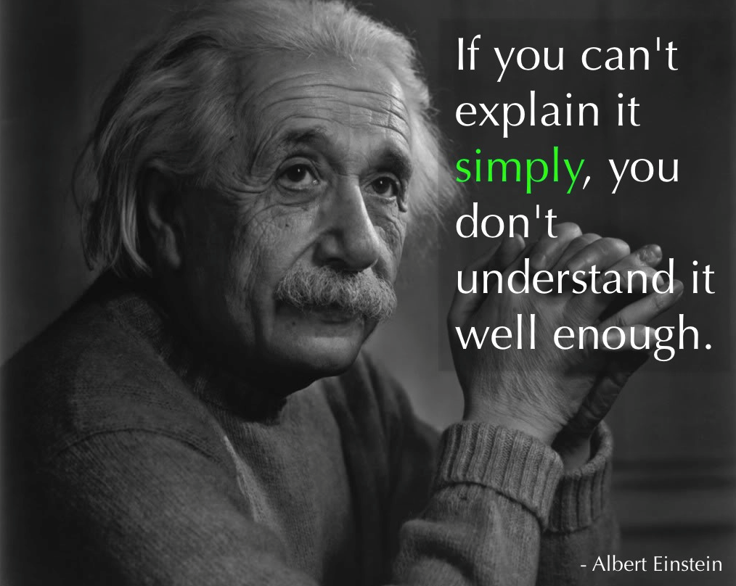
Albert Einstein

Slide 18


Slide 19
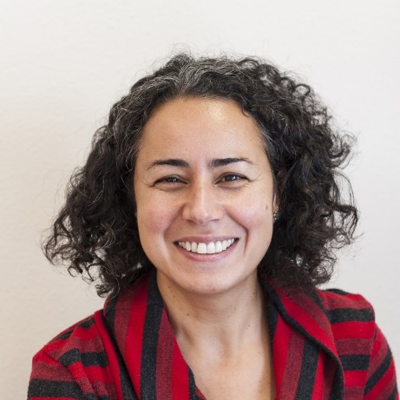
“It is amazing how much we have learned about the working of our universe by using our five senses and how little we still know about the working of these senses themselves!
Even though the molecular mechanism of sight, taste, and smell is known, we still don’t know how the mechanical sensations of touch and hearing function at the molecular level.
Mechanosensitive (MS) ion channels, present in membranes, are the molecules…”
Argaman Kocer

Slide 20
<excercise>

Slide 21
Get help!!!!!!!
supervisor
colleague
National Contact Point
partner at home
Do not let them be nice to you!!!

Slide 22
Faculty Funding Officers at your Faculty or your Institute

Slide 23
Groningen Grants Week
22 May Special day for Early Career researchers
23 May MSCA-Individual Fellowships
20 June Writing workshop on MSCA-IF
www.rug.nl/grants-week

Slide 24


Slide 25
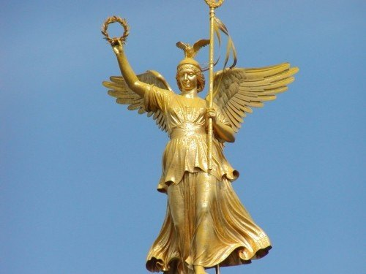

Slide 26
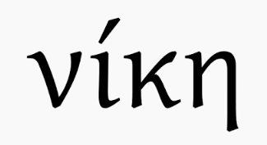
Greek goddess of Victory:

Slide 27
Greek goddess of Victory:
NIKE

Slide 28


