Slide 1
Which test when?
Christine zu Eulenburg
Medical Statistics and Decision Making
UMCG

Slide 2
Help! Statistics! Lunchtime Lectures
What? frequently used statistical methods and questions in a manageable timeframe for all researchers at the UMCG
No knowledge of advanced statistics is required.
When? Lectures take place every 2nd Tuesday of the month, 12.00-13.00 hrs.
Who? Unit for Medical Statistics and Decision Making
When? | Where? | What? | Who?
Jan 10, 2017 | 3212.0217 | Which test when? | C. zu Eulenburg
Feb 14, 2017 | 3212.0217 | Some common misconceptions about p-values and confidence intervals | H. Burgerhof
Mar 14, 2017 | Room 16 | Mediation analysis | S. la Bastide
Apr 11, 2017
Slides can be downloaded from http://www.rug.nl/research/epidemiology/download-area

Slide 3
Which test when?
The most important questions to answer:
What is the main study hypothesis?
Are the data independent?
What types of data are being measured?
Notes:
1. Sometimes, researchers do not have a hypothesis but just want to see what is in their data. No hypothesis, no test! It is important to decide a priori which assumptions should be confirmed and which questions are exploratory. Not a single study can support a whole series of hypotheses!

Slide 4

Example:
1. What is the main study hypothesis?
“I have a great dataset! Let’s see what’s in there!”
Notes:
1. Sometimes, researchers do not have a hypothesis but just want to see what is in their data. No hypothesis, no test! It is important to decide a priori which assumptions should be confirmed and which questions are exploratory. Not a single study can support a whole series of hypotheses!

Slide 5
Example:
1. What is the main study hypothesis?
“I am interested in studying the difference between group 1 and group 2.”
Notes:
1. Sometimes, researchers do not have a hypothesis but just want to see what is in their data. No hypothesis, no test! It is important to decide a priori which assumptions should be confirmed and which questions are exploratory. Not a single study can support a whole series of hypotheses!

Slide 6
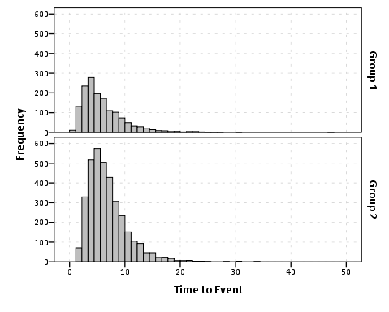
What is the main study hypothesis?
Are you mainly interested in…
testing (differences in) measures of location?
(means, medians,…)
testing (differences in) variability?
distributional assumptions?
(test for normal distribution)
outcome
Notes:
Although it is valid to use statistical tests on hypotheses suggested by the data, the P values should be used only as guidelines, and the results treated as very tentative until confirmed by subsequent studies. A useful guide is to use a Bonferroni correction, which states simply that if one is testing n independent hypotheses, one should use a significance level of 0.05/n. Thus if there were two independent hypotheses a result would be declared significant only if P<0.025. Note that, since tests are rarely independent, this is a very conservative procedure - one unlikely to reject the null hypothesis.

Slide 7
What is the main study hypothesis?
Frequently applied tests for testing differences in means:
t-test (2 groups, normally distributed data)
ANOVA (>2 groups, normally distributed data)
Wilcoxon test
Man-Whitney U test
Kruskall Wallis
} Nonparametric tests
(Non-normal data)
Notes:
Although it is valid to use statistical tests on hypotheses suggested by the data, the P values should be used only as guidelines, and the results treated as very tentative until confirmed by subsequent studies. A useful guide is to use a Bonferroni correction, which states simply that if one is testing n independent hypotheses, one should use a significance level of 0.05/n. Thus if there were two independent hypotheses a result would be declared significant only if P<0.025. Note that, since tests are rarely independent, this is a very conservative procedure - one unlikely to reject the null hypothesis.

Slide 8
Which test when?
The most important questions to answer:
What is the main study hypothesis?
Are the data independent?
Differences in means / medians / proportions between two or more groups,
Hypotheses on distributions, correlations, regression coefficients, …
Notes:
1. Sometimes, researchers do not have a hypothesis but just want to see what is in their data. No hypothesis, no test! It is important to decide a priori which assumptions should be confirmed and which questions are exploratory. Not a single study can support a whole series of hypotheses!

Slide 9

2. Are the data dependent or independent?
Data are dependent when two specific observations are per se more similar to each other than two random other observations.
Families (LifeLines)
Repeated measurements
Patients within one centre
Etc.
For dependent variables, paired tests should be used.

Slide 10
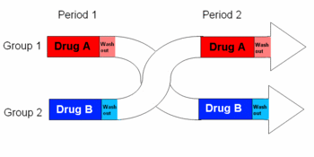


2. Are the data dependent or independent?
The analysis should also reflect the study design:
In a cross-over trial and
In a matched case-control study ,
tests for dependent data should be applied.
In most RCTs, observations are independent

Slide 11
Example 1:
A group of patients was measured before and after treatment of a new medication XY.
“Does medication XY lower the mean blood pressure?”
Repeated measurements of the same patients -> dependent observations!
Notes:
1. Sometimes, researchers do not have a hypothesis but just want to see what is in their data. No hypothesis, no test! It is important to decide a priori which assumptions should be confirmed and which questions are exploratory. Not a single study can support a whole series of hypotheses!

Slide 12
Example 2:
To compare treatments A and B for leg ulcers regarding the time to cure, 30 ulcers in 20 patients treated with A or B where retrospectively compared.
-> Some patients have more than one ulcer
-> Considering the ulcers as independent observations is not correct!
Ignoring the cluster structure…
…underestimates within-cluster variation
…overestimates between-cluster variation

Slide 13

Confounding:
A swedish longterm study resulted in a higly significant correlation (p<0.001) between the number of storks and the number of births in communities.
The observations are independent. But a third variable is strongly associated with both, the number of storks and birth.
TIME
is a confounder in this study and should be controlled for!
Notes:
A spurious correlation

Slide 14
Which test when?
The most important questions to answer:
What is the main study hypothesis?
Are the data independent?
What types of data are being measured?
Differences in means / medians / proportions between two or more groups,
Hypotheses on distributions, correlations, regression coefficients, …
Two legs of a patient, patients within one centre, repeated measurements over time, etc. are dependent! Are there confounding variables to control for?

Slide 15
3. What types of data are being measured?
Examples
Treatment arm, blood group, Being alive (yes/no)
Test scores, Likert scales
Number of children, Weight in kg Percentages Time to death
Nominal
Ordinal
continuous Time to event
It is helpful to answer the question of variable type for input variables and outcome variables!

Slide 16

Frequently applied tests
Outcome variable | Dependent observations | Independent observations
Nominal (e.g. cured yes/no)
Ordinal (e.g. pain scale 1 to 5)
Quantitative (e.g. blood pressure)
Time-to-event (e.g. Time to death)
Chi2
Logistic Regression
Mc Nemar’s test
Wilcoxon sign test
Man-Whitney-U
t-test, ANOVA
Lin. Regression
Sign test
Paired t-test
Mixed model
Kaplan-Meier
Cox Regression
Frailty Model
For some tests, assumptions have to be met!
Notes:
The choice of the test depends further on
- The type of the independent variable (categorial/ continuous)
- the distribution of the independent variables (normal/nonnormal)
- The model assumptions

Slide 17
Key assumptions for tests
Tests | Assumptions | Alternative
Categorial (Chi2, McNemar, logistic regression) | Sufficient numbers in each cell (n>=5) | Exact tests (Fisher’s exact test, McNemar’s exact test)
Linear models (t-tests, ANOVAs, linear regression, mixed models,…) | Linear relationship Normally distributed outcome (important for small samples) Equal variances | Nonlinear models Nonparametric tests (sign-test, U- test, Kruskal-Wallis…)
Time-to-event (Kaplan-Meier, Cox) | Cox regression assumes proportional hazards | Time-dependent models
Notes:
Graphical display can help to assess linear relationship
Alternative when variances are unequal: Welch test

Slide 18
Which test when – in the web
Usefull overviews can also be found at
the UCLA homepage
http://www.ats.ucla.edu/stat/mult_pkg/whatstat/
MGH Biostatistics homepage
http://hedwig.mgh.harvard.edu/biostatistics/support/stat-key

Slide 19
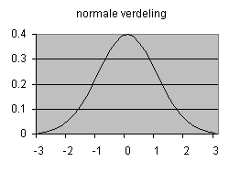
Parametric versus nonparametric tests
Many statistical test are based upon the assumption that the data are sampled from a Gaussian distribution.
These tests are called parametric tests.
(i.e. t-test, ANOVA, …)
Tests not making this assumption are referred to as nonparametric tests.
(i.e. Mann-Whitney, Wilcoxon, Kruskal Wallis,…)
Notes:
Q-Q Plot: quantile-quantile plot

Slide 20
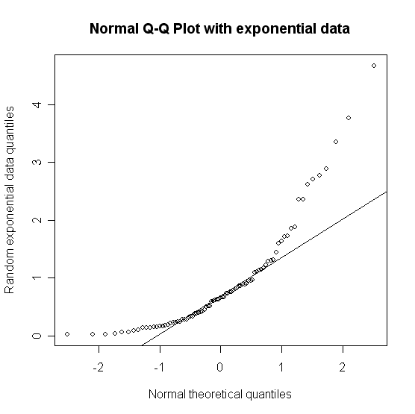
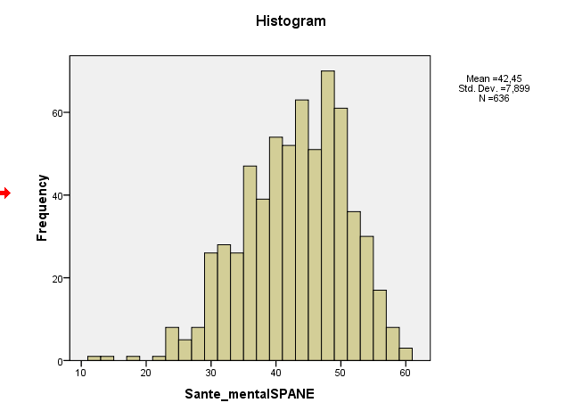
3. What types of data are being measured?
Tests for normal distribution:
Graphical tests:
Histogram
Q-Q Plot
Theoretical test:
Kolmogorov-Smirnov-test
Notes:
Q-Q Plot: quantile-quantile plot
Beobachtungen werden der Grösse nach geordnet. Empirische quantile werden gegen die theoretischen quantile der Normalverteilung abgetragen. Wenn die Merkmalswerte aus der Vergleichsverteilung stammen, stimmen die empirischen und die theoretischen Quantile annähernd überein, d. h. die Werte liegen auf einer Diagonalen

Slide 21
Parametric versus nonparametric tests
You should definitely choose a parametric test when you are sure that your sample comes from a normally distributed population, because
parametric tests allow effect estimation
parametric tests have more power
parametric tests allow for covariate adjustment
Some non-normal distributions can be transformed to normal.
Notes:
Q-Q Plot: quantile-quantile plot
Beobachtungen werden der Grösse nach geordnet. Empirische quantile werden gegen die theoretischen quantile der Normalverteilung abgetragen. Wenn die Merkmalswerte aus der Vergleichsverteilung stammen, stimmen die empirischen und die theoretischen Quantile annähernd überein, d. h. die Werte liegen auf einer Diagonalen

Slide 22
Parametric versus nonparametric tests
You should better choose a nonparametric test,
…when the outcome is a rank or score and clearly not Gaussian
…when extreme outliers are present

Slide 23
Parametric versus nonparametric tests
What happens when I choose a…
 | parametric test (Distribution: non-normal) | nonparametric test (Distribution: normal)
Large sample
Small sample
No problem, robust test (central limit theorem)
valid results, slightly too high p-values
Results are not valid!
valid results, low statistical power
Notes:
Q-Q Plot: quantile-quantile plot
Beobachtungen werden der Grösse nach geordnet. Empirische quantile werden gegen die theoretischen quantile der Normalverteilung abgetragen. Wenn die Merkmalswerte aus der Vergleichsverteilung stammen, stimmen die empirischen und die theoretischen Quantile annähernd überein, d. h. die Werte liegen auf einer Diagonalen

Slide 24
Examples
1. Clinical Trial. Input variable: nominal, say type of treatment; outcome variable: clinical measure (normal), say blood pressure
t-test
2. Observational study. Input variable: clinical measure (normal), say blood pressure; outcome variable: nominal, say cured (yes/no)
logistic regression
t-test?
3. Cross-sectional study. Input variable: nominal, say sex, outcome variable: Ordinal, say rating of their general practitioner on a five-point scale
Man-Whitney-U test / t-test
(But what if some go to the same GP?)

Slide 25
Type I and Type II Error in a box
Your Statistical Decision
True state of null hypothesis
H₀ True
(example: the drug doesn’t work)
H₀ False
(example: the drug works)
Reject H₀
(ex: you conclude that the drug works)
Type I error (α)
Correct
Do not reject H₀
(ex: you conclude that there is insufficient evidence that the drug works)
Correct
Type II Error (β)

Slide 26
Error and Power
Type I error rate (or significance level): the probability of finding an effect that isn’t real (false positive).
    If we require p-value<.05 for statistical significance, this means that 1/20 times we will find a positive result just by chance.
Type II error rate: the probability of missing an effect (false negative).
Statistical power: the probability of finding an effect if it is there (the probability of not making a type II error).
    When we design studies, we typically aim for a power of 80% (allowing a false negative rate, or type II error rate, of 20%).

Slide 27
The next Help! Statistics! Lecture:
Hans Burgerhof:
“Some common misconceptions about p-values
and confidence intervals”
Tuesday, 14 February 2017, 12.00 – 13.00
Room 3212.0217 UMCG

Slide 28
