Slide 1
Help! Statistics! Some common mistakes in statistics
Hans Burgerhof
Epidemiology

Slide 2
Programme
Misuse of Bonferroni
The sd of the difference between two random variables X and Y. A geometric surprise!
The 95% Probability Interval (PI95)
Frequentist Confidence Interval versus Bayesian Credible Interval
Simple example to trigger your intuition regarding probabilities
Example of a PI95
Definition of the PI95
Back to the simple example
(My) Conclusion

Slide 3
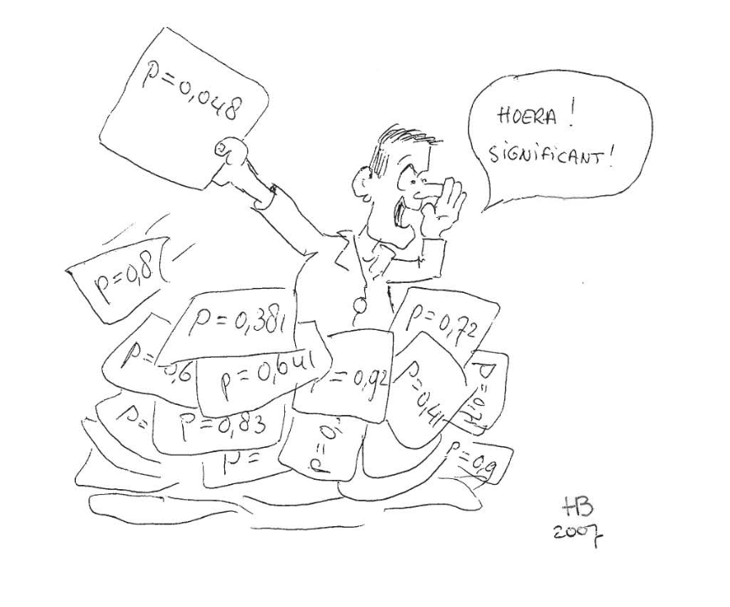
Multiple testing: change capitalization

Slide 4
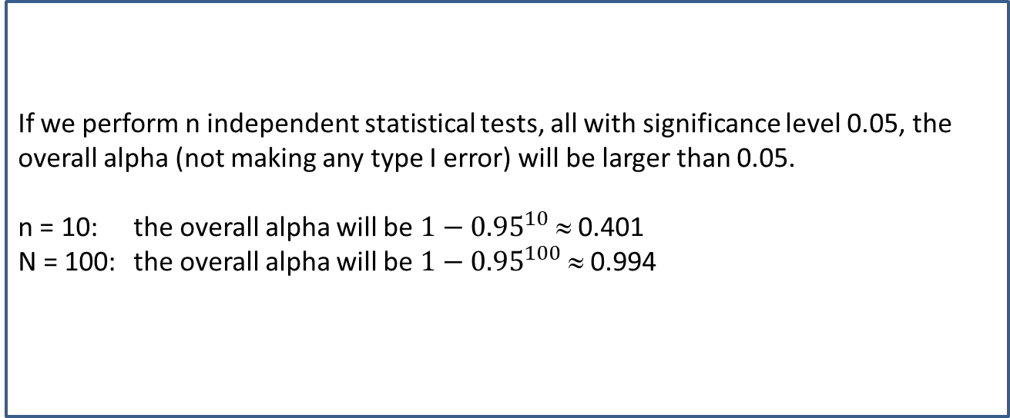
What is exactly the problem?
If we perform n independent statistical tests, all with significance level 0.05, the overall alpha (not making any type I error) will be larger than 0.05.
n = 10: the overall alpha will be $1−{0.95}^{10}$ ≈ 0.401
N = 100: the overall alpha will be $1−{0.95}^{100}$ ≈ 0.994

Slide 5
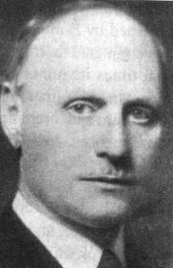
The Bonferroni correction
The idea of Bonferroni is simple: if you perform c independent tests and you would like to maintain an overall alpha equal to 0.05, perform each individual test on a significance level of 0.05 / c.

Slide 6
Oneway ANOVA with three groups and Post-hoc tests
Y is continuous, normally distributed response variable
We want to compare the group means of the groups A, B and C
Step 1: Oneway ANOVA P > 0.05: done; there are no significant differences
P ≤ 0.05: Post-hoc tests
What will be your step 2 if P ≤ 0.05?

Slide 7

Oneway ANOVA $H_{0}:μ_{1}=μ_{2}=μ_{3}$
There are only three possible situations:
All means have exactly the same value
Two means (say the first two) have exactly the same value, the third one is different.
All means have different values

Slide 8
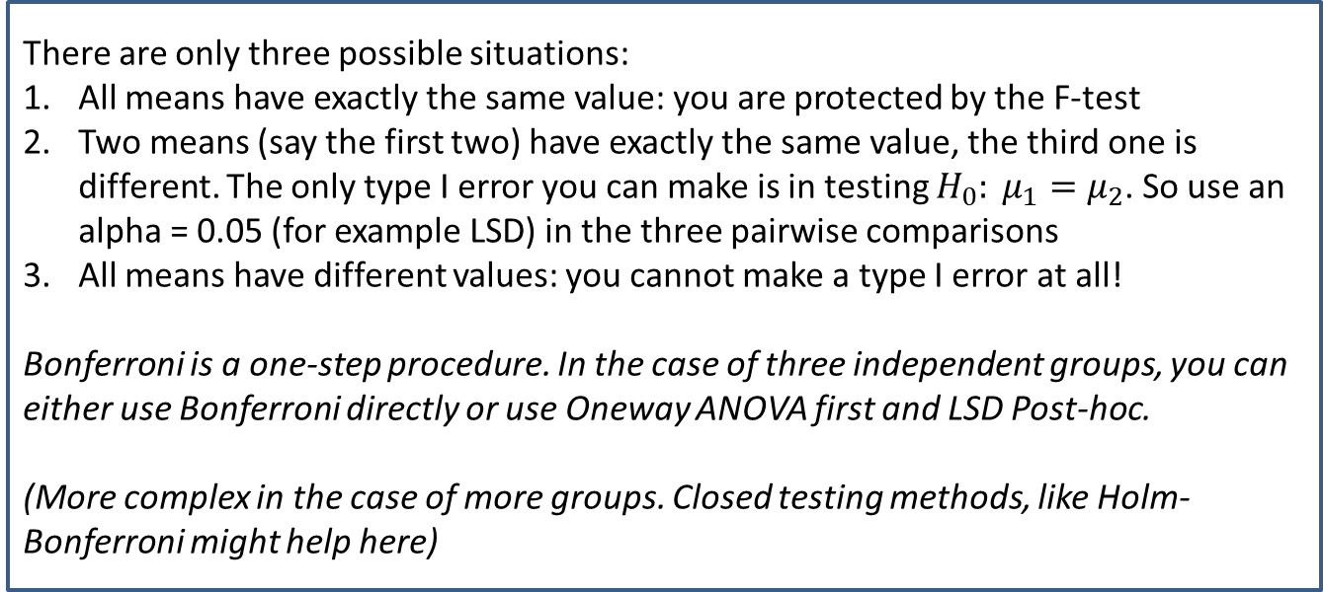
Oneway ANOVA $H_{0}:μ_{1}=μ_{2}=μ_{3}$
There are only three possible situations:
All means have exactly the same value: you are protected by the F-test
Two means (say the first two) have exactly the same value, the third one is different. The only type I error you can make is in testing $H_{0}: μ_{1}=μ_{2}$. So use an alpha = 0.05 (for example LSD) in the three pairwise comparisons
All means have different values: you cannot make a type I error at all!
Bonferroni is a one-step procedure. In the case of three independent groups, you can either use Bonferroni directly or use Oneway ANOVA first and LSD Post-hoc.
(More complex in the case of more groups. Closed testing methods, like Holm-Bonferroni might help here)

Slide 9

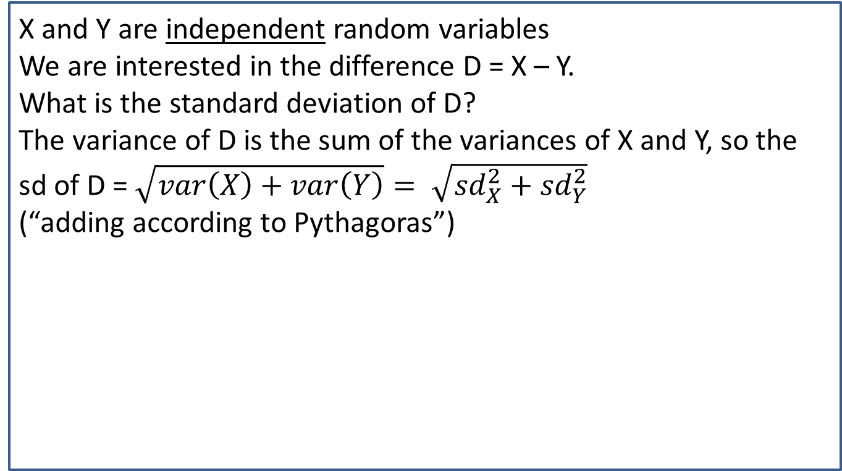

The SE of the difference between two random variables X and Y
X and Y are independent random variables
We are interested in the difference D = X – Y.
What is the standard deviation of D?
The variance of D is the sum of the variances of X and Y, so the sd of D = $\sqrt{var\left(X\right)+var\left(Y\right)}= \sqrt{{sd}_{X}^{2}+{sd}_{Y}^{2}}$
(“adding according to Pythagoras”)
$$a^{2}+b^{2}=c^{2}$$
a
c
$$c= \sqrt{a^{2}+b^{2}}$$
b

Slide 10
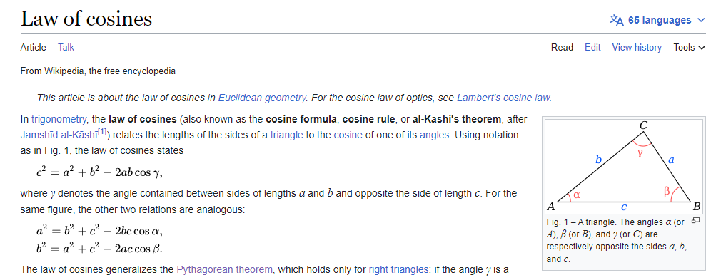
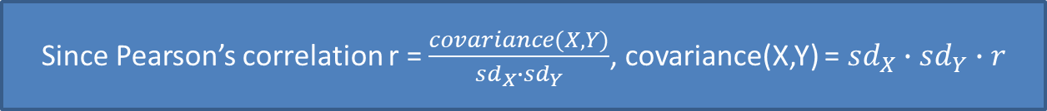

What if X and Y are not independent?
the sd of D = $\sqrt{{sd}_{X}^{2}+{sd}_{Y}^{2} −2∙covariance(X,Y)}$
Since Pearson’s correlation r = $\frac{covariance(X,Y)}{{sd}_{X}∙{sd}_{Y}}$, covariance(X,Y) = ${sd}_{X}∙{sd}_{Y}∙r$
the sd of D = $\sqrt{{sd}_{X}^{2}+{sd}_{Y}^{2} −2∙{sd}_{X}{∙sd}_{Y}∙r}$

Slide 11
P-values, Confidence Intervals and Bayesian credible intervals
Since decades, there has been discussion about P-values, confidence intervals, Bayesian credible intervals and other alternatives.
From my point of view (teaching statistics to non-statisticians in very limited time) there is a need for a simple alternative that relates to experienced probabilities

Slide 12
Background (2)
Starting from probability theory, NHST, P-values and Confidence Intervals seem natural steps introducing inferential statistics.
For communicating statistical results in scientific journals, P-values, Confidence Intervals and Bayesian analyses have drawbacks

Slide 13

Background (3)
Alternatives like Bayesian statistics also create difficulties in teaching statistics to non-statisticians (how to explain conjugate priors to students in medicine in 15 minutes?)
I have been struggling with this problem for many years and my suggestion is to switch to Probability Intervals (PI95)

Slide 14
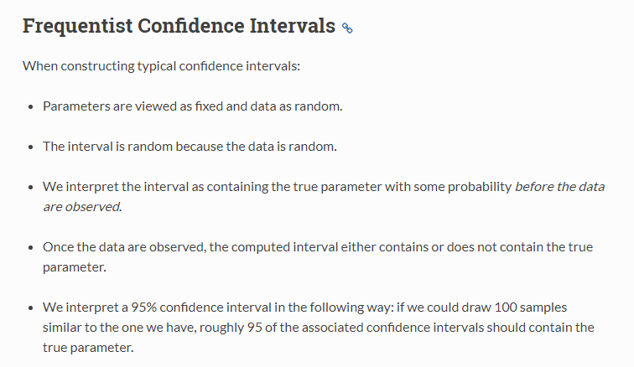
Background frequentists
Fundamentalist Frequentists
Liberal Frequentists do not agree!

Slide 15
Background Bayesians (1)
They start with a prior distribution (reflecting the researchers believe)
They look at the data (likelihood function)
They update the prior, based on the likelihood, to get the posterior distribution. From that, you can calculate a 95% credible interval.
Based on different prior distributions, two researchers can reach different conclusions, looking at the very same data
David van Dantzig: Statistical Priesthood (1957)
Reaction on Savage’s personal probabilities

Slide 16
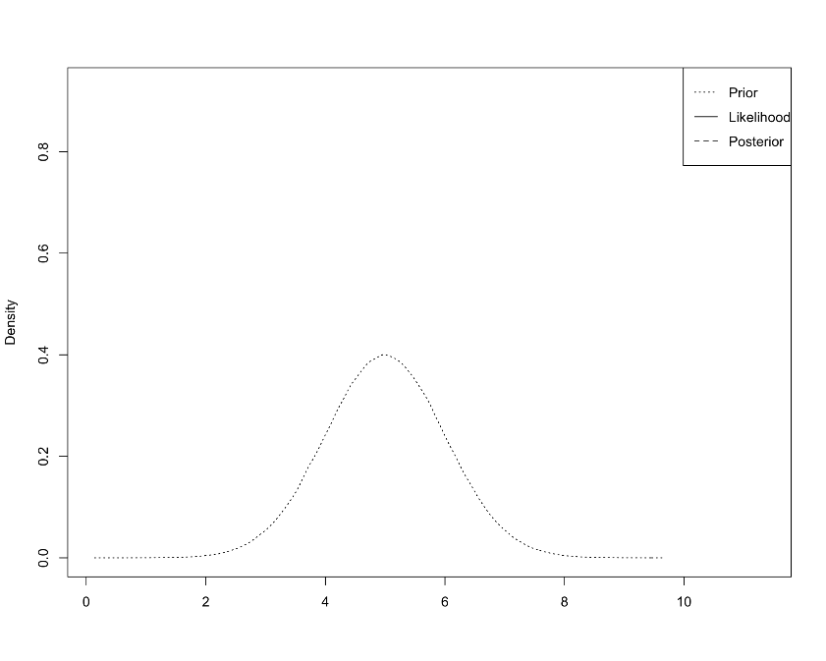
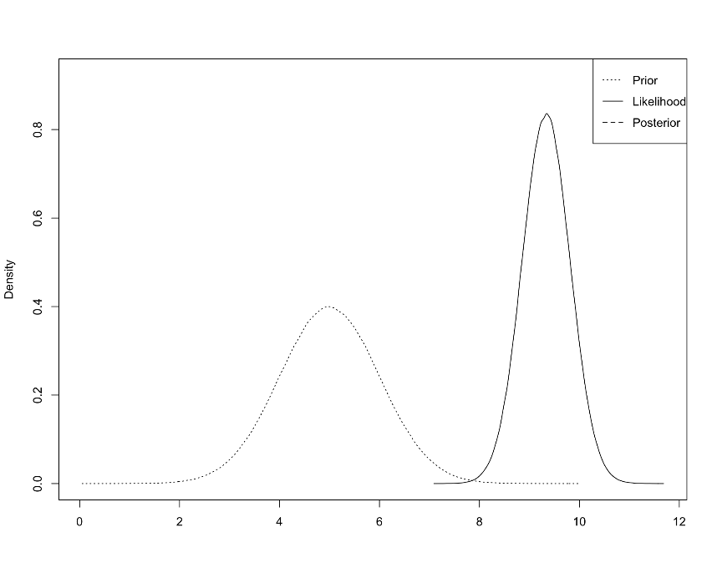
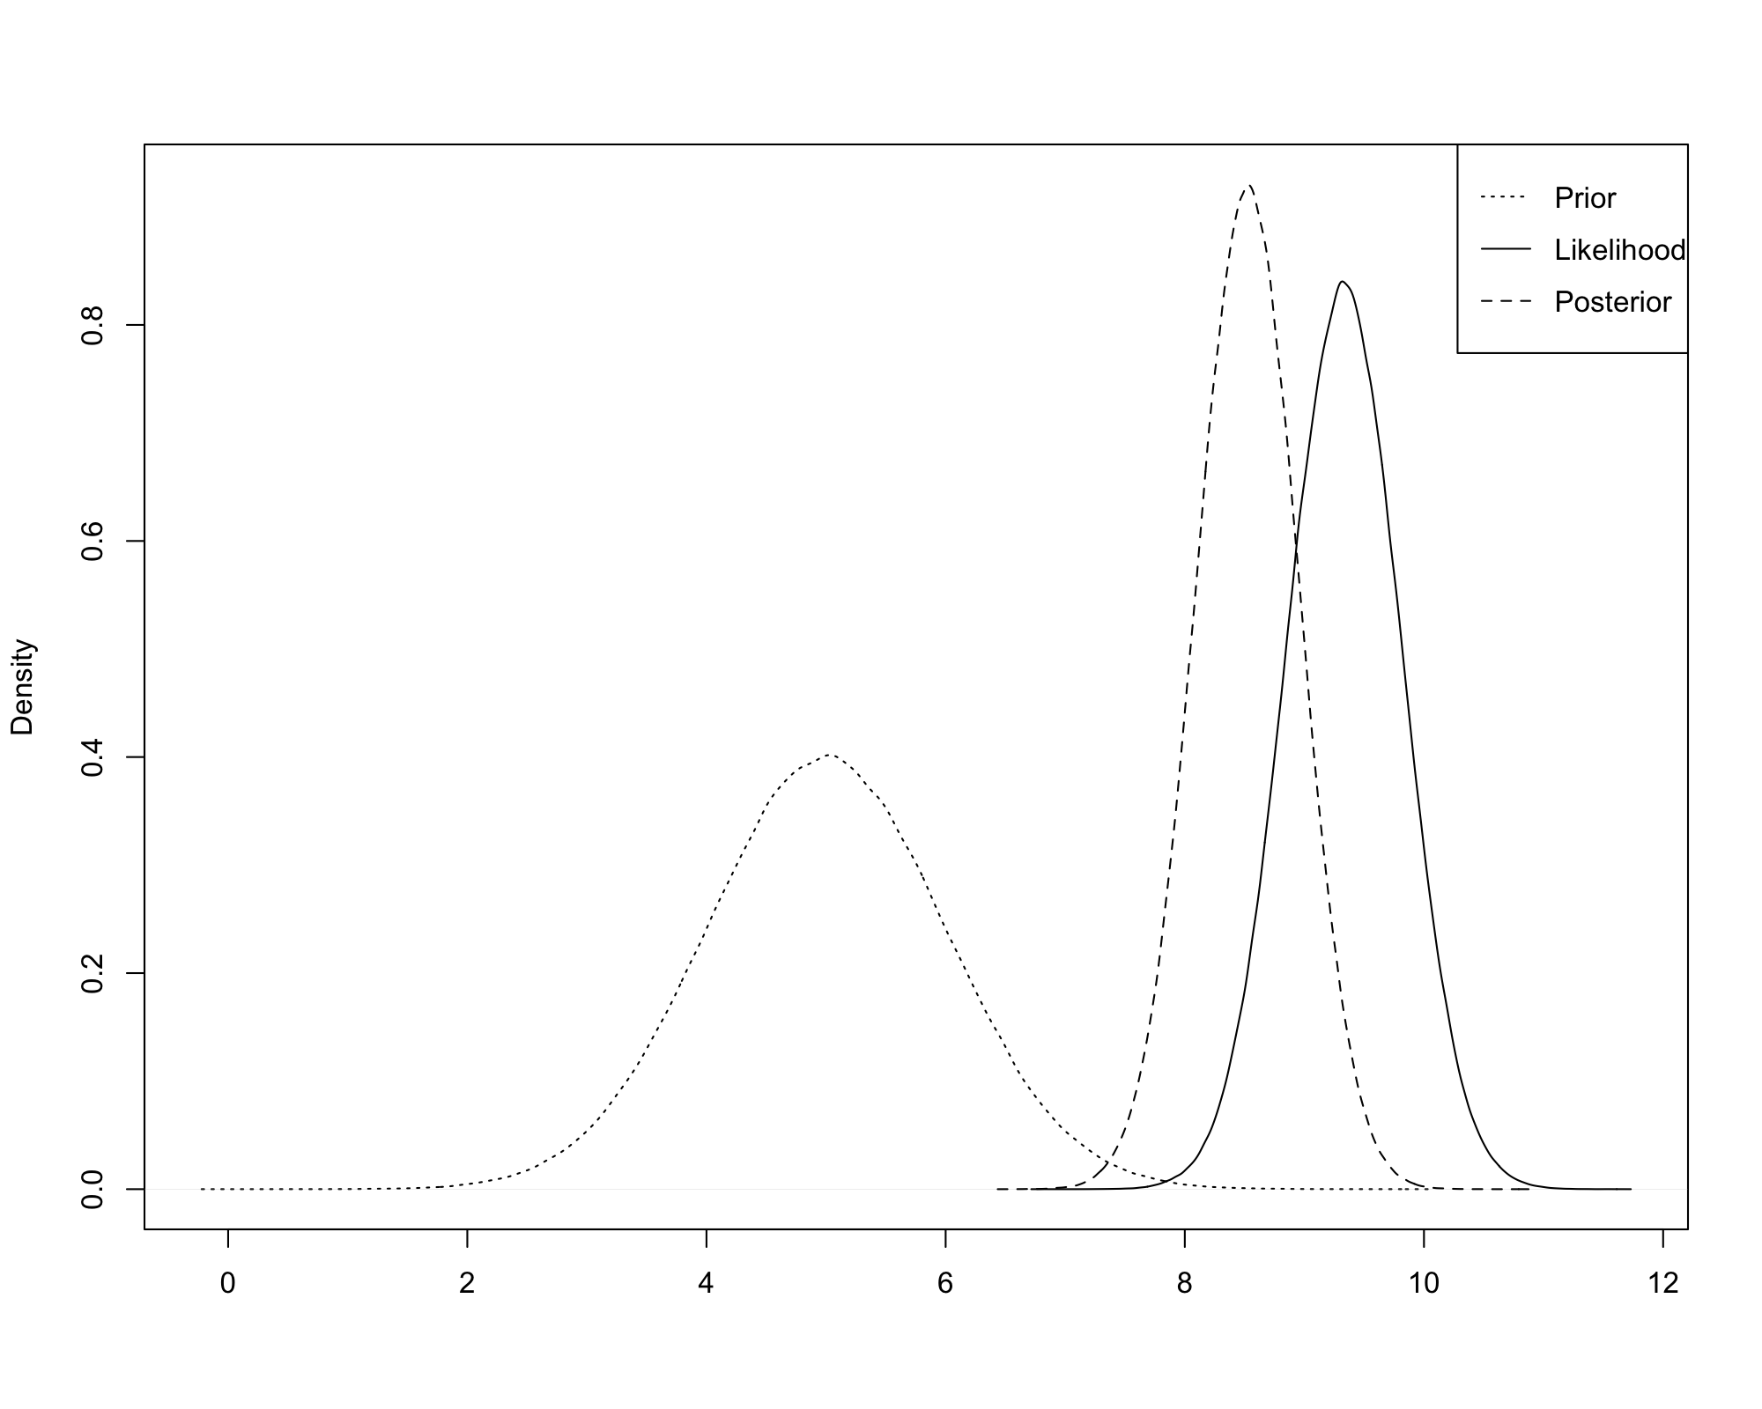
Background Bayesians (2) common prior

Slide 17
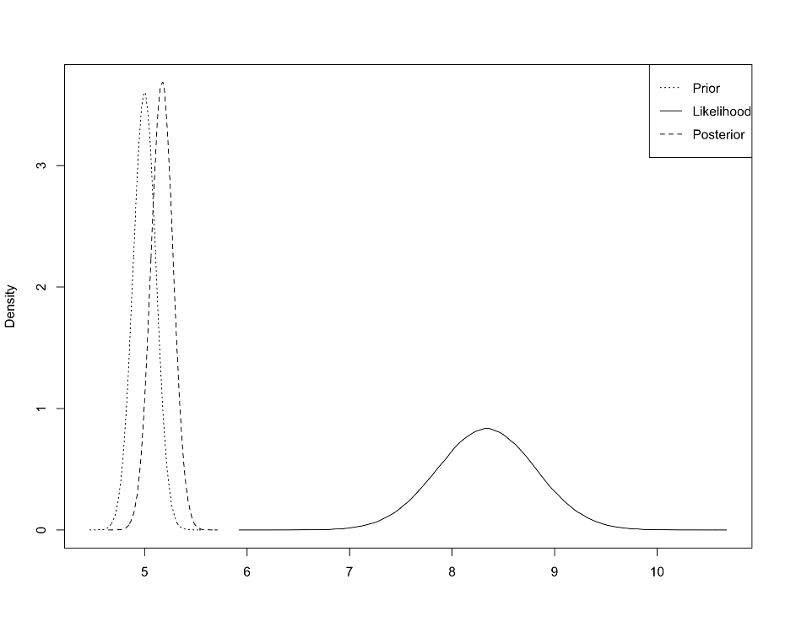
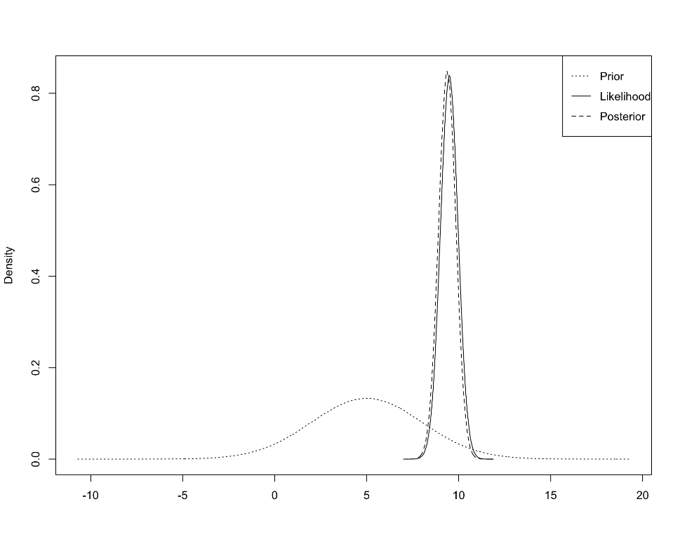
Background Bayesians (3) other priors
(very) informative prior
Non-informative prior

Slide 18
Back to frequentists Simple example of a probability
You hope to win a grant (1,000,000 euros)
You wrote a perfect protocol (all of you did!)
The committee of wise (wo)men cannot decide which protocol is best
They ask an independent solicitor to draw randomly one of the candidates

Slide 19
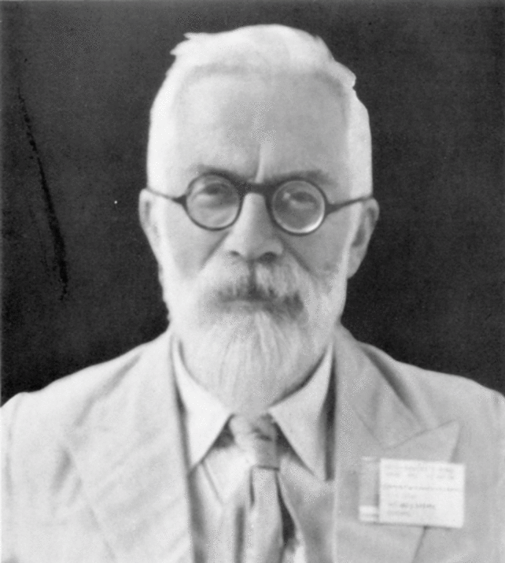
R. Fisher
Independent solicitor

Slide 20
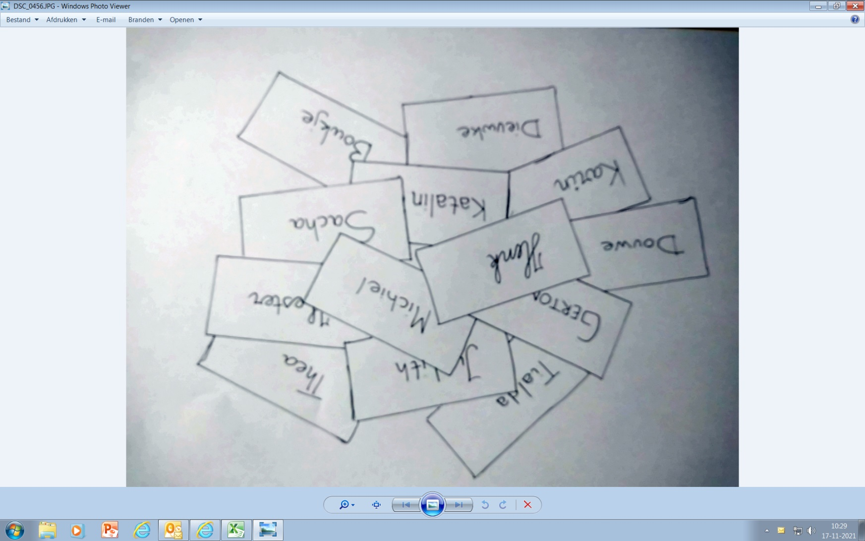
Mr Fisher takes 50 identical papers, writes down your names, folds the papers and put them in a bowl
Mr Fisher will take out randomly one paper.
What is the probability that your name is on that paper?
Model assumption:
Random draw
1/50 = 0.02

Slide 21
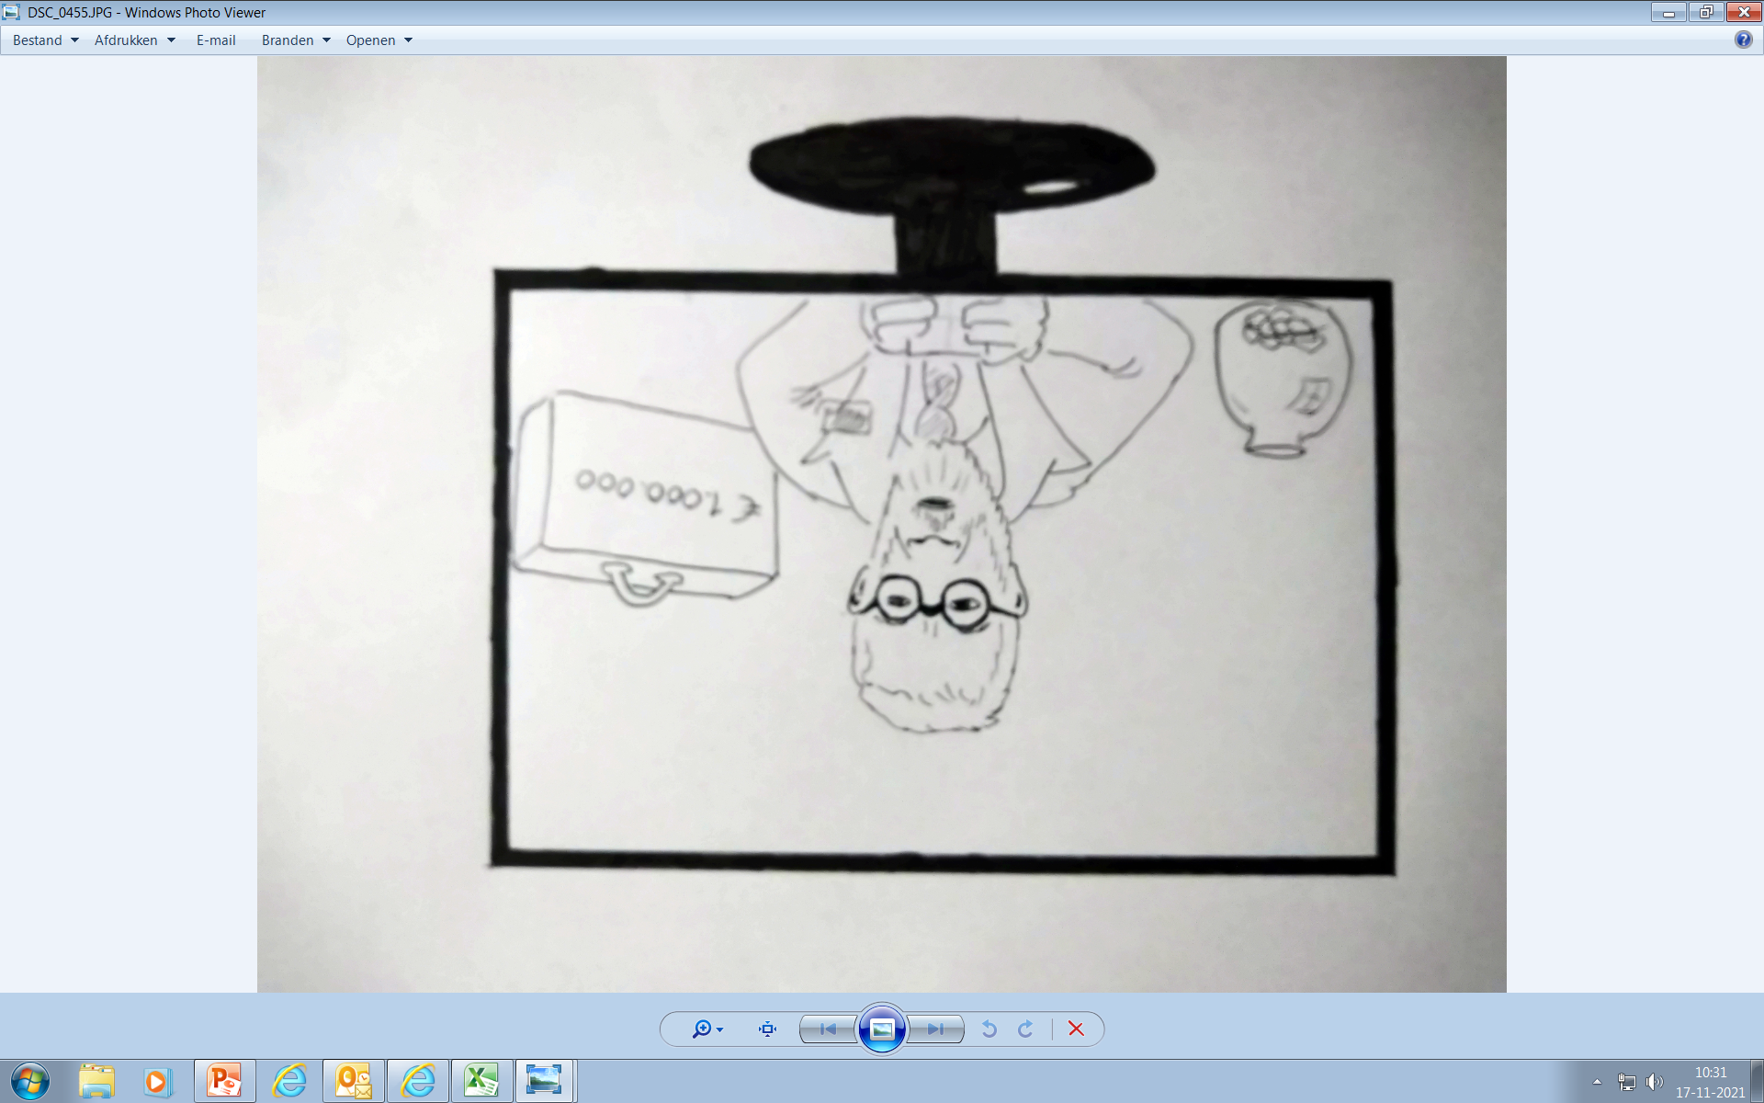
Randomly Mr Fisher takes out one of the papers …
Can you feel the tension?
And the
winner is ….
What is the probability that your name is on this paper?
You are still in the race …

Slide 22
A real statistical problem
We want to estimate the mean systolic blood pressure of all individuals living in the Netherlands (µ) …
… on May 9th 2023, 1 PM
Of course, we will never know the exact value of µ. It is a fixed and unknown value, and the population mean will not have exactly equal values on other time points

Slide 23
Confidence Interval for μ
(assuming normality)
X₁ = 99
X₂ = 104
….
X_{n} = 97
μ ?

Slide 24
Classical meaning of the 95% CI
We are 95% confident that the fixed and unknown population mean is inside this interval.
Frequentists do not talk about probabilities here; µ is either inside or outside the interval.
What is the mathematical definition of “being confident”?

Slide 25
If you do not want to make model assumptions (like normality)
calculate a bootstrap interval, based on your random sample

Slide 26
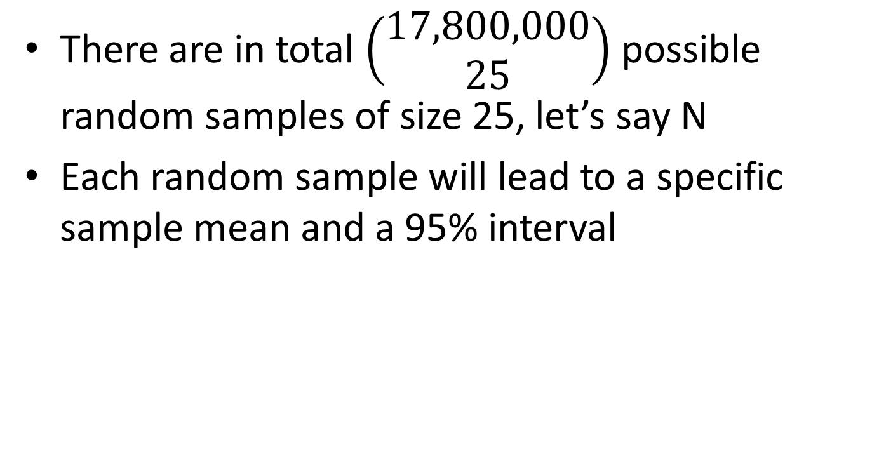
Formula or bootstrap …
There are in total $\left(\begin{aligned}17,800,000 \\ 25\end{aligned}\right)$ possible random samples of size 25, let’s say N
Each random sample will lead to a specific sample mean and a 95% interval

Slide 27

Distribution of all sample means
Ordered sample means
$${\overline{X}}_{1}$$
$${\overline{X}}_{2}$$
$${\overline{X}}_{3}$$
.
.
$${\overline{X}}_{k}$$
$${\overline{X}}_{k+1}$$
$${\overline{X}}_{k+2}$$
.
.
$${\overline{X}}_{N}$$
Interval does not contain µ
Interval does contain µ
(almost) 95% of the intervals will be green

Slide 28

What do we observe?
Mean of our random sample
$$\overline{X}$$
µ?
The interval, based on our random sample, is a random construct.
Since µ is unknown, we do not know the colour of the interval
µ is fixed and either in the interval or not: that’s true.
But as long as µ is unknown, what is the perceived probability that your random interval contains µ?
Since our sample was randomly chosen from all possible samples, we can see the interval as a random draw from a population of intervals of which 95% is green and 5% is red
P(interval = green)?
Our interval is still “in the race”: 0.95

Slide 29
The PI95
The PI95 is an interval for a population parameter, having a probability of 95% to contain the fixed and unknown value of this population parameter

Slide 30
Mr Fisher was not in the room (due to COVID19 rules)
And the
winner is ….

Slide 31

ME!
We will never know the name on the paper
What is the probability that it was your name?

Slide 32
(My) conclusion
We keep on teaching NHST, P-values and 95% intervals
Show the analogy with justice
H0: suspect is innocent
Jury / judge collect data
Decision: guilty or not guilty
Stress that the intervals are more informative than the P-values
Rename the intervals into: 95% probability intervals (PI95)
Journals should advocate the use of PI95’s instead of P-values

