Slide 1
Help! Statistics!
Resampling; the Bootstrap
Hans Burgerhof
j.g.m.burgerhof@umcg.nl
May 8 2018

Slide 2
Help! Statistics! Lunchtime Lectures
What? frequently used statistical methods and questions in a manageable timeframe for all researchers at the UMCG.
No knowledge of advanced statistics is required.
When? Lectures take place every 2nd Tuesday of the month, 12.00-13.00 hrs.
Who? Unit for Medical Statistics and Decision Making.
When? | Where? | What? | Who?
May 8 2018 | Room 16 | Resampling: the bootstrap | H. Burgerhof
June 12 2018 | Room 16 | Missing data | S. la Bastide
Sept 11 2018 | Room 16
Oct 9 2018 | Rode Zaal
Slides can be downloaded from http://www.rug.nl/research/epidemiology/download-area

Slide 3
Outline
What is resampling?
  Definitions of permutations and combinations
Some early examples of resampling
  Permutation test
  The Jackknife
The basic idea of the bootstrap
Some examples of bootstrapping
  Nonparametric bootstrap
  Parametric bootstrap
Some more history

Slide 4
Resampling technicques.
What and why?
What is resampling?
  Statistical methods using permutations or subsets of the observed data (sampling within your sample)
Why do we use these methods?
  robust, simple idea, easy to perform (with a fast computer), giving new and relevant information
Why not use these methods always?
- if assumptions are fulfilled, other methods are better (more efficient, more power)
- for some questions, resampling cannot be used

Slide 5
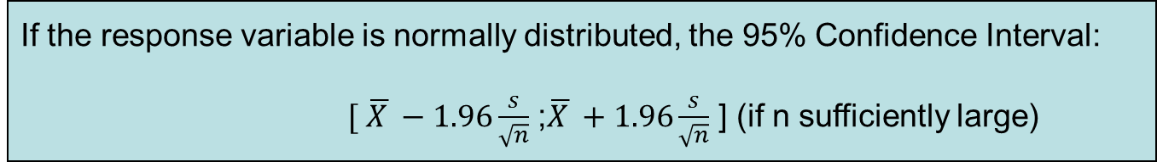
(Parametric) inferential statistics
What if we do not know if
X has a normal
distribution?
population
μ?
Random sample
How to use the observed data in a more creative way?

Slide 6

Back to basics
Basic terminology: what exactly are permutations and combinations?
  Example, we have 4 letters (A, B, C and D).
  How many different “words” of 4 letters can you make with these letters? (use each letter once)
  ABCD, ACDB, BCAD, BDAC, …
  4! = 4*3*2*1 = 24 (4 factorial = 24 permutations)
  7! = 5040
  10! = 3.628.800

Slide 7
Combinations
We have n different letters. In how many ways can you take a group of k letters (0 ≤ k ≤ n) without replacement, if the order does not matter?
“n over k” : the number of combinations of k from n
A, B, C, D, E
ABC, BCD, ACE, …
Example:

Slide 8
Permutation test
(randomisation test) Fisher, 1935
We would like to test the null hypothesis that the samples of two groups (sizes n1 and n2) are from the same distribution. We have no idea about the shape of this distribution; we do not assume normality
Calculate the difference in means between the two samples:
Add all observations together into one group. Sample, without replacement, n1 observations from the total group and consider those observations to be group 1 (and the other observations group 2) and calculate

Slide 9
Permutation test (continued)
Repeat this for all possible combinations
  or, if this number is too large, take a random sample of combinations (Monte Carlo testing)
The distribution of the calculated differences is used to test the null hypothesis of no difference
  or, if the number of combinations is too large, the distribution is estimated
The one sided P-value is the proportion D-values larger than or equal to the observed difference

Slide 10
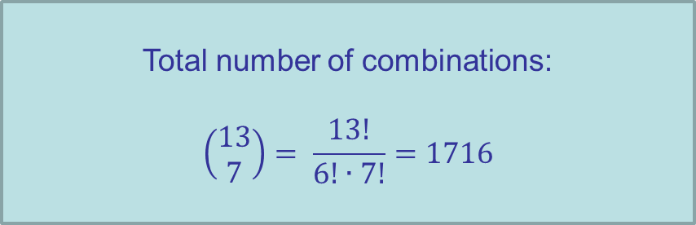
Example permutation test
Do males and females have the same mean height?
xm <- c(176, 180, 186, 190, 193, 170, 198)
xf <- c(160, 178, 166, 180, 157, 172)
mean(xm)
[1] 184.71
mean(xf)
[1] 168.83
D <- mean(xm) - mean(xf)
D
[1] 15.88

Slide 11
Simple program in R
Data are pooled
xt <- c(xm, xf)
myperm <- function(x)
{
cc <- rep(0,1000)
for (i in 1:1000)
{
x1 <- sample(x,7)
m1 <- mean(x1)
m2 <- (sum(x)-sum(x1))/6
cc[i] <- m1 - m2}
cc
}
res <- myperm(xt)
hist(res)
Vector containing1000 zeros
Sample randomly 7 observations
(without replacement) and
calculate the mean
Calculate the mean of the other 6
Put the difference between the means
in the vector cc on place i

Slide 12
D = 15.88
quantile (res, c(0.025,0.975))
2.5% 97.5%
-12.59 13.42
pvalue <- sum(res>D)/1000
pvalue
[1] 0.009

Slide 13
Permutation tests
.. are part of non-parametric tests
Fisher’s exact toets is a permutation test
Mann-Whitney test is a permutation test on the ranks of the observations

Slide 14

Jackknife
(Quenouille (1949), Tukey (1958))
In estimating an unknown parameter we think two aspects are of major importance:
  The estimator should be unbiased, meaning the mean of an infinite number of estimates should be equal to the real parameter
  we want to have an estimate of the variance of the estimator
For some estimation problems we can make use of the Jackknife procedure

Slide 15
How does the Jackknife work?
The estimator is calculated again n times, each calculation based on datasets of n – 1 observations, according to the “leave one out” principle (in the first “pseudo sample”, the first observation is left out, in the second pseudo sample the second observation, and so on)
Based on the n estimates, we can
- make an estimate of the bias, and so a better estimate of the unknown parameter
- estimate the variance of the estimator

Slide 16
Summary Jackknife
The Jackknife uses n subsets of a sample of n observations
The Jackknife estimator can reduce bias (Quenouille 1956)
It gives a useful variance estimate for complex estimators
It is not consistent if the estimator is not smooth, like the median
It underestimates extreme value problems

Slide 17
Bootstrap (Efron 1979)
Basic idea of the bootstrap: we have a sample of size n. Estimate the distribution of the statistic you are interested in (for example the mean) by repeatedly, with replacement, sample n observations from your original sample
Using the distribution of the bootstrap-samples, you can make inference on the unknown population parameters
Example:
what is the mean Grade Point Average (GPA) of first year
students in medicine in Groningen?

Slide 18
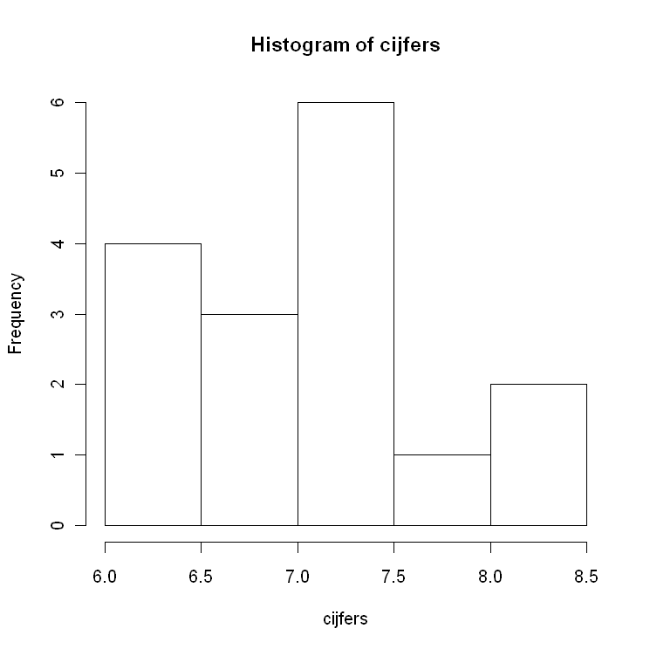
Non-parametrische bootstrap
N = 16,
Mean GPA = 7.12
For inference, use the bootstrap:
Sample, with replacement,
16 observations and calculate
the mean
Repeat this1000 times
GPA

Slide 19
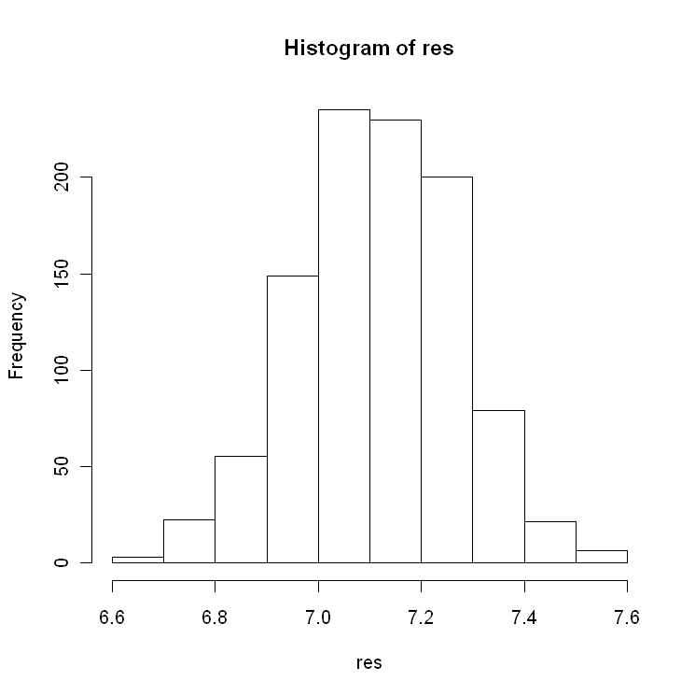
Bootstrap results (1000)
> quantile(res, c(0.025, 0.975))
2.5% 97.5%
6.81 7.41
Based on the original 16
observations,
if we assume normality:
7.12 ± 2.13*0.157
[6.79 ; 7.45]

Slide 20
Second Bootstrap example
H0: ρ = 0
Pearson r = 0.37
Test?
height weight
175 73
184 79
168 64
179 81
….
193 88
Weight (kg)
Sample pairs
repeatedly
Height (cm)

Slide 21
Histogram of 1000 correlation coefficients, calculated
using 1000 Bootstrap samples
quantile(res, c(0.025, 0.975))
2.5% 97.5%
0.188 0.529
Using Fisher’s z-transformation:
[0.16 ; 0.54]

Slide 22
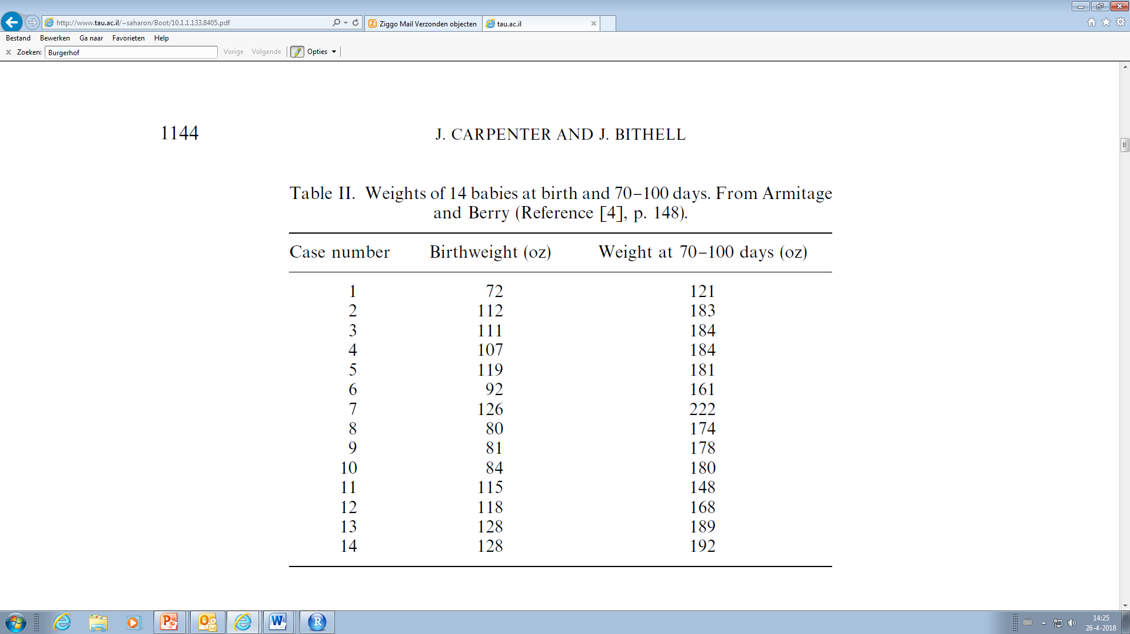
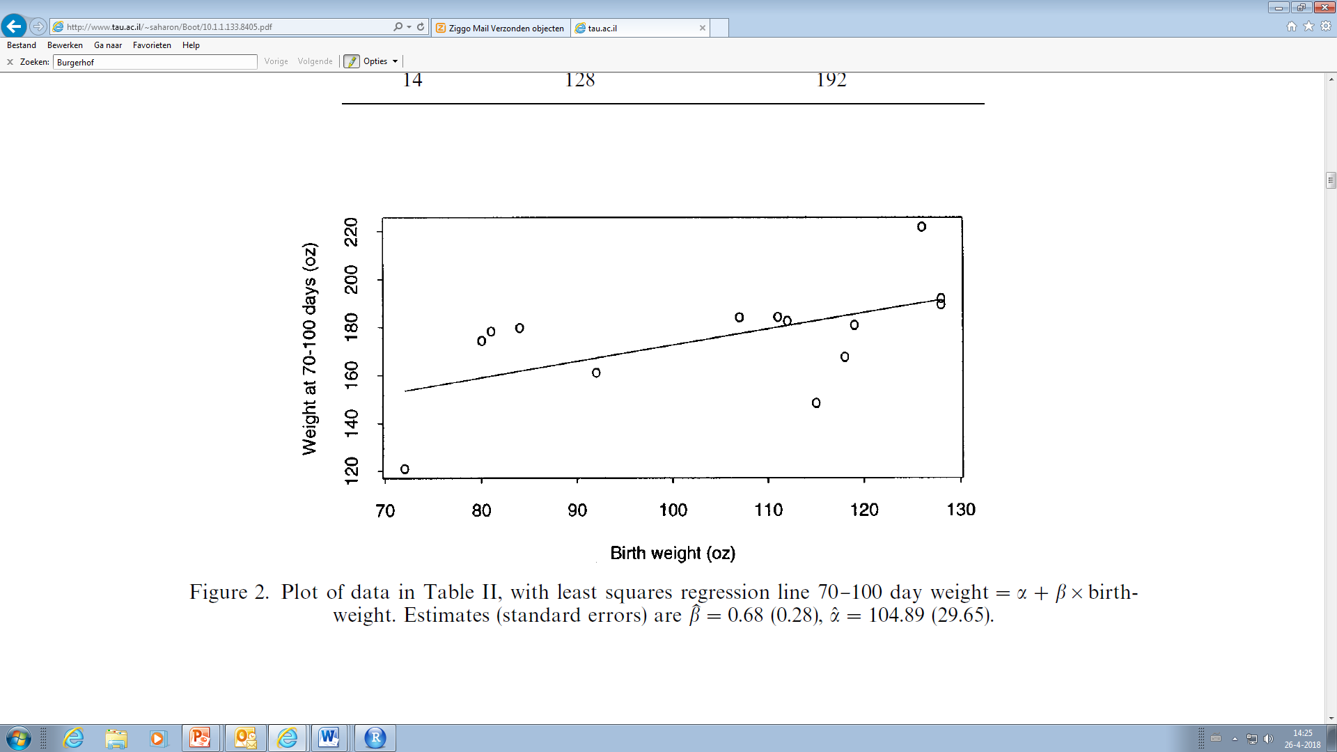
Linear regression bootstrap
(example from Carpenter and Bithell, 2000)
1 ounce ≈ 28.3 grams
W = β0 + β1·BWT
b1 = 0.68

Slide 23
Non-Parametric resampling
Like in the correlation example, sample, with replacement, 14 cases from the original dataset and calculate the regression coefficient b1
Repeat this (at least) 1000 times
Construct the 95% CI for β1 by taking percentiles of the distribution of b1’s

Slide 24
Non-Parametric resampling
x = datamatrix, n = number of bootstrap samples
mybootnon <- function(x,n)
{ m <- dim(x)[1]
numb <- seq(1,m)
resul <- rep(0,n)
for (i in 1:n)
{pick <- sample(numb,m,replace=T)
fillx <- x[pick,1]
filly <- x[pick,2]
resreg <- lm(filly ~ fillx)
resul[i] <- summary(resreg)$coefficients[2,1] }
hist(resul)
print(quantile(resul,c(0.025,0.975)))
}
Random bootstrap case number

Slide 25
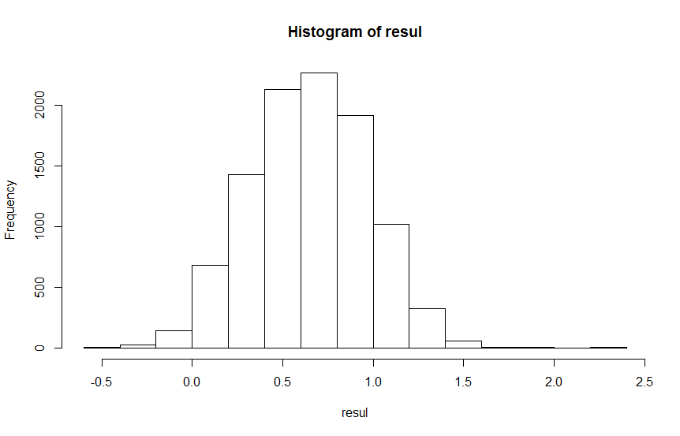
Non-Parametric resampling
(n = 10,000)
2.5% 97.5%
0.046 1.260

Slide 26
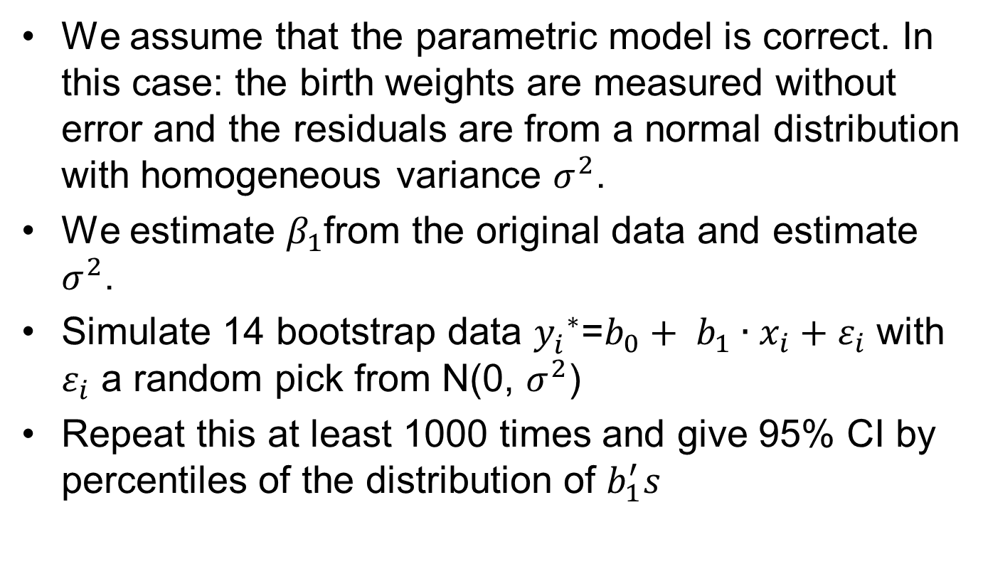
Parametric resampling
We assume that the parametric model is correct. In this case: the birth weights are measured without error and the residuals are from a normal distribution with homogeneous variance $σ^{2}$.
We estimate $β_{1}$from the original data and estimate $σ^{2}$.
Simulate 14 bootstrap data ${y_{i}^{}}^{∗}$=${b_{0}+ b_{1}∙x}_{i}+ε_{i}$ with $ε_{i}$ a random pick from N(0, $σ^{2}$)
Repeat this at least 1000 times and give 95% CI by percentiles of the distribution of $b_{1}^{′}s$

Slide 27
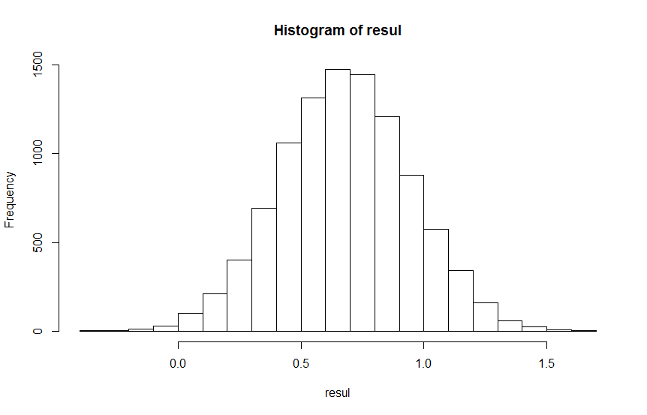
Parametric resampling
(n = 10,000)
2.5% 97.5%
0.154 1.199
Smaller interval compared to
nonparametric bootstrap

Slide 28
Linear regression bootstrap
(modified example from Carpenter and Bithell)
1 ounce ≈ 28.3 grams
o
15 71 318
W = β0 + β1·BWT
b1 = -0.20

Slide 29
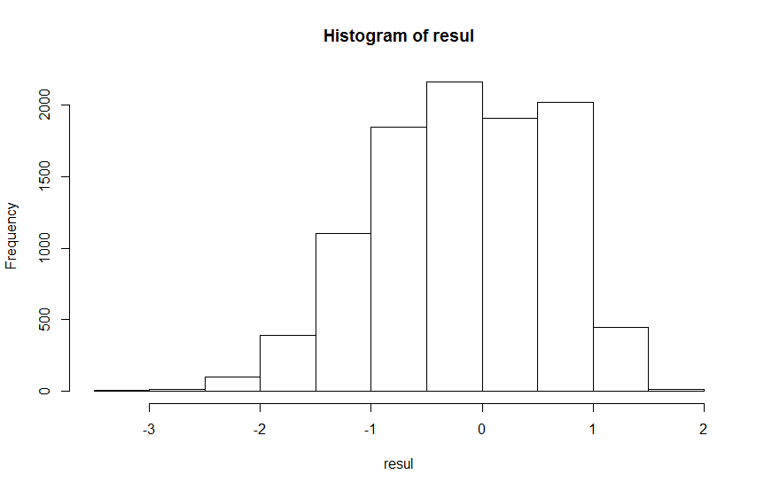
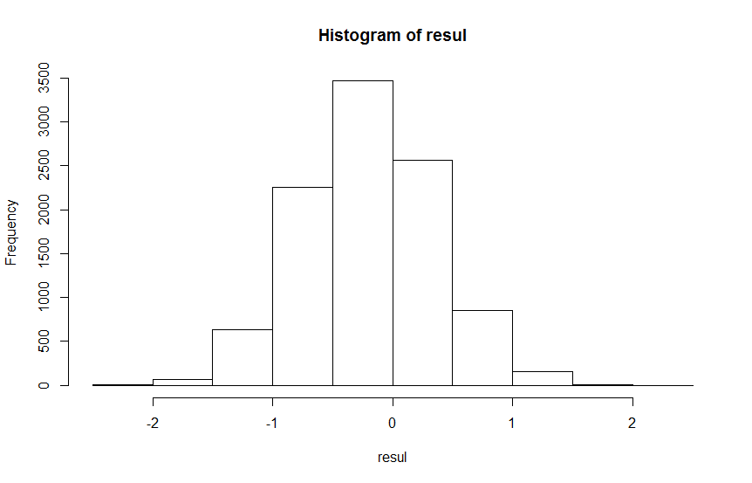
Results with extra case
Nonparametric bootstrap
2.5% 97.5%
-1.75 1.09
Parametric bootstrap
2.5% 97.5%
-1.26 0.90

Slide 30
Some remarks on the bootstrap
How many bootstrap samples?
  According to Carpenter and Bithell: 1000 should be enough, with fast computers 10,000 or even 100,000 is no problem (but will add hardly any new information in a lot of cases)
Choosing the simulation model
  Only choose the parametric bootstrap if you are quite sure about the assumptions. “The simulation process should mirror as closely as possible the process that gave rise to the observed data” (Carpenter and Bithell, 2000)

Slide 31

The name “bootstrap”

Slide 32
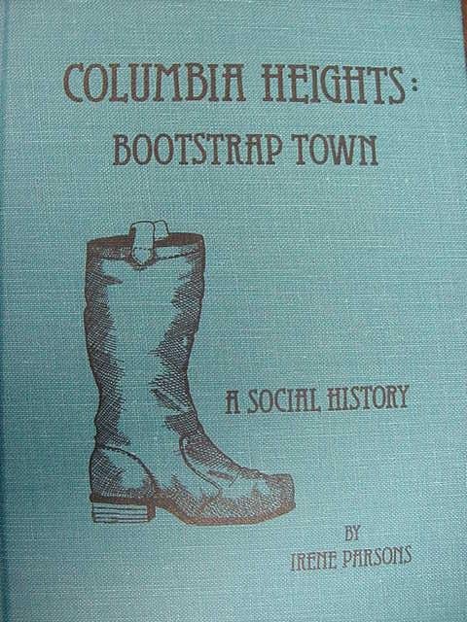
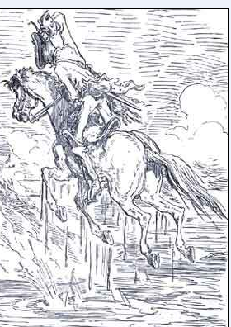
To pull oneself up by one’s bootstraps
Pull yourself from the statistical swamp

Slide 33
In summary
Permutation tests
  Can be a solution in testing hypotheses if the underlying distribution is unknown
Jackknife
  Can be used in some cases to reduce bias and estimate variances
Bootstrap
  Estimation of the distribution of a statistic

Slide 34
Literature
Quenouille, M.H.: Notes on bias in estimation, Biometrika 1956
Efron, B. & Tibshirani, R.: An introduction to the bootstrap, Chapman and Hall 1993
Chernick, M.: Bootstrap Methods – a guide for practitioners and researchers, Wiley 2008
Carpenter, J.: Bootstrap confidence intervals: when, which, what? A practical guide for medical statisticians. Statistics in Medicine , 2000
Hongyu Jiang ; Zhou Xiao-Hua: Bootstrap confidence intervals for medical costs with censored observations Statistics in Medicine, 2002

Slide 35
Next month
Tuesday June 12
12 – 13 uur
Room 16
Sacha la Bastide
Missing Data

