Slide 1
Pitfalls of Statistical testing
Michiel de Boer, Dept General Practice and Elderly Care Medicine, UMCG.
PollEv.com/michielboerde712

Slide 2
Today’s program
Introductions
  Me and you
Pitfalls of null hypothesis significance testing (NHST)
How to deal with this stuff

Slide 3
Who am I
Human movement Sciences (1998)
Epidemiologist (2004)
PhD (2005)
Assistant / Associate Professor Methodology and Applied Statistics (2005 onwards: @VU until spring 2020 → UMCG)
  Teaching Epidemiology and statistics to Bachelor, Master and PhD students and GPs in training
  Research (often as methodologist in research projects)

Slide 4
Who are you?
Professional experience
Knowledge and perceptions about statististical significance, p-values, BI’s and related.

Slide 5

Notes:
Poll Title: Do not modify the notes in this section to avoid tampering with the Poll Everywhere activity.
More info at polleverywhere.com/support
What field / topic do you work in/on?
https://www.polleverywhere.com/free_text_polls/VXm3SrYBdphXQDmfgXAuV

Slide 6
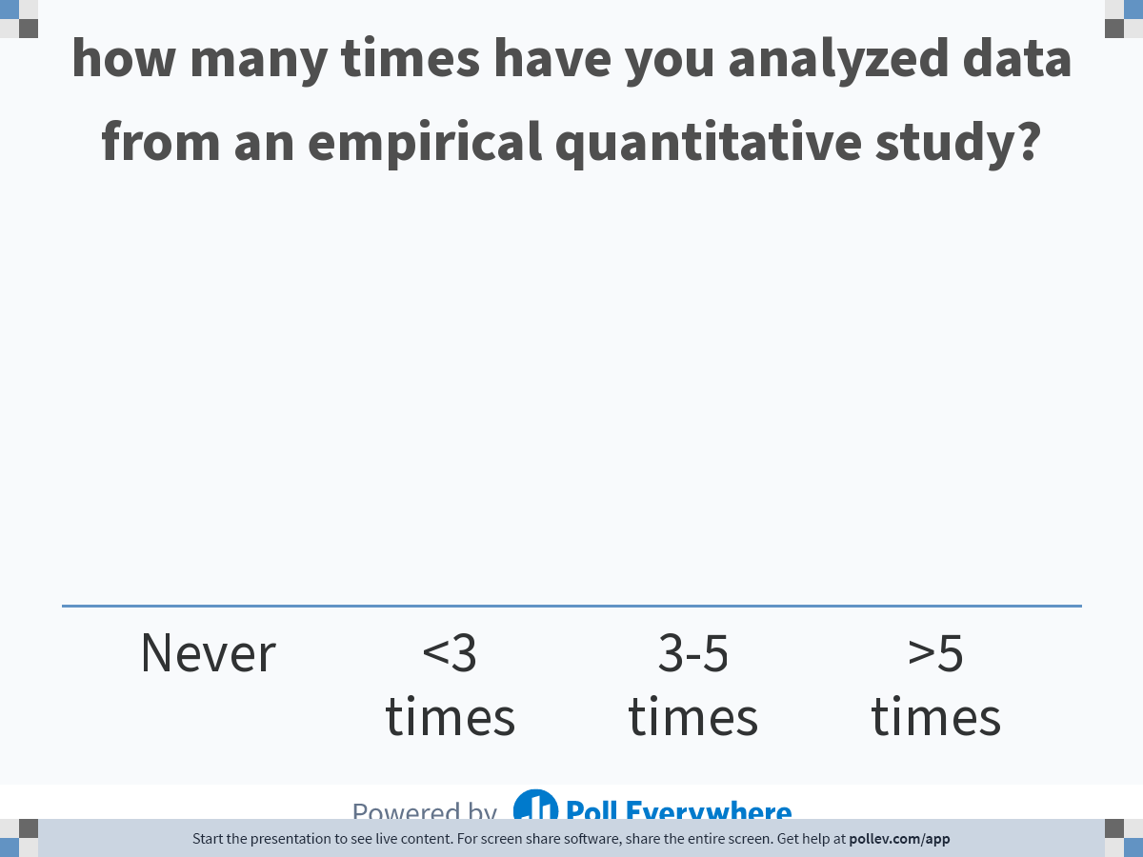
Notes:
Poll Title: Do not modify the notes in this section to avoid tampering with the Poll Everywhere activity.
More info at polleverywhere.com/support
how many times have you analyzed data from an empirical quantitative study?
https://www.polleverywhere.com/multiple_choice_polls/74Mc4vWKCI4sCABJ2hIgY

Slide 7
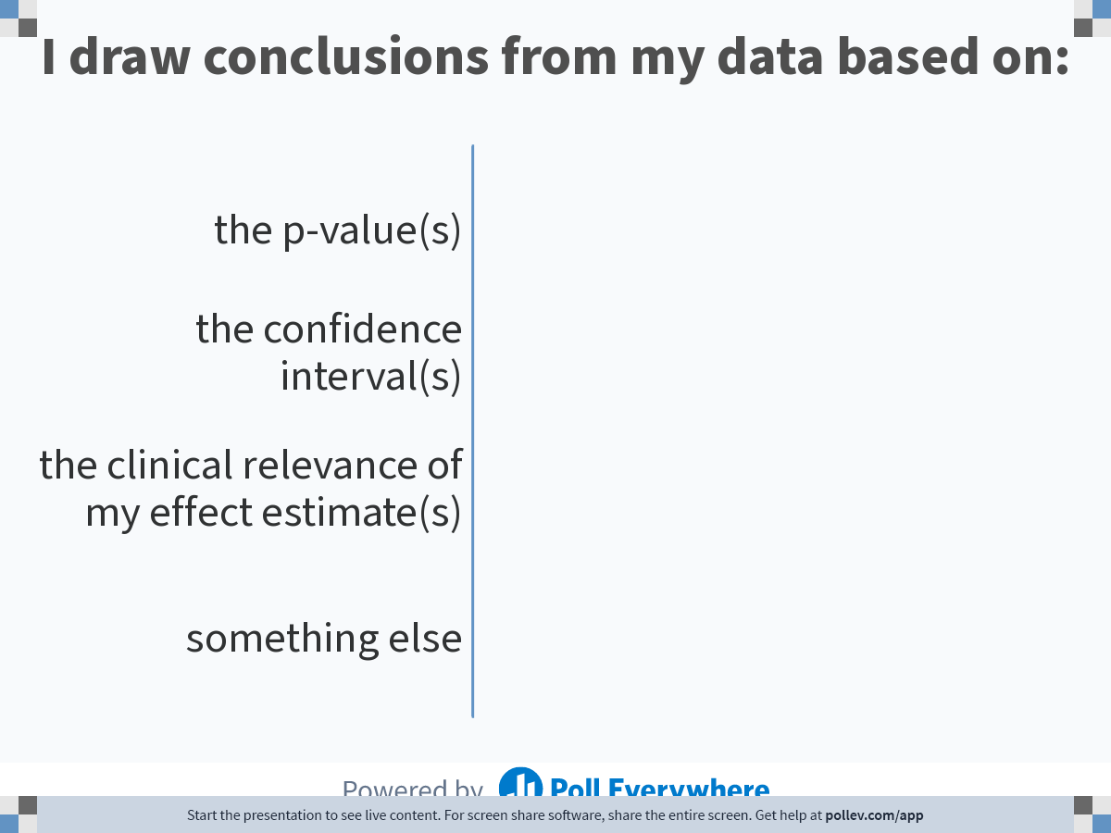
Notes:
Poll Title: Do not modify the notes in this section to avoid tampering with the Poll Everywhere activity.
More info at polleverywhere.com/support
I draw conclusions from my data based on:
https://www.polleverywhere.com/multiple_choice_polls/vZy5E51YvdIgICYmoYjDc

Slide 8
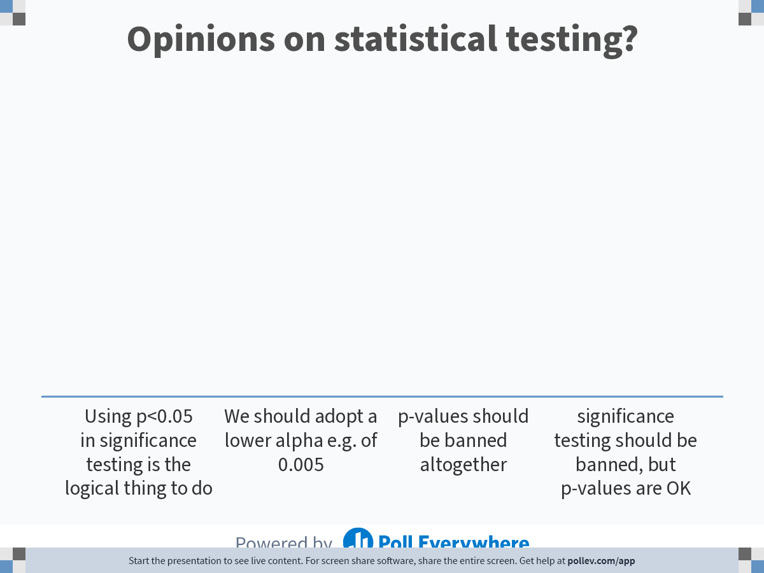
Notes:
Poll Title: Do not modify the notes in this section to avoid tampering with the Poll Everywhere activity.
More info at polleverywhere.com/support
Opinions on statistical testing?
https://www.polleverywhere.com/multiple_choice_polls/1W35PaYKilKuS8YUuFUcc

Slide 9
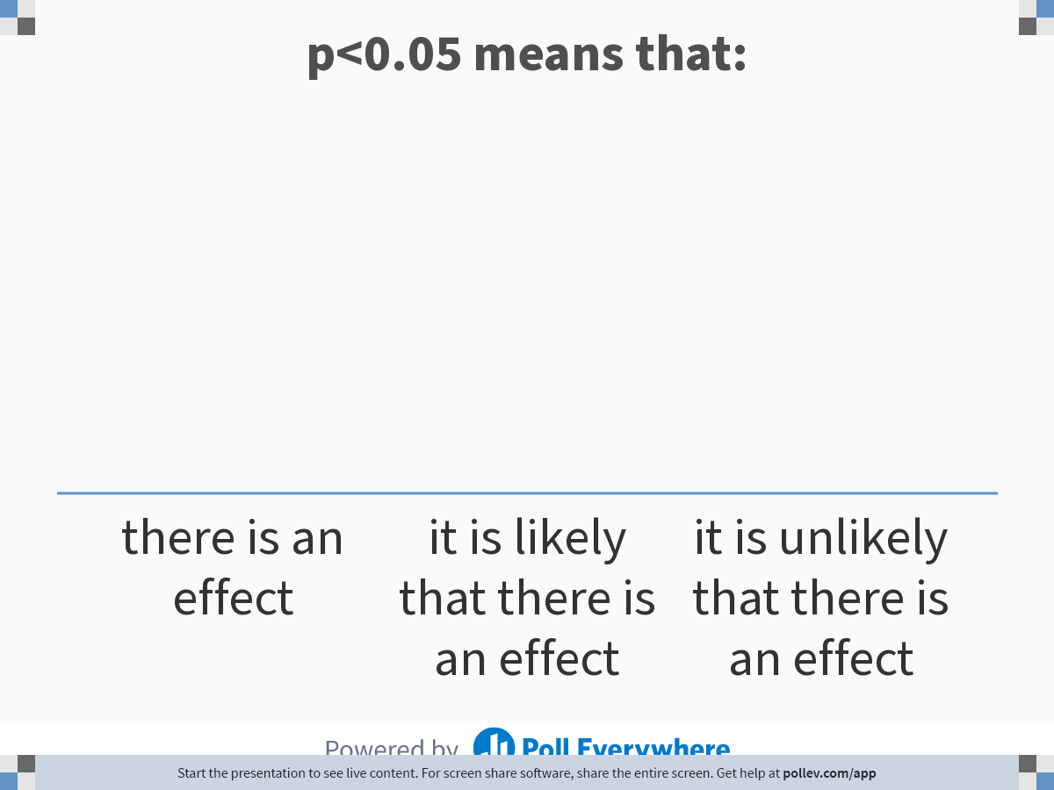
Notes:
Poll Title: Do not modify the notes in this section to avoid tampering with the Poll Everywhere activity.
More info at polleverywhere.com/support
p&lt;0.05 means that:
https://www.polleverywhere.com/multiple_choice_polls/cAUVu2eNYC75jFh62iiYb

Slide 10
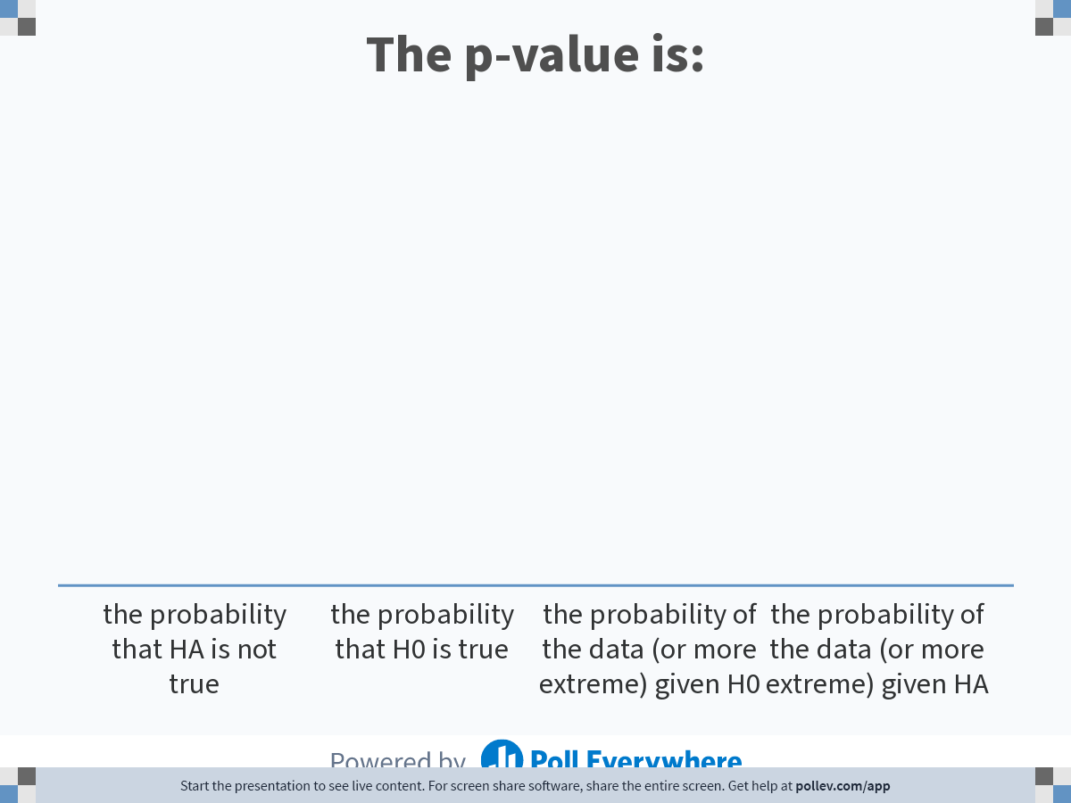
Notes:
Poll Title: Do not modify the notes in this section to avoid tampering with the Poll Everywhere activity.
More info at polleverywhere.com/support
The p-value is:
https://www.polleverywhere.com/multiple_choice_polls/SJOV2wBVvxmAvtRr49s0l

Slide 11
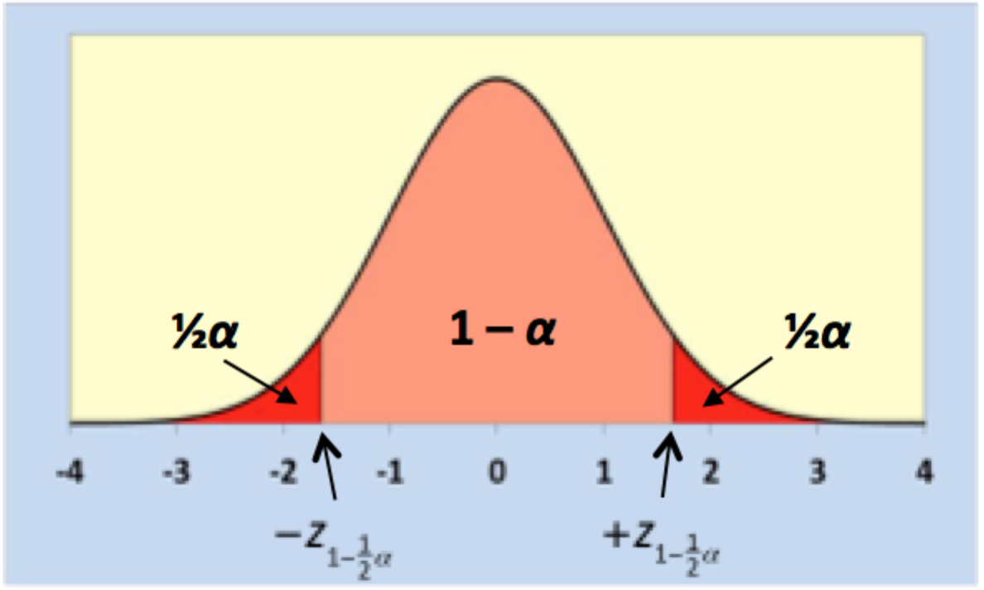
Interpretation of p-values
We start with the idea that the population effect is as hypothesized under H₀
Our conclusion is not about the data but about H₀!
P = p(data|H₀)

Slide 12
Pitfall #1:
Inverse inference

Slide 13
Another look at inverse inference
Research finding (sig) | True relationship
 | Yes | No
Yes | 1-β | α
No | β | 1-α

Slide 14
Another look at inverse inference
_{Typical values}
Research finding (sig) | True relationship
 | Yes | No
Yes | 0.8 | 0.05
No | 0.2 | 0.95

Slide 15
Another look at inverse inference
Research finding | True relationship |  | PV
 | Yes | No
Yes | 1-β | α | positive
No | β | 1-α | negative
total | prevalence | 1-prevalence

Slide 16
PPV as a function of prevalence
power
alpha
Research finding (sig) | True relationship |  | PV
 | Yes | No
Yes | 0.8 *0.8 = 0.64 | 0.05 * 0.2 = 0.01 | 0.64/0.65 =98%
No | 0.2 *0.8 = 0.16 | 0.95 * 0.2 = 0.19 | 0.19/0.35 =54%
total | 0.8 | 0.2
prevalence

Slide 17
PPV as a function of prevalence
Research finding (sig) | True relationship |  | PV
 | Yes | No
Yes | 0.8 *0.5 | 0.05 * 0.5 | 0.40/0.425 =94%
No | 0.2 *0.5 | 0.95 * 0.5 | 0.475/0.575 =83%
total | 0.5 | 0.5

Slide 18
PPV as a function of prevalence
Research finding (sig) | True relationship |  | PV
 | Yes | No
Yes | 0.8 *0.2 | 0.05 * 0.8 | 0.16/0.20 =75%
No | 0.2 *0.2 | 0.95 * 0.8 | 0.76/0.80 =95%
total | 0.2 | 0.8

Slide 19
PPV as a function of power
power
alpha
Research finding (sig) | True relationship |  | PV
 | Yes | No
Yes | 0.8 *0.5 | 0.05 * 0.5 | 0.40/0.425 =94%
No | 0.2 *0.5 | 0.95 * 0.5 | 0.475/0.575 =83%
total | 0.5 | 0.5

Slide 20
PPV as a function of power
power
alpha
Research finding (sig) | True relationship |  | PV
 | Yes | No
Yes | 0.5 *0.5 | 0.05 * 0.5 | 0.25/0.275=91%
No | 0.5 *0.5 | 0.95 * 0.5 | 0.475/0.725=66%
total | 0.5 | 0.5

Slide 21
Pitfall #2:
Binary thinking

Slide 22
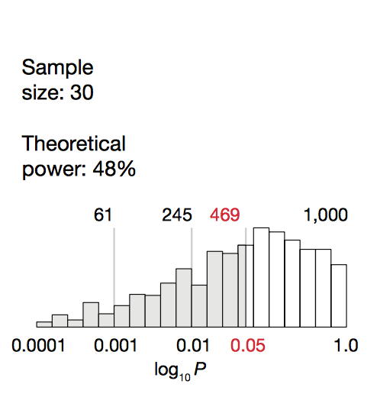

A distribution of p-values
For moderate effect; standardized effect size 0.5

Slide 23
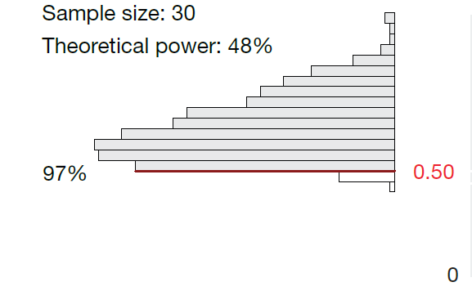
Effect sizes and statistical significance
True standardized effect

Slide 24
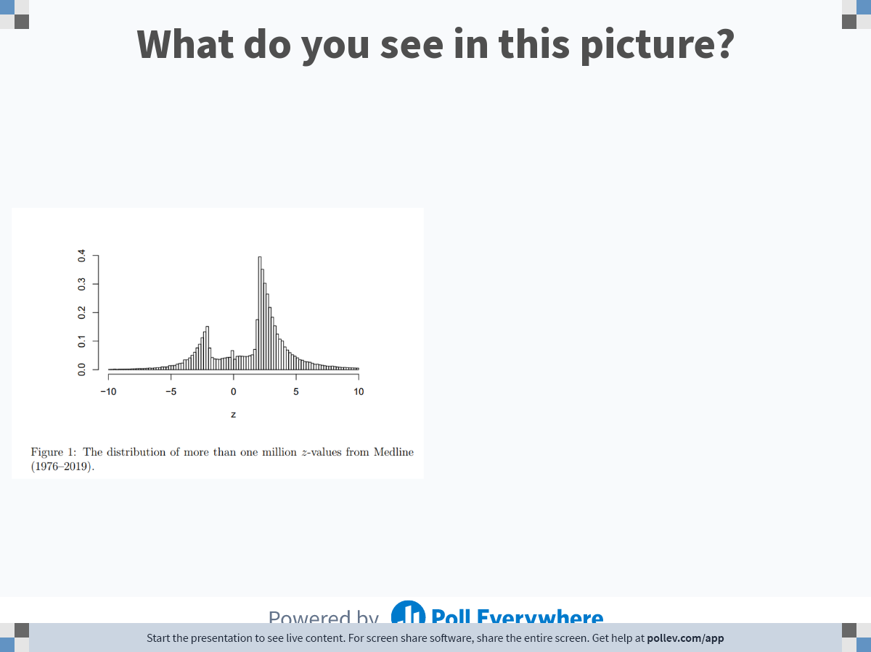
Notes:
Poll Title: Do not modify the notes in this section to avoid tampering with the Poll Everywhere activity.
More info at polleverywhere.com/support
What do you see in this picture?
https://www.polleverywhere.com/free_text_polls/NY5Ke8WtElRPVPWnoCVuT

Slide 25
Publication bias
Effect sizes with p<0.05 are more often published (publication bias)
Literature contains more p-values between 0.01 and 0.05 than we would expect.

Slide 26
Overestimating effect sizes
Effect sizes with p<0.05 are more often published (publication bias)
Effect sizes with p<0.05 are more often reported (reporting bias)
(unintentional) P-hacking: trying out several analysis strategies and reporting the ones with p<0.05
Effect sizes with p<0.05 are more often used for conclusion (‘inferential’ bias or SPIN)
This leads to overestimated effect sizes
Gets worse when power decreases → small study effects!

Slide 27
Other pitfalls of Null Hypothesis Significance Testing (NHST)
  A p-value does not convey any information about the strength or importance of the association:
    Effect size 0.1 (p=0.01) / effect size 1.0 (p=0.10)
  Null hypotheses are usually not informative
    They’ re never true!
  Statistical models do not meet assumptions
    Random sampling from ‘known’ population
    Other theoretical, auxiliary and statistical assumptions

Slide 28
Some possible solutions: Pitfall #1: Inverse inference
Bayesian statistics
  Solves some problems
  but also creates a few
  and beware of old pitfalls
Using an priori procedure
  Elegant, intuitive but costly (in terms of sample size)
  only available for relatively simple models

Slide 29
Bayesian statistics
Use (model) prior information (earlier studies, other evidence) and update this with study results
Advantages:
  Circumvents inverse inference
  Is true to the empirical cycle
  Is a very flexible procedure
Disadvantages
  More assumptions
  Often complicated (although we do have JASP now: www.JASP.org)
  Still harbors the problem of appealing to the use of thresholds and dichotomous thinking

Slide 30
a-priori inference
Aim research: we want to be confident that our estimate is close to the population parameter
So why not decide how confident and close we want to be and then calculate how large our sample should be?

Slide 31

A priori calculations
Simple example where there is one group mean and random and independent sampling from a normal distribution is assumed
Critical Z-score for desired probability (usually 95%)
Sample size
Fraction of a standard deviation defined as “close”

Slide 32
A priori calculations
Then I do the study with 385 participants, calculate descriptives and effect/association measures and …..
Trust them!
For instance, suppose we assume a normal distribution and we want to know the sample size needed to have a 95% probability of obtaining a sample mean within .1 standard deviations of the population mean
The answer is = = 384.16 ≈ 385

Slide 33
Some possible solutions: Pitfall #2: Binary thinking
Use confidence intervals
  As a continuous measure
  Adequately interpreted

Slide 34
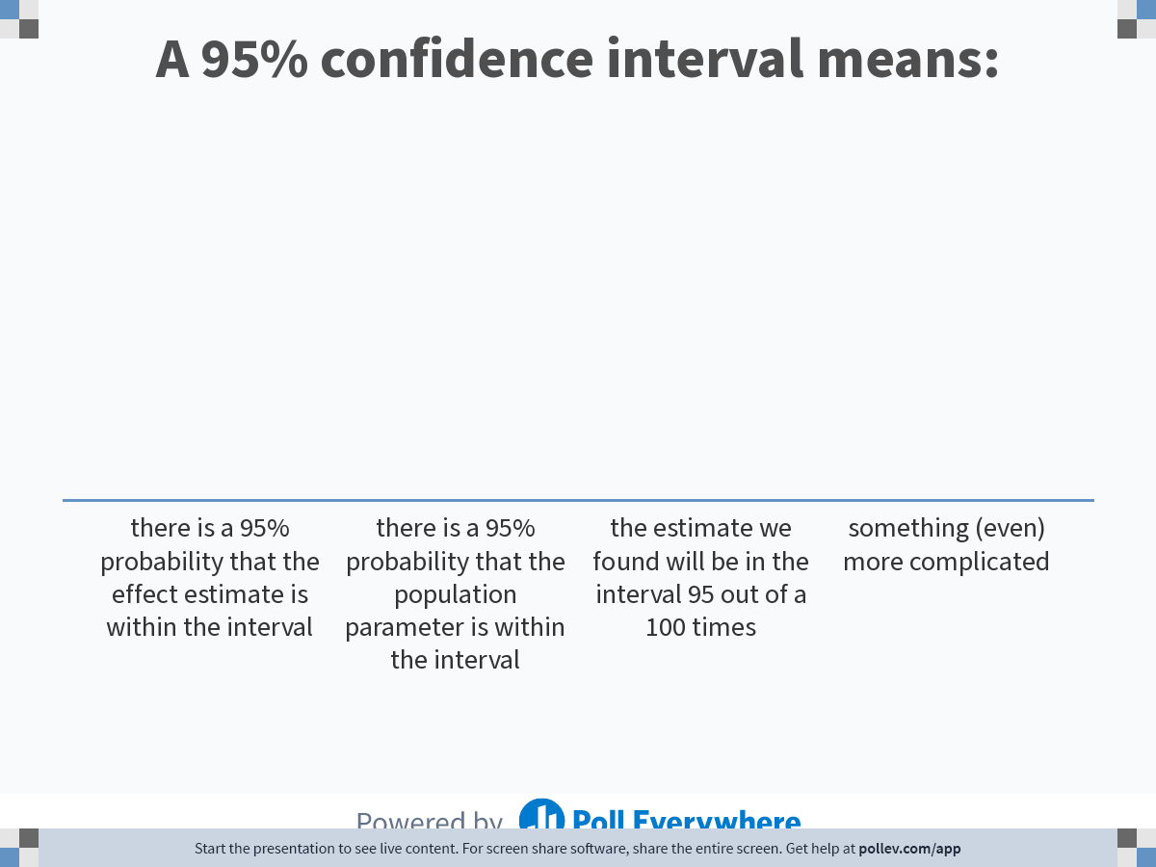
Notes:
Poll Title: Do not modify the notes in this section to avoid tampering with the Poll Everywhere activity.
More info at polleverywhere.com/support
A 95% confidence interval means:
https://www.polleverywhere.com/multiple_choice_polls/MloTJVvVoQog9cJU0mFI5

Slide 35
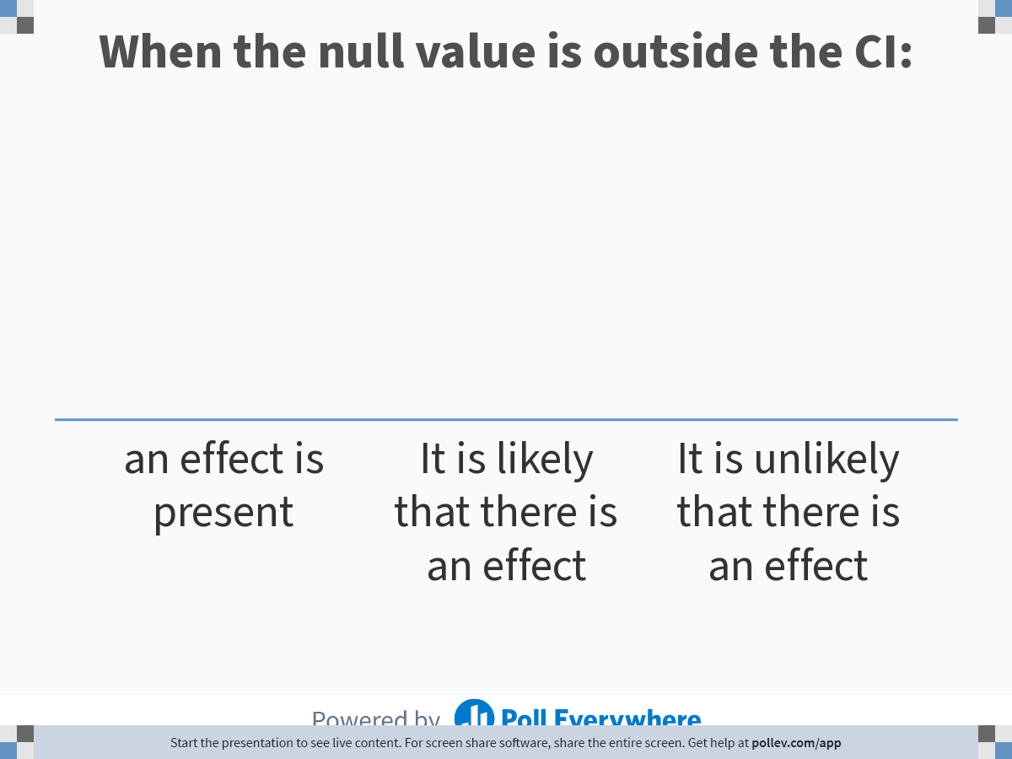
Notes:
Poll Title: Do not modify the notes in this section to avoid tampering with the Poll Everywhere activity.
More info at polleverywhere.com/support
When the null value is outside the CI:
https://www.polleverywhere.com/multiple_choice_polls/SIPBg1dH8Rgu4PLn3EpBj

Slide 36
Topic IV: Interpretation of CI’s

Slide 37
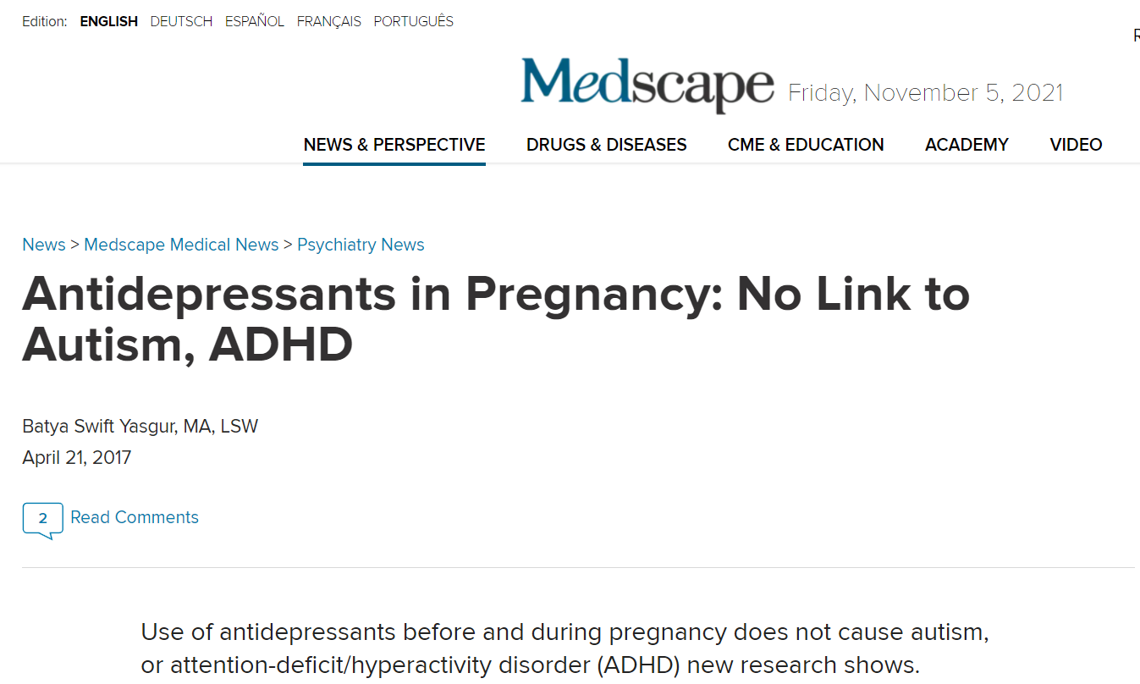

Slide 38
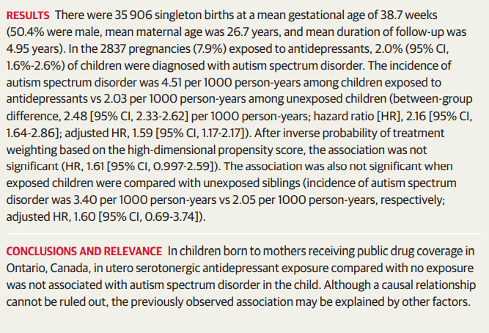
JAMA. 2017;317(15):1544-1552. doi:10.1001/jama.2017.3415

Slide 39
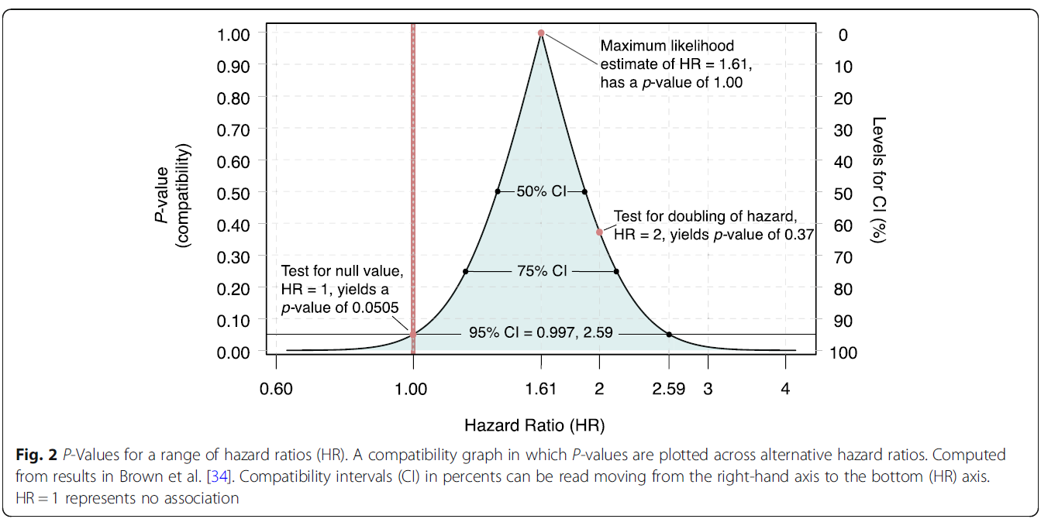
Compatibility curve / p-value function
Rafi and Greenland BMC Medical Research Methodology (2020) 20:244
https://doi.org/10.1186/s12874-020-01105-9

