Slide 1
Multivariable regression analysis:
What to do when and how
Henk Groen, Patient-centered HTA Unit, Dept of Epidemiology
Help! Statistics! June 7, 2022

Slide 2
Data analysis in Epidemiology
Epidemiology is rooted in observational research
Observational data are vulnerable to bias
Analysis methods are applied that handle bias
More specific: confounding, interaction
Commonly used method: regression analysis

Slide 3
Regression analysis
Determine the association between a determinant/exposure and an outcome
Outcome: dependent variable
Determinant/exposure: independent variable
Can be expanded from univariable to multivariable
Source: wikipedia

Slide 4
Ungfunction from age
Regression analysis: linear
age (year)
Source: Vlagtwedde/Vlaardingen cohort

Slide 5
Ungfunction from age
Regression analysis: linear
age (year)
Source: Vlagtwedde/Vlaardingen cohort

Slide 6
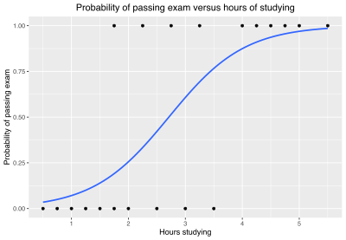
Ungfunction from age
Regression analysis: logistic
Source: wikipedia

Slide 7
Regression analysis
Regression equation
Y = constant + b1*X1
FEV1=c + b1*age
b1: coefficient; decrease FEV1 per year
Source: wikipedia

Slide 8
How to conduct multivariable analysis?
Depends on the research question:
Interested in effect of one specific exposure?
Interested in multiple independent effects?
Interested in prediction model for outcome?

Slide 9
How to conduct multivariable analysis?
Interested in effect of one specific determinant or exposure
  Select possible confounders / effect modifiers
  Look for confounding and effect modification
  Adjust and present results according to findings

Slide 10
Briefly: confounding
Exposure
Outcome
Third factor

Slide 11
Briefly: confounding
Exposure
Outcome
Third factor
Be associated with exposure
- without being the consequence of exposure
Be associated with outcome
- independently of exposure (not an intermediary)

Slide 12
Briefly: confounding
Down syndrome and birth order
Apparent of birth order
Confounded by maternal age
Y = c + b1*BO + b2*age
b1 changes>10%: confounding

Slide 13

Choosing independent variables
Literature, previous research, expertise
Biological plausibility
Significantly related with outcome
Caveat: limitations by sample size

Slide 14
Briefly: interaction/effect modification
A third factor influences the effect of interest
Does gender modify the effect of age on FEV1?
FEV1=c + b1*age + b2*gender
FEV1=c + b1*age + b2*gender + b3*(age*gender)
Source: Vlagtwedde/Vlaardingen

Slide 15
Briefly: interaction/effect modification
If b3 is significant: show stratified results by level of effect modifier
Here: show results by gender
  Direction of the effect
  Size of the effect
Subgroup analyses RCT
Source: Vlagtwedde/Vlaardingen

Slide 16
How to conduct multivariable analysis?
Interested in multiple independent effects
“Explorative”, no emphasis on confounding
Look at the data (scatter plot, compare means)
Perform univariable analysis first!
Note: for linear regression normal distribution is not required
Check distribution of residuals (standardized)

Slide 17
How to conduct multivariable analysis?
Interested in multiple independent effects
Perform univariable analysis
Select all variables with significant effect on outcome
Combine into one model
All effects are mutually adjusted
Compare ALL adjusted effects to univariable effects
Size, SE, confidence interval (p-value)
Variables no longer significant in multivariable model can still be important if other variables are not available!
Remember: all effects are adjusted!

Slide 18
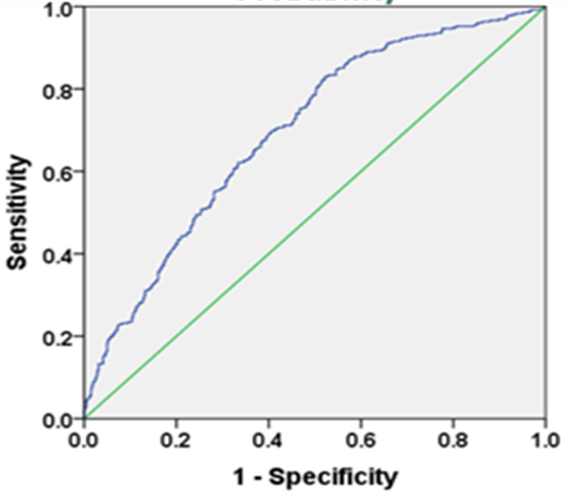
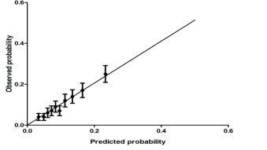
How to conduct multivariable analysis?
Interested in prediction of outcome
Perform univariable analysis
Select variables more liberally (p<0.157, AIC, etc)
Look at model characteristics, not effects of individual variables
←ROC curve
Calibration plot →

Slide 19

Summary
Approach to multivariable analysis depends on research question
Follow the right approach
Start simple!
Use the right terminology: uni- or multivariable

Slide 20
Questions?

