Slide 1
Help! Statistics! Multiple testing. Problems and some solutions.
Hans Burgerhof
j.g.m.burgerhof@umcg.nl
February 12 2019

Slide 2
Help! Statistics! Lunchtime Lectures
What? frequently used statistical methods and questions in a manageable timeframe for all researchers at the UMCG
No knowledge of advanced statistics is required.
When? Lectures take place every 2nd Tuesday of the month, 12.00-13.00 hrs.
Who? Unit for Medical Statistics and Decision Making
do not
When? | Where? | What? | Who?
Feb 12 2019 | Room 16 | Multiple testing. Problems and some solutions | H. Burgerhof
April 9 2019 | Room 16 | Kaplan-Meier survival curves and the log rank test | D. Postmus
June 11 2019 | ? | ? | ?
Slides can be downloaded from http://www.rug.nl/research/epidemiology/download-area

Slide 3
Program Today
Multiple testing. What is the problem?
(Stochastically) independent tests versus dependent tests
3. Controlling the Familywise Error Rate (FWER)
4. Controlling the False Discovery Rate (FDR)
5. Some references (for finding more solutions)

Slide 4
Type I and Type II errors for a statistical test
H₀: effect new treatment = effect standard treatment
H₁: effect new treatment > effect standard treatment
 |  | Decision
 |  | H0 true | H0 not true
Reality | H0 true | OK Probability: 1 - α | Type I error Probability: α
 | H0 not true | Type II error Probability: β | OK power Probability: 1 - β
The significance level α is generally 0.05;
We allow 5% probability to reject H0, while in fact it is true

Slide 5
The classical problem of multiple testing
In statistical testing, we usually define the significance level α at 0.05. This means we accept a probability of 0.05 to reject a null hypothesis, while in fact the null hypothesis is true
This is called the Comparison-wise error rate (CWER)
What can we say about the probability of rejecting at least one null hypothesis if we have more than one hypothesis to test?
Chance capitalisation!
“Overall alpha”
Family-wise error rate (FWER)

Slide 6

FWER and CWER
If we perform n independent tests, each with CWER = 0.05, then
the probability of making a type I error = 0.05 (in one test)
The probabilty of not making a type I error (per test) =
1 – 0.05 = 0.95
The probability of making no type I errors in n independent tests = ${(0.95)}^{n}$
So, the probability of making at least one type 1 error
equals 1 - ${(0.95)}^{n}$
Number of tests overall alpha
n (FWER)
3 0.143
10 0.401
100 0.994

Slide 7

A simple, classical, example
We would like to compare three independent groups with respect to a continuous, normally distributed, outcome variable.
Performing all pairwise comparisons will take three tests (1 to 2, 1 to 3, 2 to 3).
Three null hypotheses: $μ_{1}=μ_{2}$, $μ_{1}=μ_{3}$, $μ_{2}=μ_{3}$ will be tested.
Are these hypotheses independent of each other?
No: if $μ_{1}=μ_{2}$ is true and $μ_{1}=μ_{3}$ is true, automatically $μ_{2}=μ_{3}$ has to be true!

Slide 8
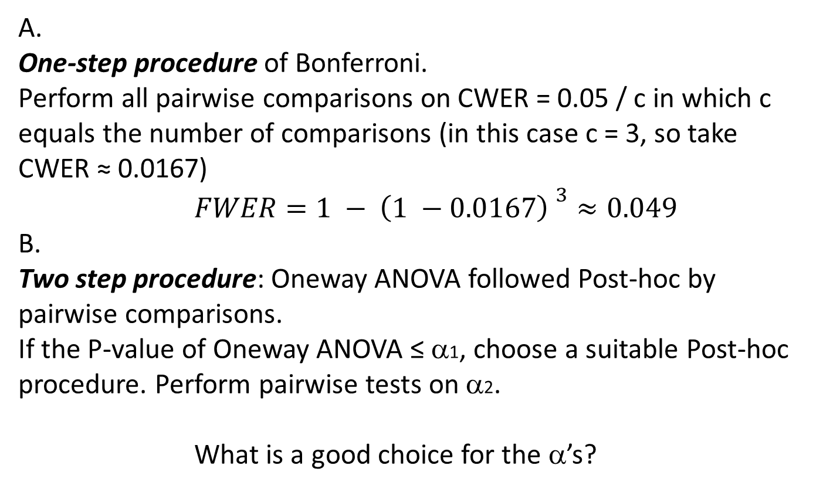
How to control the FWER at 0.05 in this situation?
A.
One-step procedure of Bonferroni.
Perform all pairwise comparisons on CWER = 0.05 / c in which c equals the number of comparisons (in this case c = 3, so take
CWER ≈ 0.0167)
$FWER=1 − {\left(1 −0.0167\right) }^{3}≈0.049$
B.
Two step procedure: Oneway ANOVA followed Post-hoc by pairwise comparisons.
If the P-value of Oneway ANOVA ≤ α1, choose a suitable Post-hoc procedure. Perform pairwise tests on α2.
What is a good choice for the α’s?

Slide 9
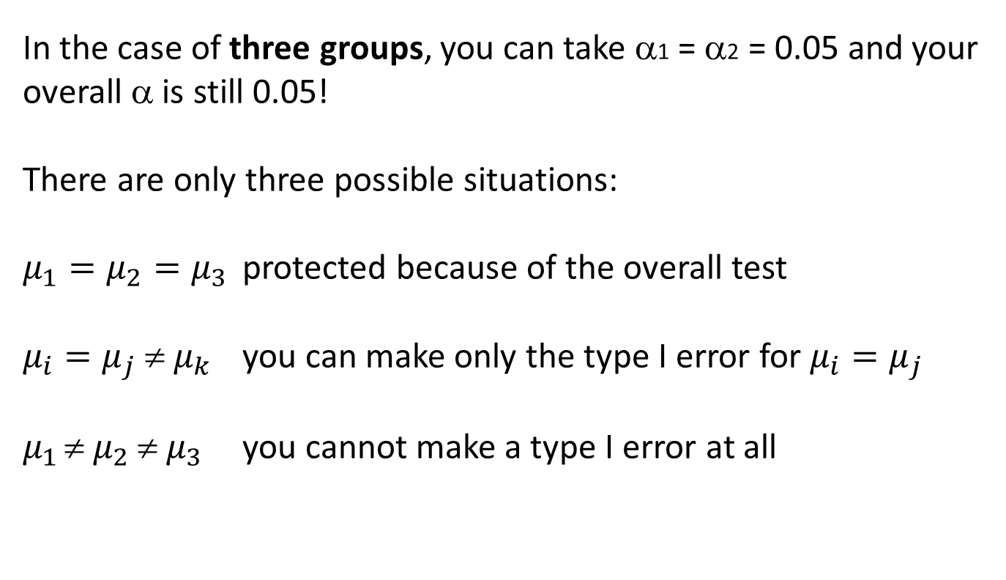
Choice of α’s for three groups
In the case of three groups, you can take α1 = α2 = 0.05 and your overall α is still 0.05!
There are only three possible situations:
$μ_{1}=μ_{2}=μ_{3}$ protected because of the overall test
$μ_{i}=μ_{j}  μ_{k}$ you can make only the type I error for $μ_{i}=μ_{j}$
$μ_{1 }{ μ}_{2}  μ_{3}$ you cannot make a type I error at all
Using Bonferroni correction after a significant ANOVA is too conservative!

Slide 10
Multiple tests on cumulating data (dependent tests)
Theory is used for interim analyses
Armitage, McPherson en Rowe (1969)
Tables with overall alpha after sequential tests for observations from Binomial, Normal en Exponential distributions
As an illustration we will recalculate an example (n patients are treated with both A and B and have to tell which is better).
H₀: π_{A} = π_{B} = 0.5. We will test after each new patient.

Slide 11
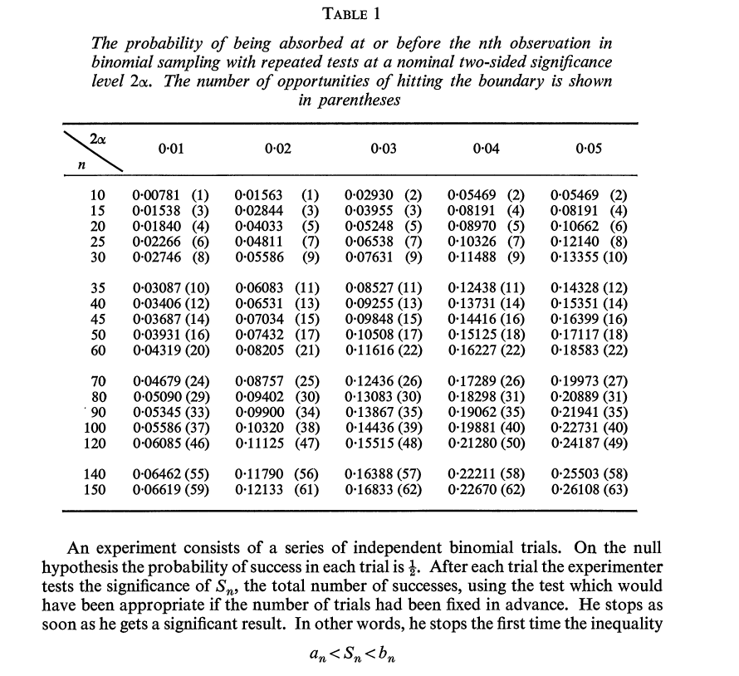
A
A
B
A
etcetera
A
B
B
A
A
B
B
X~B(n, 0.5)
A
B
B
Overall alpha increases,
but not as extreme as
in the case of
independent tests
(100 independent tests:
overall α > 0.99)
does no longer hold

Slide 12
Binomial distribution n = 1, .., 10 and π = 0.5
P(k = 0) = P(k=n)
n | P(k = 0) = P(k = n) | Two sided
1 2 3 4 5 6 7 8 | 0.5 0.25 0.125 0.0625 0.03125 0.015625 0.0078125 0.00390625 | 1 0.5 0.25 0.125 0.0625 0.03125 0.015625 0.0078125

Slide 13
H₀: π = 0.5; α = 0.01 two sided (per test): total probability to reject if H₀ is true :0.00781 (1)
Number of
successes
for A
Boundary is hit once
X ~ B(7, 0.5)
P(X = 0) = P(X = 7)
= 0.5⁷ ≈ 0.0078
Two-sided: 0.0156 > α
10
9
8
7
6
5
4
3
2
1
0
X ~ B(8, 0.5)
P(X=0) = P(X=8)
≈ 0.0039
Two sided: 0.0078
Reject H₀
X ~ B(10, 0.5)
P(X≤1) = P(X≥9)
≈ 0.0107
Do not reject H0
X~B(n, 0.5)
1 2 3 4 5 6 7 8 9 10 n
Actual overall alpha
is 0.0078

Slide 14
α = 0.03 two sided (for each test): total probability to reject if H₀ is true = 0.02930 (2)
Number of
successes
for A
X ~ B(10, 0.5)
P(X≤1) = P(X≥9)
≈ 0.0107
Reject H0
10
9
8
7
6
5
4
3
2
1
0
X ~ B(7, 0.5)
P(X = 0) = P(X= 7)
≈ 0.0078
P(X = 1) if n = 10 is
P(X = 1) if n = 7 followed
by three failures:
0.0547*(0.5)³ ≈ 0.0068
1 2 3 4 5 6 7 8 9 10 n
Overall α rounded 2*0.0078 + 2*0.0068 = 0.0293

Slide 15
Many independent tests
We are interested in genes, possibly related to a certain disease.
Example:
We have 100 candidate genes and compare their expressions in a group of diseased respondents with the expressions in a group of non-diseased respondents.
We test 100 (more or less) independent tests (H0: no effect).
How to correct for multiple testing?

Slide 16

The 10 genes with smallest P-values
No correction: α = 0.05;
14 genes are significant
Simple Bonferroni correction:
α* = 0.05/100 = 0.0005
Conclusion: only two genes are significant
Can we do better?

Slide 17
The False Discovery Rate (FDR) Benjamini en Hochberg, 1995
FDR = the expected proportion of all rejected null hypotheses that has been rejected falsely
not significant total
significant
True null hypotheses U V m0
False null hypotheses T S m1
m – R R m
Only m
is known
Only R
can be observed!
FDR = E(V/R)

Slide 18
The FDR
not significant total
significant
True null hypotheses U V m0
False null hypotheses T S m1
m – R R m
Benjamini and Hochberg (1995):
if all null hypotheses are true, so T = S = m1 = 0, than controlling the FDR equals controlling the FWER
(so the overall alpha is smaller than a defined max)

Slide 19
About the FDR
If, in reality, some of the null hypotheses are false, the FDR is smaller than the FWER. Controlling the FDR does not imply control over FWER, but will give you more power.
The more null hypotheses are false, the larger the gain in power

Slide 20
Multiple testing according to Benjamini and Hochberg: FDR procedure
m nulhypotheses: H1, H2, … , Hm
m P-values: P1, P2, … , Pm
Rank the P-values: P(1) ≤ P(2) ≤ … ≤ P(m)
Find k = the largest i holding
q = chosen level of control (e.g. 0.05 or 0.1)
Reject all H(i) i = 1, 2, … , k

Slide 21
Closer look at the FDR
Sequential FDR is a bit conservative, specially if the number of false null hypotheses is relatively large
Benjamini e.a. (2001): two step procedure in which the proportion true null hypotheses (π0) is estimated in the first step and used to determine q is the second:
Storey (2002): direct method to estimate π0

Slide 22
How to estimate π0?
π0 = m0/m
not significant total
significant
True null hypotheses U V m0
False null hypotheses T S m1
m – R R m
What does the distribution of P-values look like, if the null hypothesis is true?

Slide 23
H0: µ = 100
sample
What do you expect
for the P-value?
If H0 is true

Slide 24
H0: µ = 100
Equal areas
P(P-value < k) = k
for 0 ≤ k ≤ 1
If H0 is true …
the P-value has a uniform distribution on [0,1]

Slide 25
If the null hypothesis is false …
..the P-value does not have a uniform distribution on [0 ; 1], you will find relatively more often small P-values
Number of
P-values
P-values
from m1
P-values
from m0
0
1

Slide 26


Back to our 100 genes
$$q_{(i)}=\frac{m}{i}P_{(i)}≤q$$
Find k = the largest i holding
(i)
$$q_{(i)}=\frac{m}{i}P_{(i)}≤qq$$
For example, if q = 0.05:
3 genes will be significant
(of which probably 5% are false discoveries)

Slide 27
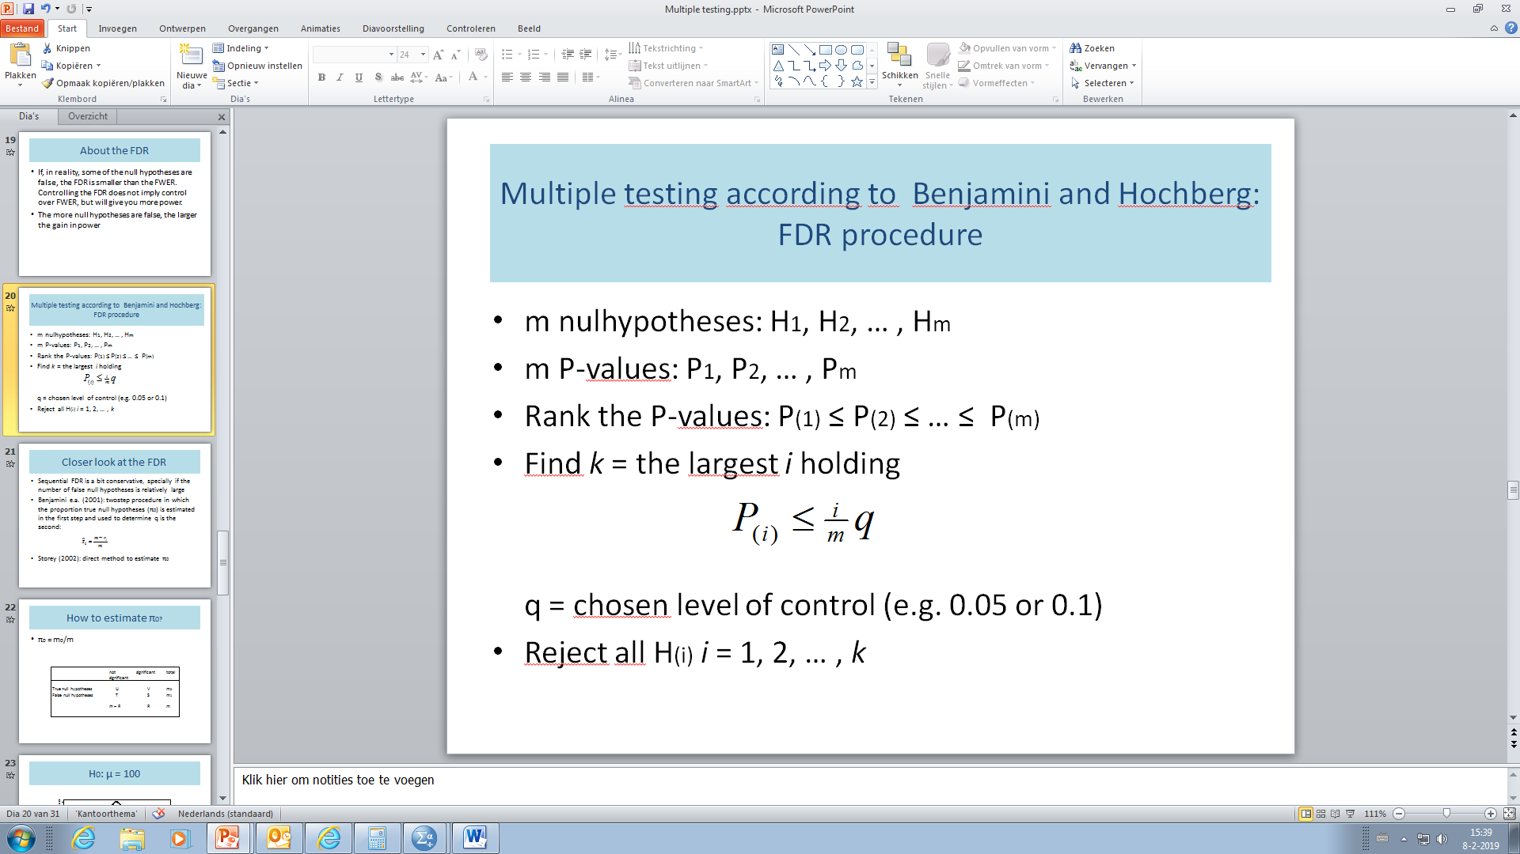
Back to our 100 genes
If we take q = 0.1?
(we are willing to accept that about 10% of the selected genes in fact are false discoveries)
(i)
The FDR is a step-up prcedure!

Slide 28
literature
Armitage P., McPherson K. and Rowe B. (1969) Journal of the Royal Statistical Society Series A. 132(2) 235 - 244
Austin S., Dialsingh I. and Altman N. (2014) Multiple hypothesis testing: a review. http://personal.psu.edu/nsa1/paperPdfs/Mult_Hyp_Review_final.pdf
Benjamini Y. and Hochberg Y. (1995). Controlling the False Discovery Rate: a practical and powerful approach to multiple testing. Journal of the Royal Statistical Society Series B, 289-300
Benjamini, Y. and Yekutieli, D. (2001). The control of the false discovery rate in multiple testing under dependency. Annals of Statistics, 29, 1165-1188.
Storey J.D. (2002). A direct approach to false discovery rates. Journal of the Royal Statistical Society Series B, 479 – 498.

