Slide 1
Help! Statistics!
Meta analysis on continuous outcomes, OR’s and diagnostic tests
Hans Burgerhof
j.g.m.burgerhof@umcg.nl
June 11 2019

Slide 2
Help! Statistics! Lunchtime Lectures
What? frequently used statistical methods and questions in a manageable timeframe for all researchers at the UMCG
No knowledge of advanced statistics is required.
When? Lectures take place every 2nd Tuesday of the month, 12.00-13.00 hrs.
Who? Unit for Medical Statistics and Decision Making
do not
When? | Where? | What? | Who?
Sep 10 2019 | Room 16 | * | H. Burgerhof
Nov 12 2019 | Room 16 | ? | ?
* Send your favourite subject to j.g.m.burgerhof@umcg before July 1!
Slides can be downloaded from http://www.rug.nl/research/epidemiology/download-area

Slide 3
Program Today
Meta Analysis. What is it?
Several types of outcome variables
3. “Effect size”
Heterogeneity
Some examples, focus on diagnostic tests

Slide 4
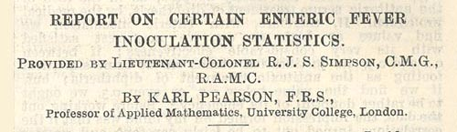
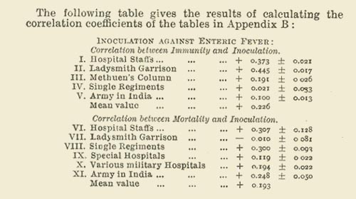
1904

Slide 5
The early years
1932: Fisher’s inverse chi-square to combine several P-values
1935: combined study on the effect of fertilizing (dung)
1940: Pratt and Rhine (psychologists) reviewed 145 articles (including a notion of “unpublished results”)
1976: Glass introduces the term “meta analysis” in the literature (although Cochran laid out foundation in 1953)

Slide 6
Glass (1976)
“Meta-analysis refers to the analysis of analyses. I use it to refer to the statistical analysis of a large collection of results from individual studies for the purpose of integrating the findings. It connotes a rigorous alternative to the casual, narrative discussions of research studies which typify our attempts to make sense of the rapidly expanding research literature.”
1940: 2,300 biomedical journals
1990: 23,000 biomedical journals

Slide 7
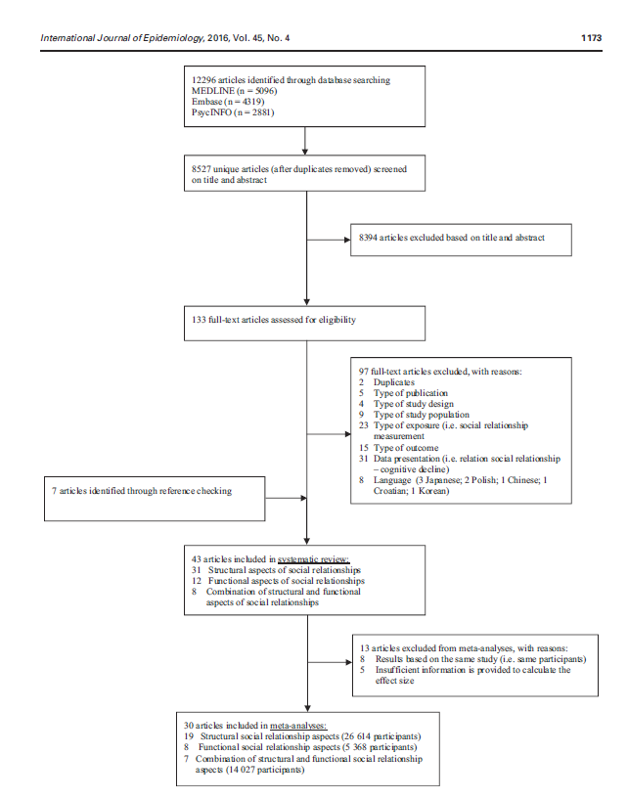
From Kuiper et al, Social relationships and cognitive decline: a systematic review and meta analysis of longitudinal cohort studies.
International Journal of Epidemiology. 2016 45(4); 1169 - 1206
All kinds of sources:
Pubmed,
Cochrane collaboration,
Medline,
….

Slide 8
Effect size: quantifying the results
To make results of several studies comparable, we need the same outcome variable in all studies, e.g.
  Standardized mean difference (“effect size”) for a continuous outcome
  Odds Ratio for a binary outcome (or RR or RD)
  - Correlation coefficient
  Any standardized index
  Diagnostic tests
Generally, not all selected articles use the same outcome variable

Slide 9
Summary measure for effect E
More precise studies should have larger weight
(inverse variance weighting). Precision is determined by sample size and within study variation σ. If the studies have the same σ, larger studies have more effect than smaller ones.

Slide 10
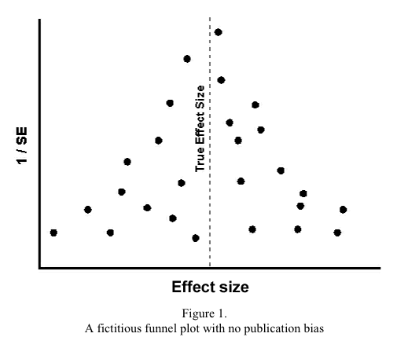
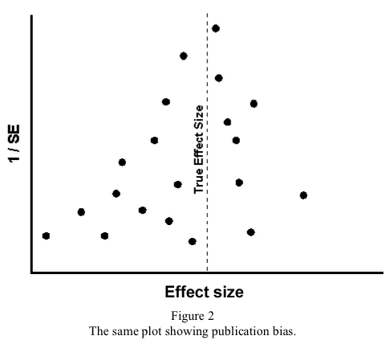
Publication bias (pitfall in M.A.)
If n is large, SE will be small, so 1/SE is large
Funnel plot
Estimated effect size
In this example, a small effect size
indicates a positive effect of the treatment
Checking publication bias

Slide 11
Standardized mean difference (SMD)
In some articles, data extraction is straight forward.
In other articles, you have to use given information to calculate the SMD yourself.
Examples (group sizes have to be given):
95% CI’s are given
t-value is given
P-value is given

Slide 12
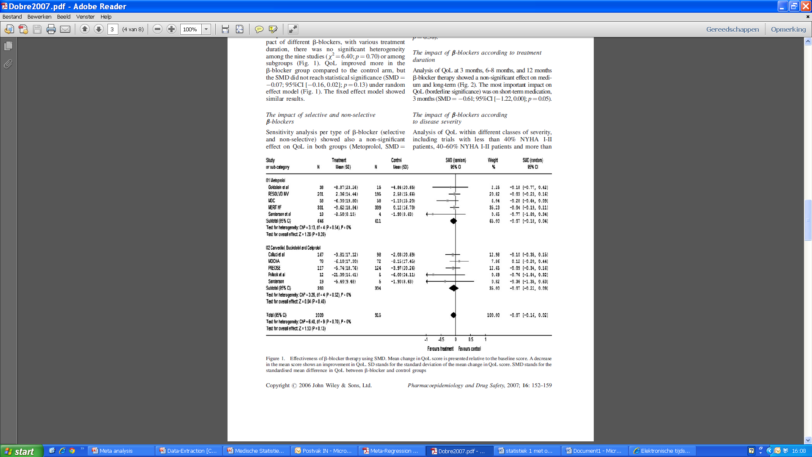
Example: difference in QoL
(study by D. Dobre 2007)
Forest plot

Slide 13
Odds Ratio
We need information of all four cells.
Information about RR and the sample sizes is not sufficient.
At least one of the cells or one of the other marginals has to be known.

Slide 14
Transforming RR to OR
OR = 9.75
RR = 8
OR = 8.32

Slide 15
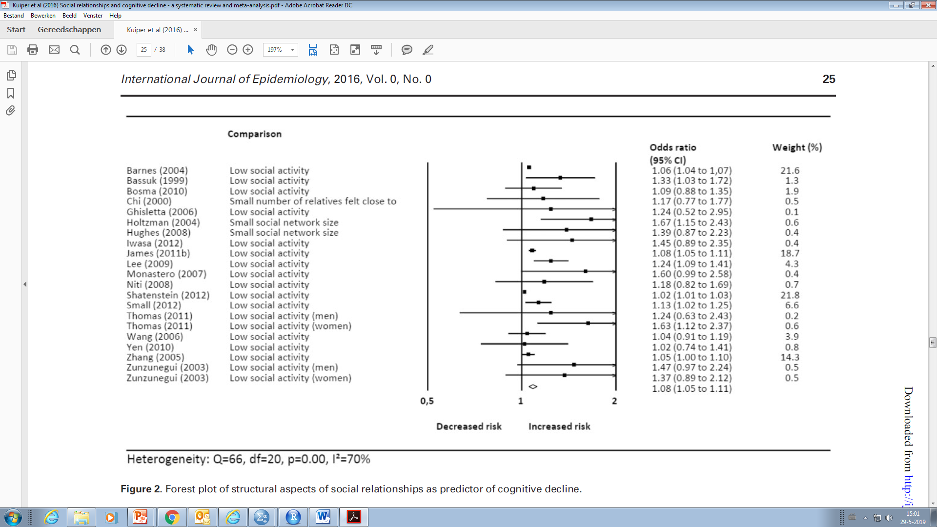
Example from Kuiper et al. (2016)
(Social relationships and cognitive decline)

Slide 16
Heterogeneity: Q
Estimating a mean effect makes sense if all studies test the same effect. Too much heterogeneity suggests this is not the case.
Cochran’s Q:
with
This can be tested using a Chi-square distribution with k – 1 df (k = number of studies).
William Cochran (1909 – 1980)
Archibald Cochrane (1909 – 1988)

Slide 17
Heterogeneity: I²
The test based on Cochran’s Q has low power to detect heterogeneity if the number of studies is small.
Higgins and colleagues: Index for Inconsistency (2002)
The larger I², the more heterogeneity.
25%: low 50%: moderate 75%: high
(complex formulas for Confidence Intervals)

Slide 18
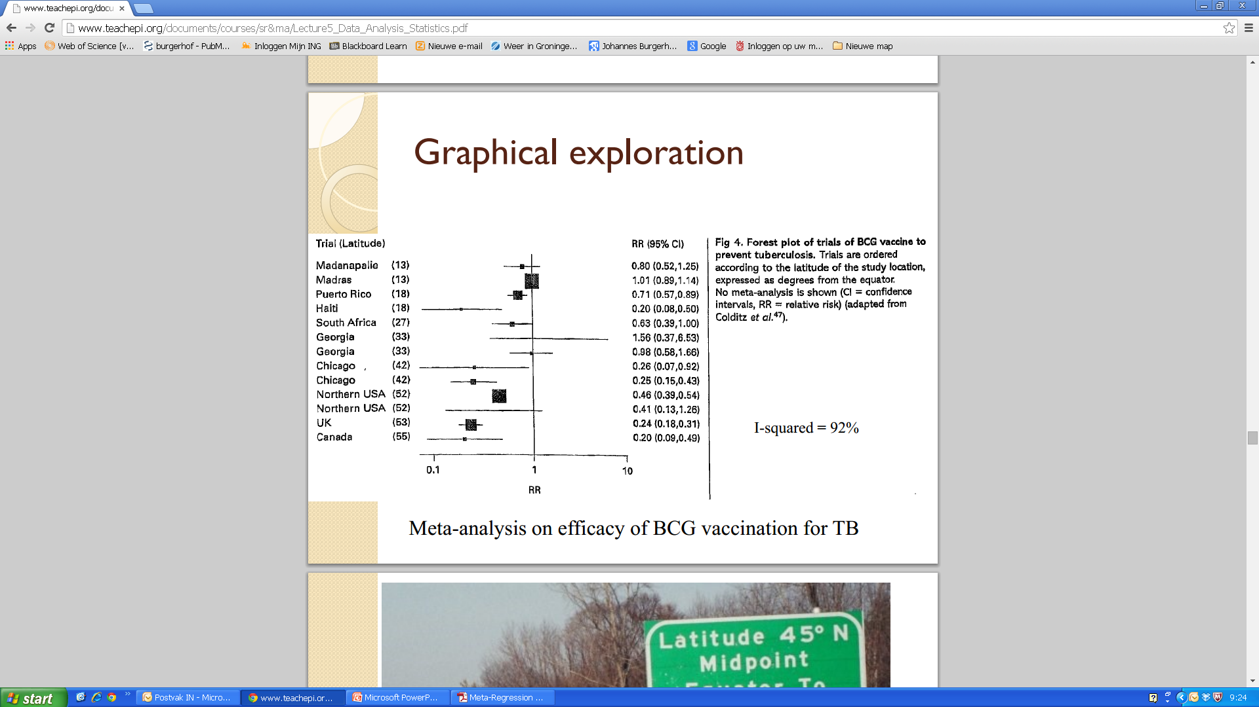
How to deal with heterogeneity?
Example from “Comprehensive Meta Analysis”

Slide 19
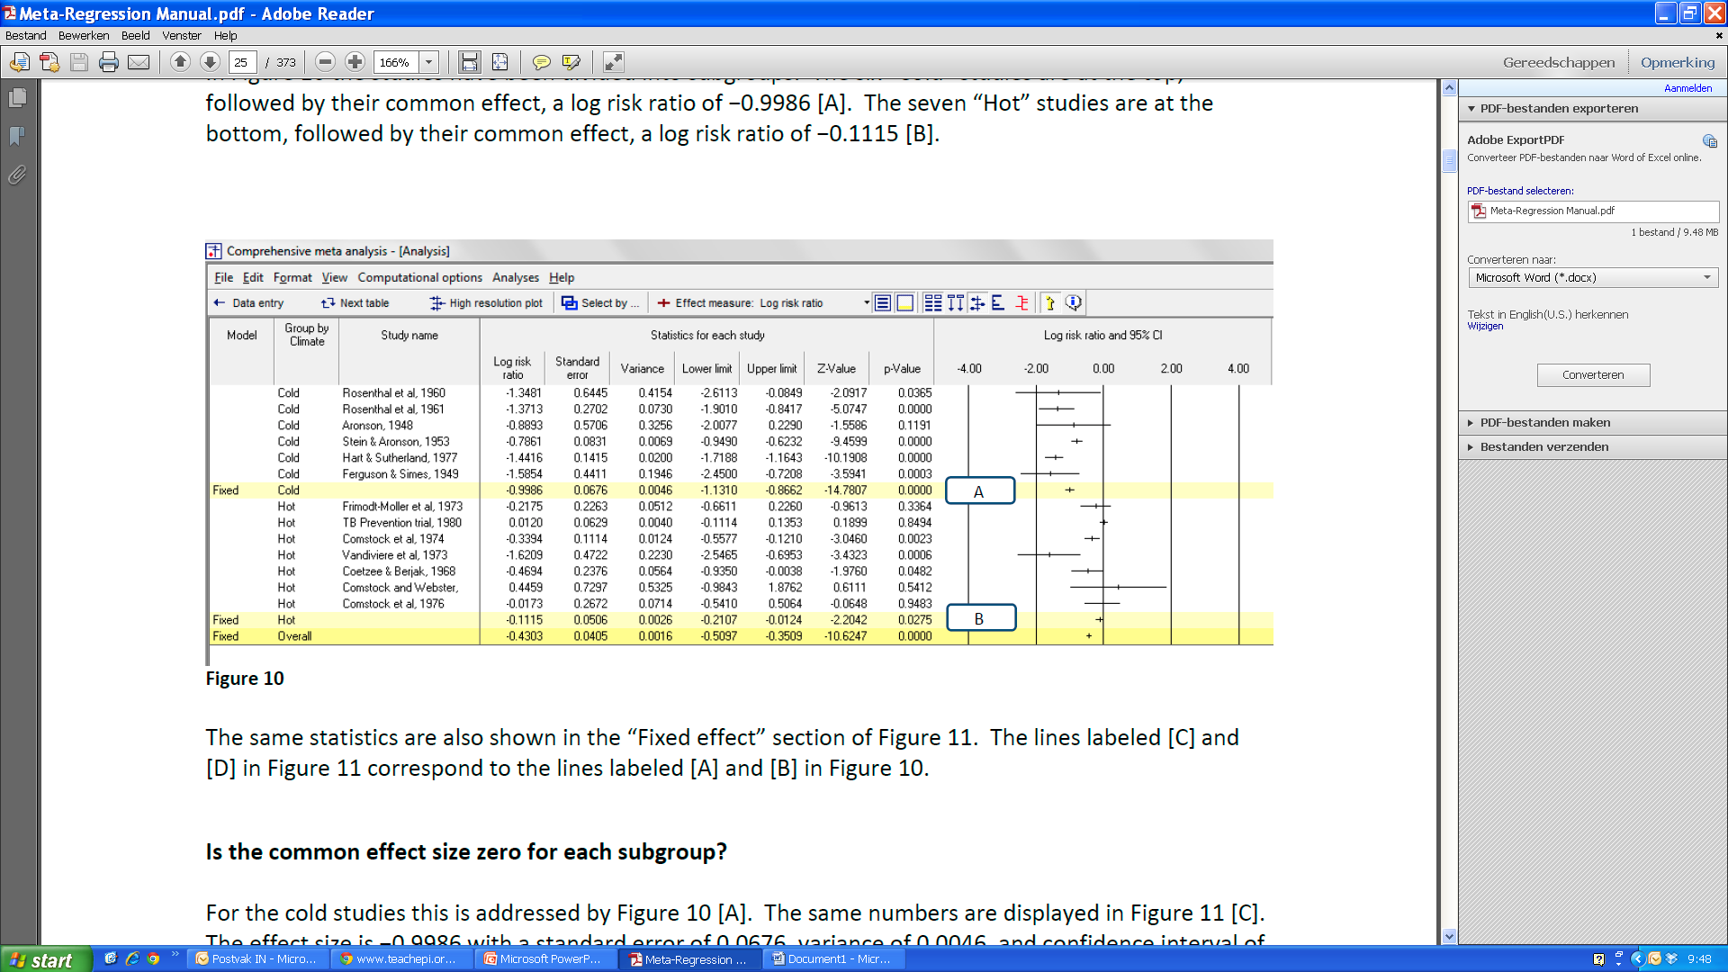
1. Subgroup analyses

Slide 20
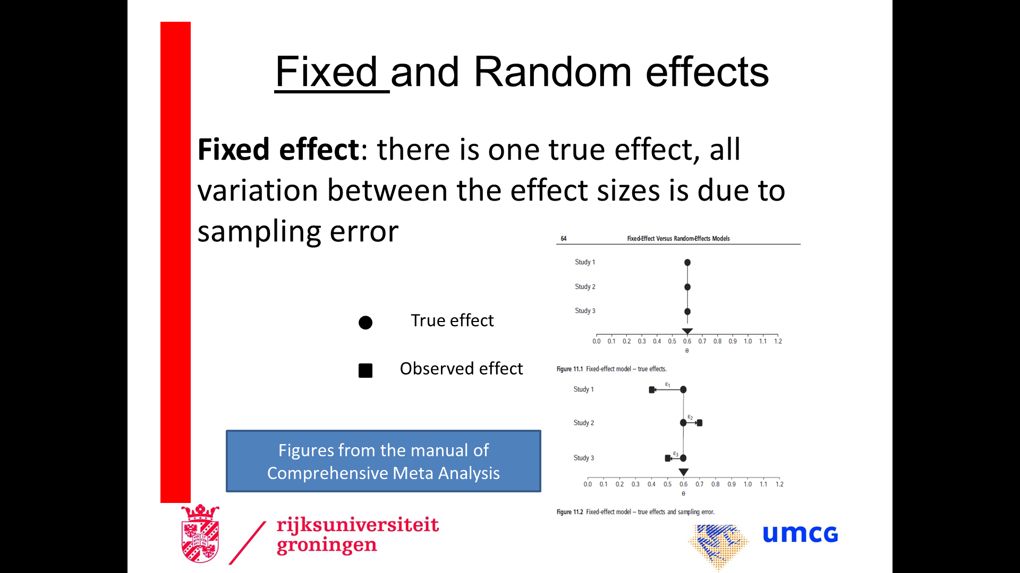
Fixed or Random Effects?
Difference in weights! (1)

Slide 21
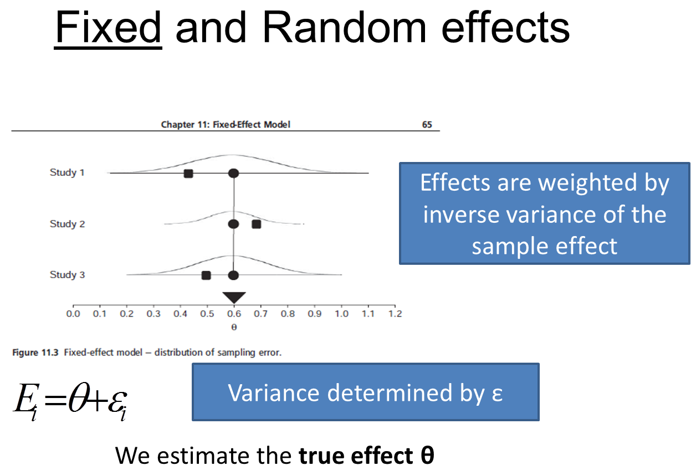
Fixed or Random Effects?
Difference in weights! (2)

Slide 22
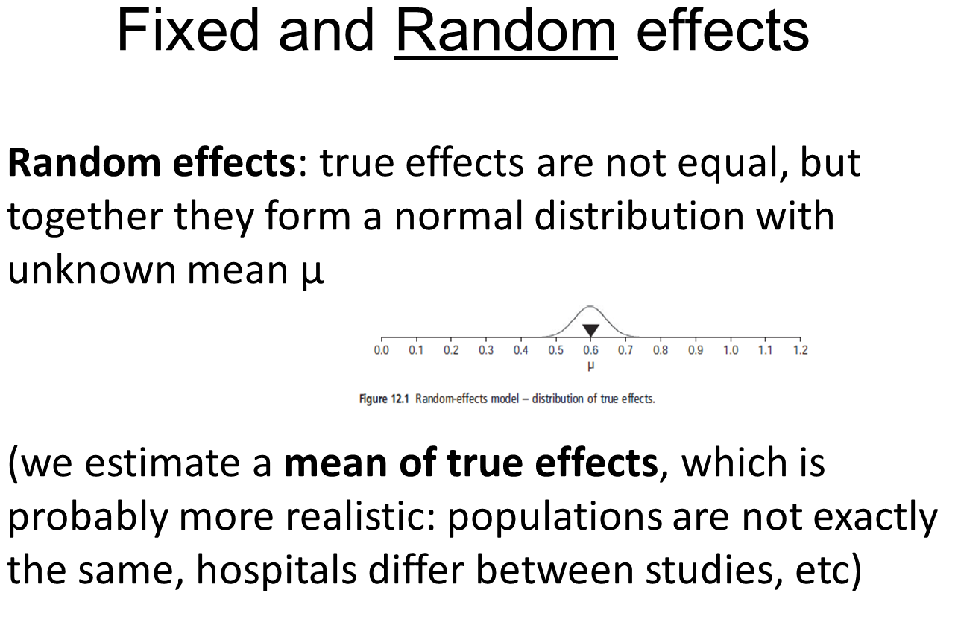
Fixed or Random Effects?
Difference in weights! (3)

Slide 23
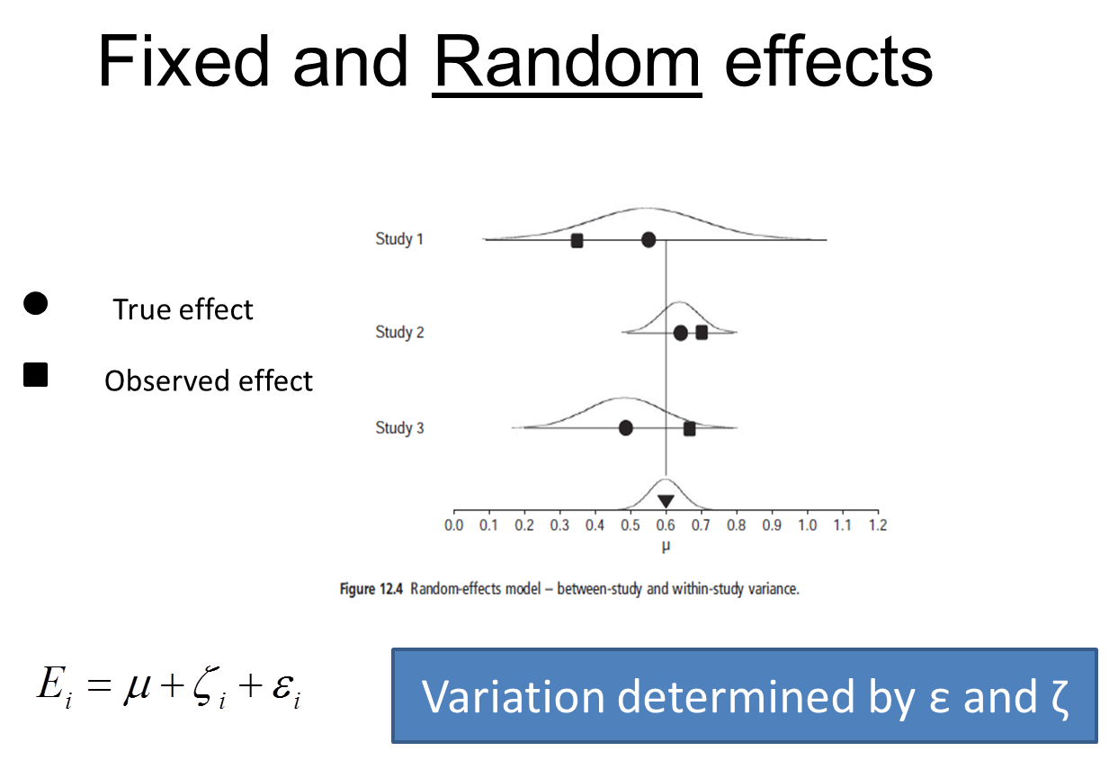
Fixed or Random Effects?
Difference in weights! (4)
You have to decide on fixed / random on theory, not on heterogeneity!

Slide 24
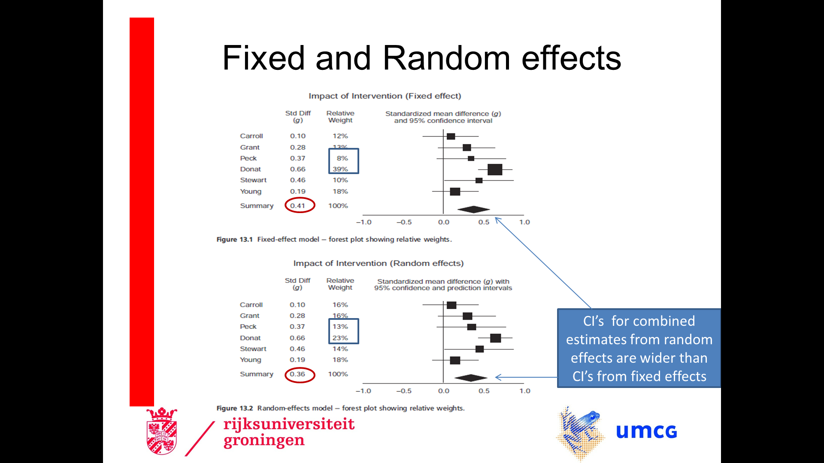
Fixed or Random Effects?
Difference in weights! (5)

Slide 25
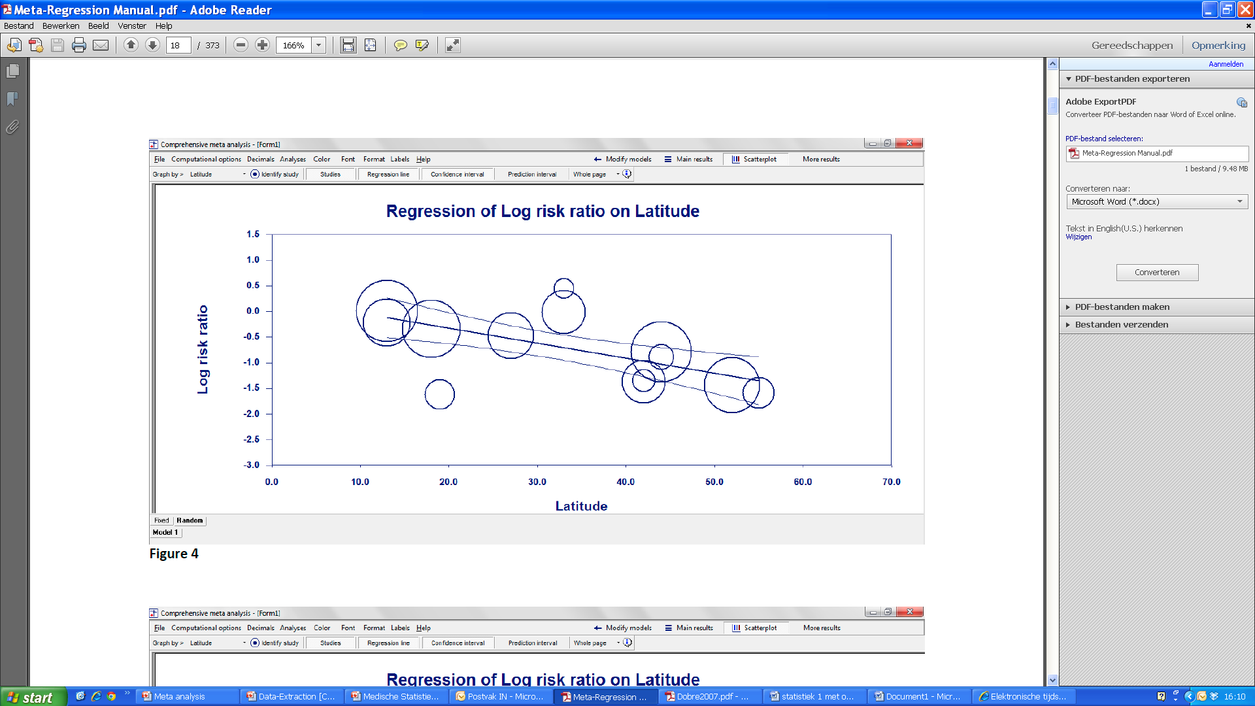
2. Meta regression
Study = unit (so n = 13)
Ln(RR) = b₀ + b₁∙Latitude

Slide 26
Meta analysis on diagnostic tests
For diagnosing Dementia, several diagnostic tests exist.
The sensitivity of diagnostic test T is P(T+ | D+)
The specificity of diagnostic test T is P(T- | D-)
So the quality of a diagnostic test has two, correlated, features.
This makes a meta analysis (even) more challenging

Slide 27
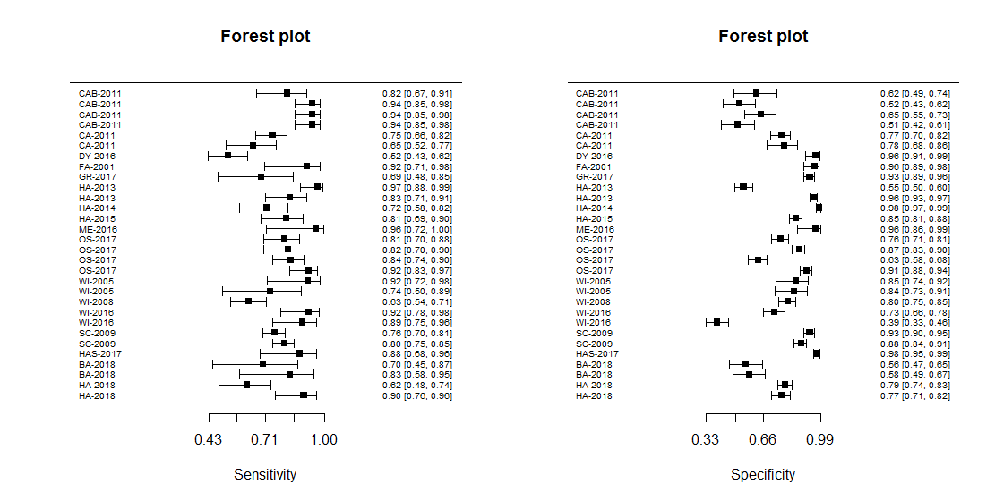
Linked forest plots

Slide 28
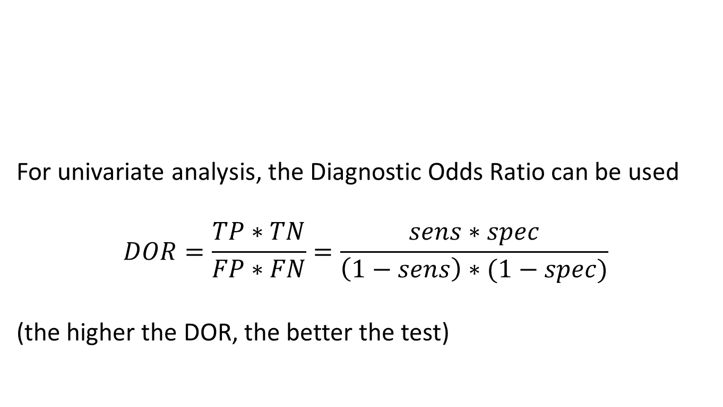
Summary measure: the DOR
 | Diseased | Non-diseased
Test positive | TP | FP
Test negative | FN | TN
For univariate analysis, the Diagnostic Odds Ratio can be used
$$DOR=\frac{TP∗TN}{FP∗FN}=\frac{sens∗spec}{\left(1−sens\right)∗(1−spec)}$$
(the higher the DOR, the better the test)

Slide 29
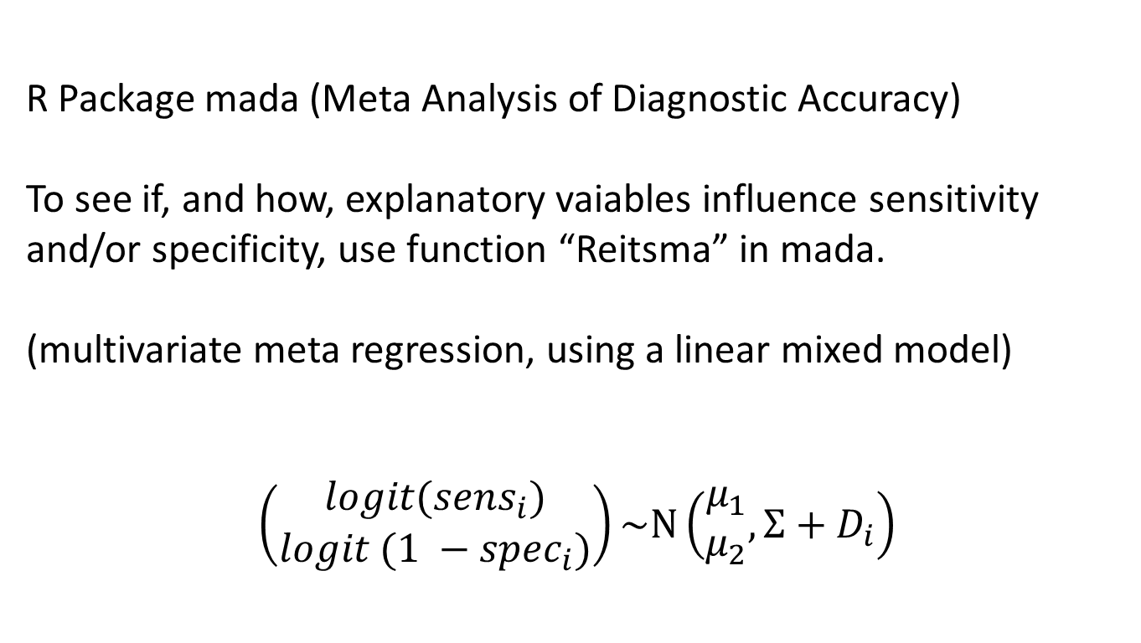
More complex analyses: both sensitivity and specificity as outcome
R Package mada (Meta Analysis of Diagnostic Accuracy)
To see if, and how, explanatory vaiables influence sensitivity and/or specificity, use function “Reitsma” in mada.
(multivariate meta regression, using a linear mixed model)
$$\left(\begin{aligned}logit({sens}_{i}) \\ logit (1 −{spec}_{i})\end{aligned}\right)\sim N\left(\begin{aligned}μ_{1} \\ μ_{2}\end{aligned}, Σ+D_{i}\right)$$

Slide 30
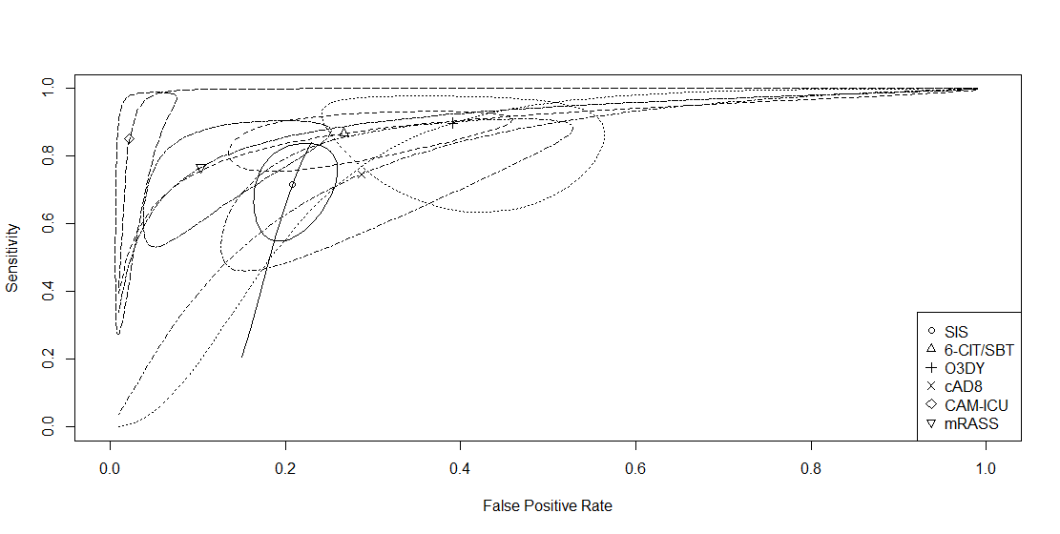
Summary ROC plot (in R)
Comparing 6 diagnostic tests for diagnosing Cognitive Impairment

Slide 31
Summary
It takes a lot of time and effort to perform a systematic review
Not all selected articles give the measure of interest directly
Complex statistical techniques might be needed
Individual Patient Data (IPD) can give more information!

Slide 32
Some more information
PhD Course on Systematic Reviews and Meta Analysis (coordinated by Nynke Smidt); twice a year
Cochrane library and Review Manager (RevMan)
https://www.cochranelibrary.com/about/about-cochrane-reviews
https://training.cochrane.org/resource/introduction-revman

