Slide 1
Help statistics! Missing data
Dorien Neijzen, d.neijzen@umcg.nl
Dept. Epidemiology, Unit Medical statistics and decision making

Slide 2
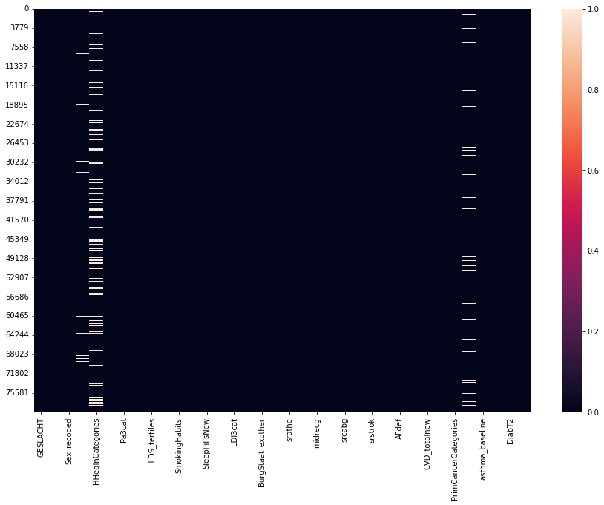
Lifelines missingness
Notes:
Maybe not so bad?
Delete 1 variable, or two? Importance of variable?

Slide 3
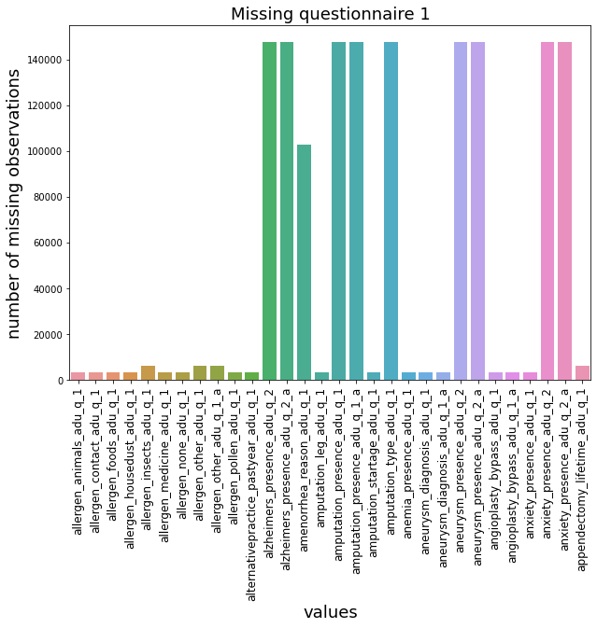
Notes:
But the raw data…

Slide 4
Overview
What is missing data?
Why? Causes of missing data
How: Use the observed data?
How: Analysis with missing data
Summary
Questions

Slide 5
What

Slide 6
Missing: cov/outcome
Patient ID | Diabetes | Medication | Blood pressure
1 | 0 | $9 | 120
2 | 1 | yes | 69
3 | 1 | no | 80
4 | - | yes | -
outcome
Covariates
Notes:
Non-response (unit, item)
1. covariates
2. outcome

Slide 7
Missing: unit, item
Patient ID | Diabetes | Medication | Blood pressure
1 | 0 | $9 | 120
2 | 1 | yes | 69
3 | 1 | no | 80
4 | - | yes | -
unit
item
item
Notes:
3. per patient (drop-out)

Slide 8
Possible problems?
Patient ID | Diabetes | Medication | Blood pressure
1 | 0 | $9 | 120
2 | 1 | yes | 69
3 | 1 | no | 80
4 | 0 | yes | 80
Notes:
Bias introduced? Missing disease outcome for diseased patients!
Possible introduction of bias: difference in completers, non-completers (too ill to answer)
We need to know why data is missing, before deciding on how to deal with it

Slide 9
Missing data (problems)
Patient ID | Diabetes | Medication | Blood pressure
1 | 0 | $9 | 120
2 | 1 | yes | 69
3 | 1 | no | 80
4 | 0 | yes | 80
Notes:
Missing entire samples (similar to doing complete case analysis!)
Dropout: smaller sample size, thus less precision lower power

Slide 10
Longitudinal
Patient ID | Diabetes 2020 | Diabetes 2021 | Diabetes 2022
1 | 0 | $9 | 1
2 | 1 | 1 | 0
3 | 1 | 1 | 1
4 | 0 | 0 | -

Slide 11
Why?
Household equivalent income
Notes:
Large fraction of missingness for one variable.
Think about possible reasons:
Random
Non-random: high/low income less likely to disclose?
Maybe with children less likeliy to disclose income?
Maybe income only registered if below/above some value
Or only if relevant for outcome?

Slide 12
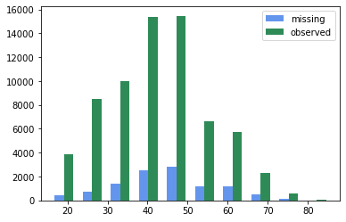
Distribution age

Slide 13
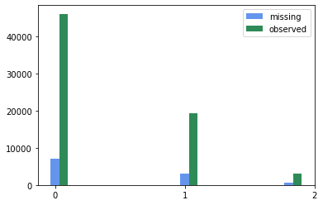
Distribution multimorbidity score

Slide 14
Why? Reasons
Natural processes (drop-out/death)
Non-applicability (skip question if no on previous)
Informative non-response (too ill to answer)
Logistic/administrative (data management, patient recruiting)
Notes:
Most of these only possible to figure out by THINKING about data collection process!
Document missingness
Recover where possible
Use underlying reasons for missingness to impute appropriately

Slide 15
Case Study
Missing values in the SICS-II models
Wenbo Zhang​
Supervisor: Prof. Harold Snieder​
Co-supervisor: Prof. Gerton Lunter​
Daily supervisor: Dr. Eric Keus

Slide 16
Simple intensive care study (SICS) - II
Adult patients were all from the UMCG intensive care units (ICU)
We collected basic information about the patient and the first 7-day clinical variables after admission to the ICU
Goal: predict patient deterioration¹ within ICU
Notes:
1. We used Sequential Organ Failure Assessment (SOFA) score as our outcome to describe the deterioration.

Slide 17
Overall missing values of the model
variable | total | missing(%)
totSOFA_d1 | 964 | 157(16.27)
totSOFA_d2 | 667 | 25(3.75)
totSOFA_d3 | 460 | 46(10.00)
age | 1034 | 24(2.32)
gender | 1034 | 24(2.32)
tempcentr | 1034 | 522(50.48)
map | 1034 | 481(46.50)
hr | 1034 | 481(46.50)
rr | 1034 | 485(46.91)
mechvent | 1034 | 96(9.28)
fio2 | 1034 | 95(9.19)
apco2 | 1034 | 488(47.20)
aph | 1034 | 488(47.20)
variable | total | missing(%)
natrium | 1034 | 38(3.68)
creat | 1034 | 50(4.84)
urea | 1034 | 67(6.48)
gluc_low | 1034 | 84(8.12)
gluc_high | 1034 | 84(8.12)
bilirubin | 1034 | 117(11.32)
wbc_low | 1034 | 337(32.59)
wbc_high | 1034 | 337(32.59)
ht | 1034 | 43(4.16)
gcs | 1034 | 95(9.19)

Slide 18
Risk factors of δSOFA score ≥ 2 in the next 24h
Notes:
Impute with healthy value for missing values: clinician decision to not measure (which is not observed/in data!)

Slide 19
Categories for missing data
MCAR: missing completely at random
MAR: missing at random
MNAR: missing not at random

Slide 20
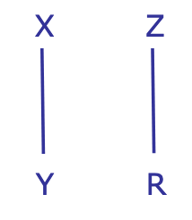
1. MCAR
Outcome (Y) independent of missingness
Covariates (X) independent of missingness
Notes:
Reason for missingness is independent of observed AND unobserved values
No bias
Loss power, but can be regained with proper treatment: larger SE
Machine malfunctions randomly

Slide 21
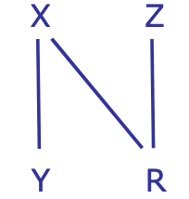
2. MAR
Outcome independent
Covariates dependent
Notes:
Missingness depends on other observed variables
Missingness does NOT depend on value of variable itself
Missing value can be predicted using observed variables
Biased sample! Bias is recoverable
Protocol

Slide 22

3. MNAR
Outcome dependent on missingness
Covariates dependent on missingness
Notes:
Missingness depends on outcome of variable itself
Results in bias that can not be corrected
PREVENT! Careful planning of study can reduce MNAR
Non-ignorable
Models unverifiable: sensitivity analysis!
Clinician judgement (not observed!) and based on value/outcome itself!

Slide 23
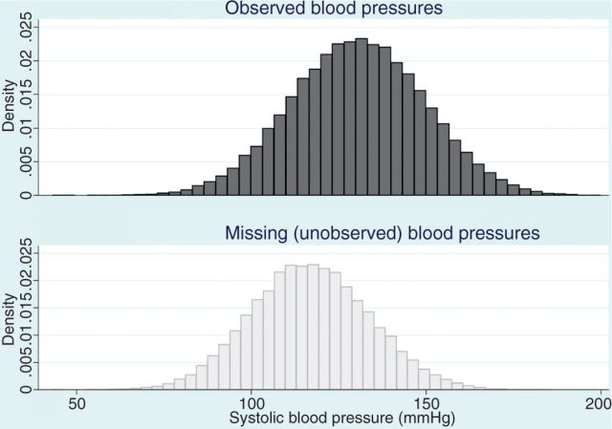
https://www.ncbi.nlm.nih.gov/pmc/articles/PMC4121561/

Slide 24
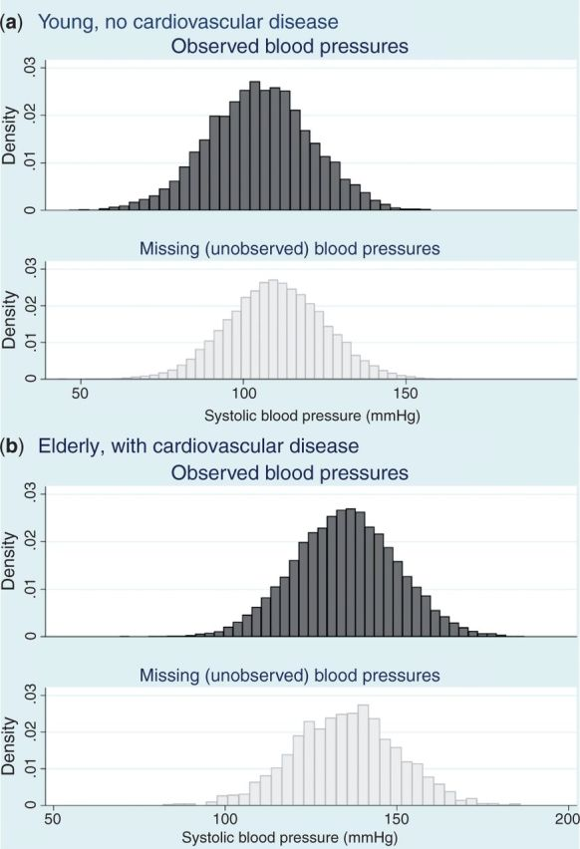
https://www.ncbi.nlm.nih.gov/pmc/articles/PMC4121561/

Slide 25
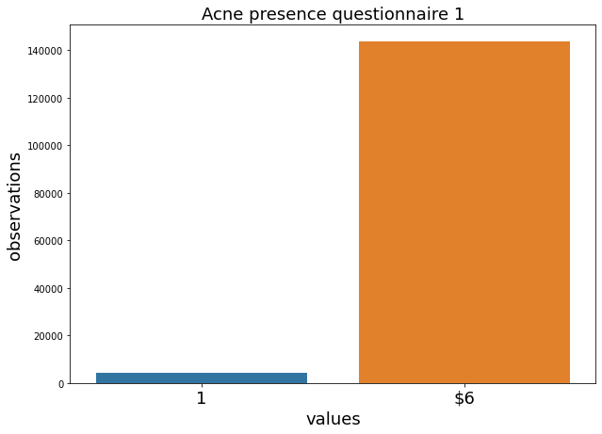
Can we use what we observed?
Missing
Observed
Notes:
What if 1% observed, other missing?
And what if I observe 95%
What is the maximum fraction of missingness we can work with?
Goal: use maximum available information, while maintaining reliability

Slide 26
Testing missing data mechanisms
Visualize - differences between groups with/without missing values - summary statistics (mean, std, distribution of features)
Think
What observed and missing?
Cause of missingness
Relation observed versus missing

Slide 27
Can we use observations?
Sample size affects robustness
Imputation is more accurate if we observe sufficient variables related to the missing value
Delete samples/variables for item missingness?

Slide 28
Methods
Single imputation
Fill in median or mean
Complete/available case analysis
Ignore records with missing values
Summary measures (longitudinal)
Use mean across time, ignoring missing values
Multiple imputation
Notes:
Complete cases analysis: Loss of information
Available case analysis: Loss of information (bias for MAR/MNAR)
Summary measures: longitudinal (bias for MAR/MNAR)
Single imputation (not accounted for uncertainty, underestimates SE, bias for MAR/MNAR)
Methods & Assumptions (mechanism cause)

Slide 29
Multiple imputation
Assumptions: MAR
Makes use of available information to predict missing
Narrower CI, not alter conclusions (no bias introduced)

Slide 30
Analysis report
Report fraction of missing values
Document cause of missingness
Describe imputation method and/or deletion criteria
Perform sensitivity analysis

Slide 31
Summary
Missing data: prevent, report
Mechanism for missing data: MCAR, MAR, MNAR
Methods: Multiple imputation (MAR)
Report on - WHAT is missing - HOW you dealt with missing values (imputation/deletion) - WHY (assumptions, causes of missing values, mechanism)

Slide 32
Software
.
SPSS: MULTIPLE IMPUTATION http://bayes.acs.unt.edu:8083/BayesContent/class/Jon/SPSS_SC/Manuals/v18/PASW%20Missing%20Values%2018.pdf https://www.youtube.com/watch?v=ujf0ifOmvwg
R package: MICE https://www.ncbi.nlm.nih.gov/pmc/articles/PMC4731595/

Slide 33
Additional literature recommendations
Carpenter, James R., and Melanie Smuk. "Missing data: A statistical framework for practice." Biometrical Journal 63.5 (2021): 915-947.
https://www.ncbi.nlm.nih.gov/pmc/articles/PMC4121561/
Little, Todd D., et al. "On the joys of missing data." Journal of pediatric psychology 39.2 (2014): 151-162

Slide 34
Questions

Slide 35
Testing for MCAR, MAR, or MNAR
MCAR versus MAR: - Little’s test (but might be wrong, as all tests...) - use missingness-dummy variables and chi-square or t-tests to help suggest patterns (both available in SPSS missing value module)
MAR versus MNAR: – use information on the missing data whenever possible (f.e. follow-up phone-calls in a survey) – examine model fit of different patterns of missingness – use commonly known information on ignorability of missing data from your research field

Slide 36
Multiple Imputation intuition
X, Y, Z include missing observations
Split into observed (o) and missing (m)
Iteratively estimate models for Xo(Yo,Zo) and impute Xm using this model
Same for Y and Z
Keep an imputed dataset ever 10-20 cycles
Can be used for linear/Poisson/logistic/etc. to reflect type of variable
Carpenter, James R., and Melanie Smuk. "Missing data: A statistical framework for practice."

Slide 37
Use sensitivity analysis
Y: outcome
X: covariates
Z: confounders with missings
GLM to regress Z on Y, X → Obtain pars b0, b1, b2
Change obtained parameters b0* = d+b0
Re-impute missing values in Z using b0* and leave imputed values of other vars unchanged.
https://onlinelibrary.wiley.com/doi/pdfdirect/10.1002/bimj.202000196

Slide 38
Building the future of health

