Slide 1
Help! Statistics!
Introduction to Longitudinal Data Analysis
Sacha la Bastide-van Gemert
Medical Statistics and Decision Making
Epidemiology, UMCG

Slide 2
Help! Statistics! -lunch time lectures
What? Frequently used statistical methods and questions in a manageable timeframe for all researchers at the UMCG.
No knowledge of advanced statistics is required.
When? Lectures take place every 1st Tuesday of every two months, 12.00-13.00hrs.
Who? Unit for Medical Statistics and Decision Making and colleagues
When? | Where? | What? | Who?
Feb 7, 2023 | Room 16 | Introduction to longitudinal data analysis | Sacha la Bastide
April 4, 2023 | Room 16 | Machine Learning | Hylke Donker
Jun 6, 2023 | Room 16 | … | …
Slides from each presentation can be downloaded from:
https://www.rug.nl/research/epidemiology/download-area

Slide 3
Introduction to longitudinal data analysis: overview
What is longitudinal data?
Why does it need a special approach?
revisiting the linear regression model
Longitudinal data analysis:
  using summary measures
  introduction of the multilevel model for change (a.k.a. mixed effects model)

Slide 4
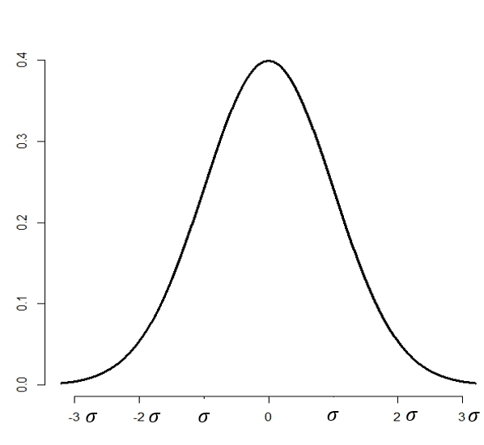
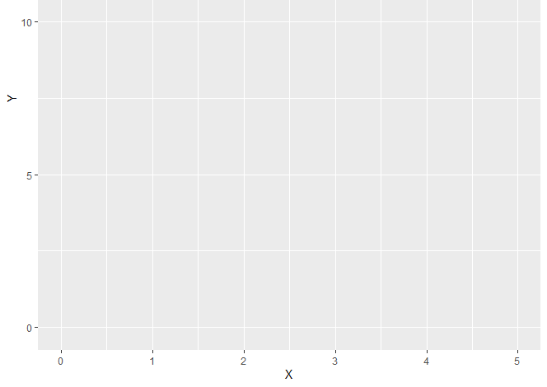

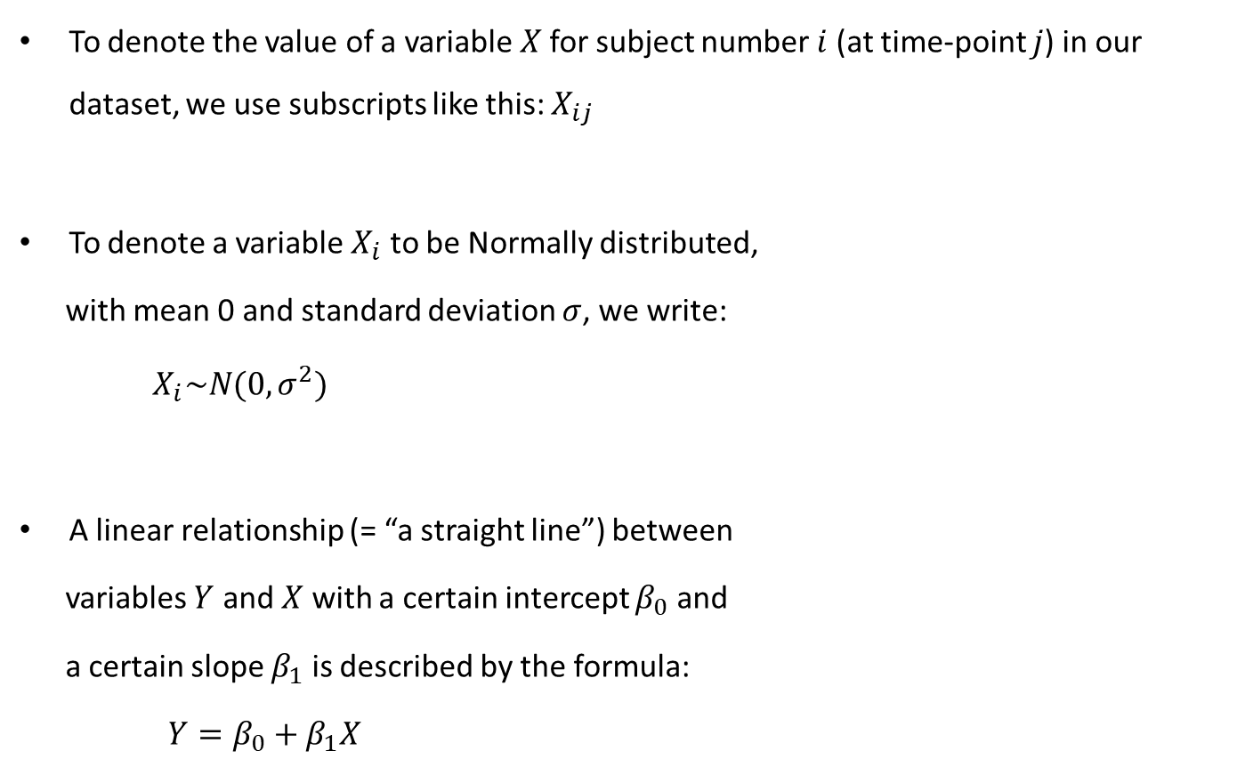


And yes, there will be some mathematical notation…
To denote the value of a variable $X$for subject number $i$ (at time-point $j$) in our dataset, we use subscripts like this: $X_{ij}$
To denote a variable $X_{i}$ to be Normally distributed,
with mean 0 and standard deviation $σ$, we write:
$X_{i}\sim N(0,σ^{2})$
A linear relationship (= “a straight line”) between
variables $Y$ and $X$ with a certain intercept $β_{0}$ and
a certain slope $β_{1}$ is described by the formula:
$Y=β_{0}+β_{1}X$
$$Y$$
$$Y=2.5 +0.5∗X$$
$$X$$

Slide 5
What is longitudinal data? (1)
Clustered data
For many more examples, see the previous Help! Statistics! lecture
Clustered (or nested/multilevel/hierarchical/...) data
Example: several classrooms, within each classroom students
Observations from students from the same classroom are more alike than students from different classrooms: students are nested in classrooms
Variables at student level: gender, SES, ...
Variables at classroom level: teacher effect, ...
multilevel data

Slide 6
What is longitudinal data? (2)
Longitudinal data: several subjects, each measured at several (different) points in time t1, t2, t3, t4, t5:
Measurements (at different time points) from one subject are more alike than measurements from different subjects: measurements are nested within subjects
Variables at each time point: lengths, grades...
Variables for each subject: gender, SES, ...
t1
t1
t1
t1
t5
t5
t5
t2
t2
t2
t3
t4
t3
t4
t4
t4
Today: focus on continuous
outcome variables
multilevel data

Slide 7
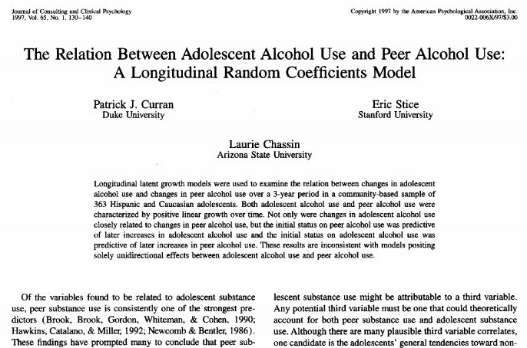
Example: adolescent alcohol use (Curran et al, 1997)*
Sample of 82 adolescents:
37 are Children Of an Alcoholic parent (COAs), 45 are non-COAs
Research design:
  - each child assessed 3 times
  (at ages 14, 15, 16)
  - outcome: alcuse (continuous,
  “alcohol use”-questionnaire)
  - covariate: coa (dichotomous, 0=no, 1=yes)
Research question:
Do trajectories of adolescent alcohol use differ by parental alcoholism?
* Example from: Singer & Willet: Applied longitudinal data analysis. Modeling change and event occurence (Oxford, 2003)

Slide 8
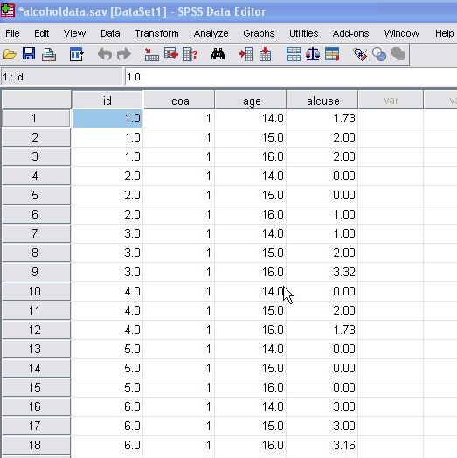
Longitudinal data
The data-set: person-period format
Data in long format:
for each person, each repeated measurement is stored as a new case.
Here: 3 rows per person
a time variable: age
an outcome variable: alcuse
a (time-independent) covariate: coa
person 1
person 2
...
clustered data!

Slide 9
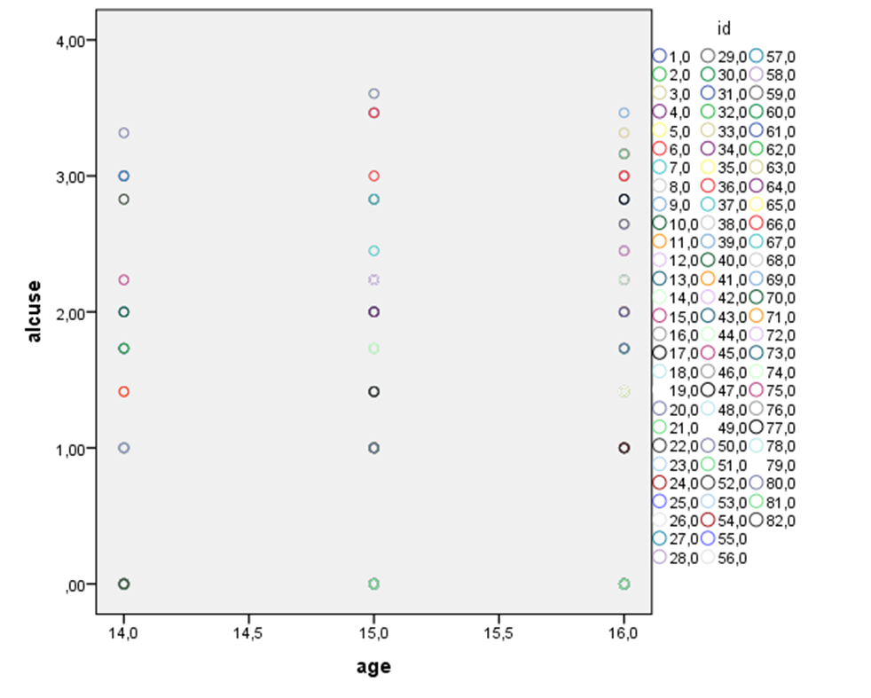
Investigating change over time
Scatterplot age-alcuse for the whole data-set:
Continuous outcome variable alcuse, covariates age and coa…
... what about linear regression of alcuse on age?
alcuse
Let’s revisit (simple) linear regression analysis...
age (years)

Slide 10
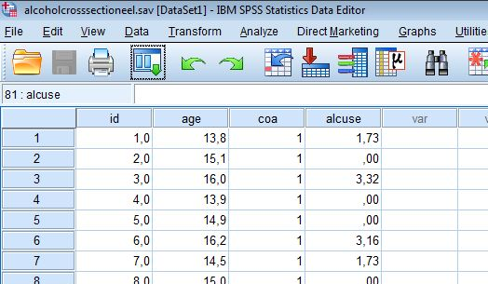
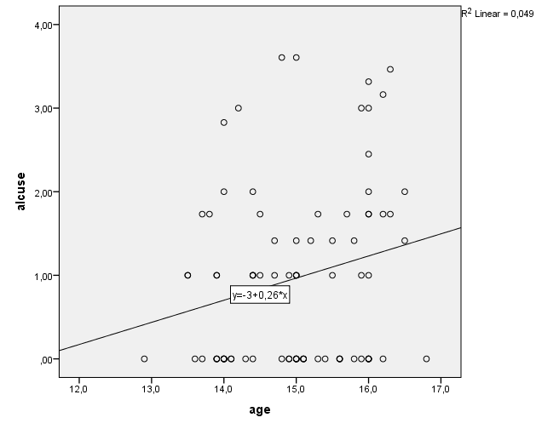





Intermezzo
The linear regression model revisited (1)
Cross-sectional data: for each adolescent i one observation (alcuse, age, coa)
Investigating the linear relation between age and outcome alcuse:
what is the best fitted straight line?
  = find the line “closest” to the data points in the scatter plot
Note: cross- sectional data
$$Y_{i}=β_{0}+β_{1}X_{i}$$
$$+ε_{i}$$
$$ε_{i}\sim N(0,σ^{2})$$
etc
Here, $β_{0}$and $β_{1}$ are estimated to be -3.0 and 0.26 :
$$\hat{alcuse}=−3.0+0.26∗age$$
residuals $ε_{i}$

Slide 11




Intermezzo
The linear regression model revisited (2)
Linear regression:
- we assume mean alcohol use for fixed age values are on a straight line
- individual observations are assumed to be normally distributed around these means (random residual)
Formally: we assume an underlying true population linear relationship
Assumptions made in order for the model to be valid:
independent observations
linear relation between Y and X
normally distributed residuals
homogeneity of the residuals’ variance across values of X
  Back to our longitudinal data-example...
Residual $ε_{i}$: random variable,
normally distributed with
constant variance σ²,
independent from the value of X
$$Y_{i}=β_{0}+β_{1}X_{i}$$
$$+ε_{i}$$
$$ε_{i}\sim N(0,σ^{2})$$

Slide 12
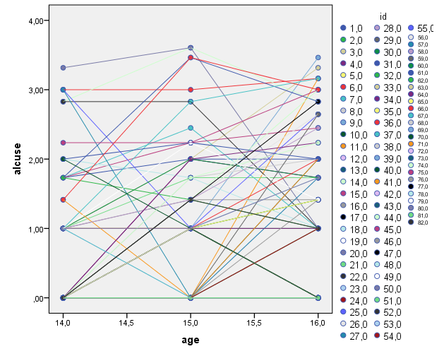
Longitudinal data
Plot of whole group
Remember the research question:
Do trajectories of adolescent alcohol use differ by parental alcoholism?
Different measurements from one adolescent are related:
dependency within observations!
Linear regression is no longer an option...

Slide 13

Analysis of longitudinal data
Using summary measures (1)
Solution:
Choose ONE suitable summary measure Y which reflects a relevant feature of the curve:
  mean over time
  maximum value
  time of reaching the maximum
  maximal velocity/increase
  ...
Now there is just one outcome variable (the summary measure Y)
per adolescent ⟶ independent observations ⟶ multiple regression analysis!
Advantages:
  simple and easy (can be done using standard techniques)
  provides nice summaries of the data
Disadvantages:
  inefficient use of the whole data
  not all types of research questions can be addressed

Slide 14
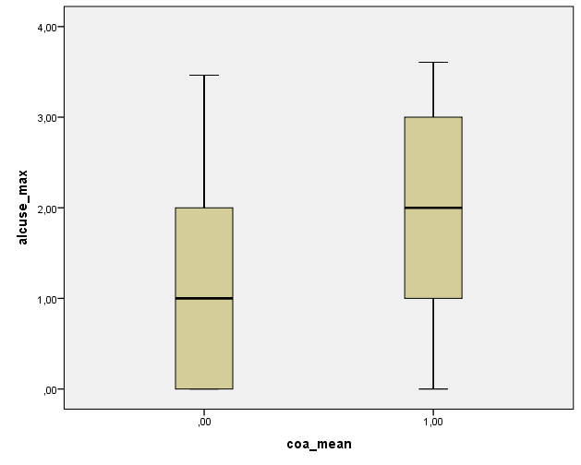
Analysis of longitudinal data
Using summary measures (2)
Example: for each adolescent we take the maximum value of alcohol use alcuse_max over the three years:
Higher median alcuse_max for COA=1 group than for COA=0 group
Different distributions of two groups
  alcuse_max much more skewed in COA=0 than in COA=1
Does COA affect maximum alcohol use?
  (Mann-Whitney test for independent groups)
coa
Let’s see if we can make better use of all our data!

Slide 15
Analysis of longitudinal data
Summarizing so far...
Investigating change over time requires longitudinal data: multiple (ideally ≥ 3 waves) measurements over time per subject
Using summary measures is an option, but means throwing away information and is limited in answering research questions on change/trajectories
Linear regression model is not applicable, due to violations to the model assumptions (dependency in longitudinal data!)
… so time to tackle the clustering!

Slide 16
Analysis of longitudinal data
Introducing the multilevel model for change
We want to expand the linear regression model with several random effects:
mixed effects or multilevel model
“random effects & fixed effects” “individual level & group level”
This model answers:
within-person questions (intra-individual)
How does each person’s alcohol use change over time?
(trajectories)
between-person questions (inter-individual)
How does having an alcoholic parent affect these trajectories?
Level 1
multilevel model
(linked pair of statistical models)
Level 2

Slide 17
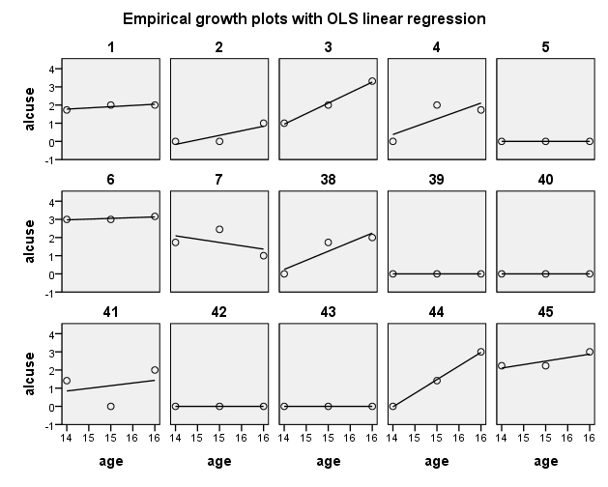
Introducing the multilevel model
Exploring individual’s growth plots
to come up with a level-1 submodel
Plotting regression models for a group of subjects i to help answer the question:
What population individual growth model might have generated these sample data?
elevation? tilt?
(non-)linear?
Note: “simpler is better”
Here we choose a linear model

Slide 18

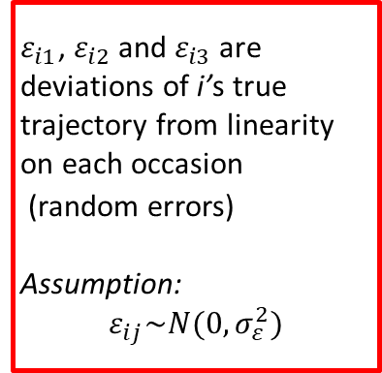
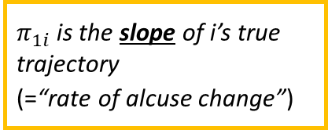
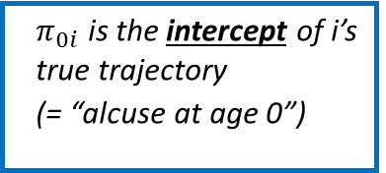


Introducing the multilevel model
The level-1 submodel for individual change
Assumption: in the population, alcuse_{ij} is a linear function of child i’s age on occasion j
$ε_{i1}$, $ε_{i2}$and $ε_{i3}$are deviations of i’s true trajectory from linearity on each occasion
(random errors)
Assumption:
$$ε_{ij}\sim N(0,σ_{ε}^{2})$$
Individual i’s (hypothesized) true trajectory
alcuse
4
$ε_{i3}$
3
  $π_{0i}$ is the intercept of i’s true trajectory
  (= “alcuse at age 0”)
$$ε_{i1}$$
2
$$ε_{i2}$$
$π_{1i}$is the slope of i’s true trajectory
(=“rate of alcuse change”)
1
i =1, ...,82 (children)
j=1, 2, 3 (measurements)
0
14
15
16
age

Slide 19
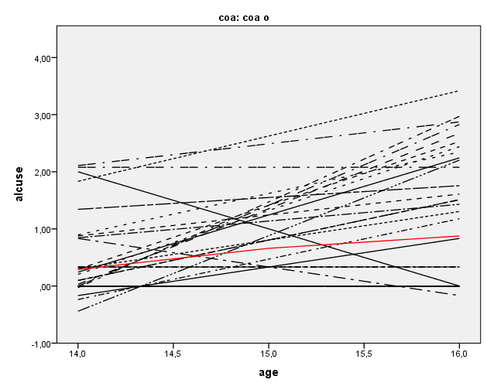
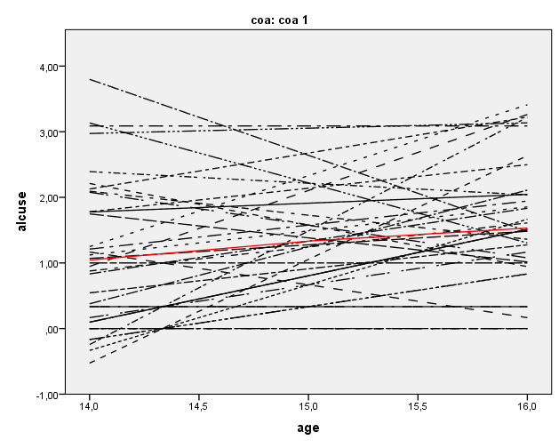
Introducing the multilevel model
What do we want from our level-2 submodels?
Demands:
1. We need two level-2 submodels :
  one for intercept π_{0i}
  one for slope π_{1i}
These models should:
2. specify the relationship between π_{0i} and π₁ and the covariate of interest (COA)
3. allow adolescents with common COA-values to have different individual trajectories
COA=0
COA=1
alcuse
alcuse
age
age

Slide 20
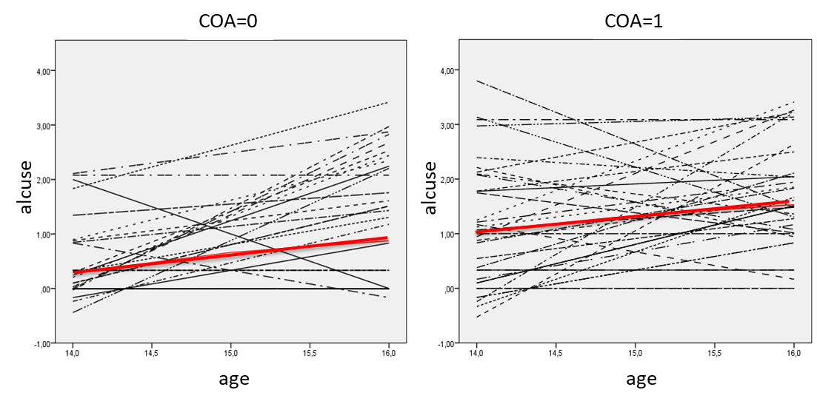
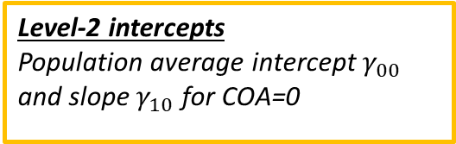


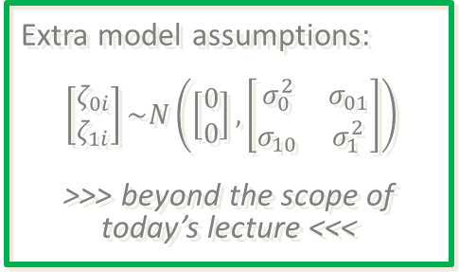

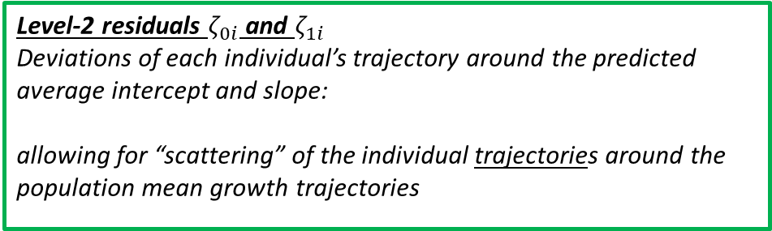

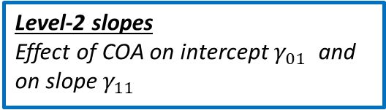
Introducing the multilevel model
The level-2 submodels for inter-individual differences in change
Level-2 intercepts
Population average intercept $γ_{00}$ and slope $γ_{10}$ for COA=0
Level-2 slopes
Effect of COA on intercept $γ_{01}$ and on slope $γ_{11}$
$$π_{0i}=γ_{00}+γ_{01}COA_{i}$$
$$+ζ_{0i}$$
(random intercept)
$$π_{1i}=γ_{10}+γ_{11}COA_{i}$$
$$+ζ_{1i}$$
(random slope)
Level-2 residuals $ζ_{0i}$ and $ζ_{1i}$
Deviations of each individual’s trajectory around the predicted average intercept and slope:
allowing for “scattering” of the individual trajectories around the population mean growth trajectories
Extra model assumptions:
$\left[\begin{matrix}ζ_{0i} \\ ζ_{1i}\end{matrix}\right]\sim N\left(\left[\begin{matrix}0 \\ 0\end{matrix}\right],\left[\begin{matrix}σ_{0}^{2} & σ_{01} \\ σ_{10} & σ_{1}^{2}\end{matrix}\right]\right)$
>>> beyond the scope of today’s lecture <<<

Slide 21

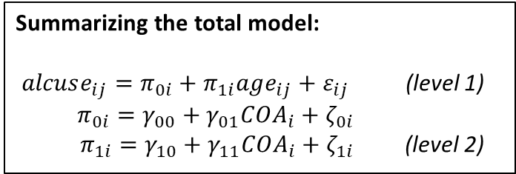

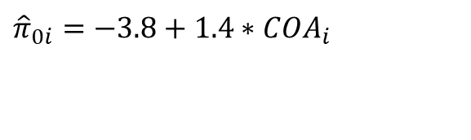
Introducing the multilevel model
Estimating the fixed effects ($γ_{00} γ_{01}$, $γ_{10}$, $γ_{11}$)
Summarizing the total model:
$alcuse_{ij}=π_{0i}+π_{1i}age_{ij}+ε_{ij}$ (level 1)
$π_{0i}=γ_{00}+γ_{01}COA_{i}+$ $ζ_{0i}$
$π_{1i}=γ_{10}+γ_{11}COA_{i}+ζ_{1i}$ (level 2)
For the average COA-adolescent,
it is 1.4 higher (at age 0)
(difference in initial alcuse between COA-groups)
Initial alcuse (“alcuse at age 0”) for the average non-COA adolescent is -3.8
Fitted model for intercept
$${\hat{π}}_{0i}=−3.8+1.4∗COA_{i}$$
Fitted model for slope
$${\hat{π}}_{1i}=0.29−0.05∗COA_{i}$$
For the average COA-adolescent, it is 0.05 lower (non significant)
(difference in slope between COA-groups)
Annual rate of change for the average non-COA adolescent is 0.29

Slide 22
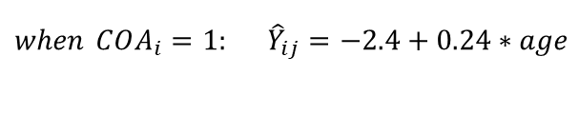

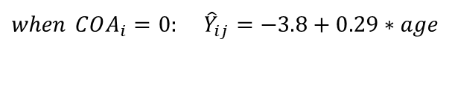

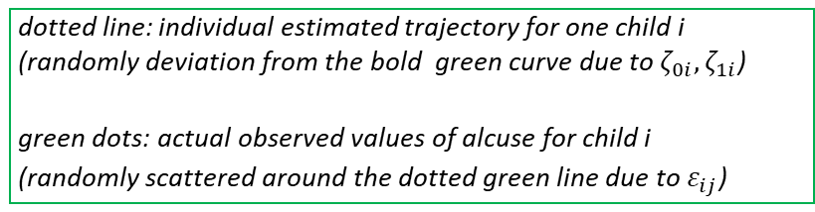




Introducing the multilevel model
Visualizing the results: constructing fitted growth trajectories
For COA=0 we get:
For COA=1 we get:
$${\hat{π}}_{0i}=−3.8+1.4∗COA_{i}$$
$${\hat{π}}_{0i}=−3.8$$
$${\hat{π}}_{0i}=−3.8+1.4∗1=−2.4$$
$${\hat{π}}_{1i}=0.29−0.05∗COA_{i}$$
$${\hat{π}}_{1i}=0.29$$
$${\hat{π}}_{1i}=0.29−0.05∗1=0.24$$
Substitute the estimates into the level-1 model
to get fitted growth trajectories:
2
ALCUSE
COA
= 1
$$\begin{matrix} \\ when COA_{i}=1: {\hat{Y}}_{ij}=−2.4+0.24∗age\end{matrix}$$
1
$$\begin{matrix}when COA_{i}=0: {\hat{Y}}_{ij}=−3.8+0.29∗age \\ \end{matrix}$$
COA
= 0
dotted line: individual estimated trajectory for one child i (randomly deviation from the bold green curve due to $ζ_{0i},ζ_{1i}$)
green dots: actual observed values of alcuse for child i
(randomly scattered around the dotted green line due to $ε_{ij}$)
0
13
14
15
16
17
AGE

Slide 23
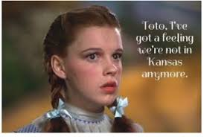
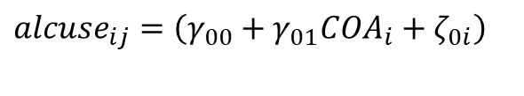
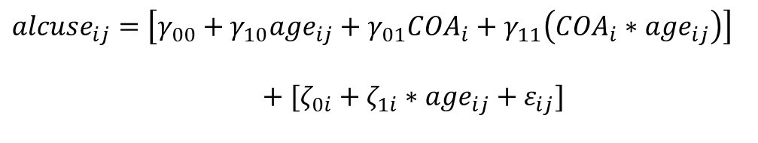
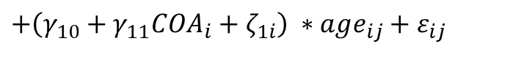



The multilevel model
Combining the levels: rewriting the model
$$π_{0i}=γ_{00}+γ_{01}COA_{i}+ζ_{0i}$$
$$π_{1i}=γ_{10}+γ_{11}COA_{i}+ζ_{1i}$$
…Toto, I’ve got a feeling this is not regular linear regression anymore…
$${alcuse}_{ij}=π_{0i}+π_{1i}age_{ij}+ε_{ij}$$
$${alcuse}_{ij}=\left(γ_{00}+γ_{01}COA_{i}+ζ_{0i}\right)$$
$$+\left(γ_{10}+γ_{11}COA_{i}+ζ_{1i}\right)\text{ ∗ }age_{ij}+ε_{ij}$$
Same
model, now in one equation!
$${alcuse}_{ij}=\left[γ_{00}+γ_{10}age_{ij}+γ_{01}COA_{i}+γ_{11}\left(COA_{i}∗age_{ij}\right)\right]$$
$$+[ζ_{0i}+ζ_{1i}∗age_{ij}+ε_{ij}]$$
Complex residuals!
They change with age now and are autocorrelated (dependent)
(… very much unlike linear regression...)
Fixed part of the model shows clearly how alcuse depends on:
  covariates age and COA
  interaction term, COA∗ age, allowing the effect of age to differ for levels of COA
  JUST LIKE LINEAR REGRESSION!

Slide 24
Some final remarks on mixed effects/multilevel models
A lot more can to be considered, such as:
- unbalanced/missing data
- time-dependent covariates
- different correlation structures/model designs/estimation methods
- models for different types of outcome variables
    …
Mixed effects models are complex and applying them correctly is a challenge
… so why bother?
  to make efficient use of all data (even for subjects with missing measurements!)
  to properly account for correlation structures within your data (and avoiding estimation bias in your confidence intervals/standard errors)
  in general: estimating fewer parameters, reducing number of tests, …

Slide 25
Books, courses and an e-module
Snijders & Bosker: Multilevel Analysis. An introduction to basic and advanced multilevel modeling (London, 1999, 2011)
Verbeke & Molenberghs: Linear mixed models for longitudinal data (New York, 2000)
Singer & Willet: Applied longitudinal data analysis. Modeling change and event occurence (Oxford, 2003)
Pinheiro & Bates: Mixed effects models in S and S-plus (New York, 2000)
Courses offered from our unit:
Generalized and Linear Mixed Effects Models (SPSS, R)
Applied Longitudinal Data Analysis (SPSS, R)
Beyond Regression (CPE-students)

Slide 26
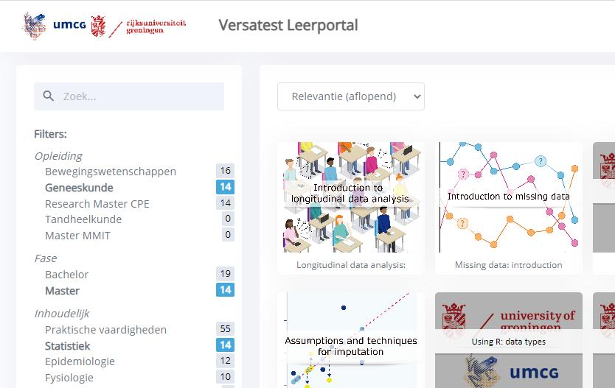
https://edubox.nl/portal.aspx#opleiding=opleiding_gnk

Slide 27
Next Help! Statistics!-lunchtime lecture
Hylke Donker
Machine learning
April 4th, 2023
Room 16

