Slide 1
Help! Statistics!
Gamification and Scientification
The use of game playing in science and education, and the use of science in games and riddles
Hans Burgerhof
j.g.m.burgerhof@umcg.nl
September 10 2019

Slide 2
Help! Statistics! Lunchtime Lectures
What? frequently used statistical methods and questions in a manageable timeframe for all researchers at the UMCG
No knowledge of advanced statistics is required.
When? Lectures take place every 2nd Tuesday of the month, 12.00-13.00 hrs.
Who? Unit for Medical Statistics and Decision Making
do not
When? | Where? | What? | Who?
Nov 12 2019 | Room 16 | ? | D. Postmus
Feb 4 2020 | Room 16 | ? | S. la Bastide
April 14 2020 | Room 16
June 9 2020 | Room 16
Slides can be downloaded from http://www.rug.nl/research/epidemiology/download-area

Slide 3
Program Today
Gamification and some examples
A riddle
Scientification
Bridge (a crash course in this noble sport)
Using probability theory during a game of bridge
Using math to solve the riddle

Slide 4
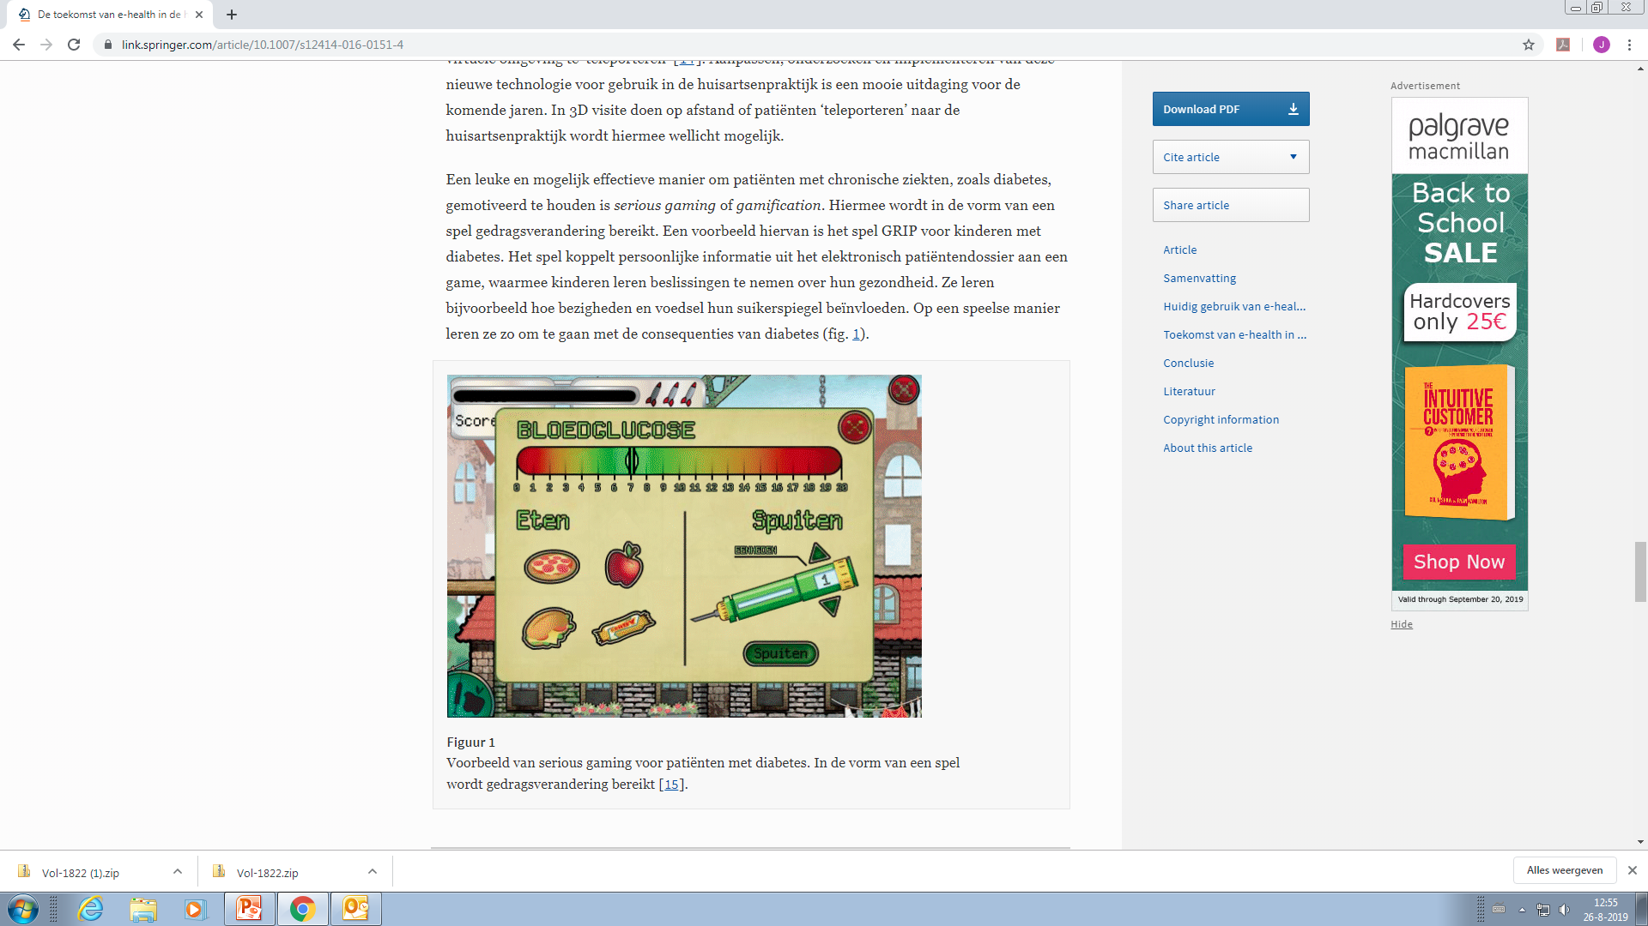
What is gamification?
Gamification is the application of game-design elements and game principles in non-game contexts (Wikipedia)
Example in medicine:
“game” for children with diabetes:
how much insuline to use, based on the food

Slide 5


Gamification in education
Flying simulator
Use of avatars

Slide 6
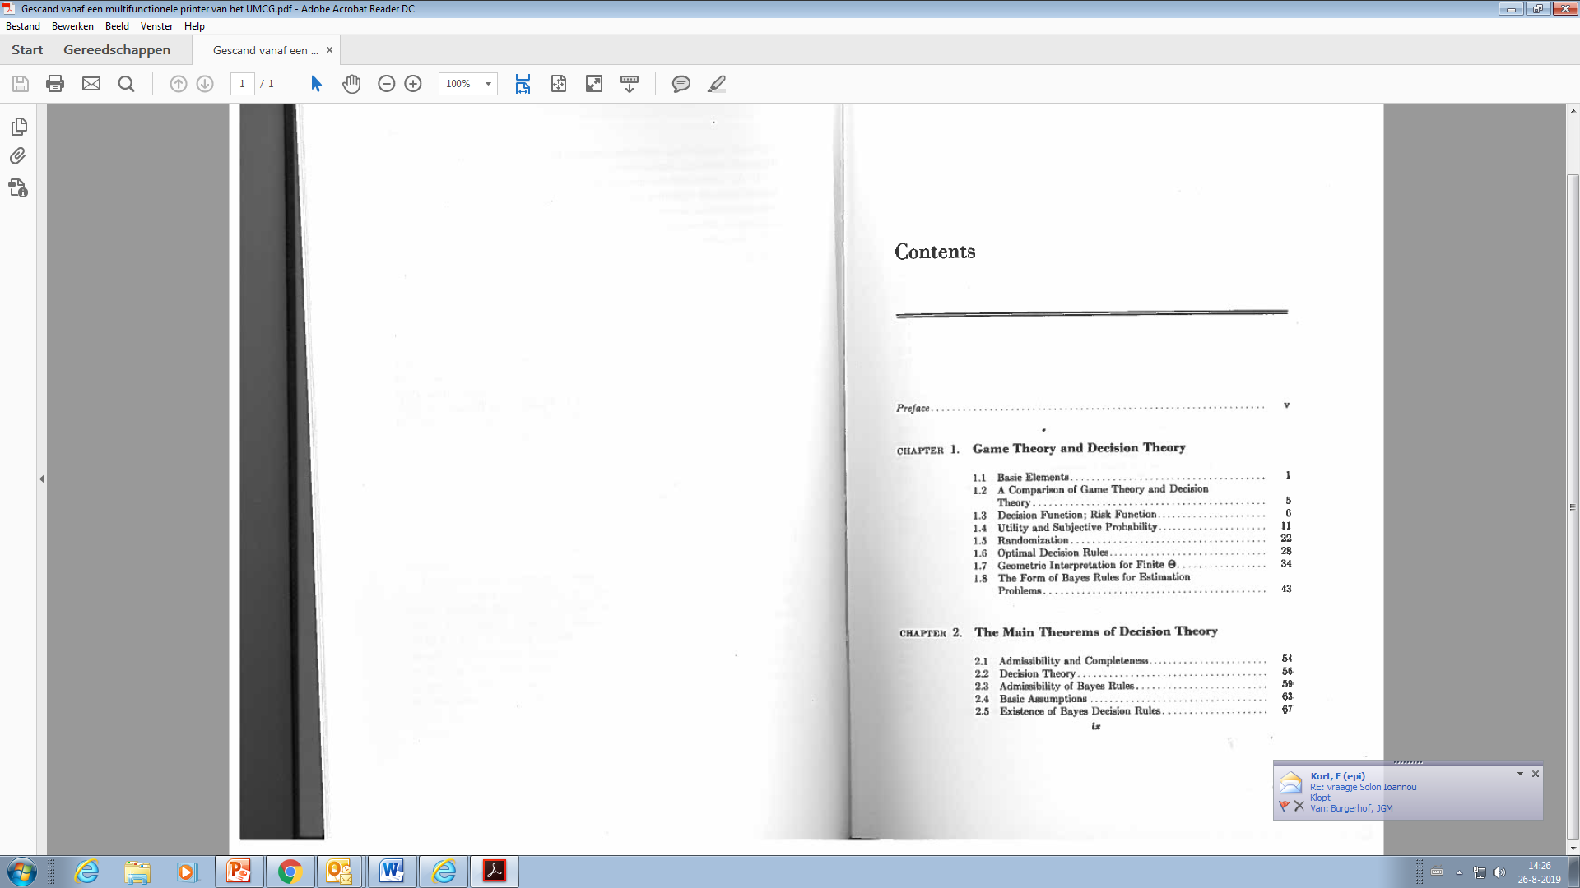
Gamification in statistics
Mathematical statistics
A decision theoretic approach
Thomas S. Ferguson
(1967)
John von Neumann
(1903 – 1957)

Slide 7
Gaming in hypothesis testing
You play against Nature.
Nature can take two or more states (generally null hypothesis and alternative hypothesis). We do not know nature’s choice.
The statistician can choose from a set of actions (generally rejecting or not rejecting the null hypothesis).
There is a loss function, taking values depending on the combinations of states and actions.
What is your best action or decision?

Slide 8
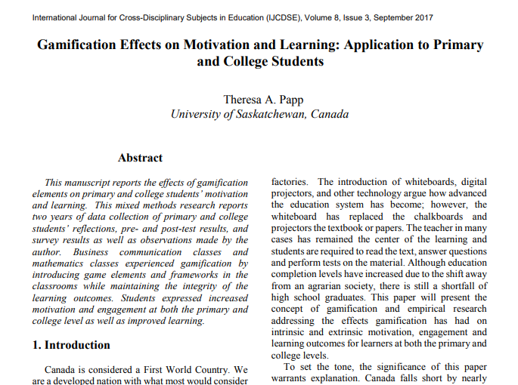

Slide 9
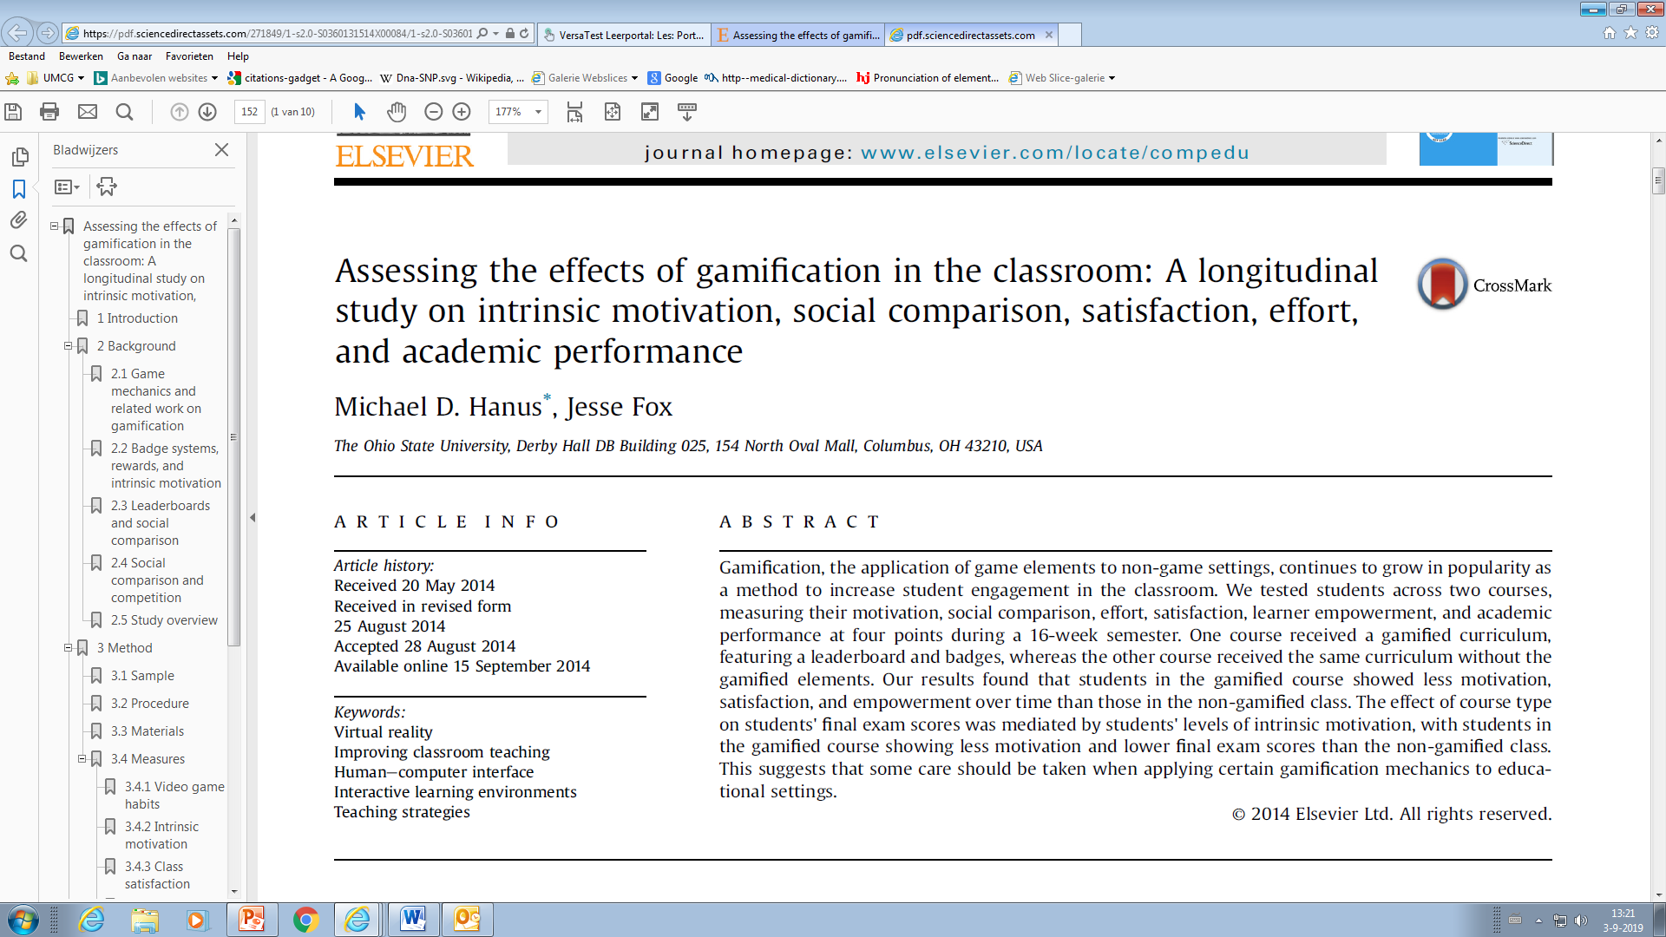
Computers & Education, 80, 2015 (152 – 161)

Slide 10
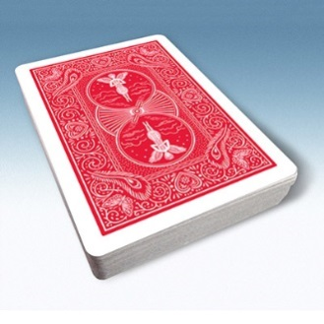
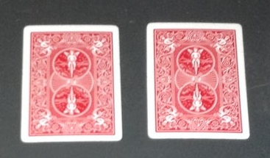
A riddle
52 playing cards
13 cards are turned “face up”
The deck is randomly shuffled, you are blinded.
Make two stacks, containing an equal number of “face up” cards
Solution will be given at the end of this lecture

Slide 11
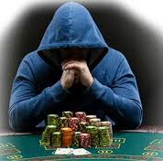
Scientification
According to the Urban Dictionary: the act of turning a non-scientific entity into an enhanced scientific property.
During this presentation “science” will be represented by math and probability theory.
There are a lot of games, in which probability theory can play a useful role: blackjack, poker, role playing games like Dungeons and Dragons, …
Most probability theory was developed based on problems from games of dice and cards (involving money …)

Slide 12
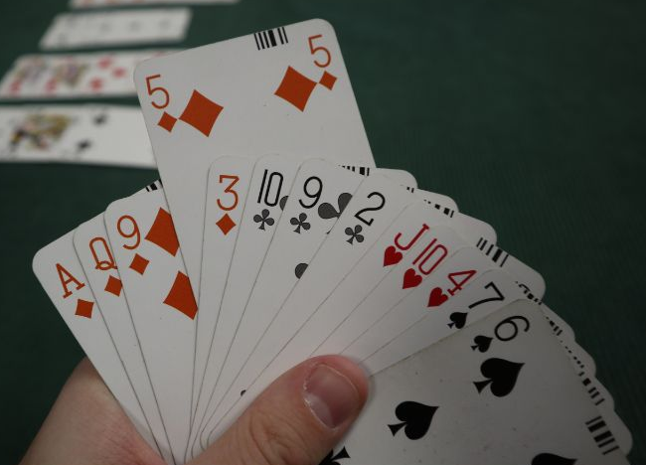

Bridge
Bridge is played by four players.
A deck of 52 cards is shuffled and randomly divided over the four players.
A “hand” of 13 cards
There are $\left(\begin{aligned}52 \\ 13\end{aligned}\right)$ = $\frac{52!}{39!∙13!}>$635 billion possible hands.
You can play bridge for a lifetime, without having the same hand twice!

Slide 13
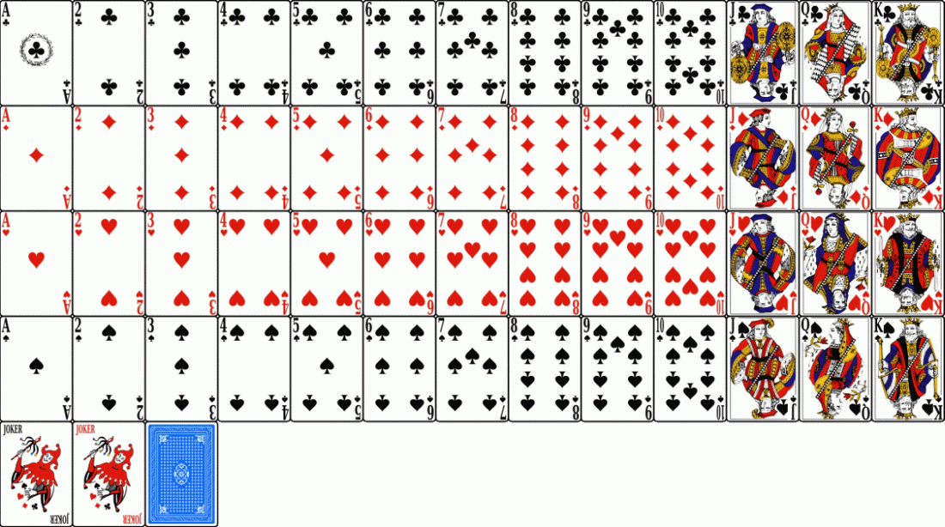
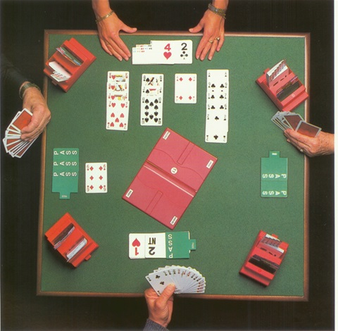
Bridge: a mind sport
N
W
E
Four “suits”: clubs, diamonds, hearts and spades
Bridge has two phases: bidding and playing
S

Slide 14
Goal of the game
One player puts a card on the table (for example 6 of diamonds).
The others have to “follow”. (If you cannot follow, because you do not have any cards of diamonds, you can put in any other card).
The highest card (in diamonds) wins the “trick”, except if one (or more) of the players plays a trump.
There are 13 “tricks” in total.
Goal: to get as many tricks as possible.

Slide 15
Bidding: the opening bid
Count your “high card points”
  Ace: 4 points (highest card)
  King: 3 points
  Queen: 2 points
  Jack: 1 point
  (you can add additional point for long suits and/or renonce (zero)/singleton (one card only) in suits)
You can open the bidding if you have at least 12 points
There is a lot to tell about bidding systems. In the Neherlands, most systems are “natural”, based on ACOL.
South hand:
♠ KQ4
♥ AJ732
♦ Q5
♣ J92
Total bidding:
N E S W
1 ♥ pass
3 ♥ pass 4 ♥ pass
pass pass
South becomes the “leader”.
South’s partner (North) becomes the “dummy”.
South has to get at least 6 + 4 = 10 tricks

Slide 16
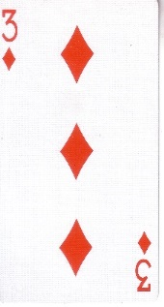
Playing
The player on the left hand side of the leader starts (puts the first card on the table)
If the first card is on the table, the dummy puts all his / her cards on the table
What strategy should the leader follow to make at least 10 tricks?
North hand (dummy):
♠ A975
♥ K1094
♦ 9742
♣ A5 (open)
Or: what strategy has the highest probability to make at least 10 tricks?
South hand (leader):
♠ KQ4
♥ AJ732
♦ Q5
♣ J92 (not open)

Slide 17
Playing
Count the number of tricks you will probably lose
Two in diamonds, one in clubs. So you cannot afford to lose a trick in trump (hearts) nor in spades.
North hand (dummy):
♠ A975
♥ K1094
♦ 9742
♣ A5 (open)
You will win three tricks in spades, and one in clubs. The third trick in clubs can be trumped by the dummy.
If all trump cards of the leader will win their tricks, the leader will win 4 + 1 + 5 = 10 tricks.
(If you are lucky, both East and West possess three cards of spades and you can drop a card of diamonds on the thirteenth card of spades before the opponents collect their high cards in diamonds).
South hand (leader):
♠ KQ4
♥ AJ732
♦ Q5
♣ J92 (not open)

Slide 18
Playing options
Two main options for playing are “drawing” and “finesse”.
- “Drawing” means: play your highest cards (Ace, King, Queen) and see what cards your opponents play
- “finesse” means: playing towards the lowest card of a “forc”
Play a card of South (for example ♠2) towards the Queen. You will have two tricks in Spades if west possesses the King
Example of finesse:
North
♠AQ76
West ? East ?
South
♠9432

Slide 19
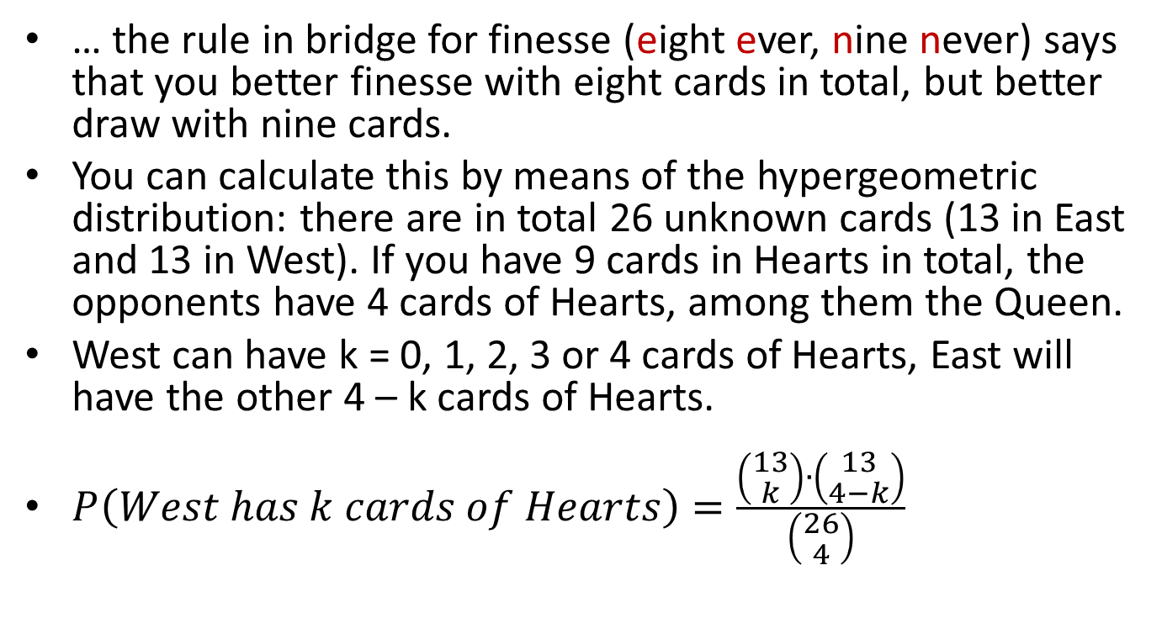
If you have Ace, King and Jack…
… the rule in bridge for finesse (eight ever, nine never) says that you better finesse with eight cards in total, but better draw with nine cards.
You can calculate this by means of the hypergeometric distribution: there are in total 26 unknown cards (13 in East and 13 in West). If you have 9 cards in Hearts in total, the opponents have 4 cards of Hearts, among them the Queen.
West can have k = 0, 1, 2, 3 or 4 cards of Hearts, East will have the other 4 – k cards of Hearts.
$P\left(West has k cards of Hearts\right)=\frac{\left(\begin{aligned}13 \\ k\end{aligned}\right)∙\left(\begin{aligned}13 \\ 4−k\end{aligned}\right)}{\left(\begin{aligned}26 \\ 4\end{aligned}\right)}$

Slide 20
The (symmetric) distribution
P(west has 0 Hearts) ≈ 0.048
P(west has 1 Hearts) ≈ 0.249
P(west has 2 Hearts) ≈ 0.407
P(west has 3 Hearts) ≈ 0.249
P(west has 4 Hearts) ≈ 0.048
Finesse East
Finesse East
Draw
Finesse West
Finesse West
North hand (dummy):
♠ A975
♥ K1094
♦ 9742
♣ A5 (open)
Conclusion: if we have no information about the distribution, drawing has a higher probability of success
South hand (leader):
♠ KQ4
♥ AJ732
♦ Q5
♣ J92 (not open)

Slide 21
What if you have more information?
Bidding:
N E S W
1 ♥ 4 ♣
4 ♥ pass pass pass
West promisses a long suit in Clubs, probably 7 or more cards in Clubs

Slide 22
What do we know now?
North hand (dummy):
♠ A975
♥ K1094
♦ 9732
♣ A5
West hand:
♠ ?
♥ ?
♦ ?
♣ xxxxxxx
East hand:
♠ ?
♥ ?
♦ ?
♣ x
Zuid hand (leader):
♠ KQ4
♥ AJ732
♦ Q5
♣ J92

Slide 23
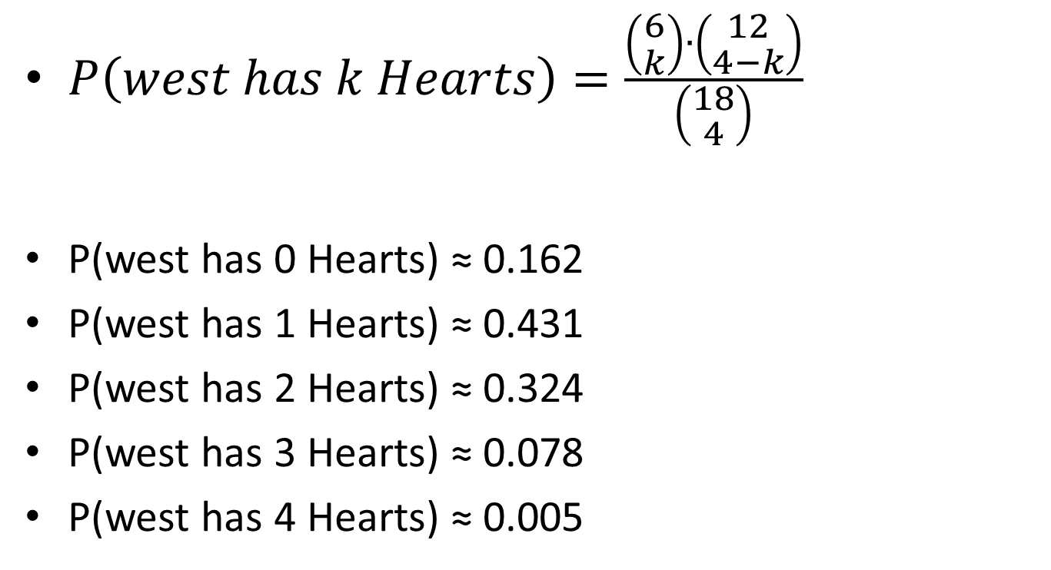
The (non-symmetric) distribution
$P\left(west has k Hearts\right)=\frac{\left(\begin{aligned}6 \\ k\end{aligned}\right)∙\left(\begin{aligned}12 \\ 4−k\end{aligned}\right)}{\left(\begin{aligned}18 \\ 4\end{aligned}\right)}$
P(west has 0 Hearts) ≈ 0.162
P(west has 1 Hearts) ≈ 0.431
P(west has 2 Hearts) ≈ 0.324
P(west has 3 Hearts) ≈ 0.078
P(west has 4 Hearts) ≈ 0.005
Finesse East
Finesse East
Draw
Finesse West
Finesse West
Conclusion: Finesse East is the best strategy!

Slide 24
Best play
Start by playing 4 of Hearts towards the Jack?
Start by drawing the King of Hearts, then finesse East
North hand (dummy):
♠ A975
♥ K1094
♦ 9732
♣ A5
West hand:
♠ ?
♥ ?
♦ ?
♣ xxxxxxx
East hand:
♠ ?
♥ ?
♦ ?
♣ x
South hand (leader):
♠ KQ4
♥ AJ732
♦ Q5
♣ J92
This will fail if west has the Queen of Hearts

Slide 25
Back to the riddle
Make two stacks, containing an equal number of “facing up” cards
Who has a solution?
stack 1 stack 2 Total
number of cards: a 52 – a 52 (1 ≤ a ≤ 51) (a is fixed)
Facing up: x 13 – x 13 (0 ≤ x ≤ min(a,13))
(x is random)
Facing down: a – x 39 – a + x 39

Slide 26
Solution
Take a = 13 (stack 1 will contain x cards facing up and 13- x facing down)
Automatically, stack 2 contains 13 – x facing up
Put stack 1 upside down
Both stacks will contain 13 – x cards facing up, whatever the value of x
Check

