Slide 1



Power analysis and sample size determination
Dr Douwe Postmus (d.postmus@umcg.nl)
13 March 2018

Slide 2
Example
The antitumor activity of a new cancer treatment is studied in a sample of 20 patients
Each patient has a probability of p of responding to the treatment
Let X denote the total number of responders (successes) in the sample
X is binomially distributed with number of trials n = 20 and success probability p

Slide 3
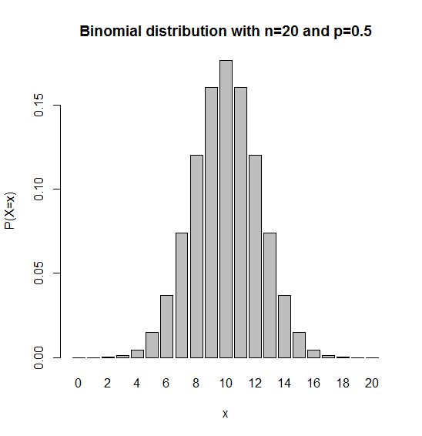
Binomial distribution (n=20)

Slide 4
Does the drug have sufficient activity?
The treatment is considered to have insufficient activity if the response rate is 30% or lower
A response rate of 50% or higher is considered to be a clinically relevant response rate
Statistical hypotheses:
Null hypothesis (H₀): p = 0.3
Alternative hypothesis (H₁): p = 0.5

Slide 5
Type I and type II errors
 |  | Decision
 |  | H0 true | H1 true
Reality | H0 true | OK | Type I error, probability: α
 | H1 true | Type II error, probability: β | OK power probability: 1 - β

Slide 6
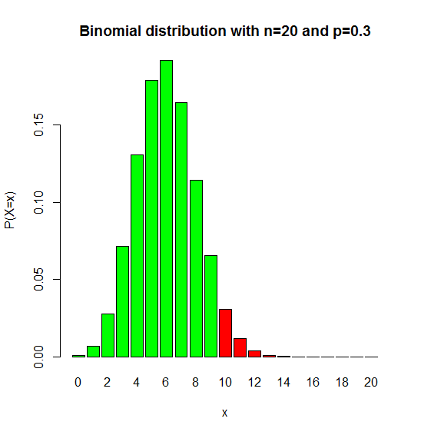
Type I error rate
The probability of making a type I error is controlled by the researcher (usually α=0.05)
Here, we decide to reject H₀ when the total number of responders X is equal to or larger than 10
Type I error rate: P(X ≥10 | p=0.3) = 0.048

Slide 7
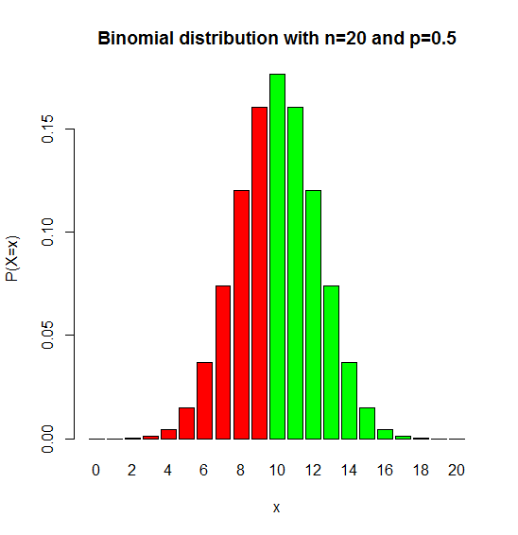
Type II error rate
Suppose that H₁ is true
We make a type II error if we accept H₀, which occurs when X < 10
Type II error rate: P(X<10 | p=0.5) = 0.41
Power: P(X ≥10 | p=0.5) = 0.59

Slide 8
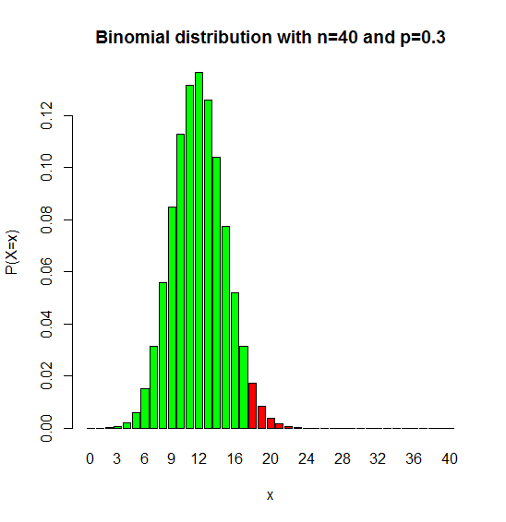
What happens if n increases?
Type I error rate:
P(X ≥10 | p=0.3) = 0.048
Type I error rate:
P(X ≥18 | p=0.3) = 0.032

Slide 9
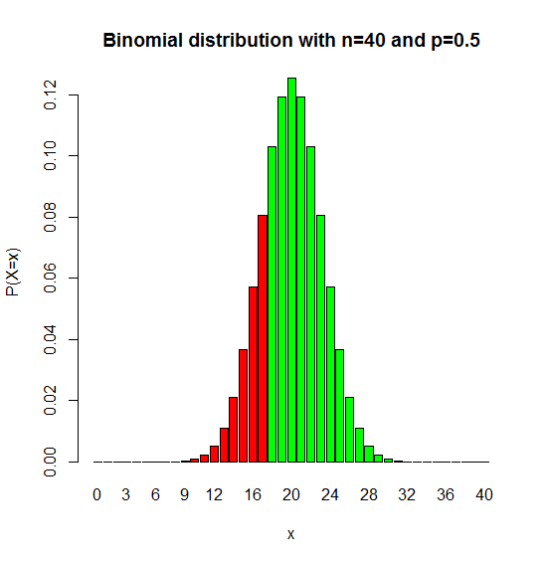
What happens if n increases?
Type II error rate:
P(X <10 | p=0.5) = 0.41
Type II error rate:
P(X <18 | p=0.5) = 0.21

Slide 10
Power as a function of n

Slide 11
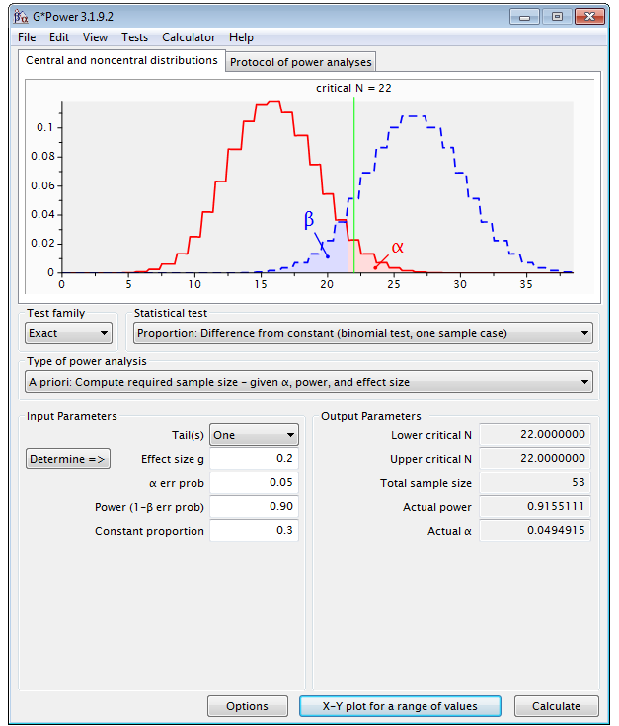
Sample size determination

Slide 12
Determinants of power
Sample size: the larger the sample size, the greater the power
Type I error rate (α): The larger the type I error rate, the more powerful the test
The effect size: the larger the difference between p₀ and p₁, the greater the power

Slide 13
Calculation of power
Use the distribution of the test statistic under the null hypothesis to define a rejection region with the desired type I error rate
Use the distribution of the test statistic under the alternative hypothesis to determine the probability that the value of the test statistic falls in the rejection region. This is the power of the test

Slide 14
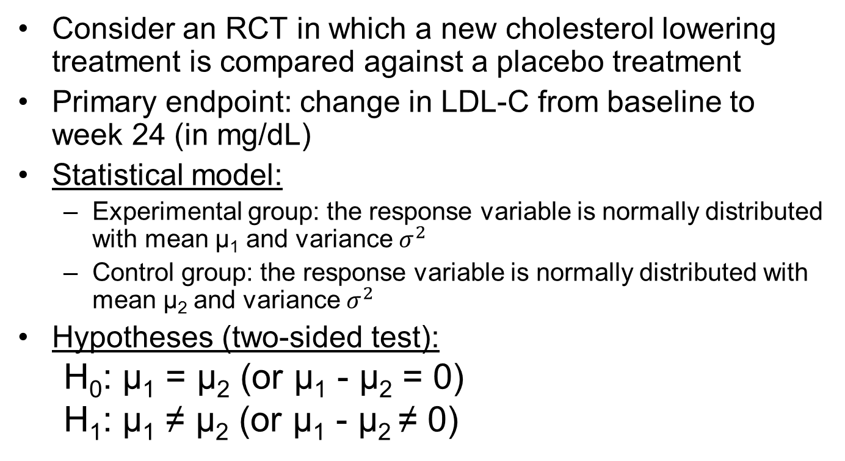
Example: cholesterol lowering treatment
Consider an RCT in which a new cholesterol lowering treatment is compared against a placebo treatment
Primary endpoint: change in LDL-C from baseline to week 24 (in mg/dL)
Statistical model:
  Experimental group: the response variable is normally distributed with mean µ₁ and variance $σ^{2}$
  Control group: the response variable is normally distributed with mean µ₂ and variance $σ^{2}$
Hypotheses (two-sided test):
  H₀: µ₁ = µ₂ (or µ₁ - µ₂ = 0)
  H₁: µ₁ ≠ µ₂ (or µ₁ - µ₂ ≠ 0)

Slide 15
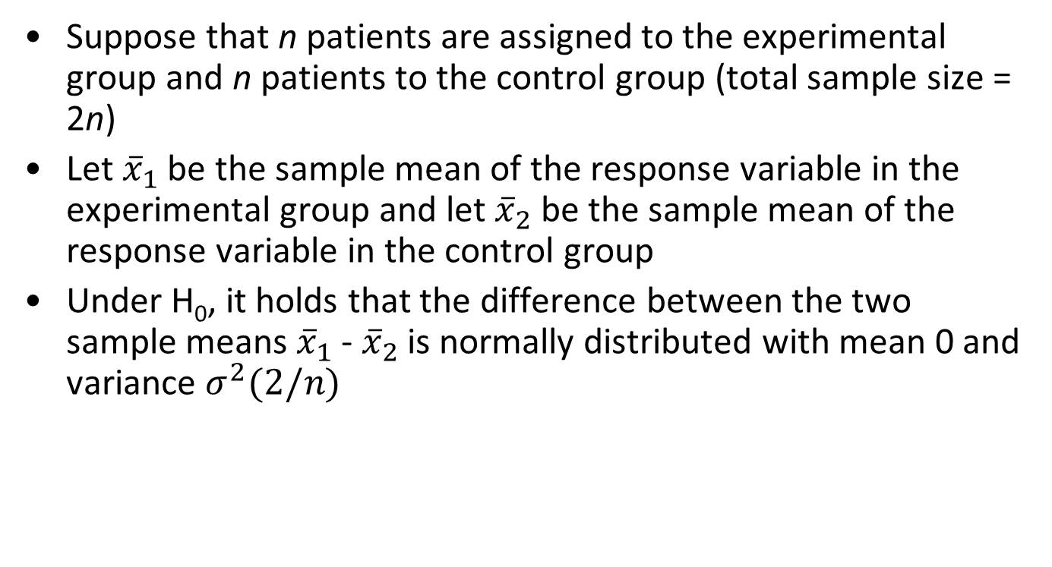
Independent samples t-test
Suppose that n patients are assigned to the experimental group and n patients to the control group (total sample size = 2n)
Let ${\overline{x}}_{1}$ be the sample mean of the response variable in the experimental group and let ${\overline{x}}_{2}$ be the sample mean of the response variable in the control group
Under H₀, it holds that the difference between the two sample means ${\overline{x}}_{1}$- ${\overline{x}}_{2}$is normally distributed with mean 0 and variance $σ^{2}(2/n)$

Slide 16
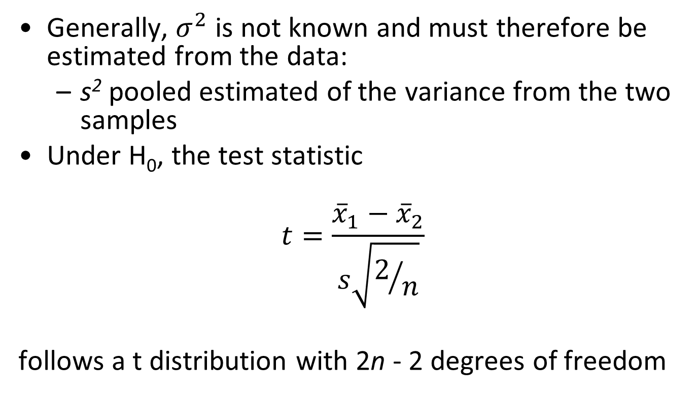
Independent samples t-test
Generally, $σ^{2}$ is not known and must therefore be estimated from the data:
  s² pooled estimated of the variance from the two samples
Under H₀, the test statistic
$$t=\frac{{\overline{x}}_{1}−{\overline{x}}_{2}}{s\sqrt{2/n}}$$
follows a t distribution with 2n - 2 degrees of freedom

Slide 17
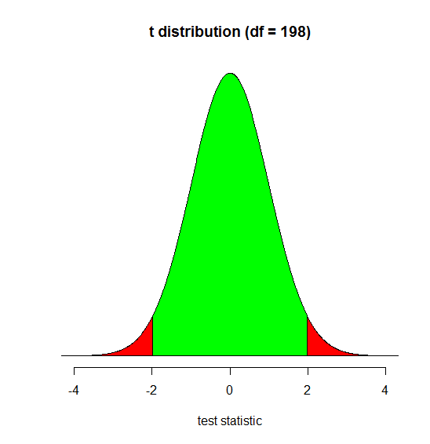
Rejection region when n=100 and α = 0.05

Slide 18
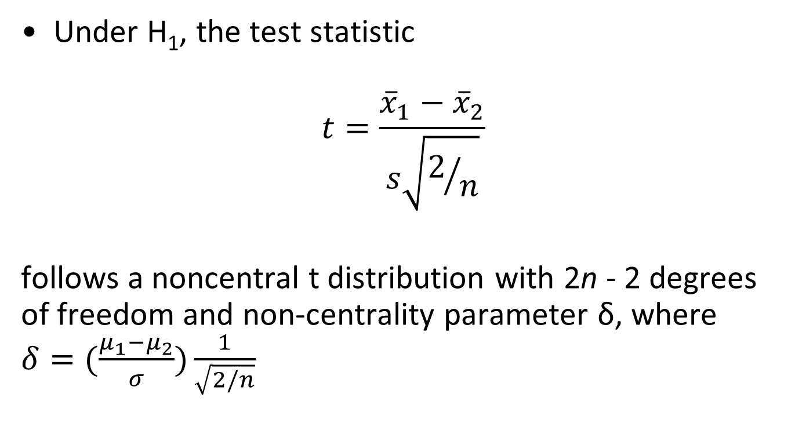
Distribution of t under H₁
Under H₁, the test statistic
$$t=\frac{{\overline{x}}_{1}−{\overline{x}}_{2}}{s\sqrt{2/n}}$$
follows a noncentral t distribution with 2n - 2 degrees of freedom and non-centrality parameter δ, where $δ=(\frac{μ_{1}−μ_{2}}{σ})\frac{1}{\sqrt{2/n}}$

Slide 19
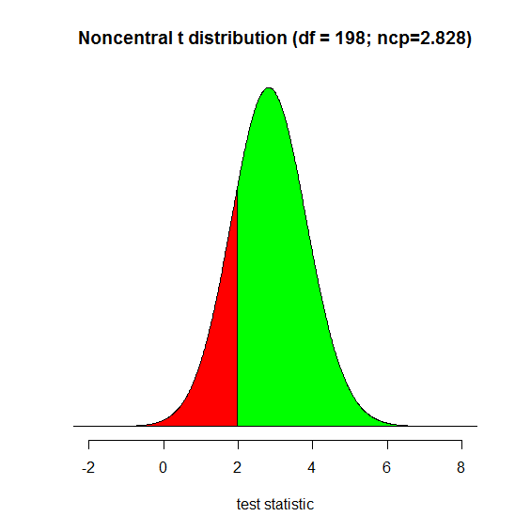

Power when n = 100 and $(\frac{μ_{1}−μ_{2}}{σ})$ = 0.4

Slide 20
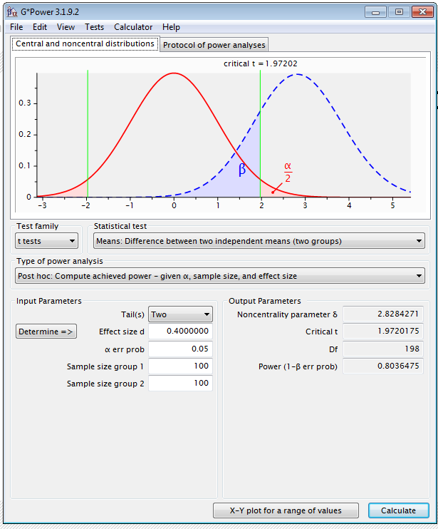
Power analysis using G*Power

Slide 21
Power as a function of n

Slide 22
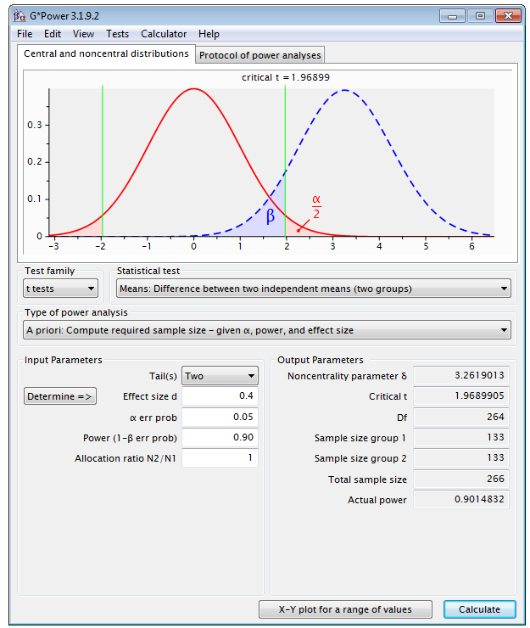
Sample size determination

Slide 23
Sample size determination
Select an appropriate test statistic
Determine the minimal clinically relevant effect size
Specify the desired type I error rate
Specify the desired type II error rate (power)
The mimimal required sample size is the smallest value of n for which the constraints on the type I and II error rates are satisfied

Slide 24
Next lectures
When? | Where? | What? | Who
April 10, 2018 | Room 16 | Conditional Survival | Y. Chen
May 8, 2018 | Room 16 | Resampling, the bootstrap method | H. Burgerhof
June 12, 2018 | Room 16 | Missing data | S. la Bastide

Slide 25
Questions?

