Slide 1
Multiple linear regression; some do’s and don’ts
Hans Burgerhof
Medical Statistics and Decision Making
Department of Epidemiology
UMCG

Slide 2
Help! Statistics! Lunchtime Lectures
What? frequently used statistical methods and questions in a manageable timeframe for all researchers at the UMCG
No knowledge of advanced statistics is required.
When? Lectures take place every 2nd Tuesday of the month, 12.00-13.00 hrs.
Who? Unit for Medical Statistics and Decision Making
When? | Where? | What? | Who?
Jun 13 2017 | Room 16 | Multiple Testing | C. Zu Eulenburg
Sep 12 2017 |  |  | H. Burgerhof
Oct 10 2017 |  |  | D. Postmus
Nov 14 2017 |  |  | S. La Bastide
Dec 12 2017 |  |  | C. Zu Eulenburg
Slides can be downloaded from http://www.rug.nl/research/epidemiology/download-area

Slide 3
Today’s Program
Introduction data and research question
Linear regression, what is it?
What are the underlying assumptions to make it a valid analysis?
Simple linear regression
Multiple linear regression
Interaction terms
Categorical explanatory variables
How to build a model?

Slide 4
The research question
W. Heesen: Isolated Systolic Hypertension, PhD thesis written 1998
Cross sectional data on 1596 individuals in the North of the Netherlands, all older than 57 years
For now:
  Which explanatory variables are related with the Systolic Blood Pressure, SBP?
  Can we predict (or explain) the SBP, using several explanatory variables?

Slide 5
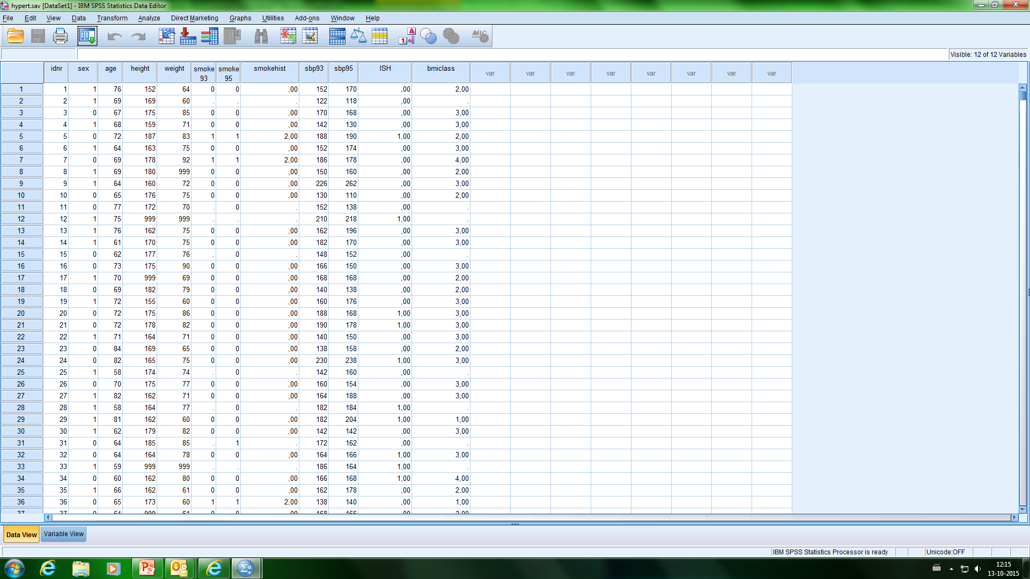
The data in SPSS

Slide 6
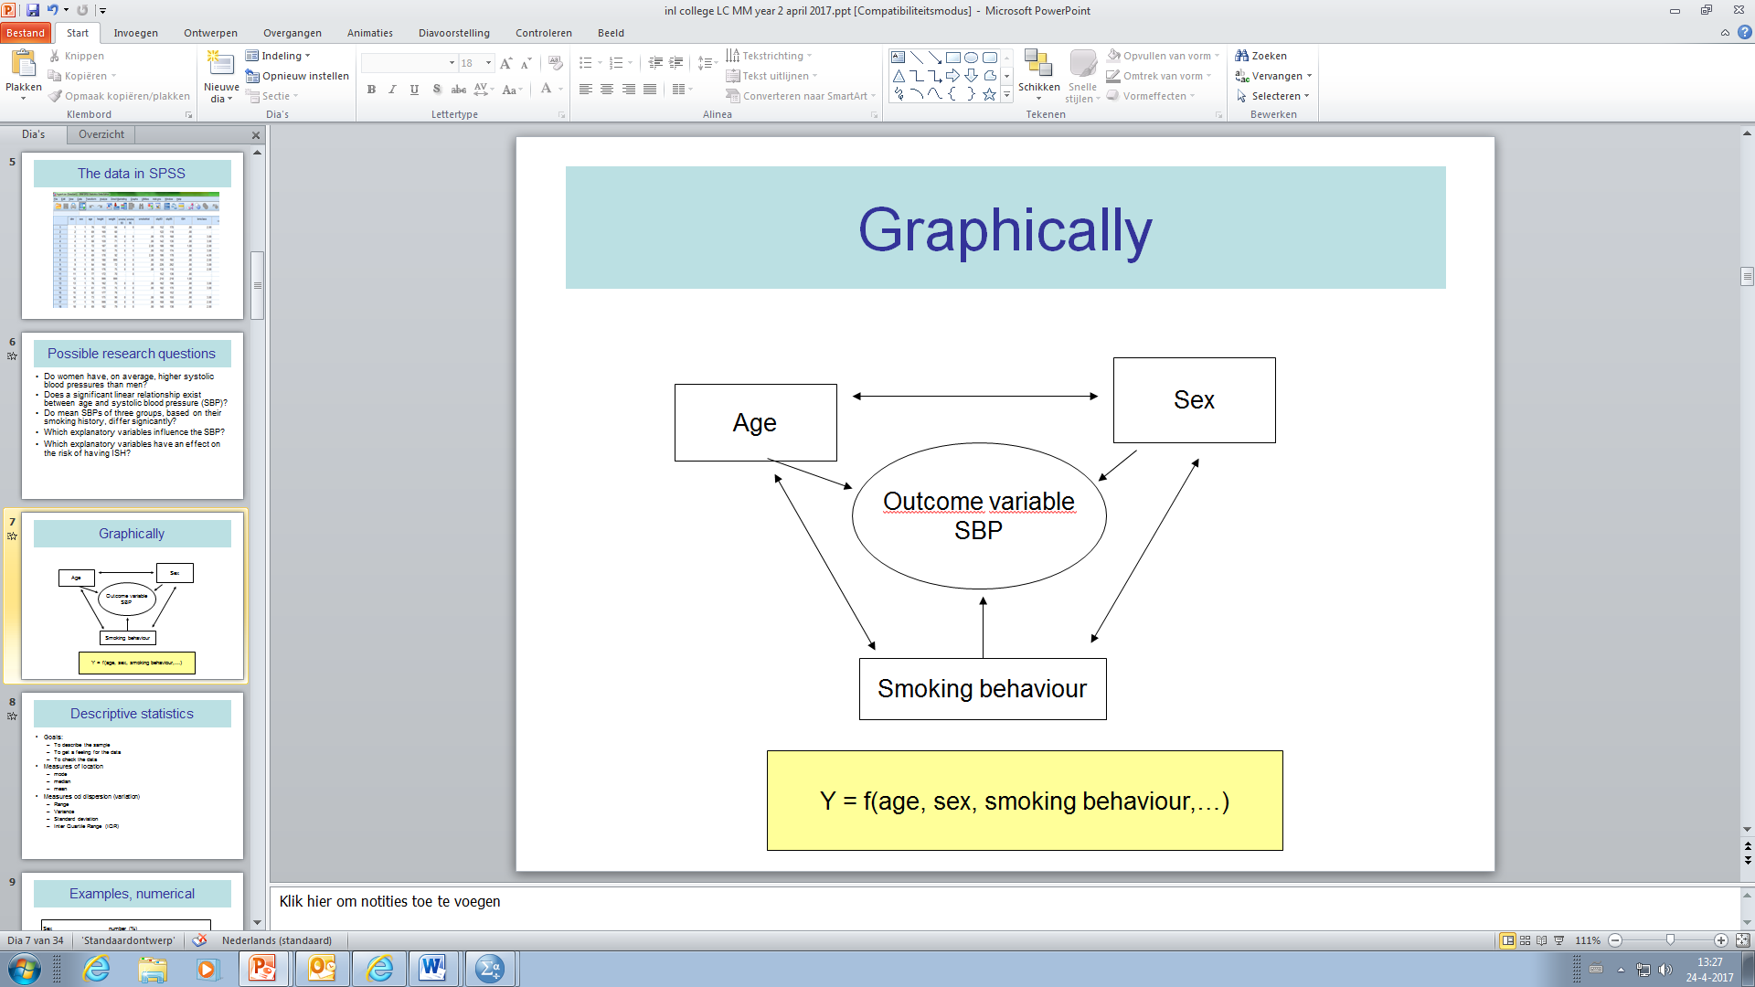
Multiple relationships

Slide 7
A simple linear regression model
In mathematics, the equation of a line is given by: y = a∙x + b
In statistics, we prefer the formula:
y = b_{o} + b₁∙x
  b₁ is the slope of the line
  b₀ is the intercept (or constant)
Y
a
1
b
0
X

Slide 8
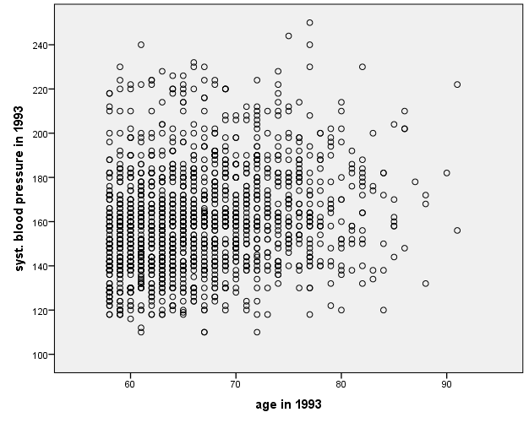
Simple linear regression of SBP on Age
(a continuous explanatory variable)

Slide 9
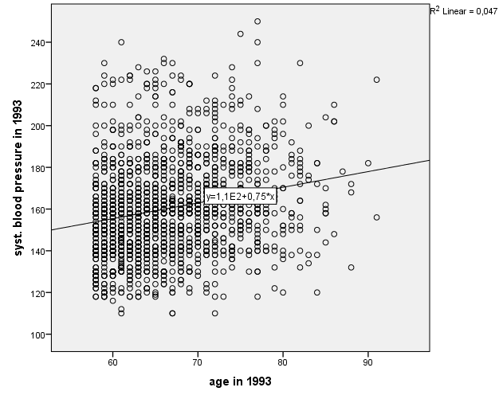
The best fitting line
(according to “least squares” criterion)
SBP = 110 + 0.75∙Age

Slide 10
Formally
We assume that in the population the relation between Y and X is:
e (the error or residual) is a random variable from a normal distribution with unknown variance. This variance of e is independent from the value of X (homoscedasticity)

Slide 11
The best fitting line
(according to “least squares” criterion)
SBP = 110 + 0.75∙Age
H₀: β₁ = 0

Slide 12
The explained part of the response variable Y (R²)
Model Summary
Model | R | R Square | Adjusted R Square | Std. Error of the Estimate
1 | ,216ª | ,047 | ,046 | 22,481
a. Predictors: (Constant), age in 1993
4.7% of the variation in Blood Pressures can be explained by the variation in Ages.
The R² gives you information about the fit of the model.
The higher the R², the better the fit.

Slide 13
Assumptions of linear regression
The outcome variable Y is a continuous variable
Independent observations
Linear relation (instead of e.g. exponential) between Y and X
The residuals come from a normal distribution
The variability of the residuals is the same for each value of X (homoscedasticity)

Slide 14
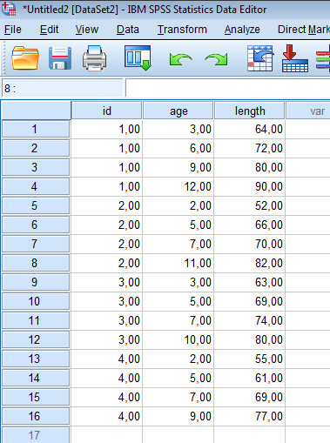
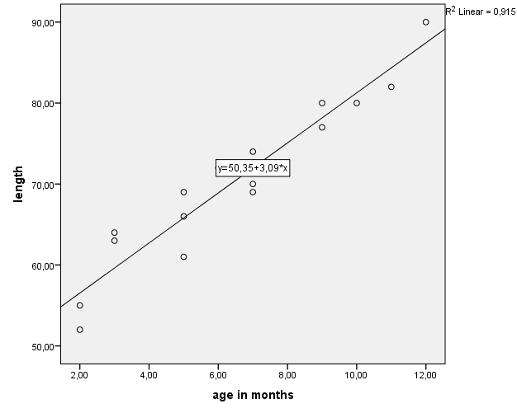
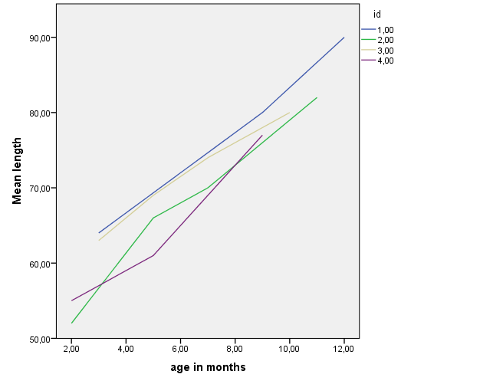
In case of repeated measures (on the same individuals) …
DON’T
These data should be analyzed using a more complex analysis

Slide 15
The linear regression table (SPSS)
Coefficientsª
Model |  | Unstandardized Coefficients |  | Standardized Coefficients | t | Sig.
 |  | B | Std. Error | Beta
1 | (Constant) | 110,293 | 5,691 |  | 19,379 | ,000
 | age in 1993 | ,752 | ,085 | ,216 | 8,825 | ,000
a. Dependent Variable: syst. blood pressure in 1993
Based on the P-value of the slope, we would conclude that there is a significant linear relationship between Age and SBP.
Is it a valid conclusion, is it a valid test?

Slide 16
Check the assumptions
DO
Independent observations
how have the data been collected?
Linear relation (instead of e.g. exponential) between Y and X
  make a scatterplot (you started with it!)
The residuals come from a normal distribution
make a histogram or P-P plot of the residuals
The variability of the residuals is the same for each value of X (homoscedasticity)
make a scatter of residuals against predicted values

Slide 17
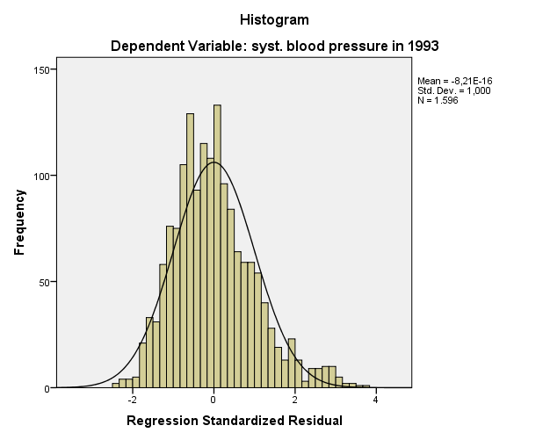
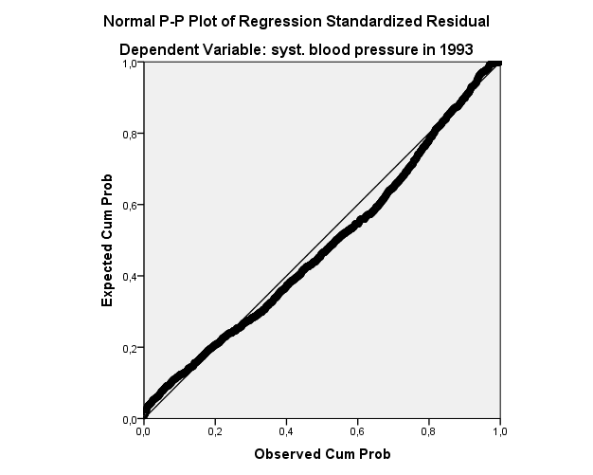
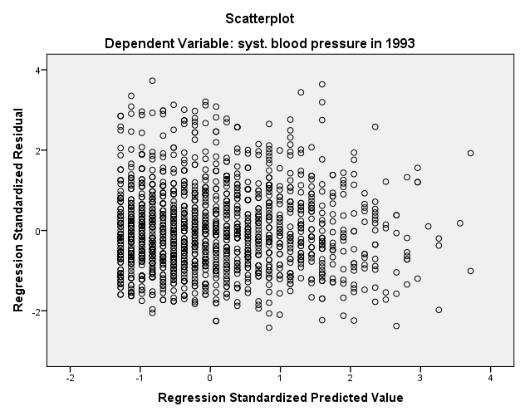
Checking the residuals

Slide 18
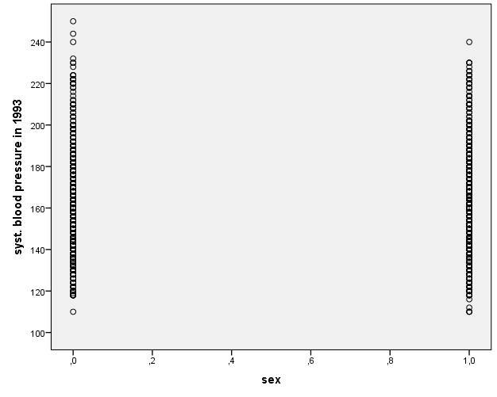
Simple linear regression of SBP on Sex
(a binary explanatory variable)
Men
Women

Slide 19
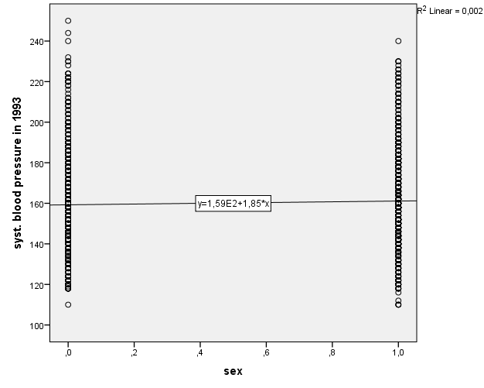
Linear regression, is it of any use in this situation?
DO
DON’T
?
or

Slide 20
Regression on Sex
Coefficientsª
Model |  | Unstandardized Coefficients |  | Standardized Coefficients | t | Sig.
 |  | B | Std. Error | Beta
1 | (Constant) | 159,257 | ,857 |  | 185,882 | ,000
 | sex | 1,853 | 1,157 | ,040 | 1,602 | ,109
a. Dependent Variable: syst. blood pressure in 1993
t-test for independent groups:
Group Statistics
 | sex | N | Mean
syst. blood pressure in 1993 | man | 721 | 159,26
 | woman | 875 | 161,11
Independent Samples Test
 |  | t-test for Equality of Means
 |  | t | df | Sig. (2-tailed) | Mean Difference | Std. Error Difference
syst. blood pressure in 1993 |  | -1,602 | 1594 | ,109 | -1,853 | 1,157

Slide 21
So:
Performing a simple linear regression with a binary explanatory variable is equivalent to performing a t-test for independent groups, assuming equal variances
Why using a linear regression in this situation?
If you want to correct (adjust) for the effect of other variables, you cannot do it in a t-test, but you can do it, using a multiple linear regression
DO

Slide 22
Correcting for Age
Mean Age of men: 65.9 years,
Mean Age of women: 67.0 years
There is a significant positive relationship between Age and SBP.
Women have higher SBP (on average) than men
Can the higher SBP for women be (partly) explained by the difference in Age?

Slide 23
A multiple linear regression
Coefficientsª
Model |  | Unstandardized Coefficients |  | Standardized Coefficients | t | Sig.
 |  | B | Std. Error | Beta
1 | (Constant) | 110,146 | 5,694 |  | 19,344 | ,000
 | sex | 1,047 | 1,135 | ,023 | ,922 | ,356
 | age in 1993 | ,746 | ,086 | ,214 | 8,720 | ,000
a. Dependent Variable: syst. blood pressure in 1993
Sex is still not a significant predictor for SBP, but the difference between the mean SBP’s is smaller than in the unadjusted analysis
SBP = 110.15 + 1.05∙Sex + 0.746∙Age

Slide 24
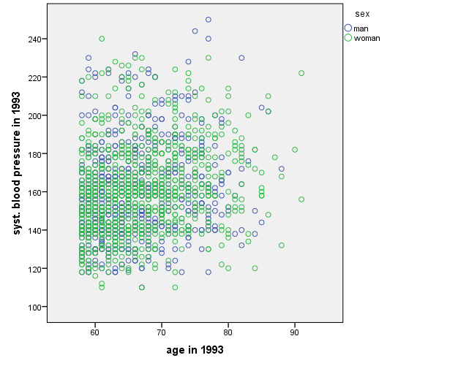
In a graph
Two lines for the price of one!

Slide 25
Should we always correct for other variables?
Sex
SBP
Age
In this graph, a causal pathway called DAG (Directed Acyclic Graph), Age is a mediator of the effect of Sex on SBP.
If you are interested in the total effect of Sex on SBP, do not include Age in the model.
If you are interested in the direct effect of Sex on SBP only, correct for Age.
In experimental studies, you can correct for Age by design

Slide 26
Effect modification
What if we think that the effect of Age on SBP might be different for males compared to females?
Also called “interaction”, “synergy”, “moderation”, …

Slide 27
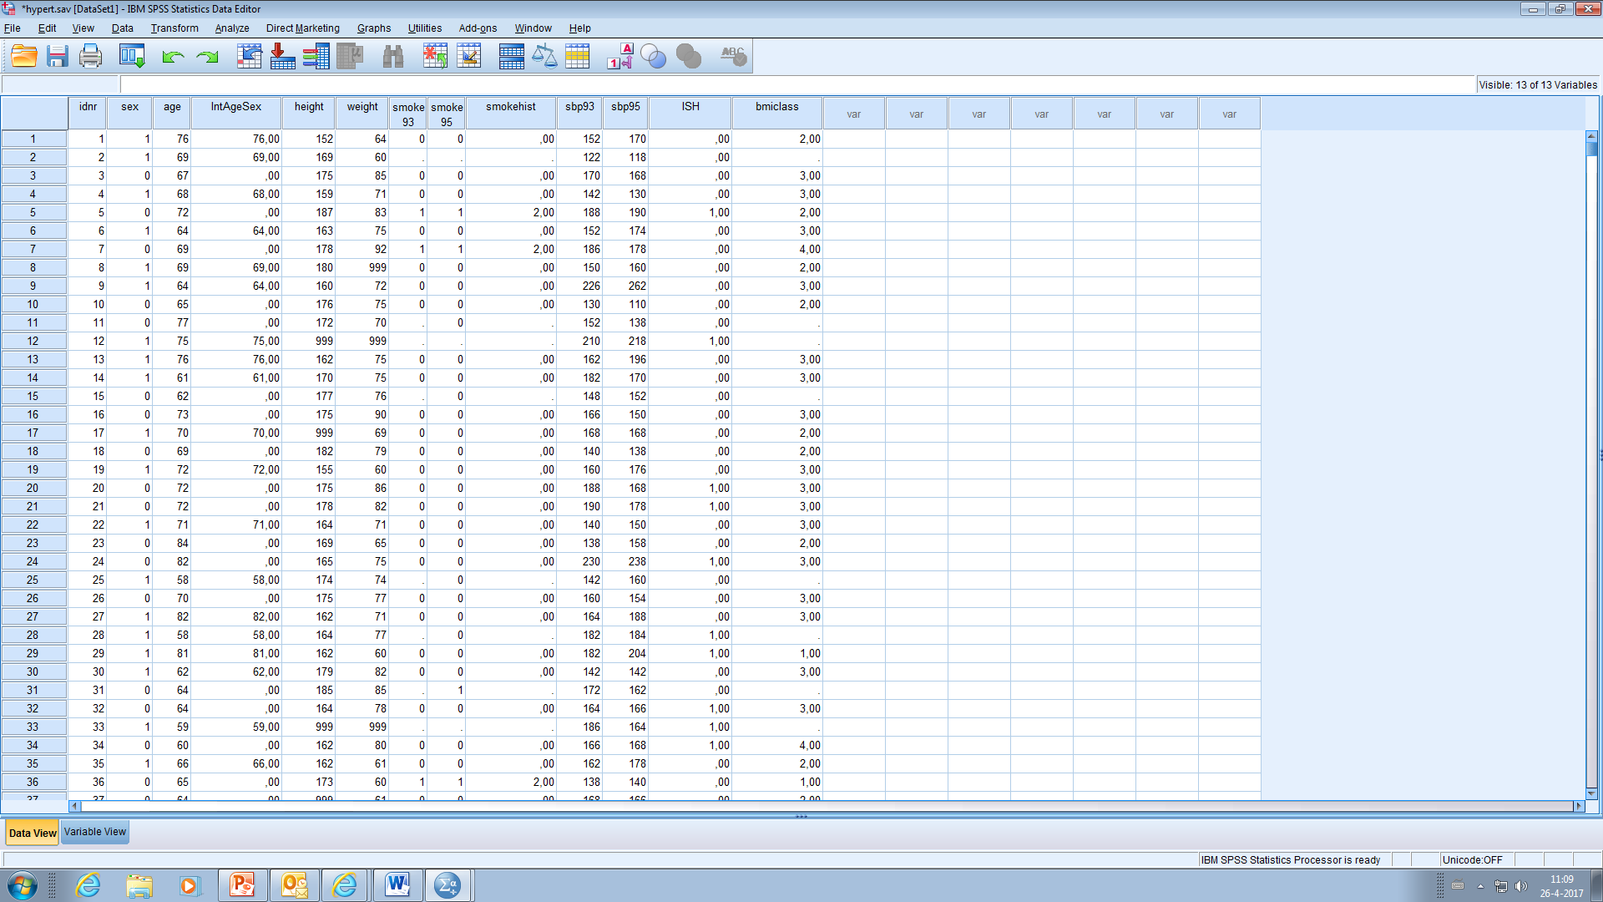
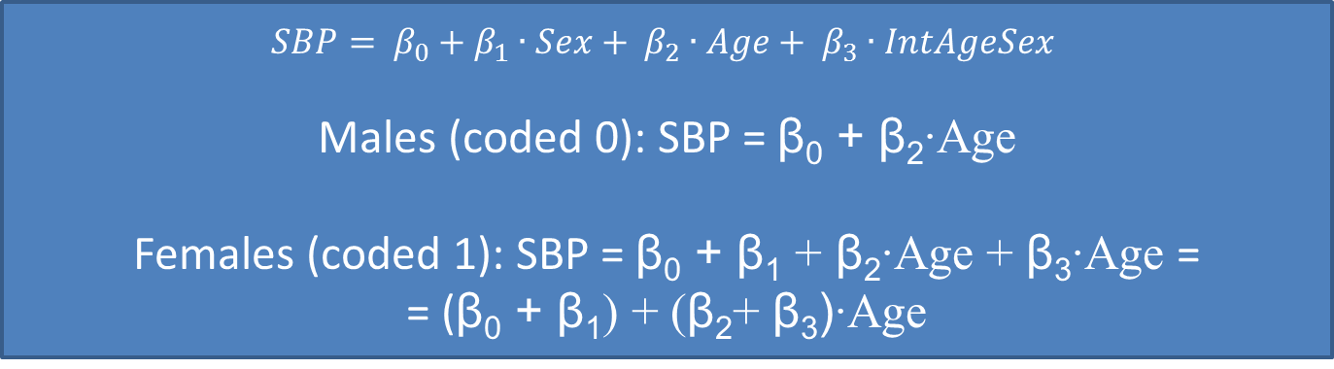
In a linear regression model, we have to introduce an interaction term
Generally the product of the main effects:
intAgeSex = Age∙Sex
$$SBP= β_{0}+β_{1}∙Sex+ β_{2}∙Age+ β_{3}∙IntAgeSex$$
Males (coded 0): SBP = β₀ + β₂∙Age
Females (coded 1): SBP = β₀ + β₁ + β₂∙Age + β₃∙Age =
= (β₀ + β₁) + (β₂+ β₃)∙Age

Slide 28
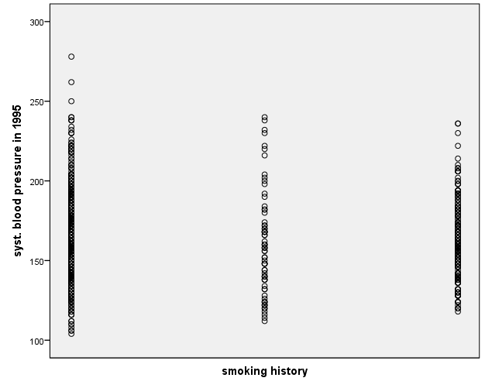
Linear regression of SBP on Smoking
(a categorical explanatory variable > 2 categories)
No period
One period
Both periods
SBP = b₀ + b₁∙SmokingHistory ?
DO
DON’T
?
or

Slide 29
For a categorical explanatory variable: use dummy variables!
DO
Categorical Variable (Smoking) | Dummy1 | Dummy2
No period | 0 | 0
One period | 1 | 0
Both periods | 0 | 1
SBP = b₀ + b₁∙Dummy1 + b₂∙Dummy2
Use the R² change test to test the effect of the categorical variable.
Do not delete non-significant dummies without a good reason!

Slide 30
How to build a (linear) model?
Select variables based on theory and/or univariate analyses (on a liberal alpha)
Make a multivariate model including all possibly relevant variables
Eliminate backward step-by-step non-significant variables (α = 0.05)
Only test for interactions based on theory or clear patterns in your data
Give the R² of the final model

Slide 31
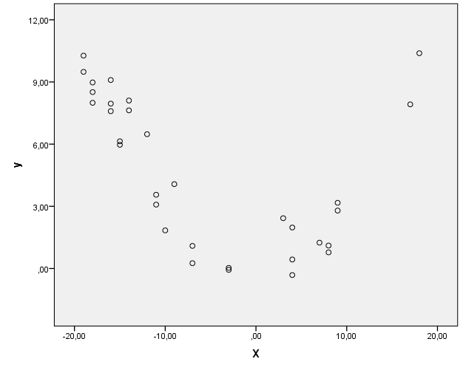

A linear model?
DO
$Y=β_{0}+β_{1}∙X+β_{2}∙X^{2}$
This is still a linear model; it is linear in its parameters!

Slide 32
Take home message
Take to work message
(regarding linear regression analyses)
DO
DON’T
Start with graphs (for continuous X)
Check the assumptions
Test for relevant interactions
Select variables on a liberal alpha
Give R² in your article
Include all variables, just because you measured them
  If you torture your data long enough …
Use arbitrary codes for categorical data (with more than two categories)

