Slide 1
Help! Statistics! Binary and ordinal logistic regression
Hans Burgerhof
j.g.m.burgerhof@umcg.nl
September 11 2018

Slide 2
Help! Statistics! Lunchtime Lectures
What? frequently used statistical methods and questions in a manageable timeframe for all researchers at the UMCG
No knowledge of advanced statistics is required.
When? Lectures take place every 2nd Tuesday of the month, 12.00-13.00 hrs.
Who? Unit for Medical Statistics and Decision Making
When? | Where? | What? | Who?
Oct 9 2018 | Rode Zaal | Big data and machine learning | C. Zu Eulenburg
Nov 13 2018 | Room 16 | Using causal graphs to unravel statistical paradoxes | S. La Bastide
Dec 11 2018 | Room 16 | Non-parametrical tests | D. Postmus
Feb 12 2019 | ? | ? | ?
Mar 12 2019 | ? | ? | ?
Slides can be downloaded from http://www.rug.nl/research/epidemiology/download-area

Slide 3
Program Today
Binary logistic regression
- the outcome variable Y has two categories (success, failure)
- interpretation of coefficients
- Wald test / Likelihood ratio test
- Pseudo-R²
- Hosmer – Lemeshow test
Ordinal logistic regression
- the outcome variable has at least three, ordered, categories
(SES, items with answers like strongly disagree … strongly agree)
- interpretation of coefficients
- checking assumption of proportionality

Slide 4
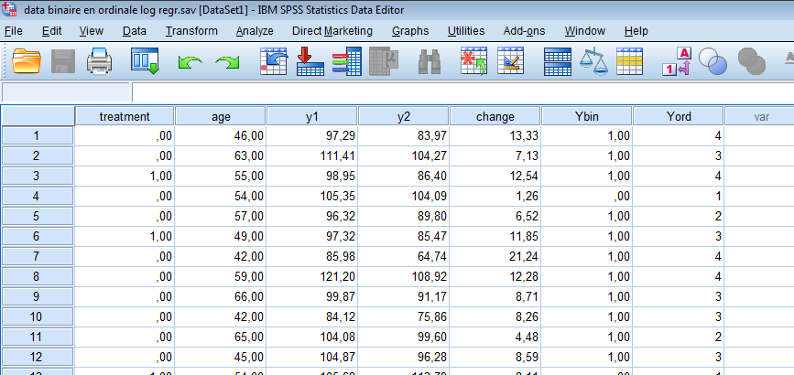
The (simulated) dataset
0 = placebo
1 = drug
0 = failure
1 = success
1 = worse
2 = no effect
3 = small effect
4 = large effect

Slide 5
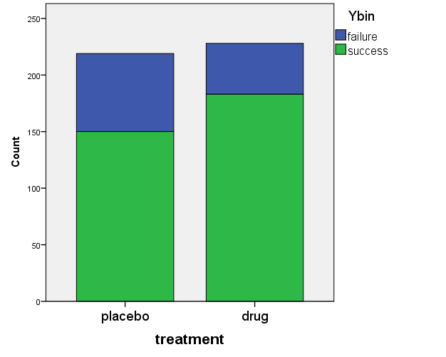
Binary logistic regression: Y = 0/1 Binary explanatory variable

Slide 6


Binary logistic regression: Y = 0/1 Binary explanatory variable
Odds(drug) = $\frac{183}{45}$
Odds(placebo) = $\frac{150}{69}$
treatment * Ybin Crosstabulation
 |  |  | Ybin |  | Total
 |  |  | failure | success
treatment | placebo | Count | 69 | 150 | 219
 |  | % within treatment | 31,5% | 68,5% | 100,0%
 | drug | Count | 45 | 183 | 228
 |  | % within treatment | 19,7% | 80,3% | 100,0%
Total |  | Count | 114 | 333 | 447
 |  | % within treatment | 25,5% | 74,5% | 100,0%
OR = $\frac{183 ∗69}{150 ∗45}$ ≈ 1.871
Odds Ratio (drug / placebo)
of having a success
Risk Estimate
 | Value | 95% Confidence Interval
 |  | Lower | Upper
Odds Ratio for treatment (placebo / drug) | 1,871 | 1,213 | 2,885
…of having a failure!

Slide 7
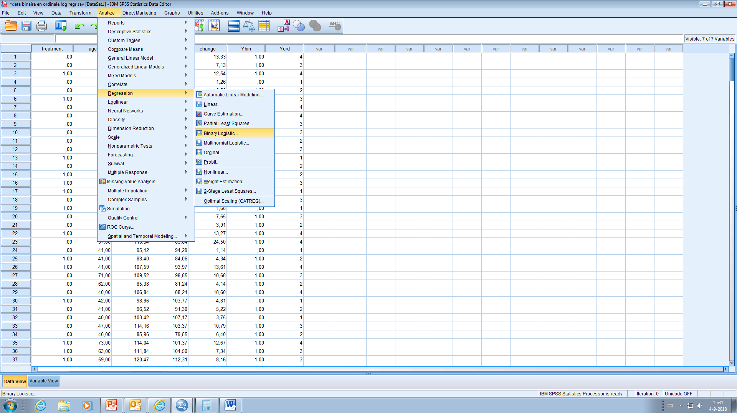
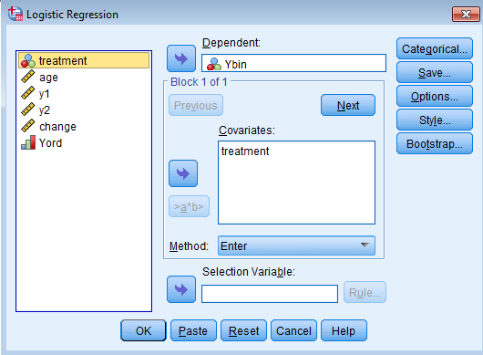
Binary logistic regression: Y = 0/1 Binary explanatory variable

Slide 8
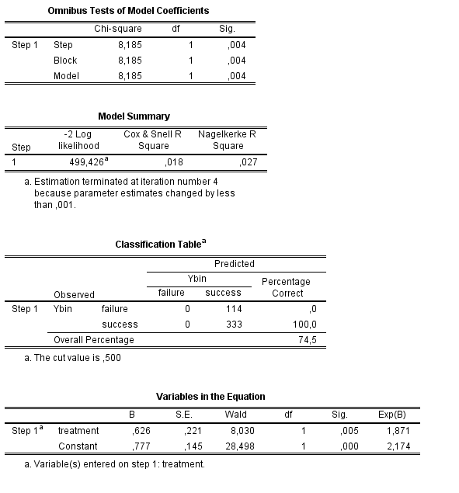
The SPSS output
Likelihood Ratio test
Pseudo R²’s
Generally not of much use
Odds Ratio of success for drug (1) compared to placebo (0)

Slide 9
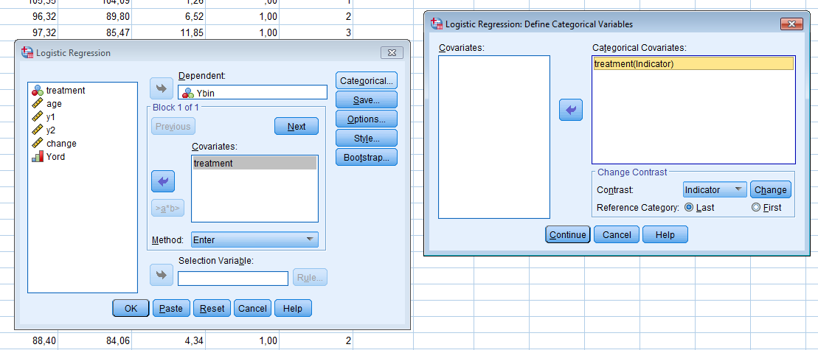
Binary logistic regression: Y = 0/1 Binary explanatory variable (categorical)
Odds Ratio of success for placebo (0) compared to drug (1)
Variables in the Equation
 |  | B | S.E. | Wald | df | Sig. | Exp(B)
Step 1ª | treatment(1) | -,626 | ,221 | 8,030 | 1 | ,005 | ,535
 | Constant | 1,403 | ,166 | 71,078 | 1 | ,000 | 4,067
a. Variable(s) entered on step 1: treatment.
0.535 = 1/1.871

Slide 10
Binary logistic regression One continuous covariate
Example
The covariate age may be grouped in classes
Per age class, the proportion can be plotted
A linear regression
Can be performed
Using the middle of the age classes as covariate
Using the proportion as response variable
Formation of age classes is somewhat arbitrary
The linear model may exceed the range [0,1] for response
succes

Slide 11
Binary logistic regression One continuous covariate
Consider a possible age x
The probability of success may be denoted by π(x).
This proportion π(x) of successes can be transformed to the odds π(x)/(1-π(x))
The odds can range from zero to infinity
The log odds (“logit”) can range from minus infinity to infinity
Thus a natural model for the proportion π(x) is

Slide 12
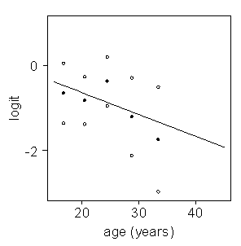
Binary logistic regression One continuous covariate
Example
The response variable may be the log odds instead of the proportions
This would overcome predictions outside the range [0 ; 1]
A linear model in age for the log odds seems reasonable (figure)
black dots are log odds
open circles indicate CI

Slide 13
Binary logistic regression One continuous covariate
Graphical representation of the proportion π(x)
Range of covariate restricted to [15 ; 50]
π(x)
Example
β₀ = 0.385
β₁ = -0.051
x

Slide 14
Binary logistic regression One continuous covariate
Graphical representation of the proportion π(x)
Range of covariate restricted to [-200 ; 200]
π(x)
Example
β₀ = 0.385
β₁ = -0.051
x

Slide 15
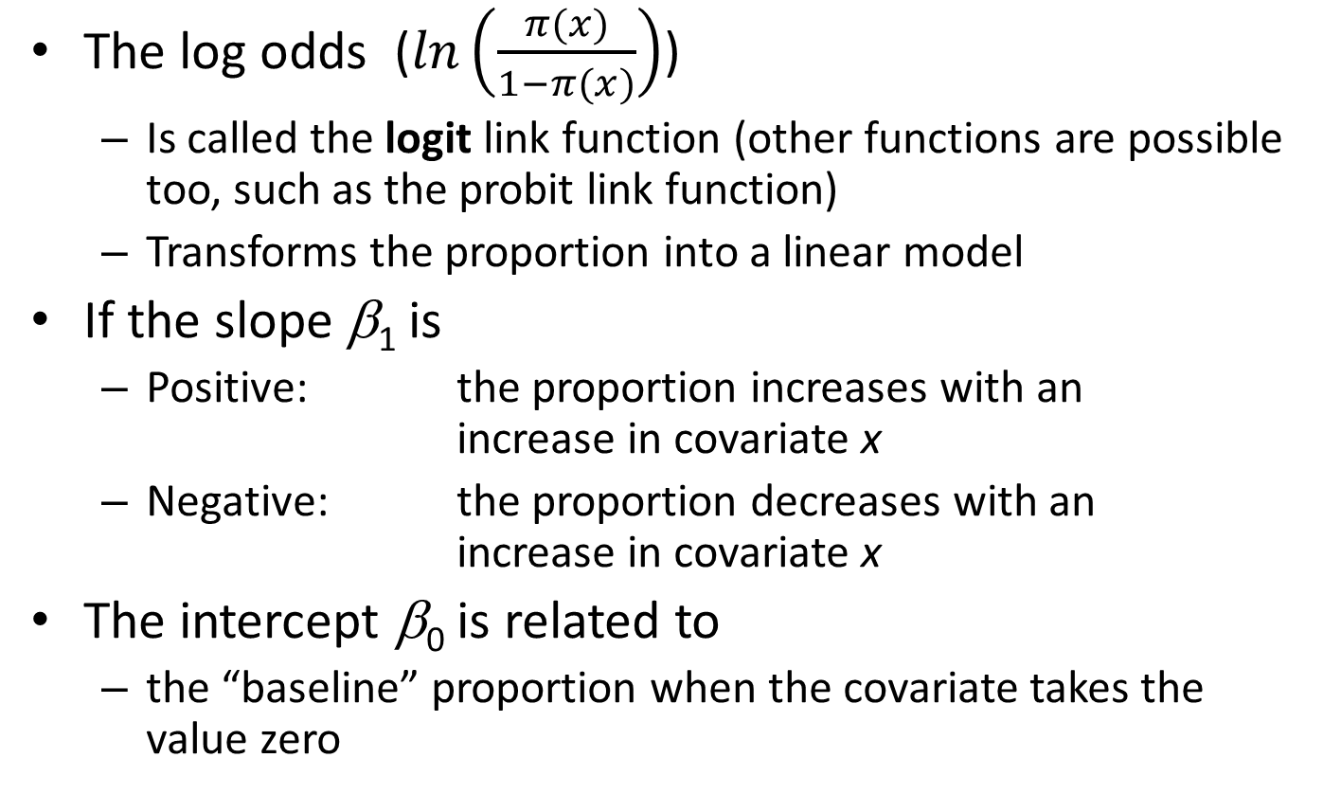
Binary logistic regression One continuous covariate
The log odds ($ln\left(\frac{π(x)}{1−π(x)}\right)$)
Is called the logit link function (other functions are possible too, such as the probit link function)
Transforms the proportion into a linear model
If the slope β₁ is
Positive: the proportion increases with an increase in covariate x
Negative: the proportion decreases with an increase in covariate x
The intercept β₀ is related to
the “baseline” proportion when the covariate takes the value zero

Slide 16
Binary logistic regression One continuous covariate
Age is not a significant predictor here
Variables in the Equation
 |  | B | S.E. | Wald | df | Sig. | Exp(B)
Step 1ª | age | -,006 | ,010 | ,336 | 1 | ,562 | ,994
 | Constant | 1,413 | ,600 | 5,550 | 1 | ,018 | 4,107
a. Variable(s) entered on step 1: age.
0.994 is the OR of having a success for an individual of a certain age, compared to an individual who is one year younger.
What about comparing two individuals, differing ten years of age?
The odds of success for the older person is ${0.994}^{10}$ ≈ 0.94 times the odds for the younger person (so 6% lower)

Slide 17
Does the model fit? The Hosmer – Lemeshow test
Contingency Table for Hosmer and Lemeshow Test
 |  | Ybin = failure |  | Ybin = success |  | Total
 |  | Observed | Expected | Observed | Expected
Step 1 | 1 | 21 | 15,045 | 24 | 29,955 | 45
 | 2 | 9 | 14,653 | 36 | 30,347 | 45
 | 3 | 12 | 14,163 | 33 | 30,837 | 45
 | 4 | 12 | 12,703 | 30 | 29,297 | 42
 | 5 | 15 | 12,436 | 27 | 29,564 | 42
 | 6 | 6 | 10,087 | 42 | 37,913 | 48
 | 7 | 15 | 9,164 | 30 | 35,836 | 45
 | 8 | 6 | 8,820 | 39 | 36,180 | 45
 | 9 | 6 | 8,589 | 39 | 36,411 | 45
 | 10 | 12 | 8,340 | 33 | 36,660 | 45
Null hypothesis HL test:
“model fits well”
Hosmer and Lemeshow Test
Step | Chi-square | df | Sig.
1 | 18,885 | 8 | ,015

Slide 18
Multiple binary logistic regression
Model Summary
Step | -2 Log likelihood | Cox & Snell R Square | Nagelkerke R Square
1 | 499,100ª | ,019 | ,028
a. Estimation terminated at iteration number 4 because parameter estimates changed by less than ,001.
-2 log likelihood simple model
(treatment): 499.426
Difference 0.316
Not significant
Variables in the Equation
 |  | B | S.E. | Wald | df | Sig. | Exp(B)
Step 1ª | treatment | ,626 | ,221 | 8,021 | 1 | ,005 | 1,870
 | age | -,006 | ,010 | ,326 | 1 | ,568 | ,994
 | Constant | 1,112 | ,606 | 3,363 | 1 | ,067 | 3,040
a. Variable(s) entered on step 1: treatment, age.

Slide 19
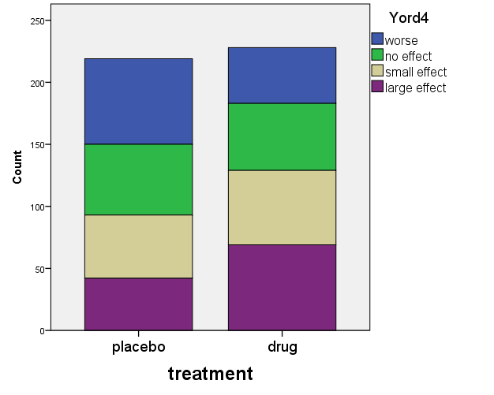
Ordinal logistic regression
1
2
3
4
In modelling, cumulative probabilities are used:
P(Y ≤ 1) = P(Y = 1)
P(Y ≤ 2) = P(Y = 1) + P(Y = 2)
P(Y ≤ 3) = P(Y = 1) + P(Y = 2) + P(Y = 3)
P(Y ≤ 4) = 1

Slide 20
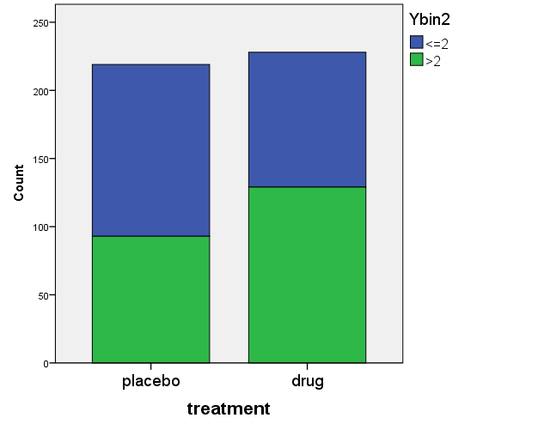
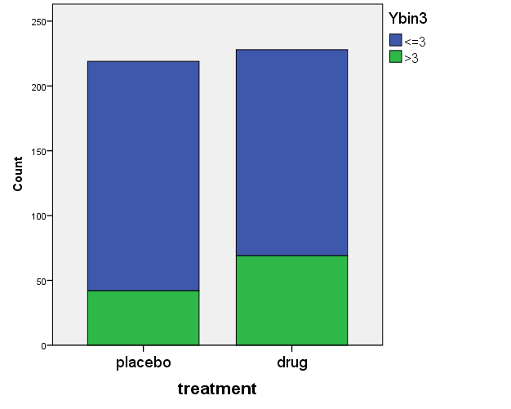






OR’s for ordinal data
Blue area: “worse” “worse” or “no effect” “worse”, “no or small effect”
$${θ }_{p1}=\frac{P(Y≤1)}{1−P(Y≤1)}$$
$${θ }_{d1}=\frac{P(Y≤1)}{1−P(Y≤1)}$$
$${θ }_{p2}=\frac{P(Y≤2)}{1−P(Y≤2)}$$
$${θ }_{d2}=\frac{P(Y≤2)}{1−P(Y≤2)}$$
$${θ }_{p3}=\frac{P(Y≤3)}{1−P(Y≤3)}$$
$${θ }_{d3}=\frac{P(Y≤3)}{1−P(Y≤3)}$$
$$OR= \frac{θ_{d1}}{θ_{p1}}$$
$$OR= \frac{θ_{d2}}{θ_{p2}}$$
$$OR= \frac{θ_{d3}}{θ_{p3}}$$
One common OR is estimated (assumption of “parallel lines”)

Slide 21

SPSS output of ordinal logistic regression (partly)
Parameter Estimates
 |  | Estimate | Std. Error | Wald | df | Sig. | 95% Confidence Interval
 |  |  |  |  |  |  | Lower Bound | Upper Bound
Threshold | [Yord = 1] | -1,385 | ,143 | 93,827 | 1 | ,000 | -1,665 | -1,10
 | [Yord = 2] | -,278 | ,127 | 4,786 | 1 | ,029 | -,526 | -,029
 | [Yord = 3] | ,838 | ,133 | 39,422 | 1 | ,000 | ,576 | 1,099
Location | [treatment=,00] | -,596 | ,171 | 12,123 | 1 | ,000 | -,932 | -,261
 | [treatment=1,00] | 0ª | . | . | 0 | . | . | .
Link function: Logit.
a. This parameter is set to zero because it is redundant.
Ln($θ_{j})= α_{j}−β∙X$
Negative coefficient: placebo has lower probability for higher values
Treatment = 1 (drug) is the reference
Model Fitting Information
Model | -2 Log Likelihood | Chi-Square | df | Sig.
Intercept Only | 44,658
Final | 32,416 | 12,242 | 1 | ,000
Link function: Logit.

Slide 22
Checking the assumption of parallel lines
H0: lines are parallel
(OR’s are equal)
Test of Parallel Linesª
Model | -2 Log Likelihood | Chi-Square | df | Sig.
Null Hypothesis | 32,416
General | 32,303 | ,113 | 2 | ,945
The null hypothesis states that the location parameters (slope coefficients) are the same across response categories.
a. Link function: Logit.
If the assumption is not fulfilled:
use Multinomial logistic regression
Three OR’s are estimated

Slide 23
Does the model fit?
Cell Information
Frequency
treatment |  | Yord
 |  | worse | no effect | small effect | large effect
placebo | Observed | 69 | 57 | 51 | 42
 | Expected | 68,4 | 58,4 | 50,0 | 42,2
 | Pearson Residual | ,082 | -,208 | ,153 | -,027
drug | Observed | 45 | 54 | 60 | 69
 | Expected | 45,7 | 52,6 | 60,9 | 68,9
 | Pearson Residual | -,109 | ,217 | -,129 | ,020
Link function: Logit.
Goodness-of-Fit
 | Chi-Square | df | Sig.
Pearson | ,113 | 2 | ,945
Deviance | ,113 | 2 | ,945
Link function: Logit.

Slide 24
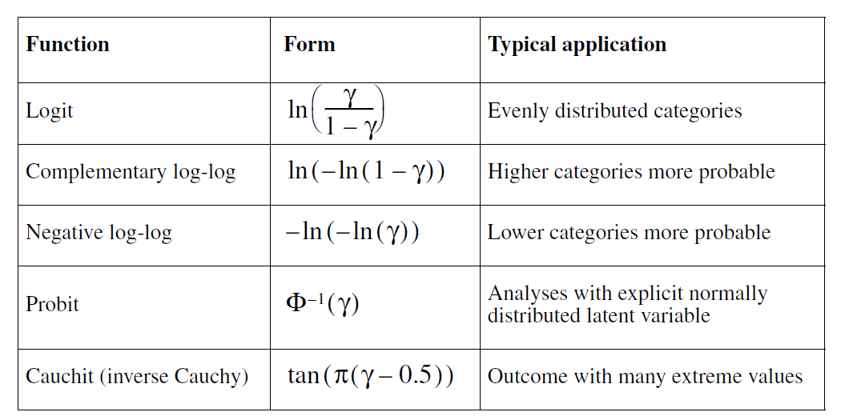
Several link functions for ordinal data (SPSS manual, chapter 4)
The interpretation of the coefficients will differ,
depending on the linkfunction used

Slide 25
Some literature
SPSS manual, chapter 4 (Ordinal Logistic Regression):
http://www.norusis.com/pdf/ASPC_v13.pdf
McGullagh and Nelder: Generalized Linear Models (Chapman & Hall, reprinted 1991)
Hosmer and Lemeshow: Applied Logistic Regression (Wiley 1989)

