Slide 1

Identity and emotion: Exploring identity negotiation in companion services
Xuedi Han

Slide 2
Definition
There are many times when simple companionship can be of value, filling this gap in service by connecting individuals to services or being present with them while navigating these (Villarreal Sosa et al. 2018, p. 22).
Literally speaking, companion services is a consumer behavior that paying money to buy somebody’s accompany, including but not limited to accompany seeing the doctor; accompany playing games; accompany renting the house; and so on.
Villarreal Sosa, L., Diaz, S., & Hernandez, R. (2018). Accompaniment in a Mexican immigrant community: Conceptualization and identification of biopsychosocial outcomes. Journal of Religion & Spirituality in Social Work: Social Thought, 38(1), 21–42.

Slide 3
Classification
Type | Description
hospital companion | Can provide transportation services to and from the hospital, pick up reports and medicine, and offer other help for patients.
Gaming companion | Can be your gaming teammate to help you upgrade in the game.
shopping companion | Provide companionship when the clients want to find someone to go shopping with.
house-viewing companion | Provide companionship when the clients want to rent or buy a house, and also can give clients some suggestions.
running companion | Running with clients, usually outdoors.
fitness companion | Working out with clients and giving some guidance when necessary, usually at the gym.
driving companion | Provide companionship when clients need practice driving, common for novice drivers.
travel companion | Provide companionship on trips or vacations of clients.
groomsmen /bridesmaids-renting companion | Play the groomsmen /bridesmaids roles when the clients need more than enough bridesmaids and groomsmen
boyfriend/girlfriend companion | Play the boyfriend/girlfriend roles when the clients need to attend some occasion with their partner.
pet companion | Provide companionship and care for pets
children companion | Provide supervision for children, and could offer playtime, activities, and educational support.
wake-up companion | Wake up clients via text chat, voice call, video call, etc.
putting to sleep companion | Putting clients to sleep through text chat, voice calls, video calls, etc.
supervisory companion | Supervising clients to do certain things, such as learning, through text chat, voice calls, video calls, etc.
companion APP | Provide companionship with animation, video, live broadcast, reading, audio, etc.
study companion | Study with clients, could be online or offline.“study with me” video-virtual study room
chat companion | Chat with clients, could be online or offline.
artificial companion | Various intelligent devices, intelligent robots, virtual study room.

Slide 4
Classification
Criteria 1: service format
Criteria 2: social emotion
Category | Type
Physical companion | “hospital companion”, “shopping companion”, “house-viewing companion”, “running companion”, “fitness companion”, “driving companion”, “travel companion”, “groomsmen /bridesmaids-renting companion”, “boyfriend/girlfriend companion”, "pet companion", “children companion”, etc.
Virtual companion | “gaming companion”,“wake-up companion”, “putting to sleep companion”, “supervisory companion”, “companion APP" with animation, video, live broadcast, reading, audio, etc.
Mixed companion | This is often the case when the companion service can happen online and offline, such as “study companion”, “chat companion”, etc.
Category | Type
Tool or facilitation companion | “gaming companion”, “learning companion”, “running companion”, “fitness companion”, “driving companion”, “travel companion”, , “children companion”, etc.
Emotional or healing companion | “groomsmen /bridesmaids-renting companion”, “boyfriend/girlfriend companion”, "pet companion", etc.
Mixed companion | “hospital companion”, “children companion”, etc.

Slide 5
Classification by social emotion
Tool or facilitation type of companion service
The aim is to help consumers to enhance their consumption experience and enjoy the process of consumption by receiving services.
Emotional or healing companion service
The aim is to satisfy consumers' needs for spiritual interaction with relatively strong social and emotional attributes.

Slide 6
Hospital companion – Community health assistant
Community health assistant is officially included in the occupational classification by the Ministry of Human Resources and Social Security in 2020 in China (Liu, 2022). It is classified separately because there is already a lot of similar work in existence.
Healthcare service
Involves clinical diagnosis and consultation which can only be achieved by doctors before.
Carer industry
People are more likely to have been in the hospital already and have been in a medical procedure,
Hospital companion
Aimed to help you do the procedure from the beginning.
It is these nuances that define the special nature of the companion service.
Liu, J. (2022). 多元需求催生“陪伴经济”_央广网. Www.cnr.cn. https://www.cnr.cn/hubei/yw/20221212/t20221212_526091967.shtml

Slide 7
Demands behind
1
2
3
4
5
Empty-nesters
Technical update
Pursue life quality
Middle-aged and elderly people whose children have left home, or who have no children and live alone.
Young people who are unmarried and living alone.
Easy to connect with each other online and change the way we live.
Under the gig economy, from 9 to 5 schedule to work at people’s own pace.
Not only rely on the natural support systems, but also external social support are needed.
Youth living alone
Work forms transfer

Slide 8
Theory clarification
Identity
Identity is not only the simple reflection of reality, but also constructing reality actively, it has been processed by people's active consciousness.
Professional
Identity
The establishment of a professional identity can help companions to better find this balance between commercial behavior and emotional flow.
Emotional
labor
Effects of emotional labor on the service agent are moderated by identification with the role in question.
Identity
negotiation
Identities emerge as a result of interaction and negotiation vis-à-vis the available positions and the particularities of a given time and place.

Slide 9
Research questions
How do the companions demonstrate who they are, as part of the way to do their identity presentation?
How do the companions interact with their clients during the real service process, as part of the ongoing process of identity negotiation?
How do the clients understand the companion’s identity, and how does this influence the negotiation of the companions’ identities?

Slide 10
1
Online display:
The creation of professional identity and self-branding process

Slide 11
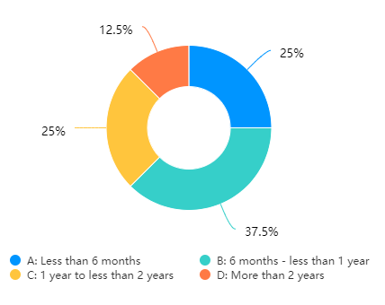
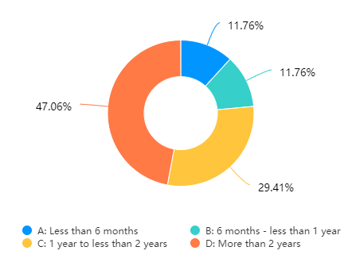
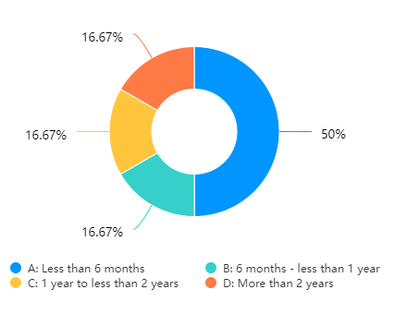
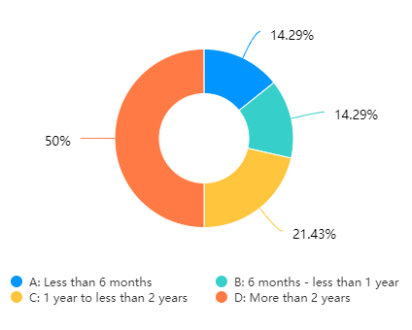
Questionnaire

Slide 12
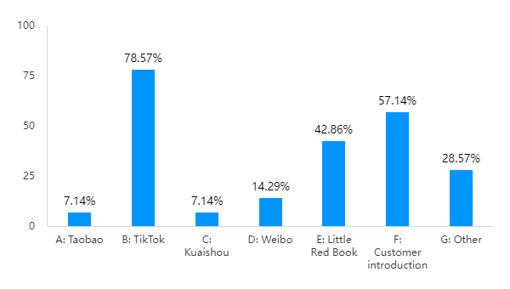
Data collection platform
I chose Red(Little red book) as the main platform to collect the ad data.
The advertisements in Red include the name, profile photos, the specific content, and the tag they use, which all shown in their personal profile.

Slide 13
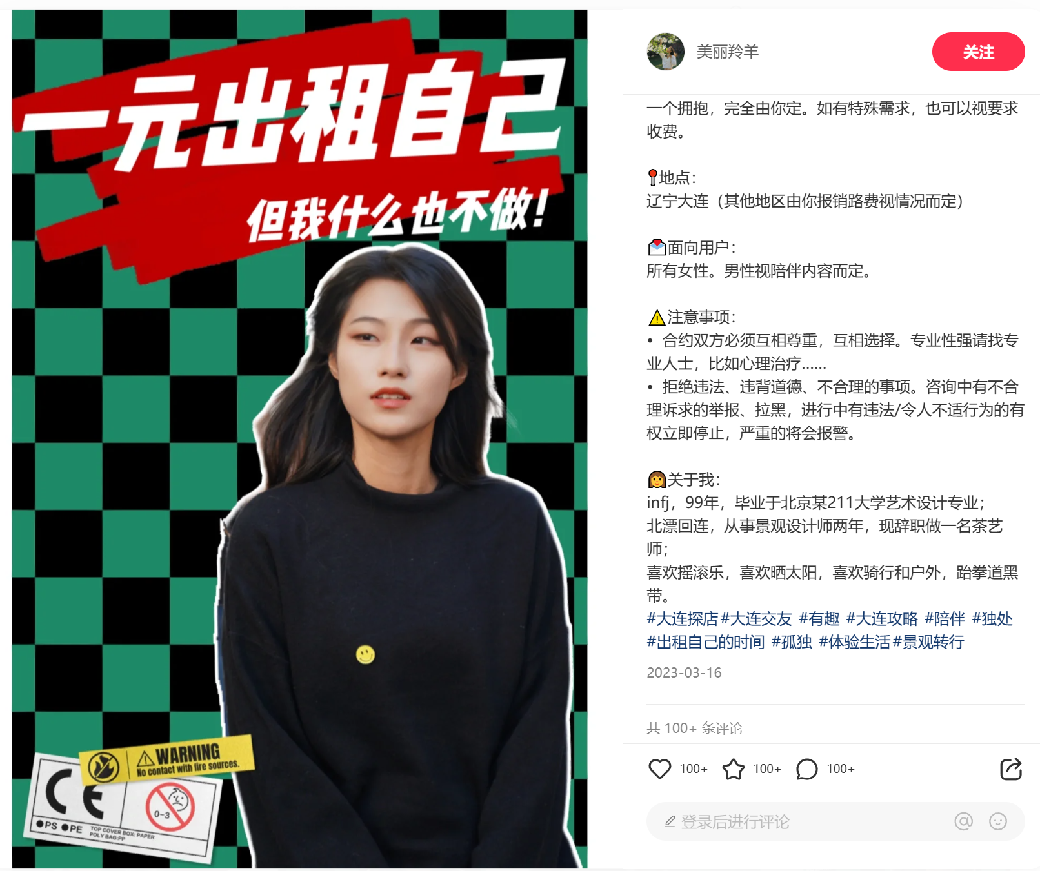


Example
Fragment | Example
Avatar
Account name | Beautiful Antelope
Title | Rent myself out for a dollar on a trial basis (Dalian)
Content | From today, I will be offering a “do-nothing" rental service. Please use this service when you only need my presence……
Hashtag | #companionship #solitude #renting your time #loneliness……
Picture

Slide 14
Hybridization of different genres:
Advertisement? Post? Self-introduction?......
CGA(Critical Genre Analysis)
‘Critical’ in Critical Genre Analysis thus reflects an attempt to be as objective as possible, rigorous in analytical procedures, integrating genre analysis and other relevant multiple perspectives and dimensions of professional genres by employing a range of methodological frameworks and procedures, which include, but are not limited to, ethnographic (including specialist interviews and/or ‘convergent accounts’ of experienced members of the professional community in question), in order to explain or demystify but not evaluate or criticise specific professional practices.
Bhatia, Vijay K. Critical Genre Analysis Investigating Interdiscursive Performance in Professional Practice. Milton Park, Abingdon, Oxon ; New York, Ny, Routledge, 2016.

Slide 15
Text-external (generic resources)
Text-internal (textual resources)
Order | Signal | Explanation | Meaning
1 | 💡 | Where did the idea come from | Storytelling of why they want to do the work
2 | 🉑 | I can provide the following services | Specifics of the service
3 | 🌟 | You need to | Requirements for consumers
4 | 📍 | Location | Locations where services are available
5 | 💌 | For | Population to be served
6 | ⚠️ | Notes | Some notes on service
7 | 👩 | About me | Introduction of companions
According to the advertisements that companions public, the “first-person" is the most common narrative used by companions.
“As of today, I will be offering a "do-nothing" rental service. Please use this service when you only need my presence!”.
"I am a xxx person"

Slide 16
• Professional genres and/or disciplines
• Professional practices and/or identities
• Professional cultures
Extract 1: We offer paid companionship services. Specialty: Swimming and fitness companionship (pool/open water are OK, can be a safety officer) Scuba diving companionship (instructor level) Freediving companionship (instructor level)
Extract 2: Lively personality, loves to laugh and is a good listener.
Extract 3: Don’t have to worry about the mood, even makeup can not make up, happy to play with you, only happy, no burden!
Extract 4: Companion services, other than simple companionship, and response, do not provide any specialized skill services.

Slide 17
References
Bhatia, Aditi. “Interdiscursive Performance in Digital Professions: The Case of YouTube Tutorials.” Journal of Pragmatics, vol. 124, Jan. 2018, pp. 106–120, https://doi.org/10.1016/j.pragma.2017.11.001.
Bhatia, Vijay K. Critical Genre Analysis Investigating Interdiscursive Performance in Professional Practice. Milton Park, Abingdon, Oxon ; New York, Ny, Routledge, 2016.
Aldairy, T., Laverick, S., & McIntyre, G. T. (2012). Orthognathic surgery: Is patient information on the Internet valid? The European Journal of Orthodontics, 34(4), 466–469. doi:10.1093/ejo/cjr046
Anna De Fina. (2012). Discourse and Identity. The Encyclopedia of Applied Linguistics, Edited by Carol A. Chapelle. © 2013 Blackwell Publishing Ltd. Published 2013 by Blackwell Publishing Ltd. DOI: 10.1002/9781405198431.wbeal0326
Ashforth, B. E., & Humphrey, R. H. (1993). Emotional Labor in Service Roles: The Influence of Identity. The Academy of Management Review, 18(1), 88–115. https://doi.org/10.2307/258824.
Bajwa, U., Knorr, L., Di Ruggiero, E., Gastaldo, D., & Zendel, A. (2018). Towards an understanding of workers’ experiences in the global gig economy. Toronto: Global Migration and Health Initiative.
Bamberg, M. (2004). Positioning with David Hogan: Stories, tellings, and identities. In C. Daiute & C. Lightfoot (Eds.), Narrative analysis. Studying the development of individuals in society (pp. 135−158). Thousand Oaks: SAGE.
Baskwill, A., Vanstone, M., Harnish, D., & Dore, K. (2019). “I am a healthcare practitioner”: A qualitative exploration of massage therapists’ professional identity. Journal of Complementary and Integrative Medicine, 17(2). https://doi.org/10.1515/jcim-2019-0067
Benwell, B., & Stokoe, E. (2006). Discourse and identity. Edinburgh: Edinburgh University Press Ltd.
Botsman, R., & Rogers, R. (2010). What’s mine is yours : the rise of collaborative consumption. Harper Business.
Bucholtz, M., & Hall, K. (2005). Identity and interaction: A sociocultural linguistic approach. Discourse Studies, 7(4-5), 585-614.
Chen, S. (2022). Individual Labor Process and Organizational Survival Strategy:An Industrial Survey of "Gaming Companion ". https://doi.org/10.27461/d.cnki.gzjdx.2022.001584
Darics, E. (2022). Language awareness in business and the professions. Cambridge University Press.
Davies, B., & Harré, R. (1990). Positioning: The discursive production of selves. Journal for the Theory of Social Behaviour, 20,43−63.
Dzieza, J. (2015, October 28). The Rating Game: How Uber and Its Peers Turned Us Into Horrible Bosses. Vox. https://www.vox.com/2015/10/28/11620138/the-rating-game-how-uber-and-its-peers-turned-us-into-horrible-bosses
Goodwin, C. (2018). Co-Operative Action. Cambridge University Press.

Slide 18
References
Guan, M., & So, J. (2016). Influence of social identity on self-efficacy beliefs through perceived social support: A social identity theory perspective. Communication Studies, 67(5), 588-604. doi: 10.1080/10510974.2016.1239645
Jiang, Qingsheng. (2022). Exploring identity work in Chinese communication. Folia Linguistica. 56. 10.1515/flin-2022-2011.
Koteyko, Nelya. DA - 2014//TI - Perspectives on Corpus-Assisted Discourse Analysis. BT - Language and Politics in Post-Soviet Russia: A Corpus Assisted Approach. PB - Palgrave Macmillan UK. CY - London
LaPointe, K. (2010). Narrating career, positioning identity: Career identity as a narrative practice. Journal of Vocational Behavior, 77(1), 1–9. https://doi.org/10.1016/j.jvb.2010.04.003.
Mishler, E. G. (1999). Storylines. Craftartists' narratives of identity. Cambridge, MA: Harvard University Press.
Naghieh, Ali. (2020). Gig Economy and the Transformation of Professional Boundaries in Healthcare. 10.1108/978-1-83867-603-220201010.
National Bureau of Statistics. (2022). National Bureau of Statistics. Stats.gov.cn. http://www.stats.gov.cn/
Polkinghorne, D. E. (1988). Narrative knowing and the human sciences. Albany, NY: State University of New York Press.
Shachak, Aviv & Reis, Shmuel & Borycki, Elizabeth. (2017). Health Professionals' Education in the Age of Clinical Information Systems, Mobile Computing and Social Networks.
Shmidt, M. (2020). Participants’ interaction with sharing economy platforms in Russia. Information Technology & People, ahead-of-print(ahead-of-print). https://doi.org/10.1108/itp-10-2018-0443
Stephen Billett * & Margaret Somerville (2004) Transformations at work: identity and learning, Studies in Continuing Education, 26:2, 309-326, DOI: 10.1080/158037042000225272
Swann, W. B., Jr., & Bosson, J. K. (2021). Identity negotiation: A theory of self and social interaction. In O. P. John & R. W. Robins (Eds.), Handbook of personality: Theory and research (pp. 587–607). The Guilford Press.
Swann, W. B., Jr., & Bosson, J. K. (2016). Identity negotiation in social interaction: Past, present and future. In S. Trusz & P. Bąbel (Eds.), Interpersonal and intrapersonal expectancies (pp. 96–101). Routledge/Taylor & Francis Group. https://doi.org/10.4324/9781315652535-13
Swann, W. B. (2009). Identity negotiation at work, Research in Organizational Behavior, Volume 29, 2009,Pages 81-109, (R. E. Johnson & J. K. Bosson, Eds.). https://doi.org/10.1016/j.riob.2009.06.005.

Slide 19
THANKS
FOR YOUR ATTENTION
Xuedi Han: xuedi.han@rug.nl

