Slide 1
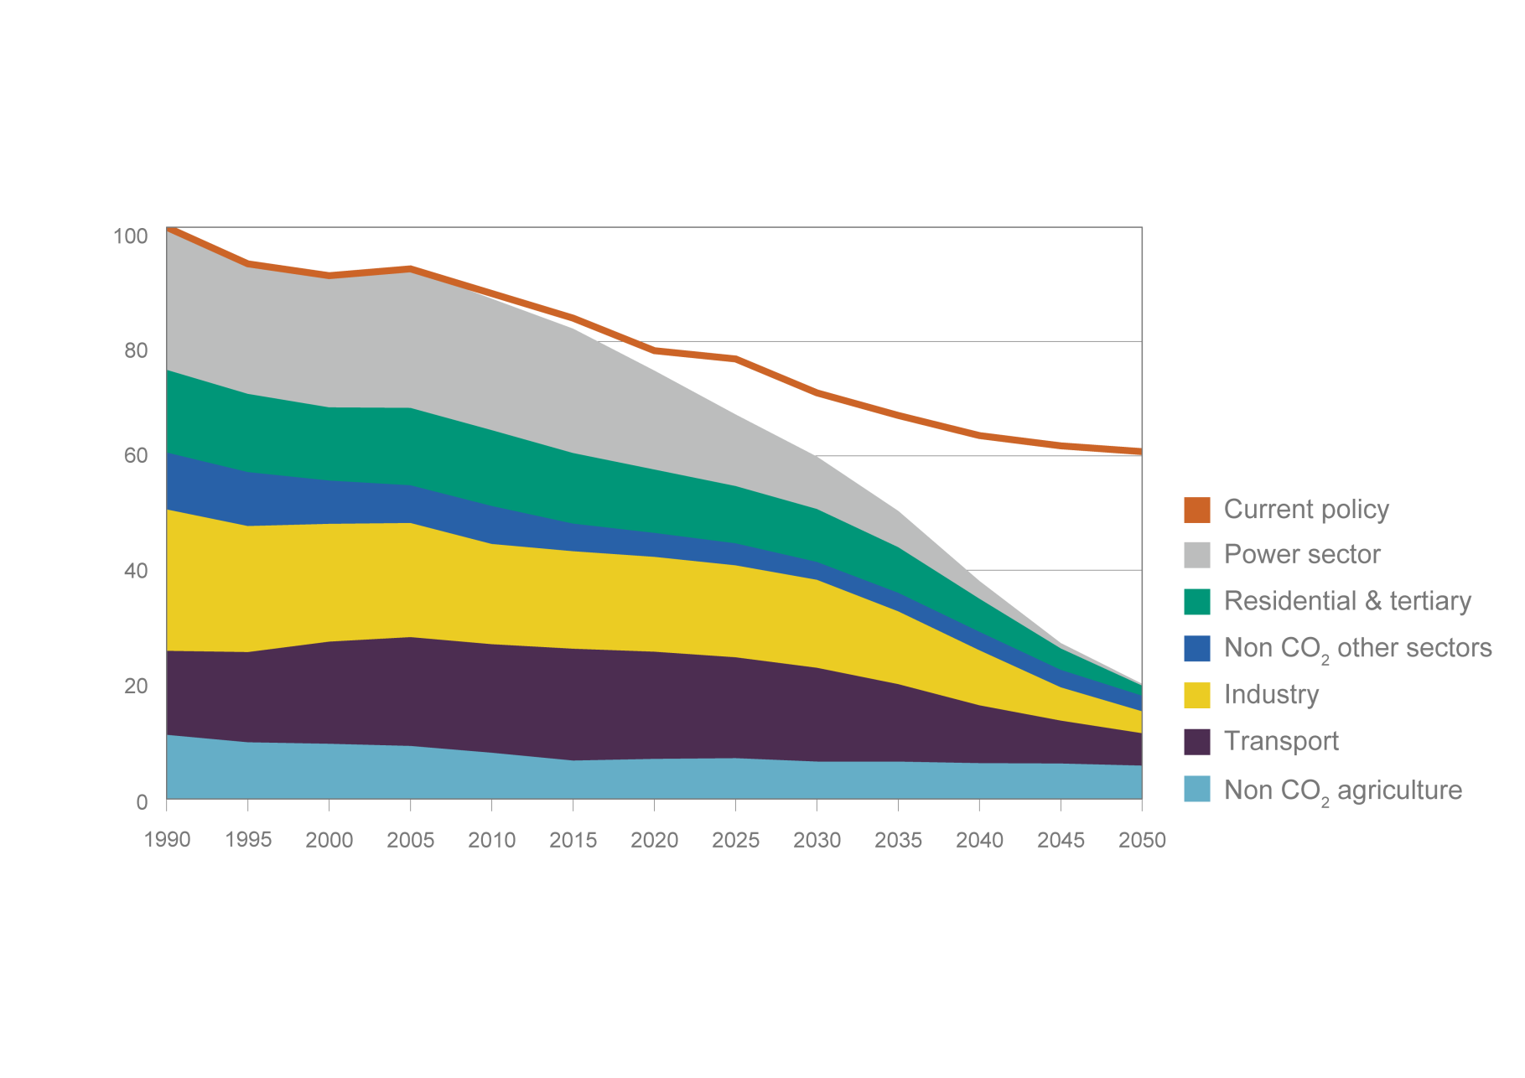
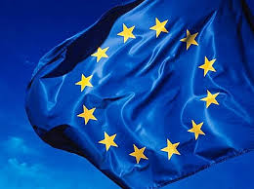
2050 EU Energy Roadmap Scenarios
European Commission Energy Roadmap 2050:
The European Council fixed the objective in 2009 to reduce GHG by 80-95% in the EU in the context of the necessary reductions of industrialised countries as a group – aiming at limiting global warming to 2°C.
Source : European Commission Energy Roadmap 2050
Notes:
1

Slide 2
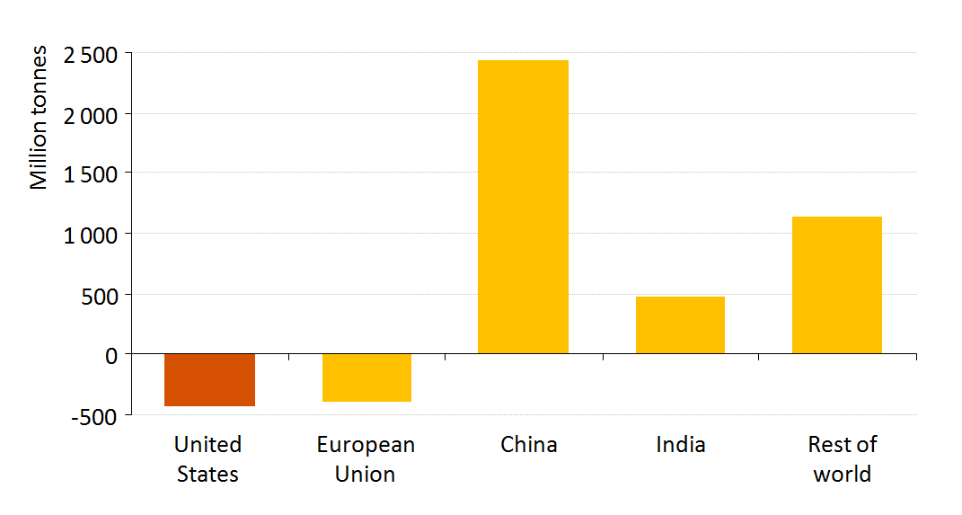
Today’s Reality check:
- 9.9%
+3.6%
Towards a “coal + renewables” paradigm in Europe ?
- 2.2%
> +2%
2011
2011
2012
2012
In EU Coal consumption
In EU Natural Gas consumption
Global CO₂ emissions growth 2006-2011
2
Source : BP, “Statistical Review of World Energy” / EIA, “Golden Age of Gas” / Euracoal
Notes:
2

