Slide 1
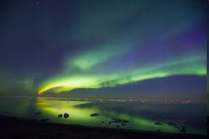
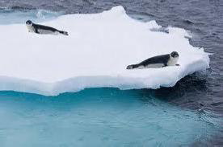
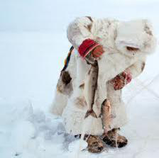
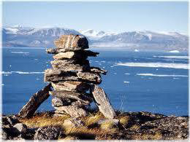
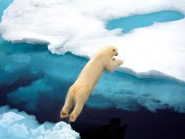
First Groningen-Moscow Conference on EU-Russian Energy Law
University of Groningen
Faculty of Law
May 30-31, 2013
EU Policy Towards Energy Development in the Arctic High North
Kamrul Hossain
Northern Institute for Environmental and Minority Law
Arctic Centre, University of Lapland

Slide 2
Contents
Why the EU is interested in the Arctic High North?
EU Policy towards High North
Arctic Energy Resources and Environmental Challenges
EU Energy Policy
Governance
Conclusion

Slide 3
Why the EU is interested in the Arctic High North?
Interests
  International Trade (shipping and transportation)
  Fishing
  Energy
  Other Economic activities
Stewardship
  Climate change and Environment
  Arctic Inhabitants/ Indigenous Peoples

Slide 4
EU Arctic Policy Development
October 2008: EU Parliament resolution on Arctic Governance
November 2008: EU Commission Communication on the European Union and the Arctic region
December 2009: European Council conclusions on Arctic issues
January 2011: Parliament Resolution sustainable EU Policy in the High North.
June 2012: Joint Communication - Developing a European Union Policy towards the Arctic Region: progress since 2008 and next steps

Slide 5
EU Policy goal for the Arctic
Protecting arctic environment in unison with its population
Promoting sustainable exploitation of Arctic resources and
Improving Arctic multilateral governance
Action
Knowledge
Responsibility
Engagement

Slide 6
Stewardship: Climate Change and Environment
Between 2003 and 2008 melting of Arctic glaciers, ice caps and the Greenlandic ice sheet contributed to 40% global sea level rise.
EU has incorporated 20% of greenhouse gas reduction commitment into law.
Emission reduction commitment of 80-95% by 2050
Promotion of high standard in international climate regulations.
Investment in Arctic research on environmental and climate change agenda
Notes:
6

Slide 7
Stewardship: Arctic Inhabitants/ Indigenous Peoples
Involvement of Arctic population
Indigenous peoples and protection of their rights
Sustainable use of natural resources

Slide 8
Arctic Hydrocarbon Resources

Slide 9
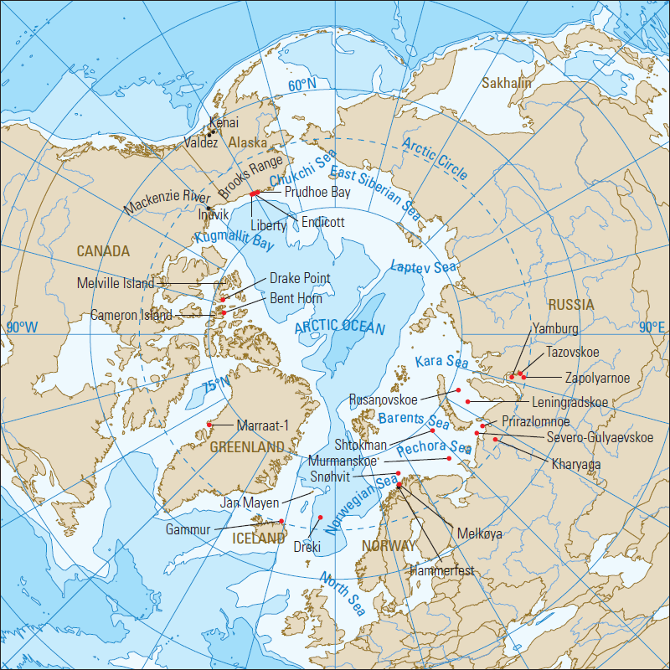
Arctic Fields and Other Locations
Source: Oilfield Review Winter 2010/2011, Vol. 22, No. 4, p. 39; Copyright © 2011, Schlumberger

Slide 10
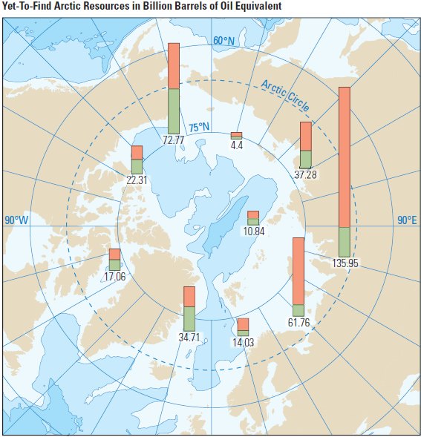
The map shows the most promising areas for finding undiscovered, or yet-to-find (YTF), conventional hydrocarbon resources. The height of each column represents the volume of YTF resources (red for gas and green for oil) in billions of barrels of oil equivalent. The base of each column is plotted approximately at the basin location.
Source: Oilfield Review Winter 2010/2011, Vol. 22, No. 4, p. 41; Copyright © 2011, Schlumberger

Slide 11
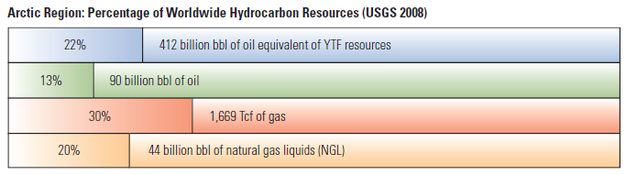
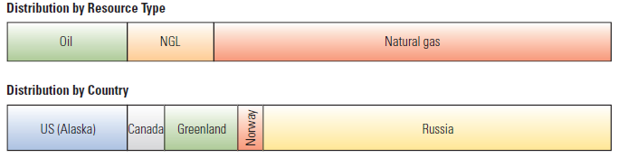
These graphs present the Arctic YTF resource volume, type and location compared with the rest of the world. The data indicate that most of these resources consist of natural gas in Russia.
Source: Oilfield Review Winter 2010/2011, Vol. 22, No. 4, p. 41; Copyright © 2011, Schlumberger

Slide 12
EU Energy Imports:
With enlarged EU in 2007 energy dependence increased by:
  84 % imported natural gas
  93 % imported oil
Current figures:
  50 % of the total EU energy consumption is imported
  38 % of oil imports come from Russia
  15 % of oil imports come from Norway
  53 % from the European High North
  65–70 % rise is predicted in next 20 years

Slide 13
Arctic Energy Development will have Adverse Environmental Consequences:
Acceleration of Climate Change
Pollution by oil spills
Difficulties in clean-up operation
Adverse impact on marine living resources
Other indirect impacts
Impact on the livelihood of indigenous peoples

Slide 14
EU Energy Policy
No integrated energy policy
A set of policies connecting
  Energy market
  Energy efficiency
  Climate change
Lisbon Treaty opened the way for a true EU Energy Policy

Slide 15
EU Energy Policy: Sustainability
Climate change
Competition/Efficiency
Supply security

Slide 16
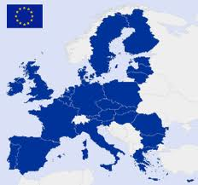
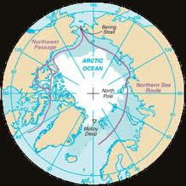
Governance
Legitimacy
Promotion of multilateral cooperation
  UN LOS Convention
  Arctic Council Initiatives

Slide 17
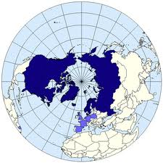
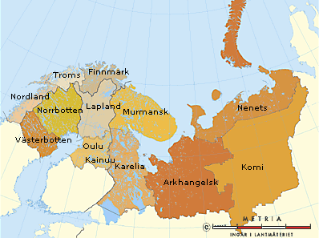
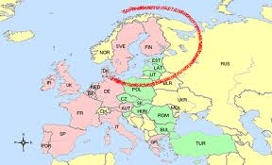
EU High North Cooperation
Circumpolar Cooperation: Arctic Council
Regional Cooperation: Barents Euro-Arctic Council
Northern Dimension Policy

Slide 18
Regulatory Challenges:
Fragmented regulations with implication of offshore development
  LOS Convention 1982
  OPRC Convention 1991
  London Convention 1972
  MARPOL 73/78 Convention
Regional and bi-lateral agreements
  Arctic Council Oil Spill Agreement
  Espoo Convention
  OSPAR Convention
  Agreement on Five European Arctic Nations
  Bilateral Agreements
Lack of centralized regulations
Soft-law initiatives

Slide 19
Conclusion
Can environmental sustainability be met with existing EU Policy towards the Arctic?
What future for Arctic energy – is moratorium an option?
If not, what then?

Slide 20
Thank you for your attention!

