Slide 1
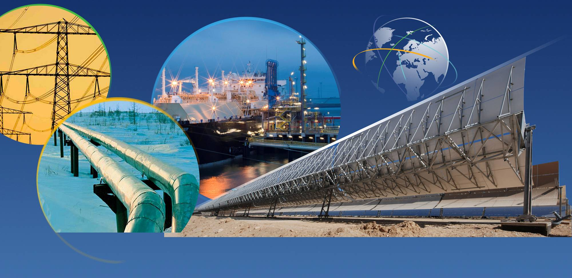

EU – Russia Energy Relations:
The legal and political framework
02/07/2013

Slide 2
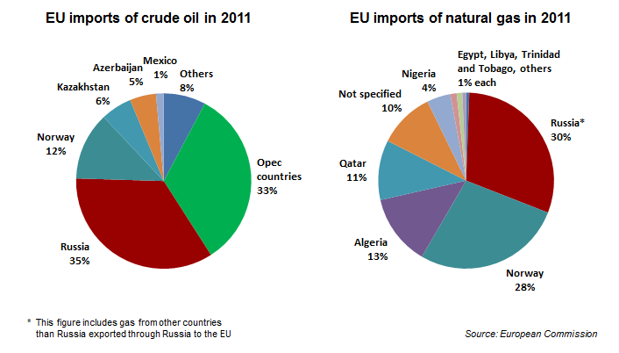
EU oil and gas imports

Slide 3
EU-Russia energy relations
Trade in energy commodities dominating

Slide 4
The Political Framework
… developed and active, but based on soft law
EU-Russia Energy Dialogue
Memoranda of Understandings / political declarations
Early Warning Mechanism
EU-Russia Energy Roadmap until 2050
Structure: Several working groups
Regular meetings
Notes:
4

Slide 5
EU-Russia Energy Dialogue: A longstanding partnership
Coordinators:
EU Energy Commissioner
RF Energy Minister
Delegated Coordinators
Director General /
Deputy Minister
Gas Advisory
Council
Group
Markets & Strategies
Thematic Group
Energy Efficiency
Thematic Group
Electricity
Thematic Group
Nuclear matters
Notes:
The EU and Russia have a longstanding energy partnership and are mutually interdependent in terms of energy relations.
Energy represents 65% of total EU imports from Russia.
39% of total EU’s gas imports and 27% of total EU’s crude oil imports, 24% of total EU coal imports origin from Russia.
The dependency on Russian supplies varies significantly and is in Eastern and South-Eastern Europe much stronger than in Southern or Western Europe.
Several member states - Finland, Estonia, Latvia, Lithuania, and Bulgaria rely to 100% on Russian gas supplies. Germany, Poland, Hungary but also Italy import significant amounts of Russian gas.
The overall level of dependency on Russian energy should be acceptable – if there was a functioning EU internal market and if all Member States could rely also on other sources if necessary.
Therefore, diversification and the completion of the internal energy market are key objectives of the EU policy.

Slide 6
The Legal Framework
– underused & outdated?
Bilateral:
Partnership and Cooperation Agreement (PCA) 1997
Negotiations on follow-up agreement: New Agreement
Multilateral:
WTO
Energy Charter Treaty
Notes:
6

Slide 7
Lisbon Treaty - a stronger legal basis for EU (external) energy policy
Competitiveness
Solidarity between MS
Sustainable Development
Security of supply
Now founded on Article in Lisbon Treaty (Art. 194 TEU)
Notes:
Article 194
1. In the context of the establishment and functioning of the internal market and with regard for the need to preserve and improve the environment, Union policy on energy shall aim, in a spirit of solidarity between Member States, to:
(a) ensure the functioning of the energy market;
(b) ensure security of energy supply in the Union;
(c) promote energy efficiency and energy saving and the development of new and renewable forms of energy; and
(d) promote the interconnection of energy networks.

Slide 8
EU: increasing reliance on external supply
100
80
60
40
20
in %
2005
2008
2020
2030
2005
2008
2020
2030
94,1%
92,7%
84,3%
82,8%
82,4%
75,9%
62,3%
57,7%
Based on 2009 baseline scenario
OIL
GAS
Notes:
8

Slide 9
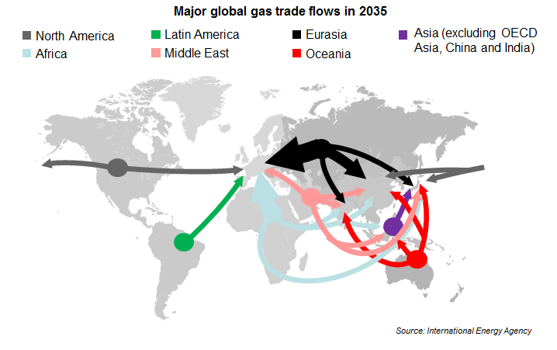
Major global gas trade flows in 2035

Slide 10
  EU-Russia: from partnership to further integration
Intensify negotiations on legal basis (New Agreement)
Step up Partnership for Modernisation in energy, intensify cooperation on energy efficiency and technology
Prepare EU-Russia energy roadmap until 2050
Conclude an agreement between the EU, Russia and Belarus on the technical rules for the management of electricity networks in the Baltic region
Cooperation on infrastructure - develop and maintain Eastern Corridor (oil and gas)
Notes:
10

Slide 11
Thank you for your attention johannes.baur@ec.europa.eu
02/07/2013

