Slide 1
EU and Russia Energy Trade: Impact of WTO, Transit and Integrated Economic Areas (introductory remarks of the session’s chair)
A.Konoplyanik
First Groningen Moscow Conference on EU-Russian Energy Law “Legal Aspects of Guaranteeing EU-Russian Security of Energy Demand and Supply”, Groningen, The Netherland, 30-31 May 2013

Slide 2
Russia-EU cross-border gas supply chain
EU-25/27 border
Since 2004/07
“New” EU-25/27
CIS
Russia
LTC
LTC
LTGEC
Retail supplies
Wholesale supplies
Export Supplies
Production
Till 2004
“Old” EU-12/15
COMECON
U S S R
EU-12/15 border
B
A
C
2
A.Konoplyanik, Groningen, Transit Session, 31.05.2013

Slide 3

RUSSIAN GAS EXPORT TO EUROPE: ON-BORDER SALES AND TRANSIT SEGMENTS
Soviet/Russian LTGEC to EU: A, B, C – points of change of ownership for gas and/or pipeline; C – delivery points to EU
Map source - IEA
C
B
А
A.Konoplyanik, Groningen, Transit Session, 31.05.2013
3
Notes:
3

Slide 4
Russian Gas Supplies to Europe: Zones of New Risks for Existing Transit Supplies Within Russia/Gazprom Area of Responsibility
Direction of Russian gas flow to Europe
Zones of new risks
France Switzerl. Italy Turkey | Germany Austria Greece | Poland Slovakia Czech R. Hungary Romania Bulgaria Baltic St. | Belarus Ukraine Moldova | Russia
New Risks 1 zone
New Risks 2 zone
А
RF
EC – 25/27
В
USSR
EC – 15
С
COMECON
Italic – non-EU countries; New EU accession states: underlined – since 01.05.2004, underlined + italic – since 1.01.2007; bold – non-EU members of Energy Community Treaty ; A, B, C – points of change of ownership for Russian gas and/or pipeline on its way to Europe
A.Konoplyanik, Groningen, Transit Session, 31.05.2013
4

Slide 5
EU internal gas market architecture according to Third EU Energy Package (entry-exit zones with virtual trading points/hubs)
-
Source: 17th Madrid Forum (Jan 2010), Energy Regulators of EU Member States
Pipelines-interconnectors between EU zones
Supplies to the EU from non-EU
A.Konoplyanik, Groningen, Transit Session, 31.05.2013
5
5

Slide 6
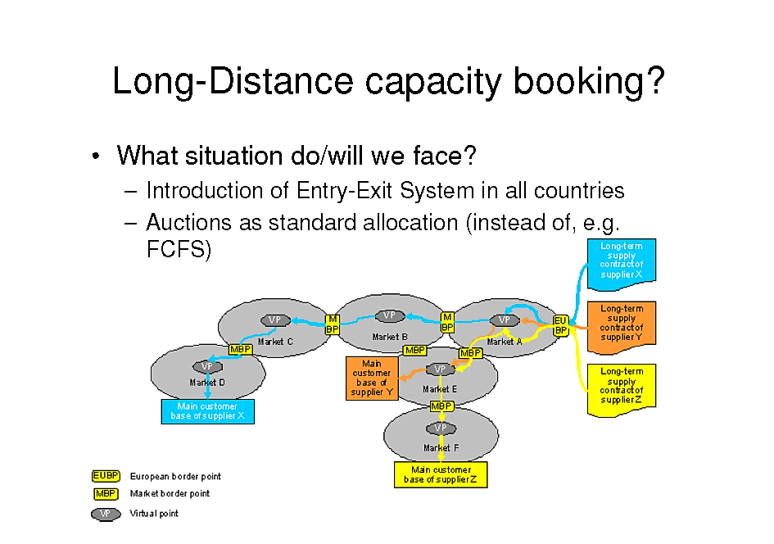
Long Distance Capacity bookings in the EU Regulatory Framework (appeared in GTM in result of Consultations)
Yes, this is a given legal reality to be dealt with by any actor at the EU market, but …
Whether Auctions are the best effective systemic solution?
3
A.Konoplyanik, Groningen, Transit Session, 31.05.2013

Slide 7
Contractual Mismatch Problem: major risk for contract parties in unbundled gas market
Duration (D)
Commodities market
CP 1
CP 2
Supply contract: D + V
Volume (V)
Contractual mismatch = = ΔD + ΔV
CP 1
Transit contract: D + V
CP 3
or
Capacities market
Transportation contract: D + V
Contractual mismatch: between duration/volumes (D/V) of long term supply/delivery contract (LTGEC; CP1-CP2) and transit/ transportation contract (CP1-CP3); the latter is integral part to fulfill the delivery contract => risk non-renewal transit/ transportation contract => risk non-fulfillment supply/delivery contract. Core issue: guarantee of access to/creation of adequate transportation capacity for volume/duration of long term contracts
7
A.Konoplyanik, Groningen, Transit Session, 31.05.2013

Slide 8
Thank you for your attention www.konoplyanik.ru andrey@konoplyanik.ru
A.Konoplyanik, Groningen, Transit Session, 31.05.2013
8

