Slide 1
Energy Investment in the EU and Russia: Investment Regulation under the Third Energy Package and the Russian Law on Foreign Investments in Strategic Sectors (comments of the discussant)
A.Konoplyanik
First Groningen Moscow Conference on EU-Russian Energy Law “Legal Aspects of Guaranteeing EU-Russian Security of Energy Demand and Supply”, Groningen, The Netherland, 30-31 May 2013

Slide 2
3rd EU Energy Package: two “standard” procedures to build new capacity in EU
Standard “no-exemptions” procedure = “bottom-up” approach based on market demand for capacity = SHOULD BE a mainstream procedure => should be (?) based on EU-wide coordinated (& legally binding) “open season”
3rd EU Gas Directive
Art. 13.2
Art. 36
Workable but (might be) not best effective procedure:
(1) too lengthy (Nabucco: 28 months to receive exemptions, while Turkmen-Uzbek-Kazakh-China pipeline was built from the scratch in shorter time),
(2) each exemption based on individual perceptions, etc.
Standard “exemptions” procedure = “top-bottom” approach (SOS-based, etc.) or when derogation from the rules of acquis = FACTUAL mainstream procedure = exemptions from the EU rules as a general rule (22 major EU gas infrastructure projects since 2003)
A.Konoplyanik, Groningen, Investment Session, 31.05.2013

Slide 3
CAM NC & new capacity
CAM NC allows to book up to 15 years, but
What if (auction shows that) there is no available capacity at the year 7-8+/-, when it is possible to invest & develop new available capacity needed by the market? CAM NC does not provide the answer…
A.Konoplyanik, Groningen, Investment Session, 31.05.2013

Slide 4
Open Season as Universal Mechanism of Long-, Medium-, and Short-Term Allocation of Capacity
10YNDP
Long-term
solution
(appr. Y5/7 forward) – to liquidate existing deficits & to prevent future deficits to appear
Market test for / Allocation of capacity
via regular annual / bi-annual mechanism
no
Opportunities to invest in capacity expansion
Available
Capacity
Short-term solution (approx. Y1-Y5/7) - to deal with existing deficits
yes
no
yes
TSO to invest (Art.13.2)
Booking: booked
(allocated) capacity
deducted from
Available Capacity
Allocation mechanism for existing
capacity – non-discriminatory,
transparent, competitive : auctions
CAM FG / NC
Investment
Prevention of speculative hoarding & capacity blocking (e.g. operational use-it-or-loose-it (UIOLI) principle)
CM FG / NC (Annex to Reg.715)
4
A.Konoplyanik, Groningen, Investment Session, 31.05.2013
Notes:
4

Slide 5
What provisions of the Third Package are supportive for such mechanism
Directive 2009/73/EC
Regulation (EC) 715/2009
  Art. 13.1(a), 13.2, 13.4
  Art. 14
  Art. 17 (e,f,g)
  Art. 22
  Art. 35.2
  Art. 36.6,
  Art. 41.1(g)
  Art. 42.2(a)
  Art. 52.1(d)
  Art. 4
  Art. 8.3(b)
  Art. 12.1, 12.2
  Art. 16.2(a), 16.5
  Art. 18.1, 18.3
  PLUS: GGPOS-2007
  Esp. Sect. 4.1 - 4.2 (esp. if “sponsor” = TSO)
“TSOs must build infrastructure to satisfy all economically reasonable and technically feasible capacity demand”
(See also: “Memorandum on TSOs Obligations to Invest in Capacity” prepared by the Russian side of WS-2 for GAC 25.04.2012 meeting)
5
A.Konoplyanik, Groningen, Investment Session, 31.05.2013

Slide 6
Open Season as Universal Mechanism of Long-, Medium-, and Short-Term Allocation of Capacity
CAM + CMP now in place
10YNDP
CEER Blueprint on Incremental Capacity being developed now
Long-term
solution
(appr. Y5/7 forward) – to liquidate existing deficits & to prevent future deficits to appear
Market test for / Allocation of capacity
via regular annual / bi-annual mechanism
no
Opportunities to invest in capacity expansion
Available
Capacity
Short-term solution (approx. Y1-Y5/7) - to deal with existing deficits
yes
no
yes
TSO to invest (Art.13.2)
Booking: booked
(allocated) capacity
deducted from
Available Capacity
Allocation mechanism for existing
capacity – non-discriminatory,
transparent, competitive : auctions
CAM FG / NC
Investment
Prevention of speculative hoarding & capacity blocking (e.g. operational use-it-or-loose-it (UIOLI) principle)
CM FG / NC (Annex to Reg.715)
6
A.Konoplyanik, Groningen, Investment Session, 31.05.2013
Notes:
6

Slide 7
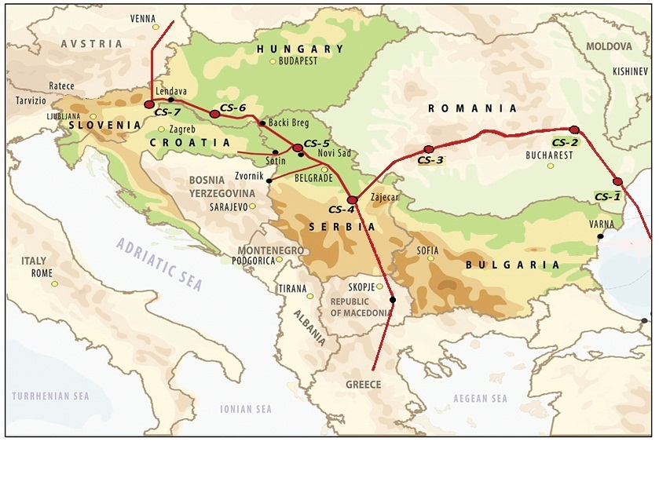
Sweet Dream Project map
A.Konoplyanik, Groningen, Investment Session, 31.05.2013

Slide 8
Some key provisions of “Sweet Dream” Project bringing it in full compliance with 3rd EU Energy Package rules (no need in exemptions)
Full ownership unbundling (supplier as a shipper only)
Legally binding “open season” (shipper to book capacity requested)
TSO shall invest – guaranteed return of investment (financial risks for TSO = 0: “ship or pay” + UIOLI)
MTPA above capacity volumes requested
Whether CAM NC provisions will apply? (20% short-term capacity reservation, 15 year-long booking, etc.) =>
CEER Blueprint on Incremental Capacity (03.06.2013 meeting) => cooperative efforts within informal Russia/GG-EU (CEER, ENTSOG, CEC) expert Consultations/GAC WS2
A.Konoplyanik, Groningen, Investment Session, 31.05.2013

Slide 9
Thank you for your attention www.konoplyanik.ru andrey@konoplyanik.ru
A.Konoplyanik, Groningen, Investment Session, 31.05.2013
9

