Slide 1
Discussion points:
EU-Russia relations, competition in gas markets
Andrei V Belyi
CEURUS, University of Tartu, Estonia
CEPMLP, University of Dundee, UK

Slide 2
EU competition policy: main issues
Forges new market practices (price indexation and short term capacity contracts) rather than correcting illegalities?
➔ Practical reversal of the liberalization dogma ‘trust the markets’
Creates competition or countervailing power against large companies? But is security of supply and consumer’s protection is best ensured ?
Forcing hubs does not especially lead to a competition (churn rates are low in most of the gas markets), allowing trading is not enough, suppliers must be in the picture

Slide 3
Russia’s response
Towards a conflict of positions, non-cooperation and non-transparency
To what extent the over-reliance on capital-intensive investments is responding economic reality of the world markets?
By withdrawing from provisional application of the ECT, Russia withdrew possibilities to defend its investment rights in the EU. Is the Draft Convention a valid alternative?

Slide 4
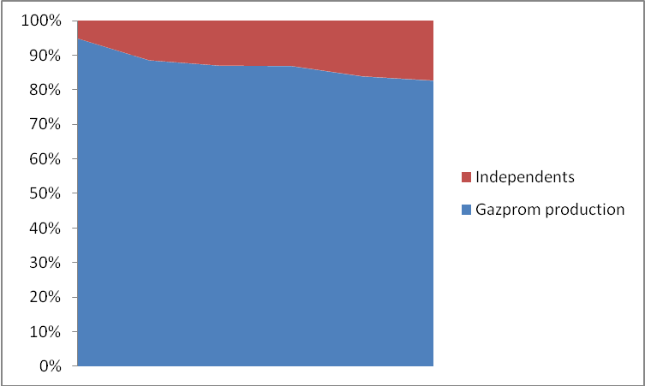
Gazprom’s gas deliveries to Europe 2007-2011
Source: T. Vehrs, Gazprom Germania presentation, Tallinn 14.11.2012
Emergence of over-capacity in export pipelines (Nord Stream, South Stream and existing pipelines ensure more than 300 bcm per annum of export capacity, whereas Russia’s gas exports are about 150 bcm)
Gazprom’s positions are also weakened domestically:
Independent producers (Novatek, Itera) and oil companies (Rosneft-TNK) Increase their share in Russia’s gas production
➔ Pressure on exports ➔ Oct 2012 Novatek concludes 10 yrs agreement to supply German costumer EnBV with 2 bcm annually
1992-2010

Slide 5
Concluding questions
Possible outcomes of anti-trust monitoring: commitment, conflict or compromise?
How Gazprom will adapt to new market realities? Will it allow a certain export demonopolization?
How the EU will combine priority of competition with security of supply? And where consumers’ interests located?
Will the new and emerging suppliers be attracted by the EU model ?

