Slide 1

University Medical Center Groningen
Economic Impact Study 2014
Victor Verrijp: Directorate Policy and Strategy
Jan Sikkema : Center for Development and Innovation
October 31, 2014

Slide 2
Two more years
Our mission is to add two more healthy years
to our lives by 2020
11.000 workers, 4500 students en 850 PhD-staff
Based in a region acknowledged by the EU as European example
Missionstatement:
“Building the future of Health 2020”

Slide 3
Adding healthy years to life
Health
Ambition
Prevention
Treatment
Life course
disorder 2
Age
birth
disorder
complication

Slide 4
Impact on Society
Changing attitude towards academic research
Impact on economy and society is additional evaluation criterion
Transfer of Technology
Initiation of spin-off and start-up companies

Slide 5

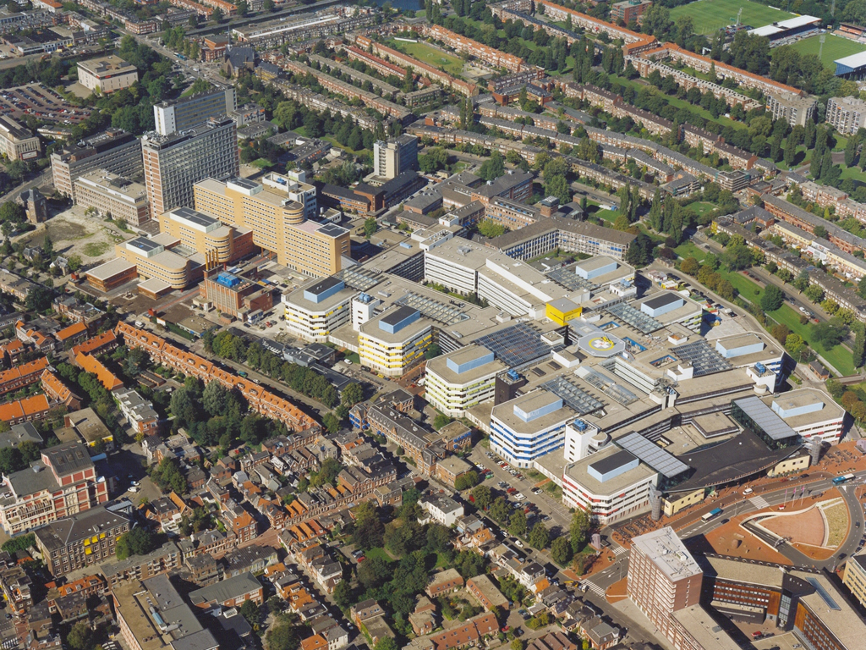


Pre-clinical and pharamaceutical
Research
New buildings: a.o. ERIBA
Spin-off
companies
LifeLines
Healthy Ageing
Campus Netherlands
Clinical Research, incl.
advanced imaging facilities
Bio-GMP
facility
Patients
Patients
Patients
Spin-off
companies
Main entrance
Valorisation
Center
Spin-off
companies
NH Hotel
University Medical Center Groningen
Notes:
5
Kop plus grafiek/schema

Slide 6

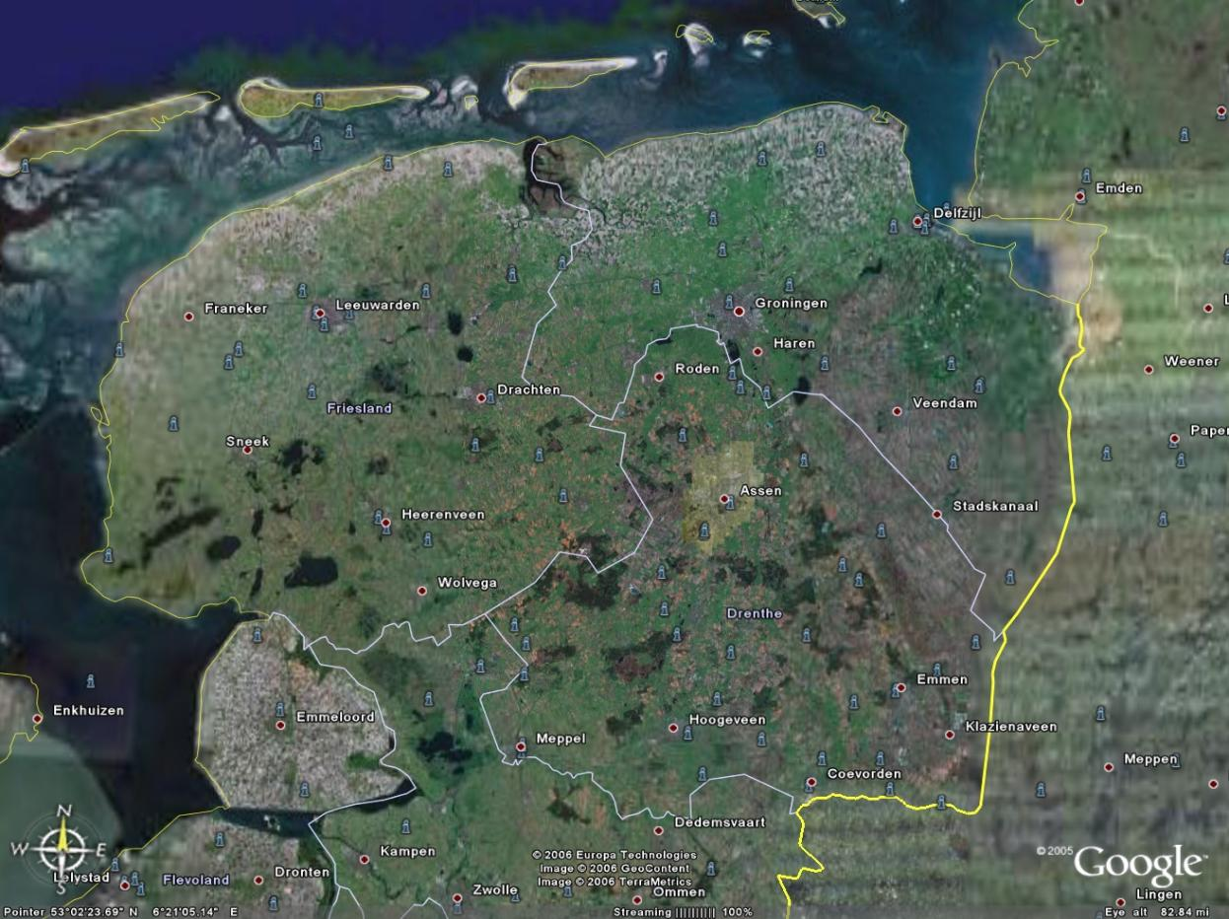
LifeLines cohort
To investigate why some people get old in a healthy manner, and others have already severe impairments or diseases early in their life

Slide 7
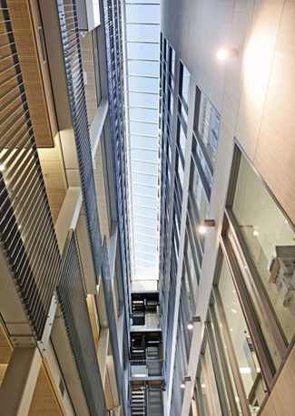
ERIBA –
European Institute for the Biology of Ageing
To understand the mechanisms that result in aberrant functioning of old cells and tissues in order to develop evidence-based recommendations for healthy ageing

Slide 8
Impact on Economy and Society
Economy: Gerdien Regts
Impact on other aspects of Society:
  Diffusion of knowledge
  Top referal care
  Regional coordination of care and medical education
  ➔ROBIJN

Slide 9
Discussion
Political debate on the value of UMCs
  What do we mean by Healthy Years?
  How to measure our succes?
    Zorgmonitor Groningen (www.sociaalplanbureaugroningen.nl/zorgmonitor-groningen)
    Citations, Publications and PhDs (www.cwts.nl)
  How should government or the insurance companies fund the UMCs?

