Slide 1
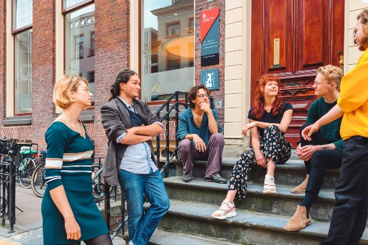

Research Master Programme
Master’s Week
Laura Georgescu (coordinator)
Email: l.georgescu@rug.nl

Slide 2

Who is the ReMa program for?
Advanced training in philosophical research
Careers requiring strong research skills (Public policy& government; Think tanks; Consultancy; Journalism)
Preparation for a PhD in philosophy or humanities

Slide 3
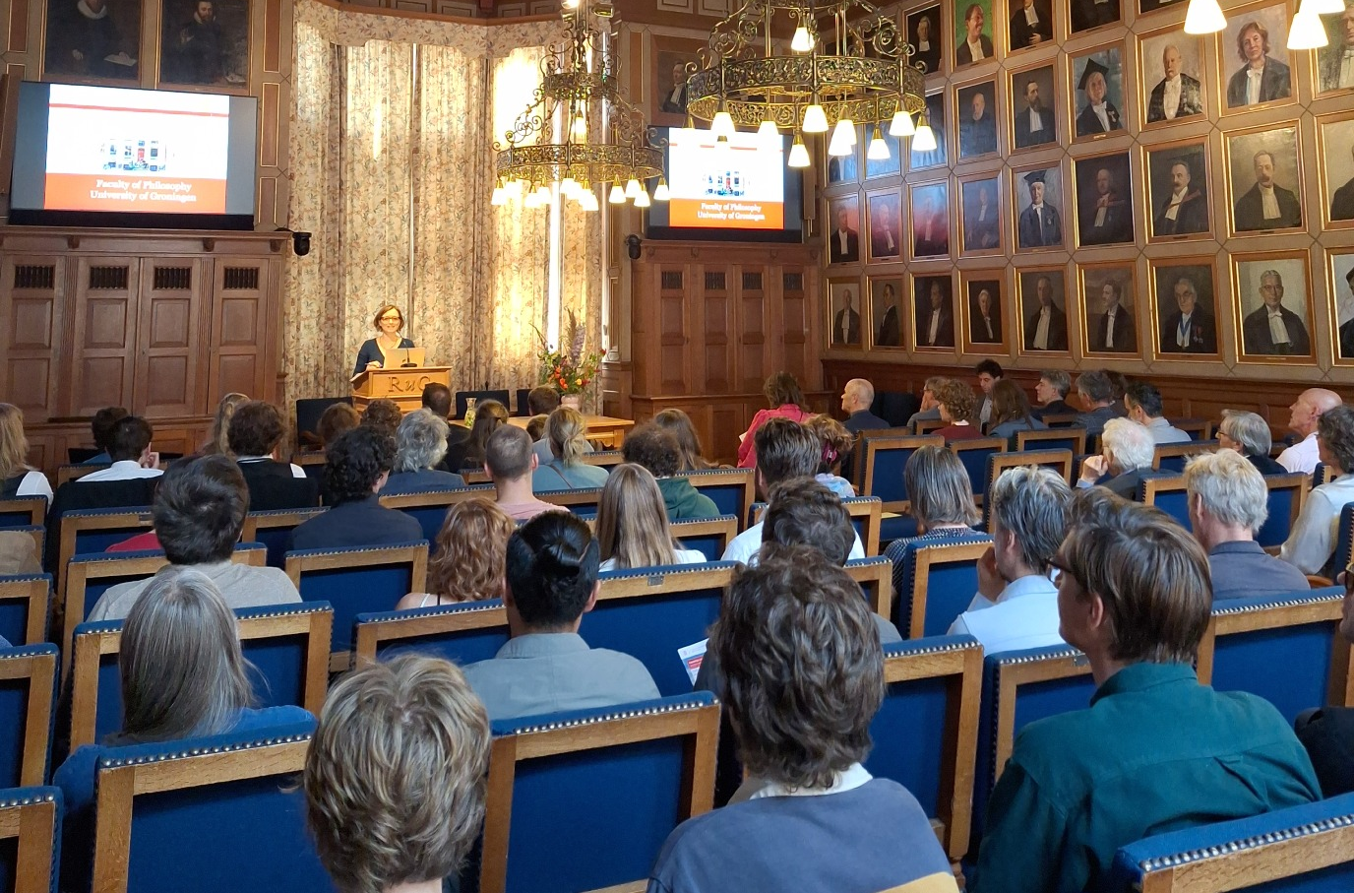
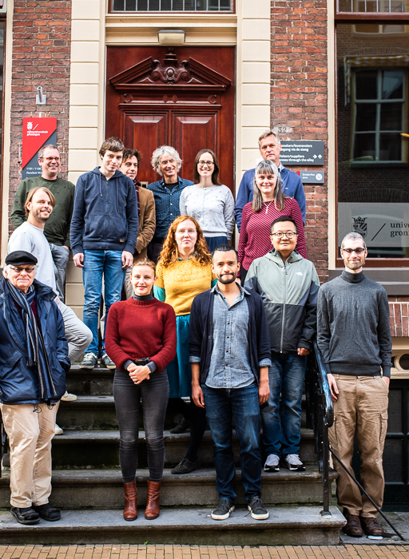
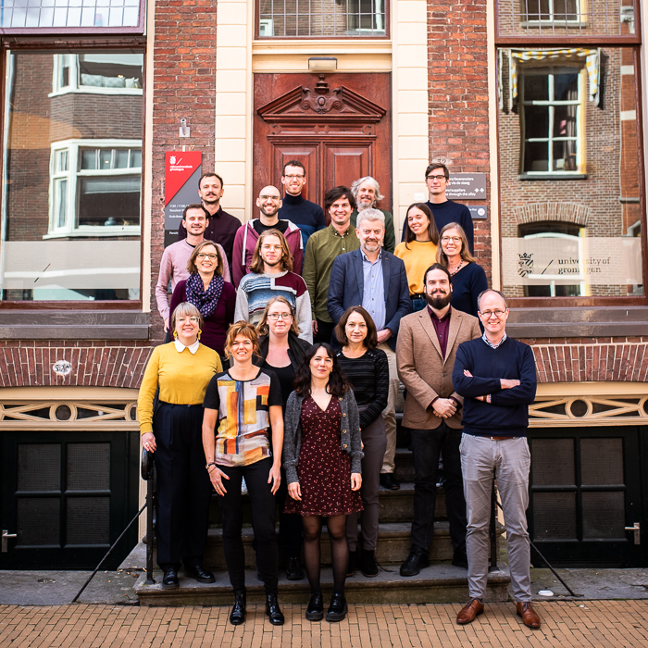
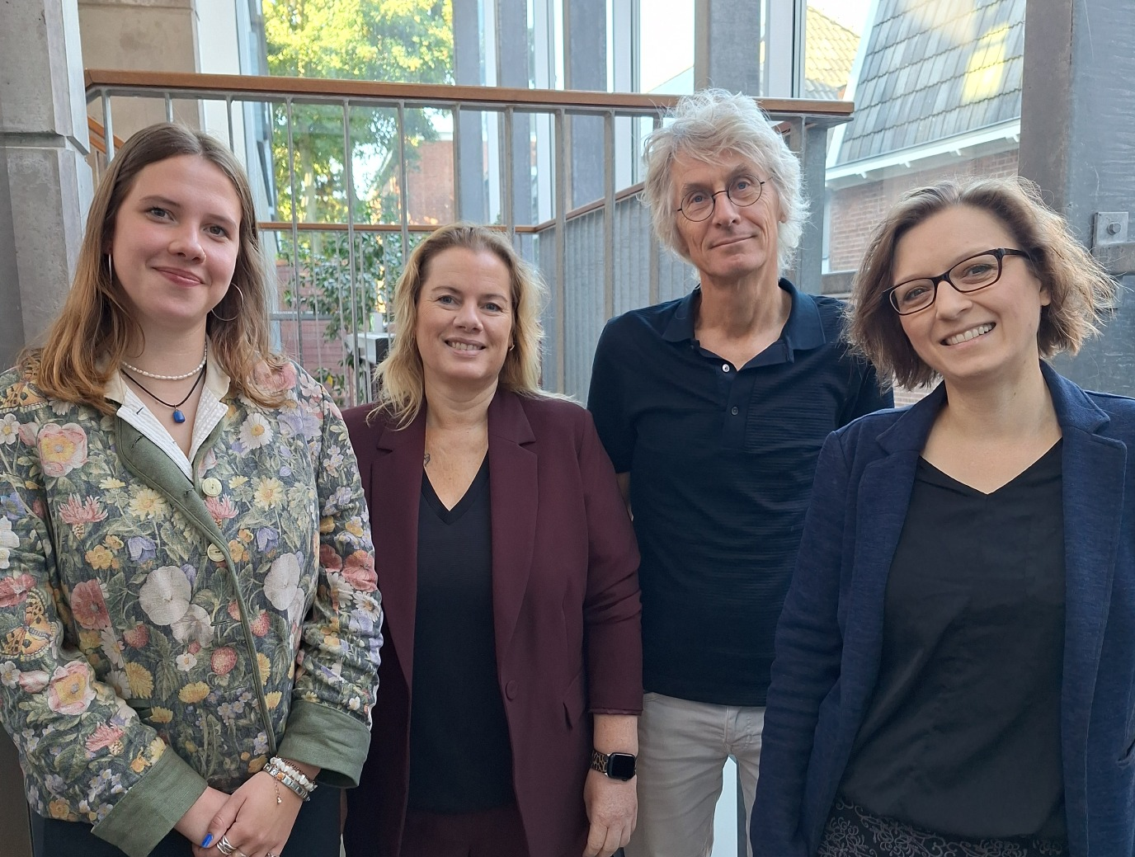
Why the ReMa at RUG’s Faculty of Philosophy?
  Independent philosophy faculty
  Small faculty
  Small scale, interactive courses
  Internationally renowned stuff
  Philosophical diversity

Slide 4
Why the Philosophy ReMa at RUG?
Work in a collaborative, faculty-mentored research environment
Connect with wider research networks and academic communities
Access funded teaching assistantships
Prepare for a PhD and/or a research intense career
Study associations (STUFF)

Slide 5
The ReMa Program
Duration: 2 years
ECTS: 120
Language of instruction: English
Starting date: September or February

Slide 6
When to apply?
May 1st
Enrolment on 1st September:
November 1st
Enrolment on 1st February

Slide 7
What will you do?
ReMa Specific Courses:
  Current Issues (CI) courses
    Instructors teach topics from their ongoing or recent research
  Research in practice I &II
    Develop advanced reading, research and writing skills
    Learn how to write a successful grant proposal
+ Elective courses: (e.g. Analytical nihilism, Medieval Metaphysics, Philosophy of Machine Learning, Philosophy of Neuroscience, Social Phenomenology, Philosophy of Death)

Slide 8
What will you do?
ReMa specific activities:
    Specialisation courses: Standard master course for 5 ECTS + an additional tutorial for 5 ECTS
    Research stay abroad (mandatory for Dutch students; optional for international students)
    ReMa thesis
      publishable journal article

Slide 9
What you can do
Attend departmental research seminars
Participate in workshops, conferences, and seminars hosted by the Faculty of Philosophy
Join reading groups for collaborative learning
Develop teaching skills through Teaching Assistant (TA) opportunities
Learn to conduct and communicate research through tutorials and lecturer–student supervision
Collaborate with actual academic researchers

Slide 10

Who can apply ? Admission requirements
Bachelor’s degree in philosophy or philosophy of a specific scientific discipline, or another Bachelor’s degree which the admissions board considers to be equivalent
Transcript with mean score of 7.5 out of 10 (according to the Dutch Grading system)
If the program included a thesis, then we expect the thesis to have received at least 8 out of 10 (Dutch Grading System)
Motivation Letter
Writing sample (e.g. BA thesis, student essay)
Two letters of recommendation
Proof of English proficiency
CV

Slide 11
How to apply
For information about the admission procedure you may contact the university’s admissions office: https://www.rug.nl/admissions, the student advisor: fil-study-advisor@rug.nl and/or the program coordinator: l.georgescu@rug.nl
fil-admissions@rug.nl

Slide 12
For information about the admission procedure you may contact the university’s admissions office: https://www.rug.nl/admissions, the student advisor: fil-study-advisor@rug.nl and/or the program coordinator: l.georgescu@rug.nl

Slide 13
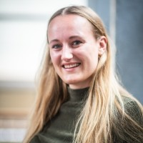
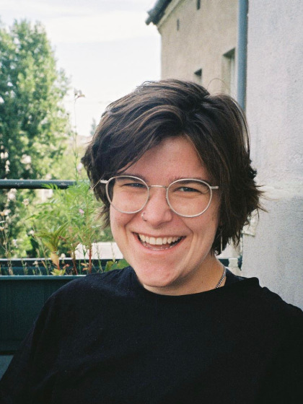
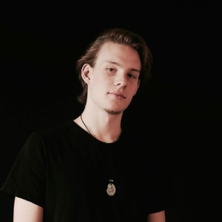
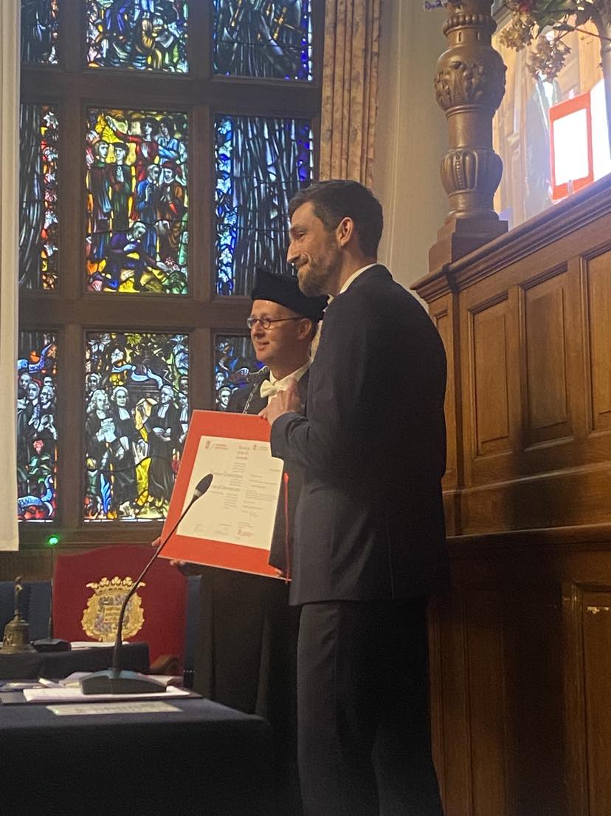
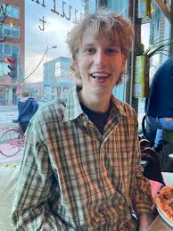
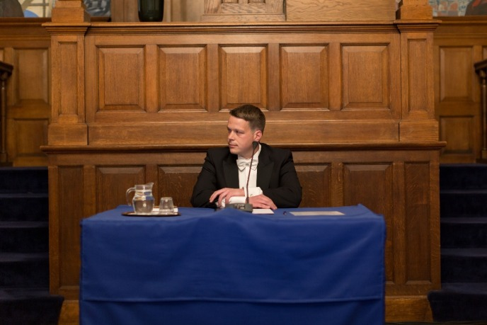
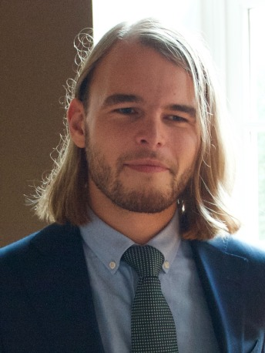
https://www.rug.nl/filosofie/contact/alumni

Slide 14
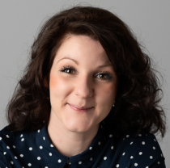
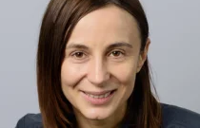
Laura (coordinator): l.georgescu@rug.nl
Janine (Student advisor): fil-study-advisor@rug.nl

