Slide 1
Master: Philosophy & Science (P&S)
Double master
Faculty of Philosophy

Slide 2
Philosophy and science
Every field of study raises philosophical questions
Foundations, methodology
Ethical and political implications
Connection to other disciplines
…
This program allows you study these questions, thus giving you a deeper insight into your discipline
You gain an additional master’s degree of 120 EC on top of your other master

Slide 3
Examples of philosophical questions
Should science aim to be free of social and political influences?
How should we understand scientific progress?
Do large language models like chatGPT have beliefs?
What makes climate change models reliable or trustworthy?
In what sense are institutions (e.g. companies) real?
Are mental disorders just brain disorders?

Slide 4
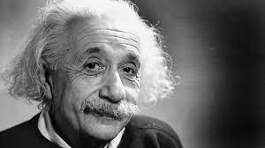
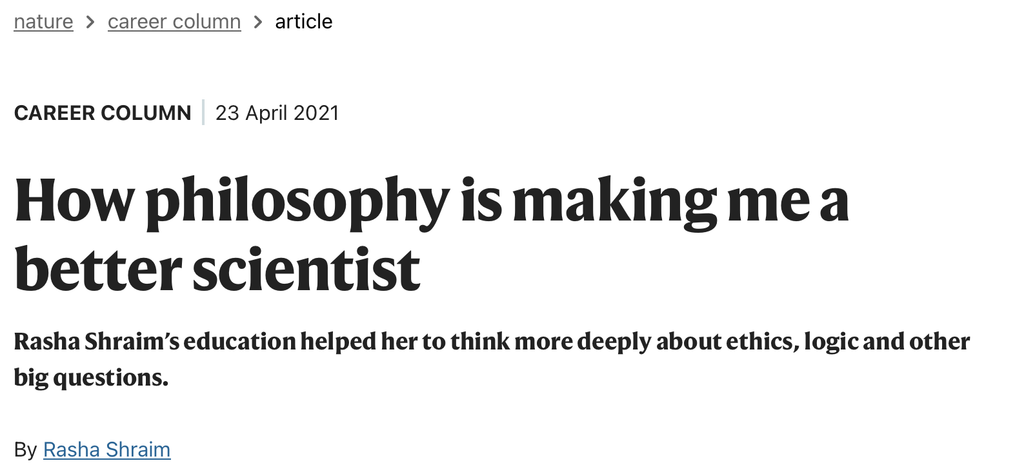
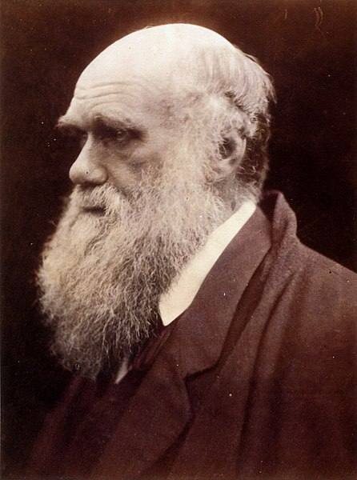

Philosophy and science

Slide 5
Philosophy of science in Groningen
Internationally renowned philosophers, often working together with scientists and scholars from other fields
Hands-on experience in applying philosophy to scientific issues
Study programs at the faculty are very highly ranked in student surveys
Small faculty, close-knit community
Top research: ERC grants, NWO Veni, Vidi, Vici grants

Slide 6
The program
Small-scale, interactive courses in history and philosophy of science
Writing skills
Tutorials where you focus on specific philosophical topics, supervised by expert
Master thesis on a topic of your own choice
Can be done in 1 or 2 years, concurrently or after your other master
Courses mostly in the evening

Slide 7
Courses
Academic philosophical writing
Philosophy of science
Social dimensions of knowledge
History of science
Intuition in science
Intervention and scientific error
Explanation
Selected topics
Tutorials
Thesis

Slide 8
Examples of tutorial topics
Autonomy, authenticity, and the brain
Decision-making in science policy
Interpretation of physical theories
David Hume and causality
Philosophy of Artificial Intelligence
The nature of mental disorders
The wisdom of crowds
…

Slide 9
After your studies
Strong communicative skills, analytical skills, a critical attitude, and awareness of fundamental assumptions - key assets in your future career!
Job examples
Science policy
Consultancy
Journalism
PhD in your field (or in philosophy)
Management
Think tank, research company
…

Slide 10
Admission
You need to be be accepted for a master program, currently study a master program, or else have completed a master program.
No previous knowledge of philosophy assumed
BA PoaSD: Welcome!
BA Philosophy: Not suited
Non-English diploma: English language test (exemption may be possible)

Slide 11
Admission
Studielink application: Sign up for one of the following tracks:
Philosophy of Natural Sciences, Philosophy of Life Sciences, Philosophy of Cognitive Sciences, Philosophy of Economic and Behavioural Science, Philosophy of Arts and Cultural Sciences, Philosophy of Political Sciences, Philosophy of History
More info: Website and study advisor

Slide 12

Video and testimonials
Philosophy & Science
https://www.rug.nl/masters/philosophy-and-science/

Slide 13
Questions?
Markus Eronen (coordinator): m.i.eronen@rug.nl
Study advisors: fil-study-advisor@rug.nl
Current students

