Slide 1
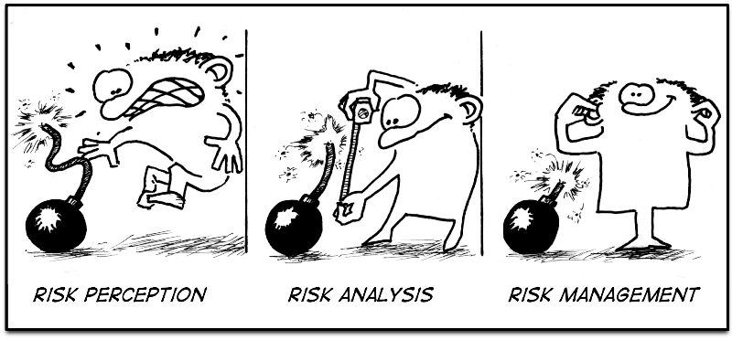
Radiation Protection Officer dental radiography - basic
Risk analysis
Frits Pleiter

Slide 2
  possible cases
  patient
  unborn child
  dentist
  waiting room
  street
  upstairs neighbours
  accident

Slide 3
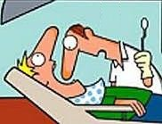
  Patient
  direct beam ?
  equivalent dose ?
  scattering radiation ?
  equivalent dose ?
  effective dose ?
  yes, on the salivary gland(s)
  H_{salivary} = H_{skin} = 5 mSv = 5000 μSv
  yes, on the thyroid
  opening PID = 4 cm × 5 cm = 20 cm2
  scattering radiation = H_{skin} / 1000
  per 100 cm2 at 1 m
  H_{scatter} = (5000 μSv / 1000) × (20 cm2 / 100 cm2)
  = 5 μSv × 0,2 = 1 μSv
  distance skin - thyroid = 0,1 m
  H_{thyroid} = H_{scatter} × (1 m / 0,1 m)2
  = 1 μSv × 100 = 100 μSv
  w_{salivary} = 0,01 / 6 = 0,0016 for 1 gland
  w_{thyroid} = 0,04
  E_{patient} = (0,0016 × 5000 μSv) + (0,04 × 100 μSv)
  = 8 μSv + 4 μSv = 12 μSv

Slide 4
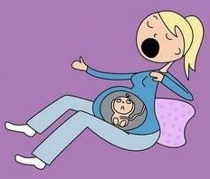
  Unborn child
  direct beam ?
  scattering radiation ?
  equivalent dose ?
  effective dose ?
  no
  yes, on the total body
  scattering radiation according to rule of thumb = 1 μSv per photo at 1 m
  distance skin - child = 0,5 m
  H_{child} = 1 μSv × (1 m / 0,5 m)2 = 4 μSv
  w_{body} = 1
  E_{child} = 1 × 4 μSv = 4 μSv
  background = 1600 μSv/y / 365 d/y
  = 4 μSv per day

Slide 5
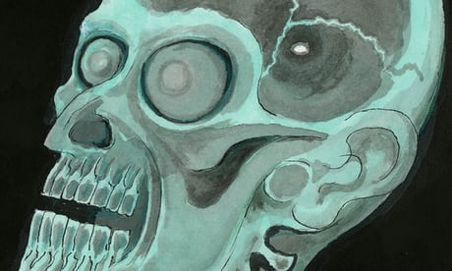
  Dentist
  direct beam ?
  scattering radiation ?
  equivalent dose ?
  annual effective dose ?
  no
  yes, on the total body
  scattering radiation according to rule of thumb = 1 μSv per photo at 1 m
  distance skin - dentist = 3 m
  no shielding
  H_{dentist} = 1 μSv × (1 m / 3 m)2
  = 0,1 μSv
  w_{body} = 1
  number of photos = 2000 per year
  E_{dentist} = 1 × 0,1 μSv × 2000
  = 200 μSv
  annual limit = 1 mSv

Slide 6
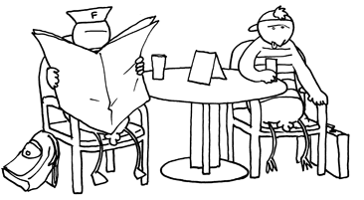
  Waiting room
  direct beam ?
  equivalent dose ?
  scattering radiation ?
  annual effective dose ?
  perhaps
  H_{skin} = 5 mSv
  distance focus - skin = 0,2 m
  distance focus - waiting room = 2 m
  no shielding
  H_{waiting room} = 5 mSv × (0,2 m / 2 m)2
  = 0,05 mSv
  yes, but the contribution is negligible
  w_{body} = 1
  number of photos = 2000 per year, half of which in the direction of the waiting room
  E_{waiting room} = 1 × 0,05 mSv × (2000 / 2)
  = 50 mSv
  annual limit = 1 mSv

Slide 7
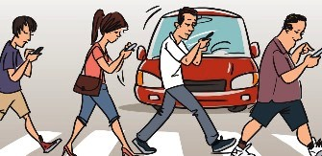
  Street
  direct beam ?
  equivalent dose ?
  scattering radiation ?
  annual effective dose ?
  perhaps
  H_{skin} = 5 mSv
  distance focus - skin = 0,2 m
  distance focus - waiting room = 3 m
  no shielding
  H_{street} = 5 mSv × (0,2 m / 3 m)2
  = 0,02 mSv
  yes, but the contribution is negligible
  w_{body} = 1
  number of photos = 2000 per year, half of which in the direction of the street
  E_{street} = 1 × 0,02 mSv × (2000 / 2)
  = 20 mSv
  annual limit = 10 μSv

Slide 8
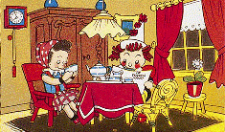
  Upstairs neighbours
  direct beam ?
  scattering radiation ?
  equivalent dose ?
  annual effective dose ?
  no
  yes, on the total body
  scattering radiation according to rule of thumb = 1 μSv per photo at 1 m
  distance skin - neighbours = 3 m
  H_{neighbours} = 1 μSv × (1 m / 3 m)2
  = 0,1 μSv
  w_{body} = 1
  number of photos = 2000 per year
  E_{neighbours} = 1 × 0,1 μSv × 2000
  = 200 μSv
  annual limit = 10 μSv

Slide 9
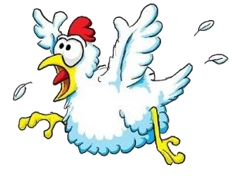
  Accident
  unintended unlikely
  not impossible
  scenario
  thyroid and all
  six salivary glands
  in the direct beam
  equivalent dose ?
  effective dose?
  H_{skin} = 5 mSv
  H_{salivary} = H_{thyroid} = H_{skin}
  w_{salivary} = 0,01
  w_{thyroid} = 0,04
  E_{accident} = (0,01 + 0,04) × 5 mSv = 0,25 mSv
  annual limit = 1 mSv
  thus no reason to panic

