Slide 1
YoungRUG
HR session
Leave hours and the Employment Option Model
Hilda van Laarhoven and Lydia Kuipers-Kremer (HR)

Slide 2


YoungRUG
1. Leave hours
2. Employment option model

Slide 3
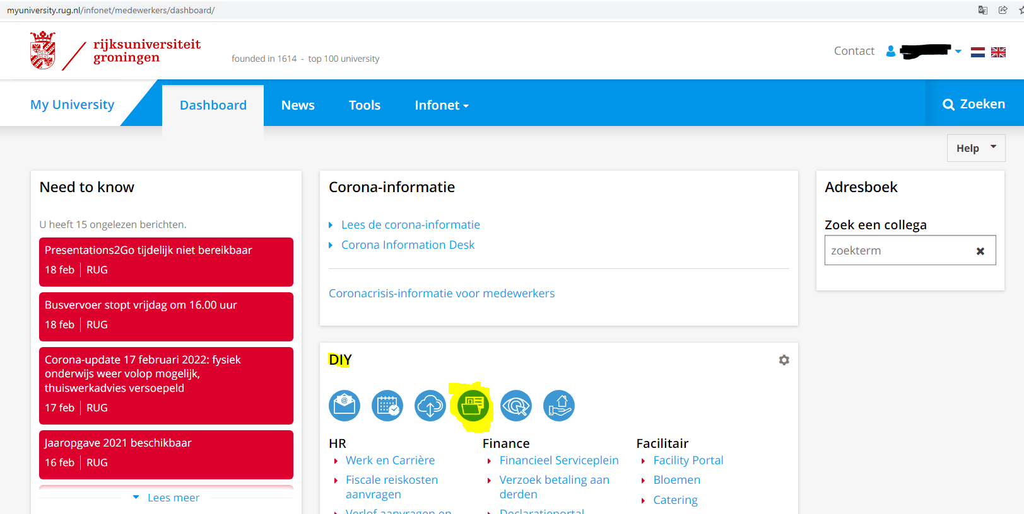
Leave hours
Via myuniversity you can visit shared services:

Slide 4
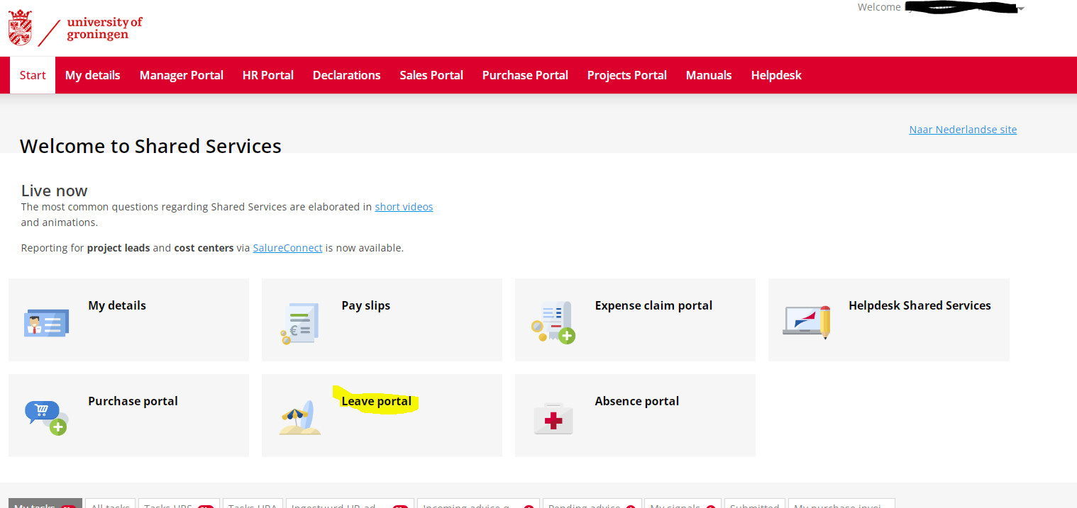
Leave hours
Visit the leave portal in shared services:

Slide 5
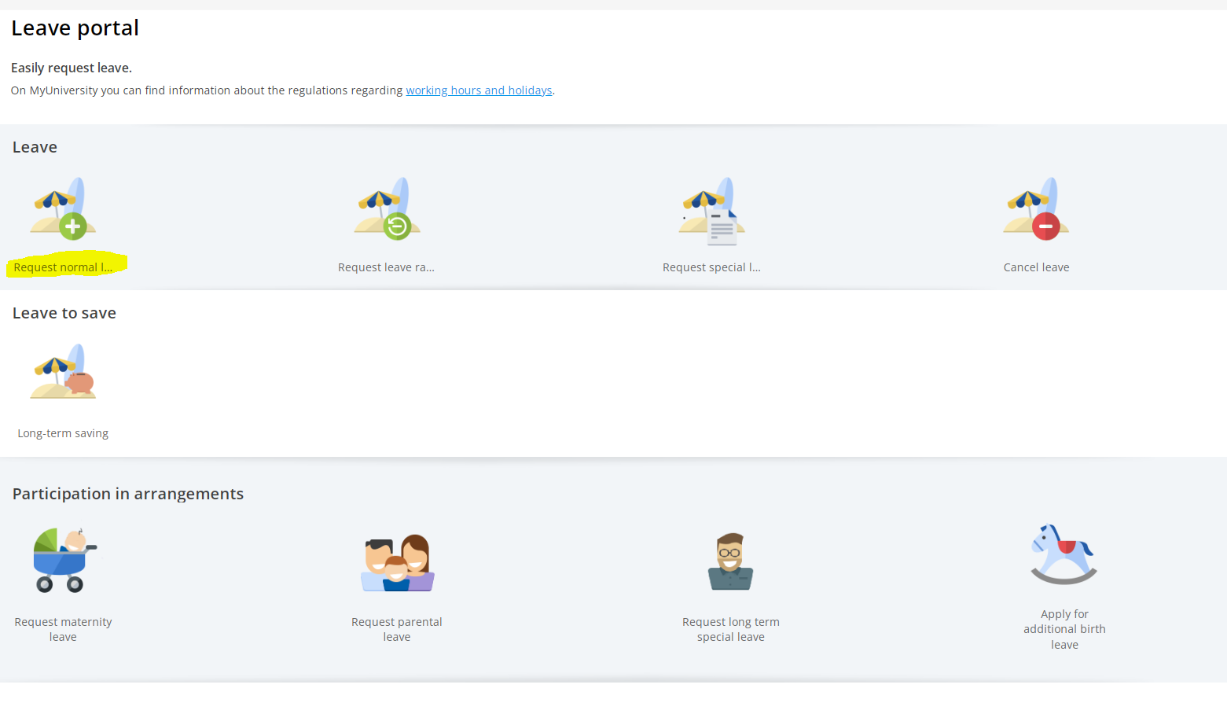
Leave hours
Here you can request all types of leave, today we will pay attention to holiday leave:

Slide 6
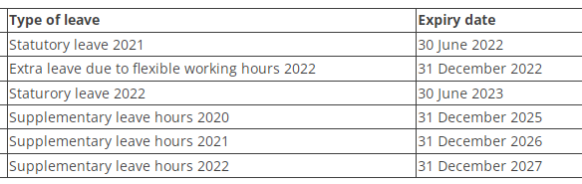
Leave hours
Types of Holiday leave:
- Statutory leave (expires after a year and a half)
- Supplementary leave hours (expires after five years)
- Extra leave due to flexible working hours (expires after a year)
For example:
Afas automatically choses the correct type of leave when you enter a holiday leave, considering the expiring dates

Slide 7
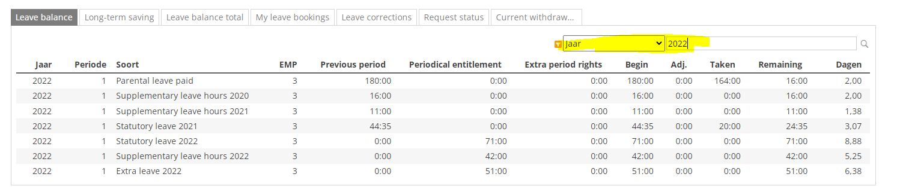
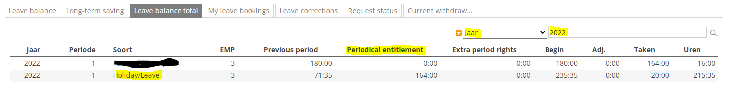
Leave hours
If you want to check your leave hours, you can scroll down in the leave portal and find it in the table, please filter on the correct year:

Slide 8
Employment options model
1. Your choice of working week (36, 38, 40)
2. Long-term saving
3. Exchanging leave hours

Slide 9
Choice of working week
Normal working week of UG = 38 hours
Choice 36, 38 or 40 can be made once a year in September/October
Affects how many hours to work per week
Affects how many leave hours you have
Does not affect salary

Slide 10
Choice of working week
Hours to work a week:
(Extra) leave hours:
Contract | 36 | 38 | 40
1 fte | 36 | 38 | 40
0,8 fte | 28,8 | 30,4 | 32
0,6 fte | 21,6 | 22,8 | 24
Contract | 36 | 38 | 40
1 fte | -96 | 152 + 80 | +96
0,8 fte | -76,8 | 121,6 + 64 | +76,8
0,6 fte | -57,6 | 91,2 + 48 | +57,6

Slide 11
Long-term saving
3 – 5 years saving (max. 72 hours a year)
Choice can be made once a year in September/October
The leave thus saved must be taken within a year of the end of the period in which it was saved
Goal sabbatical or changing your working hours per week

Slide 12
Exchanging terms
Exchanging your supplementary leave hours of this calendar year:
- for extra salary
- for contribution to ABP ExtraPensioen
Exchanging part of your salary, holiday allowance and/or year-end bonus for extra leave hours
Exchanging part of your salary, holiday allowance and/or year-end bonus for contributions to the ABP ExtraPensioen (May)

Slide 13

Questions?

Slide 14
Contact and websites
Contact us by e-mail:
arbeidsvoorwaarden@rug.nl
Website leave hours:
https://myuniversity.rug.nl/infonet/medewerkers/werk-en-carriere/voorwaarden/werktijden/vakantieenvrijedagen
Website choice model:
https://myuniversity.rug.nl/infonet/medewerkers/werk-en-carriere/voorwaarden/keuzemodellen/keuzemodelarbeidsvoorwaarden/
Shared services leave portal:
https://86961.afasinsite.nl/EN/portal-verlof-prs/mijn-verlof

