Slide 1
When the
International Classroom is not in the classroom
Building inclusive partnerships
Kevin Haines
Curriculum Developer
International Classroom Project
University of Groningen

Slide 2
The International Classroom Project at Groningen (2013-2020)
Generic principles
Internationalizing the Curriculum
(Carroll 2015; Leask 2015)
↓
Piloting, observation and evaluation
Detailed case studies
Medicine and Spatial Sciences 2013-2014
Maths & Natural Sciences 2014-2015
↓
Adjusted principles with expert advice
conceptual framework contextualizing the principles
↓
Faculty teams & project proposals
(further) implementation from 2016-2017

Slide 3
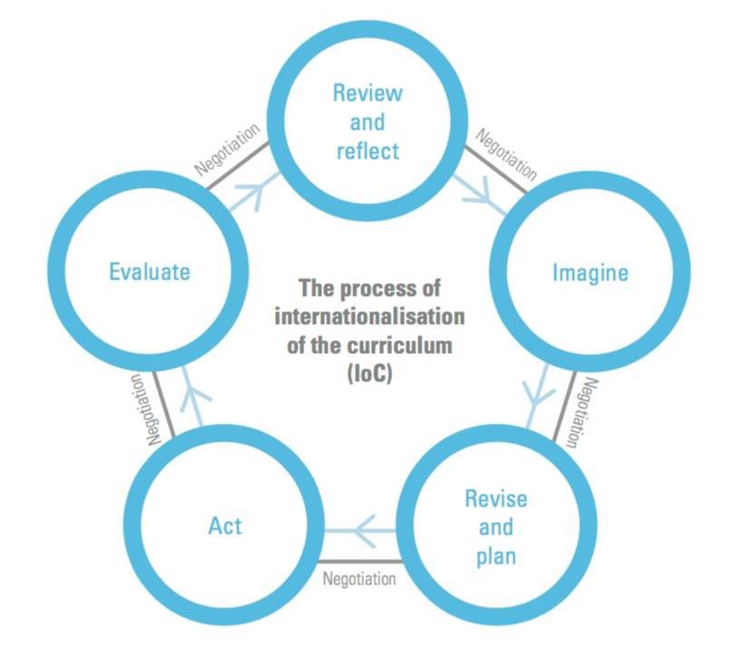
IoC Process (Leask 2015)

Slide 4
Why?
Why might the
International Classroom project
be of interest to you?

Slide 5
Internationalisation in higher education
“Student diversity and the perspectives that they bring to the classroom are key resources for the internationalised curriculum.”
(de Wit et al. 2015:29)

Slide 6
The informal curriculum
“The various support services
and additional activities and options organized
by the university that are not assessed
and don’t form part of the formal curriculum, although they may support learning within it.”
Leask 2015

Slide 7
Study associations and the International Classroom
“The role of the study associations in providing social and career-related support and in contributing to the international process should be valued and supported.
Good practices should be shared…“
IC Pilot at FMNS (FSE)

Slide 8
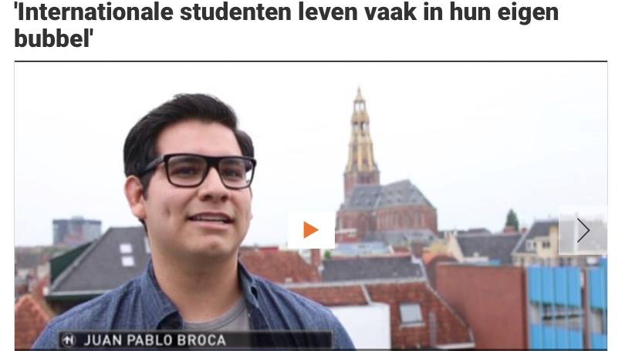
Silos

Slide 9
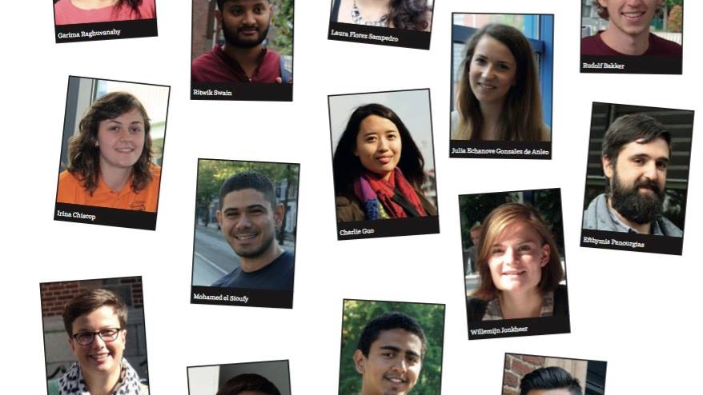
Student perspectives

Slide 10
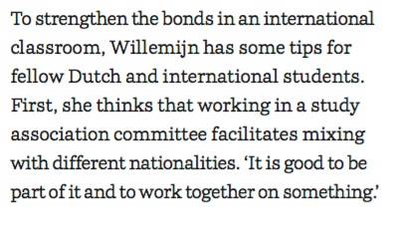
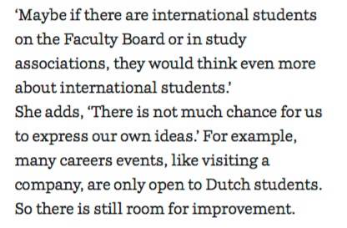
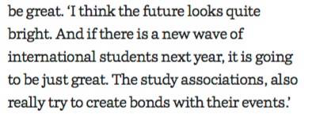

Slide 11
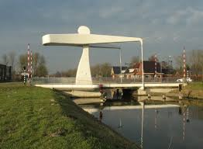
Bridging the gap
Study associations
can provide a bridge
between the formal
and the informal
curriculum.

Slide 12
Person-in-Context
“I mean a focus on real persons,
rather than on learners as theoretical abstractions; a focus on the agency of the individual person as a thinking, feeling human being, with an identity, a personality, a unique history and background, a person with goals, motives and intentions.”
(Ushioda, 2009: 220)

Slide 13
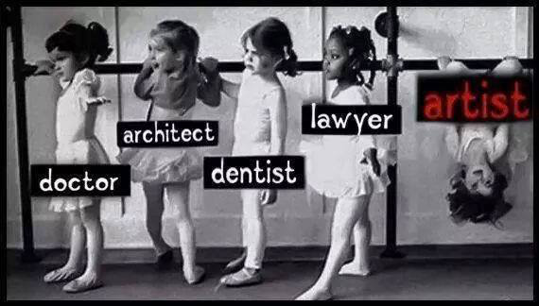

Slide 14
So together … let’s think outside the classroom
… in settings that may influence a person’s participation and well-being
and have a direct or indirect
impact
on their learning

Slide 15
How?
How might you make a
contribution to the
International Classroom project?

Slide 16
So together … let’s think outside the classroom
… And let’s focus on
areas and activities
we can influence
and things that we can change

Slide 17
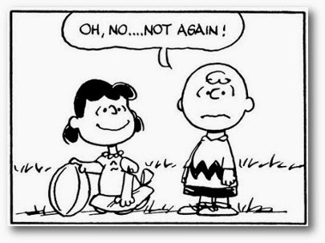
  But how do we make sure that we really do this!?

Slide 18
What?
What might the
International Classroom project
do for you?

Slide 19
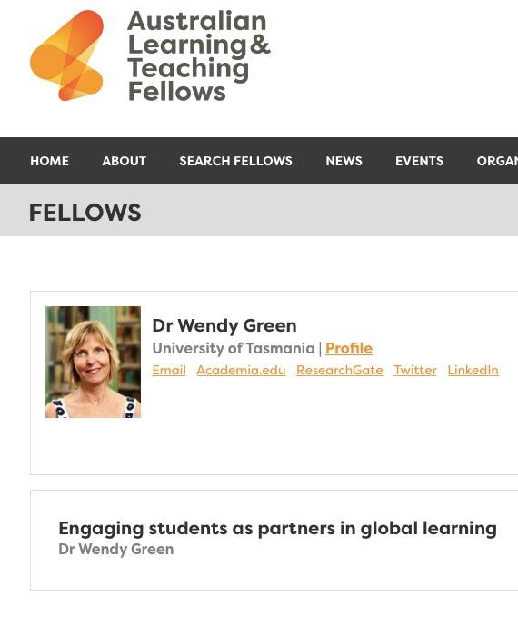

Slide 20
International Classroom seminar
Tuesday 19th September 2017
Policies, Principles and Practices
in the international classroom
We will discuss how to share good practices and how to work together on challenges.
We will define and promote action in these areas.
We may establish a student working group for the IC project 2017-2018.

Slide 21
References
Carroll, Jude. 2015. Tools for Teaching in an Educationally Mobile World. Abingdon: Routledge.
Leask, Betty. 2015. Internationalizing the Curriculum. Abingdon: Routledge.
University of Groningen. 2015. The International Classroom (IC) pilot at the Faculty of Mathematics and Natural Sciences (FMNS): findings and recommendationhttp://www.rug.nl/about-us/where-do-we-stand/education-policy/international-classroom/tweefmnsexecutivesummaryfinalversionapril2015-1.pdf
Ushioda, Ema. 2009. A Person-in-Context relational View of Emergent Motivation Self and Identity. In Zoltan Dörnyei & Ema Ushioda (eds.), Motivation, Language Identity and the L2 Self, 215–228. Bristol: Multilingual Matters.
de Wit, H.; F. Hunter; L. Howard; E. Egron-Polak. 2015. Internationalisation of Higher Education. Study requested by the European Parliament’s Committee on Culture and Education. Retrieved April 10, 2017, from http://www.europarl.europa.eu/RegData/etudes/STUD/2015/540370/IPOL_STU(2015)540370_EN.pdf

