Slide 1
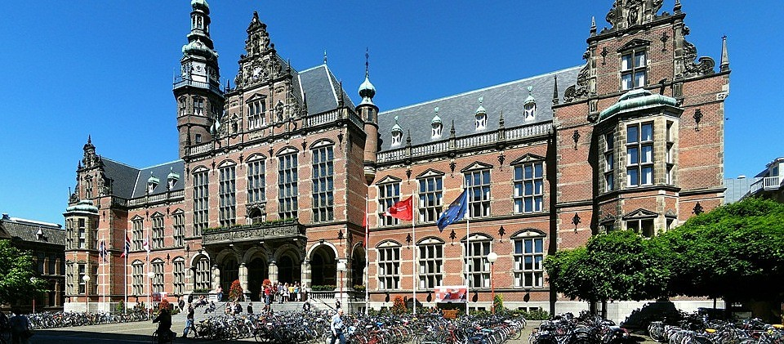
Curriculum internationalisation; an institutional approach at the University of Groningen, the Netherlands
Franka van den Hende, project manager, policy advisor and researcher (PhD)
Notes:
Embed my presentation in my personal story, with integrated roles in internationalisation and education at the University of Groningen.
Focus on practical examples of how to do it.
Illustrate the literature with examples from practice.

Slide 2
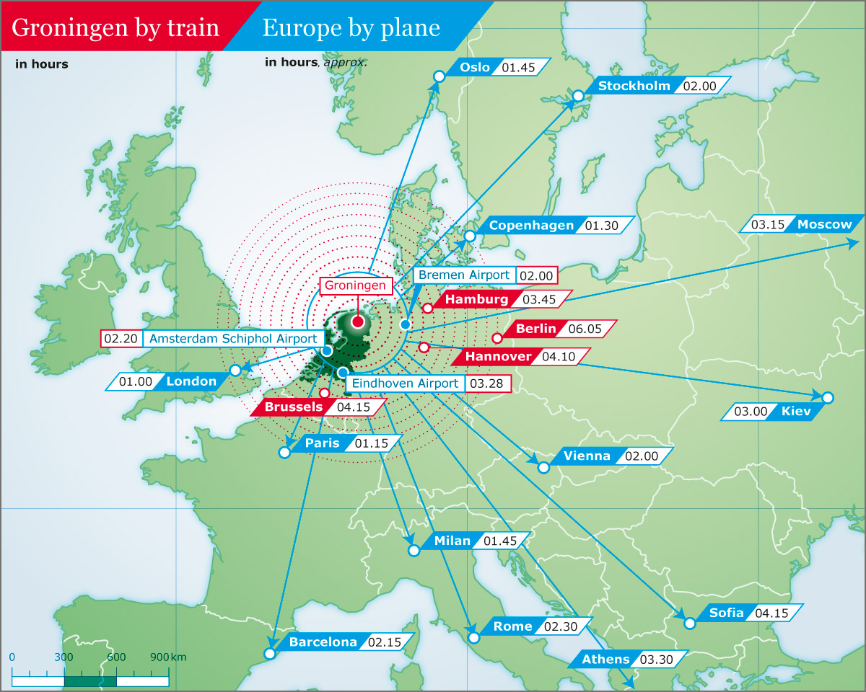
Notes:
Shows where to locate Groningen, interconnectedness and relativity of distance nowadays.
Relevance of context in internationalization!

Slide 3
Curriculum internationalisation; Lessons from the literature
  Not much research yet on CI from an organizational change perspective
  Internationalisation can be usefully approached as an institutional, organisational change process (Soderqvist 2002, Taylor, 2004) > effectiveness, competitive advantage
  Internationalisation is an intentional, contextual process (de Wit and Hunter, 2015) > relevance of stakeholders and context
  Curriculum internationalisation (CI) is about curriculum change plus changes in the competencies of stakeholders (Green and Whitsed, 2015)
  Many blockers for CI: institutional, cultural, personal (Leask, 2015).
  Implications for practice: long-term, institutional, interactive, resource-based approach
Notes:
Bridging with Craig’s introduction on CI: relevance of context, focus on academic staff, focus from education and curriculum design, many blockers for implementing strategy in practice

Slide 4
Curriculum internationalisation; Identified challenges from the Australian and Anglo contexts
Main problems in practice:
Lack of a (shared) understanding; what is curriculum internationalisation
Strong local and disciplinary culture; blocker for change
Institutional blockers: lack of time, capacity, leadership
Personal blockers: lack of knowledge, skills, attitude
How to implement curriculum internationalisation
How to make it successful
Notes:
Based on the literature (Leask 2015, Green and Whitsed 2015) and practice at the University of Groningen.
Additional issue in the Netherlands: language (EMI)
Initial focus on the language and number of international students, not the content and approach
Focus on the how question, given all the blockers!

Slide 5
Curriculum internationalisation; A multi dimensional approach at the University Of Groningen
Dimension 1: International Classroom project
  institution-wide, long term project (2013-2020)
  top-down (initiated by Executive Board) and
  bottom-up: building on good practices, enabling
  involving all levels and stakeholders, including study associations
  alignment with strategy, for education in particular
  research-based (Leask, Carroll, Green & Whitsed, 2015)
  expertise development with external experts
  resource-based (budget, acknowledgement, capacity, expertise, networks beyond disciplines)
  adjustment to specific context.
Notes:
[Characterising project approach in a way that can be adopted by other universities.
Implications of the literature for the IC project: specific approach, activities and resources needed]
Started with longer-term commitment and resources from Executive Board,
At the same time identified champions/leaders and good practices/examples,
Adopted scholarly, enabling approach to get buy in from academics (often pragmatic)
Developed expertise with externals
Platform function! Thinking and working across boundaries.
E.g. pilot case studies with different faculties, lot of recognition and exchange between Professors of Medicine, Computing Science and Spatial Sciences.
E.g. annual seminar with external presenters, internal examples, lots of discussions.

Slide 6
Curriculum Internationalisation; policy and research at the University Of Groningen
Dimension 2: policies in internationalisation of education
CI is part of the university’s process how to embed internationalisation in all departments, strategy and policies
How to acquire a quality label for internationalisation (Ce Quint)
Dimension 3: research in curriculum internationalisation from an organisational perspective
In line with research-based project, providing a different perspective, first findings expected next year
Notes:
[Characterising policy issues (and research) in a way that can be recognised by other universities]
Different expertise, cultures, networks and routines in different departments
From separate international offices to embedded internationalisation
Need to make internationalisation explicit and relevant in all aspects of education!
Lack of coherence between strategy, vision, policies and practice.
E.g. policies on graduate attributes and internationalised learning outcomes.

Slide 7
Overview of the IC project to date and observations along the way
First findings in project, policy and research:
IC project:
  many different understandings of the international classroom
  initial resistance and scepticism
  need for resources (not only budget)
  need for a platform to share across boundaries
  need for reflection and purposeful dialogue
  need to acknowledge good practices and problems
  implementation needs leadership and resources.
Notes:
First findings to make it more concrete, can be illustrated with examples
show brochures
e.g. annual seminars and activities with external experts, brochures with good practices as platforms and resources

Slide 8
Overview of the IC in policy to date and observations along the way
Realised:
20% international students, 30% international staff, extensive high-quality international network, many English-taught BA and MA degree programs.
Next steps:
  internationalisation not sufficiently explicit in university strategy
  institutional vision on internationalisation existing, but not sufficiently discussed and embedded
  gaps in policies, e.g. on graduate attributes, learning outcomes
  lack of qualitative indicators for internationalisation
  lack of an evidence-based strategy.
Notes:
Can be illustrated with concrete actions:
Intentions document with working groups to ensure coherent follow-up
Many activities beyond boundaries
Policy papers on graduate attributes and internationalising learning outcomes
Development of qualitative indicators, e.g. internationalised learning outcomes, level of English and ICC
Explicit part of governance agenda.

Slide 9
Overview of the IC project to date and observations along the way
Take aways
  CI needs longer-term, institutional, interactive approach
  CI needs leadership
  CI needs resources
  Engage and enable all stakeholders, at all levels:
  build on existing good practices, expertise and personal engagement
  address concerns and daily problems
  create purposeful dialogues and imagination.
Notes:
Based on the literature and experiences from other universities it is expected that these take aways in general will apply to all universities although context and details might be different.

Slide 10
Thank you for your attention
Further information:
www.rug.nl/internationalclassroom
or mail me at:
f.m.van.den.hende@rug.nl
Franka van den Hende

