Slide 1
EU and Russia energy trade: impact of WTO, transit and integrated economic areas
The first EU-Russian Energy Law Conference, University of Groningen
Yulia Selivanova
Trade expert, Energy Charter Secretariat

Slide 2


2

Slide 3
Issues
How transit is regulated by WTO?
What are the problematic issues in regulation of energy transit by general WTO rules?
Transit under ECT – multilateral investment treaty applying WTO rules with respect to energy

Slide 4
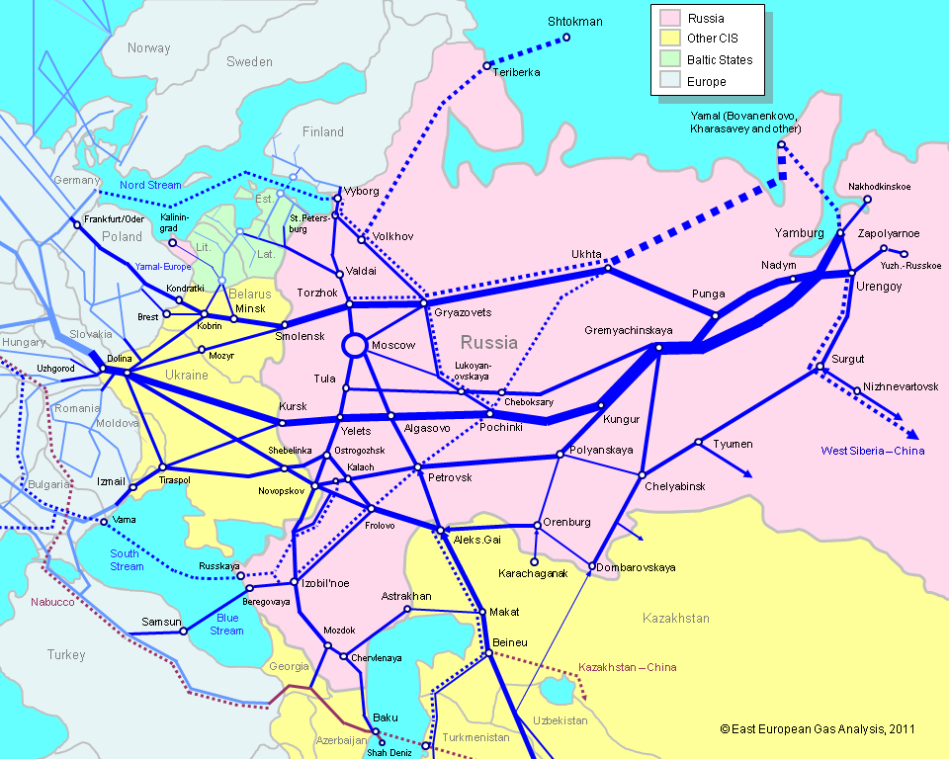
EU-Russia energy trade – importance of transit

Slide 5
How energy transit is different?
Energy difficult to store => timing matters
Reliance of energy trade on fixed infrastructure Conditions of access to infrastructure at right time – important !!!
Fixed infrastructure investment – capital intensive
Energy transportation is capacity restricted =>
Importance of investment framework
Time aspect – an energy transit dispute in a cold winter…

Slide 6
Transit regulation by WTO
GATT Art. V:
- freedom of transit
- non-discrimination
- no unnecessary delays/restrictions
- reasonable transit regulations
- no rent seeking
- reasonable, cost reflective charges
BUT no rules for creation of transit infrastructure!
Trade Facilitation negotiations – focus on energy transit

Slide 7
Russia’s WTO accession commitments & transit
General commitment to abide by Art. V GATT
Customs Union (RF/BEL/KAZ) does not affect WTO commitments
Customs procedures applicable to transit by pipeline
No commitments similar to Ukraine’s on pipeline transportation

Slide 8
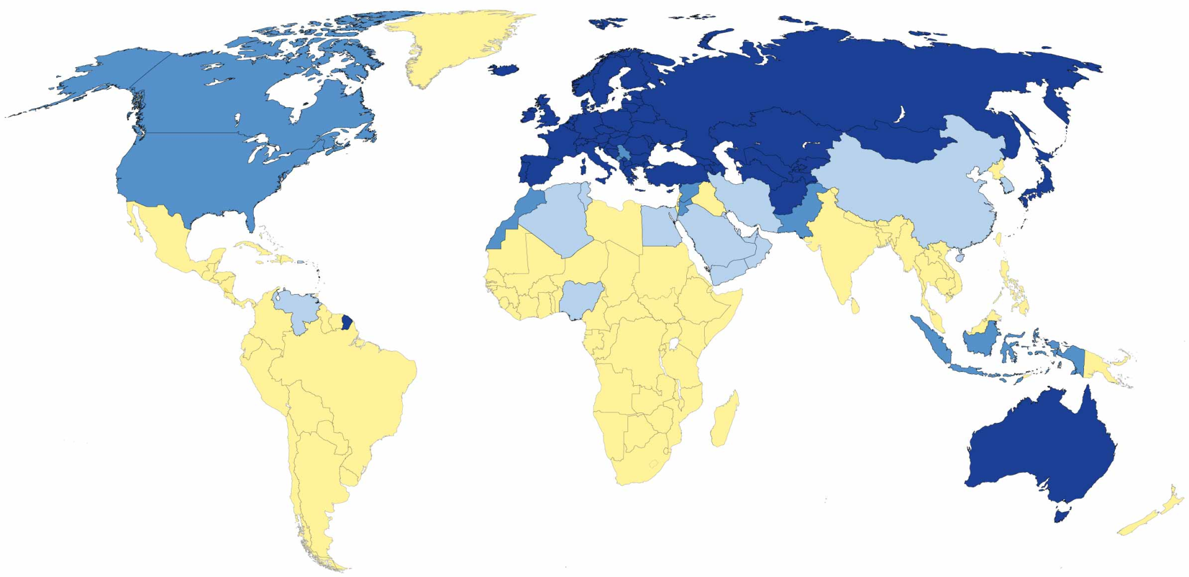
Energy Charter Constituency – importance of transit
This map is without prejudice to the status of or sovereignty over any territory, to the delimitation of international frontiers and boundaries and to the name of any territory, city or area
8

Slide 9
Energy Transit: GATT V =>
ECT Article 7 => Draft Transit Protocol
ECT Article 7: Freedom of energy transit
  Specifying GATT V for energy materials and products using fixed infrastructure
  Non-discrimination as to origin, destination, ownership or pricing
  Transit treated no less favourably than energy originating in or destined for transit country itself
PLUS IMPORTANTLY
  No obstacles to the creation of new capacity
  Non-interruption of transit in case of dispute
Dispute resolution procedures
  ECT Art. 27 / Draft Transit Protocol Art. 21
  ECT Art. 7(7) (conciliation, party to dispute can invoke)

Slide 10
Energy Charter’s Transit Protocol negotiations
Further elaborate and detail the ECT Article 7
Basic text agreed at the end of 2002:
  Definition of available capacity
  Principles of transit tariffication
  Transparent and non-discriminatory congestion management rules
  Detailed provisions for new capacity creation
Remaining open issues were discussed in bilateral consultations
between EU and Russia:
  Avoidance of mismatch between the duration of supply and transit contracts
  Application of the TP inside the EU

Slide 11
Impact of integrated economic areas on energy transportation and transit
Formation of regional economic areas intensified
Common rules for energy transportation & conditions of access to fixed infrastructure
Is discrimination in favour of customs union members allowed?
Economic integration should not increase restrictions!
Are lower transit fees allowed?

Slide 12
Conclusions
Energy transit is linked to investment rules!
It is not only about non discriminatory access to transport infrastructure
Possibility to create new transit capacity is most important
Non interruption of existing transit
WTO rules on transit are general and not designed to deal with energy transit problems!
ECT contains investment rules – important value added to WTO

Slide 13
THANK YOU

